Slide 1
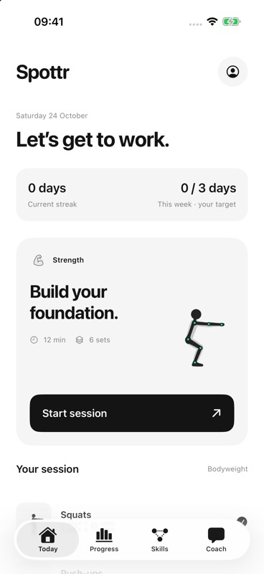
Spottr
Bodyweight coaching
on iPhone and Watch
Short workout feedback needs fresh evidence.
The user stays in control of the set.
OxHack 2026
iPhone simulator
Notes:
Opening: Spottr is an implemented native bodyweight workout prototype. The motivation is short, timely feedback with an explicit evidence boundary, not a clinical or physical-capacity claim. The image is an actual iPhone simulator screenshot approved by the owner, with missing/unearned progress shown honestly. Evidence snapshot 25 October 2026, 01:43 UTC. Sources: /Users/scsoc/dev/AI PT/docs/app-guide.md; /Users/scsoc/dev/AI PT/docs/integration-readiness.md. Asset source and SHA256 are in presentation/source/assets.json.

Slide 2
The workout flow
01
Choose the work
Goals, weekly target and an approved workout.
02
Track the set
Camera cycles for push-ups and squats. Manual logs and hold timers for the wider library.
03
Respond in the moment
A concise cue, visible controls and optional local voice. Pause or stop at any time.
04
Review the record
Actual sets, source labels and timings. Ask for an AI summary with an explicit tap.
02
Notes:
Evidence snapshot 25 October 2026, 01:43 UTC. Implemented native flow, not a measured rep-accuracy claim. Manual/timed workouts work without cloud credentials. A real camera path exists for push-ups and squats; physical accuracy/error/abstention evaluation remains pending. Local speech is opt-in, fake-playback tested, with audible phone acceptance pending. Sources: /Users/scsoc/dev/AI PT/docs/app-guide.md; /Users/scsoc/dev/AI PT/docs/voice-feedback.md; /Users/scsoc/dev/AI PT/docs/integration-readiness.md.

Slide 3
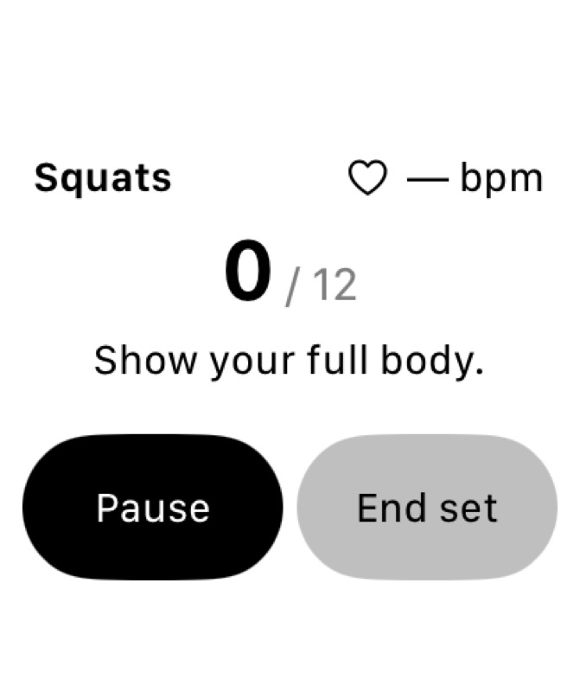
Phone, Watch and optional side camera
Watch
iPhone
Pi side camera
Session authority
Capture companion
On-device pose inference
Rep and rest timing
Cue priority and expiry
Local workout history
HTTPS pairing verified
Real initial frames
USB disconnect blocks
sustained capture
Simulator capture
Physical sensors pending
03
Notes:
Evidence snapshot 25 October 2026, 01:43 UTC. Editable architecture. Phone owns MediaPipe inference, session state and deterministic policy. Watch adapter forwards latest-value timestamped heart/motion signals, not raw lossless vectors. Simulator transport/visual evidence and unsigned device compilation are separate from physical Watch recording. Pi real HTTPS pairing/start/frame/stop tests succeeded, then USB disconnected after around two seconds. No Pi inference or sustained capture is claimed. Sources: /Users/scsoc/dev/AI PT/docs/watch-telemetry.md; /Users/scsoc/dev/AI PT/docs/watch-simulator-acceptance.md; /Users/scsoc/dev/AI PT/hardware/pi/EVIDENCE-2026-10-24.md; /Users/scsoc/dev/AI PT/hardware/pi/NATIVE-HANDOFF.md.

Slide 4
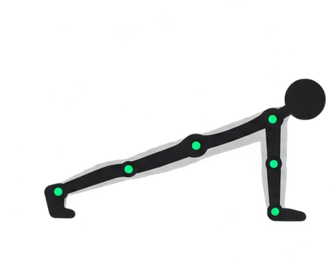
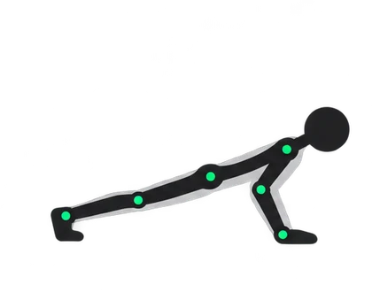
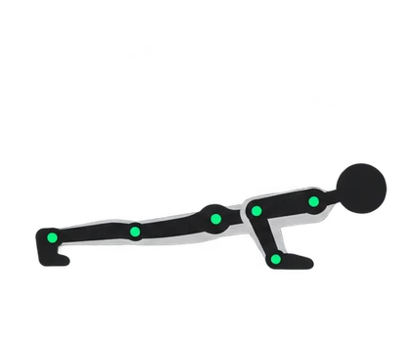
Timing decisions use observed evidence
Complete cycles count
Top, bottom, then top. A gap above 0.75s resets movement.
Pacing uses prior reps
After five valid reps, flag duration above
mean + max(sample SD, 0.25s).
Stop takes priority
Reported discomfort overrides ordinary cues.
Pause and end cancel speech and old cues.
Sensor time stays explicit
Missing or stale Watch readings remain unavailable.
Illustrated phases
04
Notes:
Evidence snapshot 25 October 2026, 01:43 UTC. These are deterministic implementation rules, not calibrated physiological thresholds or a measurement of rep-count accuracy. RepCounter requires confidence>=0.6 and a complete top-bottom-top cycle, resets on gaps>0.75s or nonmonotonic time, uses0.15s zone stability and accepts0.6–15s cycle duration. CoachingPolicy compares a new valid rep with at least five prior valid durations using mean+max(sampleSD,0.25s). Reported discomfort has an exercise-independent stop decision, including manual reps and holds. PR #64 passed 23 native checks, 26 core checks and a Watch simulator build; fake playback does not establish audible acceptance. Stop identity persists across ticks; repeated stop does not cut itself off or replay after background return. Lifecycle invalidation prevents old cues/sensor callbacks entering a new state. Sources: /Users/scsoc/dev/AI PT/Shared/Core/RepCounter.swift; /Users/scsoc/dev/AI PT/Shared/Core/CoachingPolicy.swift; /Users/scsoc/dev/AI PT/docs/watch-telemetry.md; /Users/scsoc/dev/AI PT/docs/voice-feedback.md. Phase images are existing illustrations, not captured workout evidence.

Slide 5
Skills make recorded progress visible
19 exercises. Connected tree or linear list.
Knee push-ups
3 qualifying sets
across 2 days
Push-ups
All prerequisites complete.
Practice remains open.
Sources stay visible.
Forearm plank
Replay and discomfort
do not earn completion.
One unlock example
05
Notes:
Evidence snapshot 25 October 2026, 01:43 UTC. The current app has19 catalogue entries and connected tree/linear options. This diagram shows the exact immediate prerequisite example for pushup: kneePushup and plank. Earlier prerequisites of those nodes are omitted. Node completion needs three qualifying sets across two days after all immediate prerequisites complete. Manual/camera evidence can qualify; video replay and discomfort stops do not. Game points are not physical capacity. Sources: /Users/scsoc/dev/AI PT/Shared/Core/SkillProgress.swift; /Users/scsoc/dev/AI PT/Shared/Core/ExerciseCatalog.swift; /Users/scsoc/dev/AI PT/Native/iOS/SkillsViews.swift; /Users/scsoc/dev/AI PT/docs/app-guide.md. Exercise artwork is existing PNG content, with source hashes in assets.json.

Slide 6
Four Gemini requests share a grounded contract
01
Chat
Explicit facts and preferences
Recorded sets and source labels
Selected goals and weekly target
Canonical catalogue capabilities
02
Workout proposal
03
Session summary
Checked before use
04
Weekly summary
Fact IDs and typed quantities
Current generation only
User approval before a plan starts
Real proposal approved; 3 synthetic manual sets saved 3/2/1 reps.
Signed Debug simulator, loopback gateway. Physical/quality acceptance pending.
06
Notes:
Evidence snapshot 25 October 2026, 01:43 UTC. Local gateway returned actual200 responses for chat/session/weekly/proposal using synthetic inputs. Two signed-simulator native chats reached Google. The second accepted the server-owned capability context: base push-ups and squats support camera tracking; other rep exercises use manual logging and seconds exercises use an active hold timer. After a provider-only maxItems schema projection, three explicit native production actions accepted a proposal, weekly summary and session summary with isolated synthetic inputs. The full original output validator remains enforced. The earlier proposal/report check selected Squats without saving. A later bounded real Propose request on loopback 8843 was explicitly approved for Squats alone, three sets with targets 10 and rest 60s. The signed Debug 0.1 (1) simulator then explicitly started and ended three synthetic manual sets 3/2/1, saving six actual entered reps and 96.807424s active time. Targets never counted as performed work. The subsequent request returned 429 demo_budget_exhausted before provider access. No Watch, camera, voice, reserve or physical exercise was used; cleanup restored preferences and isolated history. This accepts a synthetic native execution/persistence path, not installation of TestFlight build 4. The earlier compatibility reports described one synthetic manual session/set with two Squats reps and no Watch data/profile. Physical phone networking and real-user coaching quality remain pending. Separate native fixture checks exercise structured-response display without a provider call. Automatic facts include selected goals and weekly target, omit optional name, and retain sources. Schema/evidence validation rejects missing/unknown fact IDs; generation identity rejects late context. Plans require explicit user selection/approval and proposed targets never count as completed work. No raw camera video or sensor stream is automatically supplied here. Sources: /Users/scsoc/dev/AI PT/docs/evidence/native-gemini-chat-2026-10-24.md; /Users/scsoc/dev/AI PT/docs/evidence/gemini-structured-compatibility-2026-10-25.md; /Users/scsoc/dev/AI PT/docs/evidence/native-gemini-plan-execution-2026-10-25.md; /Users/scsoc/dev/AI PT/docs/coach-goals.md; /Users/scsoc/dev/AI PT/Shared/Core/CoachContracts.swift; /Users/scsoc/dev/AI PT/Shared/Core/CoachGrounding.swift; /Users/scsoc/dev/AI PT/docs/integration-readiness.md.

Slide 7
Operational data and batch analysis
Tiger Data
Snowflake
Operational history
Batch evaluation
Implemented snapshot adapter
Timestamped Watch scalars
Explicit optional upload
Implemented public-data batch
Pinned forecast lineage
and error reconciliation
Console schema accepted; zero rows.
Node TLS and ingestion pending.
Dry-run import/evaluation tested.
Live warehouse acceptance pending.
07
Notes:
Evidence snapshot 25 October 2026, 01:43 UTC. Operational Tiger storage and Snowflake retrospective public-data evaluation are separate. Authenticated Tiger Explorer accepted the exact gateway migration: two empty tables, 15 columns, seven validated PK/CHECK constraints, a one-day scalar hypertable and four usable indexes. No workout or sensor rows were inserted. The separate Node connection still fails strict TLS with SELF_SIGNED_CERT_IN_CHAIN; no gateway ingestion, replay/readback, rollup or standalone prototype database acceptance is claimed. Snowflake pinned public PAMAP2 import/reconciliation and bounded SQL transport are tested offline; dry-run is default and live public-data execution requires explicit opt-in. The existing account and three suspended XS warehouses were verified in an authenticated read-only console check; no SQL workload or settings change occurred. No actual SQL API statement/result is accepted. Local history and explicit optional sync remain distinct. Sources: /Users/scsoc/dev/AI PT/docs/integration-readiness.md; /Users/scsoc/dev/AI PT/docs/tiger-live-readiness.md; /Users/scsoc/dev/AI PT/docs/ISSUES.md; /Users/scsoc/dev/AI PT/docs/personal-learning.md; /Users/scsoc/dev/AI PT/docs/evidence/tiger-console-2026-10-24.md.

Slide 8
An HR forecast with a locked participant test
Future 5s mean HR, using the previous 60 seconds
Test coverage
Participants 108 / 109
10s: 803 + 4 forecasts
30s: 799 + 0 forecasts
The adapter
increased error
Exploratory public-data result. Only one person contributes at 30s. No Watch or failure validation.
08
Notes:
Evidence snapshot 25 October 2026, 01:43 UTC. Actual offline PAMAP2 run2026-10-24T20:43:51–20:43:59UTC. Source: Reiss,A.(2012), PAMAP2 Physical Activity Monitoring, UCI DOI10.24432/C5NW2H, CC BY4.0. Changes: causal features/ridge/figures/evaluation. Official source https://archive.ics.uci.edu/dataset/231/pamap2+physical+activity+monitoring. Train101–105,validation106–107,test108–109. Future target: mean of five observed1s HR-bin means ending10/30s after origin; input history60s. No interpolation, future covariates or test normalization. Validation selected HR-only ridge alpha0.1, not wrist candidates. Test108:80310s and79930s forecasts. Test109:only410s and030s forecasts from84.76s recording. Macro10s gives both participants equal weight despite tiny109 count. At30s only108 contributes. Fixed prequential bias adapter worsened full-run error. No calibrated intervals, Watch transfer, recovery, failure/RIR prediction, or app integration.13 contract tests pass. Sources: /Users/scsoc/dev/AI PT/research/hr_forecast/protocol.json; /Users/scsoc/dev/AI PT/research/hr_forecast/results/report.json; /Users/scsoc/dev/AI PT/research/hr_forecast/results/inventory.json; /Users/scsoc/dev/AI PT/docs/public-data-benchmark.md. Original plots copied unchanged into presentation/assets/ for supplementary evidence. Native chart values round the recorded metrics to three decimal places for editable workbook compatibility.

Slide 9
Provider evidence and remaining gates
Track | Evidence now | Remaining gate
Gemini | 4 types; approved plan | Physical network; real-user review
Tiger Data | Console schema; zero rows | Strict Node TLS; ingest/readback
Snowflake | Pinned batch workflow tested | SQL credentials; bounded live SQL
Vultr | Local ARM64 runtime checked | Spend scope; hosted TLS/auth
ElevenLabs | Local Apple speech only | API secret and audible acceptance
Presage | SDK plan prepared | Vitals egress decision and credits
Delta | Judge packet prepared | Operator/legal step, then one review
Python: 13 offline checks, no native/Tiger adapter. Web: 92 checks.
Cloud upload and public landing deployment remain unverified.
09
Notes:
Evidence snapshot 25 October 2026, 01:43 UTC. This table summarizes implementation/fixture/live distinctions. Never claim all sponsors/providers were used. Gemini has four actual synthetic gateway response types, two signed-simulator native chats, and three accepted native production structured actions (proposal/session/week) after the provider-only schema fix. All new inputs were isolated synthetic records. A later one-attempt loopback request accepted a Squats-only plan, explicitly approved and executed as three synthetic manual sets 3/2/1 in signed Debug 0.1 (1), not TestFlight 4. Thirteen offline behavior checks also accepted the standalone Python contributor integration from exact 42043df; it uses pretrained MediaPipe plus geometry/state rules, is separate from native/Tiger, and has no real inference, physical accuracy or audible acceptance. Web prototype 92 checks remain a separate suite. Physical phone networking and personal coaching quality remain pending. The earlier compatibility investigation used seven provider attempts, separate from the later one-request approved-plan check: initial normal native 502, two diagnostic native HTTP400, one controlled direct HTTP200 and three post-fix native responses accepted by native display validation. No automatic retry or provider fallback was introduced. Voice local Apple synthesis is implemented with fake playback tests; no audible/ElevenLabs run. Tiger authenticated console accepted the gateway schema with zero rows; strict Node TLS remains blocked without trust bypass. Ingestion, readback, rollups and the separate prototype path remain unverified. The revised local landing uses actual white simulator captures and passed four-width, keyboard and reduced-motion checks; no public deployment. Snowflake pinned batch workflow and local ARM64 gateway/Caddy runtime checks passed; no Snowflake live statement or Vultr VM/credit/spend scope; Presage automatic derived-vitals egress unresolved; Delta v2 packet and separate synthetic Codex calibration are prepared; zero actual Delta requests and missing installation/legal operator gate. No generated-output quality claim follows. Sources: /Users/scsoc/dev/AI PT/squat/README.md; /Users/scsoc/dev/AI PT/docs/evidence/native-gemini-plan-execution-2026-10-25.md; /Users/scsoc/dev/AI PT/docs/evidence/pushup-prototype-integrity-2026-10-24.md; /Users/scsoc/dev/AI PT/docs/evidence/gemini-structured-compatibility-2026-10-25.md; /Users/scsoc/dev/AI PT/docs/snowflake-analytics.md; /Users/scsoc/dev/AI PT/docs/vultr-deployment.md; /Users/scsoc/dev/AI PT/docs/integration-readiness.md; /Users/scsoc/dev/AI PT/docs/ISSUES.md; /Users/scsoc/dev/AI PT/docs/voice-feedback.md; /Users/scsoc/dev/AI PT/docs/presage-integration.md; /Users/scsoc/dev/AI PT/docs/delta-workflow.md; /Users/scsoc/dev/AI PT/docs/tiger-live-readiness.md; /Users/scsoc/dev/AI PT/docs/evidence/tiger-console-2026-10-24.md; /Users/scsoc/dev/AI PT/docs/evidence/landing-browser-2026-10-24.md.

Slide 10
A two-minute demo of the implemented flow
00:00
Today and goals
Show the actual starting state.
00:15
A tracked workout
Show the camera path and visible cue. Label any fixture.
00:55
Pause, end and review
Keep controls available and preserve source labels.
01:20
Skills and Coach
Show prerequisites, then an explicit request action.
01:45
Evidence and next gates
Use the saved HR result and current provider status.
TestFlight 4: approved, internal and external. Physical installs unverified.
Internal 4/3/2/1. External 4/3/1. Read-back 01:32:51 UTC.
10
Notes:
Evidence snapshot 25 October 2026, 01:43 UTC. This is a suggested rehearsal sequence, not an assertion that a rehearsal occurred. Use normal history safely. Open current Today/profile, then tracked workout, pause/end and source-aware record, Skills and explicit Coach controls. If fixtures or a simulator supply values, label them and do not call them live physiological data. Do not spend provider credits as part of rehearsal without the existing approved scope. Show the saved public-data benchmark as offline. Source inventory is current main 485a33c; native TestFlight build 4 is frozen at 7f4b5ba5f5478b0efa2c18605eb0252c6f9cb3ec. Build 0.1 (4) passed signed archive/export and Apple validation at 01:23:07 UTC on 25 October; upload succeeded 01:26:47 UTC. App Store Connect read-back at 01:32:51.286 UTC reports build 4 VALID, internal and external IN_BETA_TESTING, beta submission APPROVED. Internal group contains 4/3/2/1; external OxHack contains 4/3/1, preserving previous fallback builds. Build 2 remains internal only. The existing public invitation https://testflight.apple.com/join/f3MhePbf remains enabled for 25 testers. Its public Apple page and both landing HTTPS links were verified; no itms-beta deep link, invitation acceptance or installation was performed. Build 4 adds saved-workout removal and final-set Review guidance. The Gemini compatibility correction runs separately on the gateway. The later approved-plan synthetic acceptance used signed Debug 0.1 (1), not a TestFlight installation. The standalone Python contributor demo is not in this binary. All four native Gemini request types accepted real responses with synthetic inputs; physical networking and real-user guidance remain unverified. The unresolved MediaPipe upstream privacy/origin-signature gap is separate from Apple processing. The experimental source SDK has not replaced the downloaded app SDK. No physical installation or public App Store approval is claimed. Sources: /Users/scsoc/dev/AI PT/docs/evidence/testflight-build-4-2026-10-25.md; /Users/scsoc/dev/AI PT/docs/evidence/native-gemini-plan-execution-2026-10-25.md; /Users/scsoc/dev/AI PT/docs/evidence/testflight-availability-2026-10-25.md; /Users/scsoc/dev/AI PT/docs/testflight.md; /Users/scsoc/dev/AI PT/docs/app-guide.md; /Users/scsoc/dev/AI PT/docs/integration-readiness.md; /Users/scsoc/dev/AI PT/docs/release-readiness.md; /Users/scsoc/dev/AI PT/docs/testflight-provisioning.md.

