Slide 1
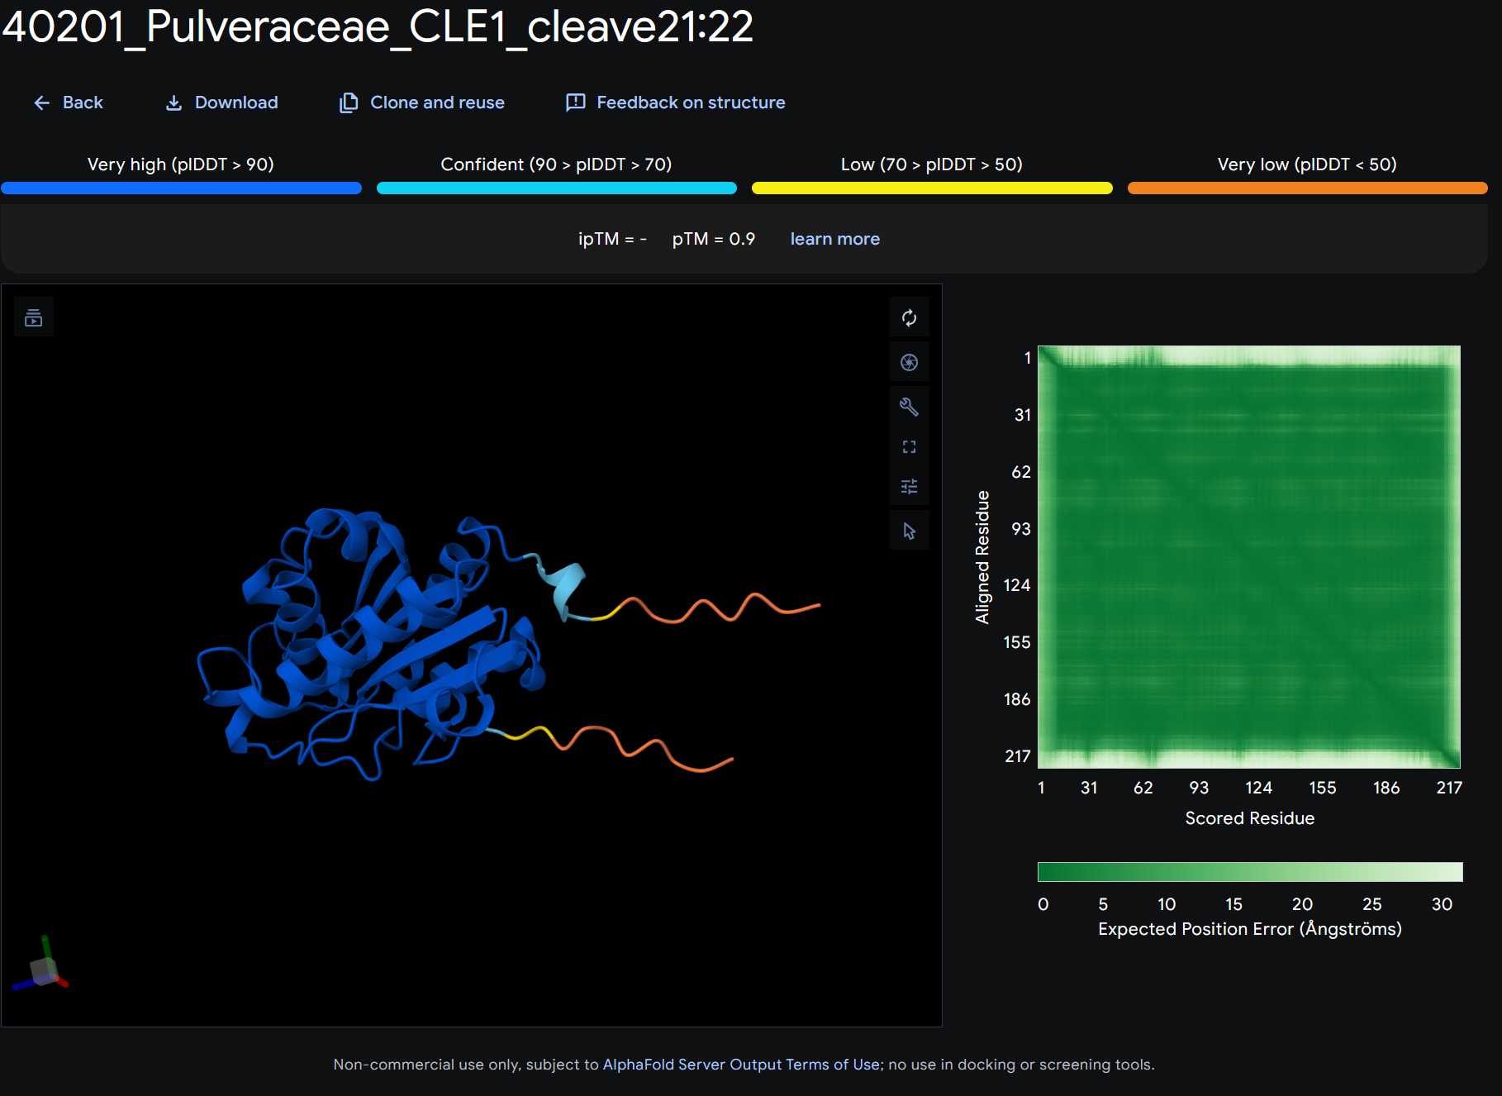
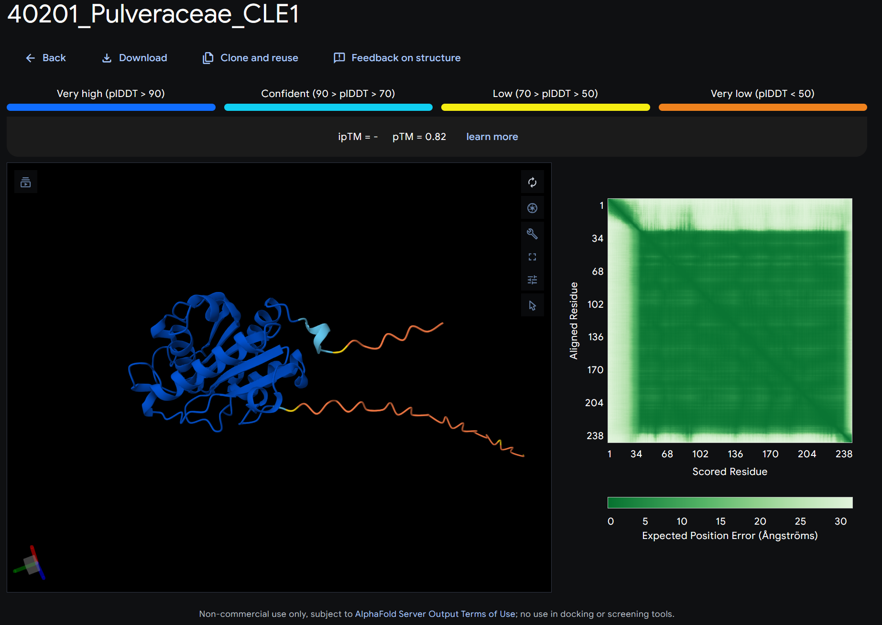
SignalP-6.0: between pos. 21 and 22
TargetP-2.0: cleavage site pos. 21-22
DeepSig: signal peptide 1-21
PrediSi: [no result]

Slide 2
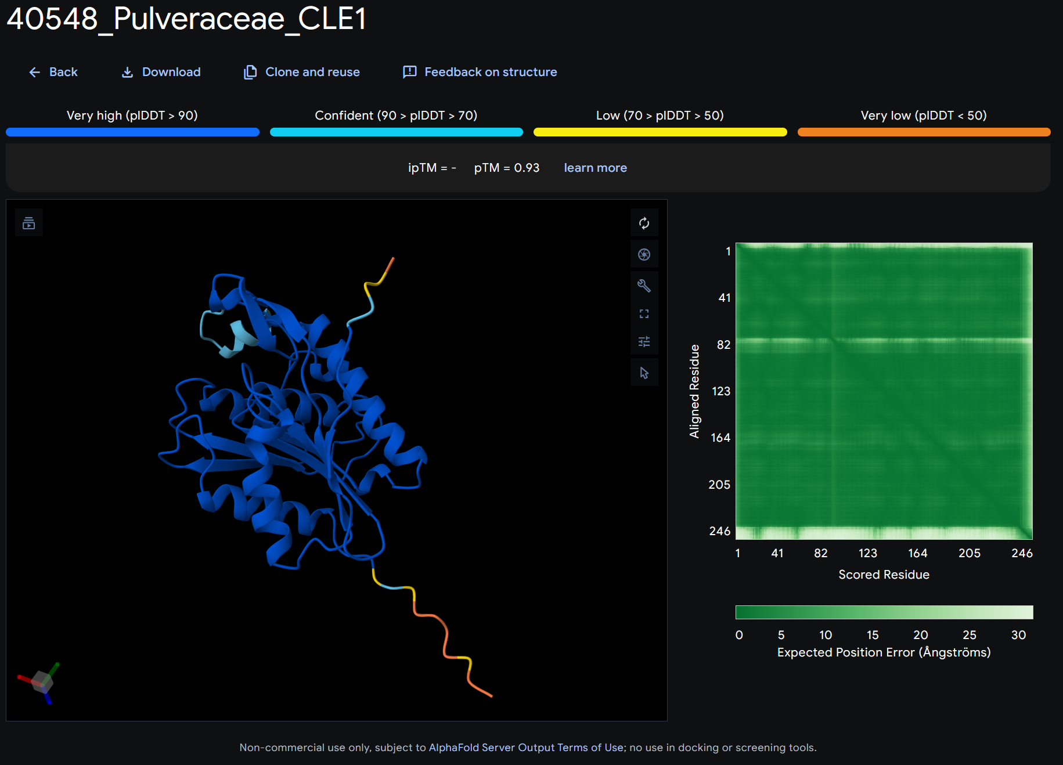
SignalP-6.0: no signal, other
TargetP-2.0: no signal, other
DeepSig: no signal peptide, likely localization somewhere within cytoplasm
PrediSi: no signal peptide, incorrect cleavage position at 37 (low score 0.2564)

Slide 3
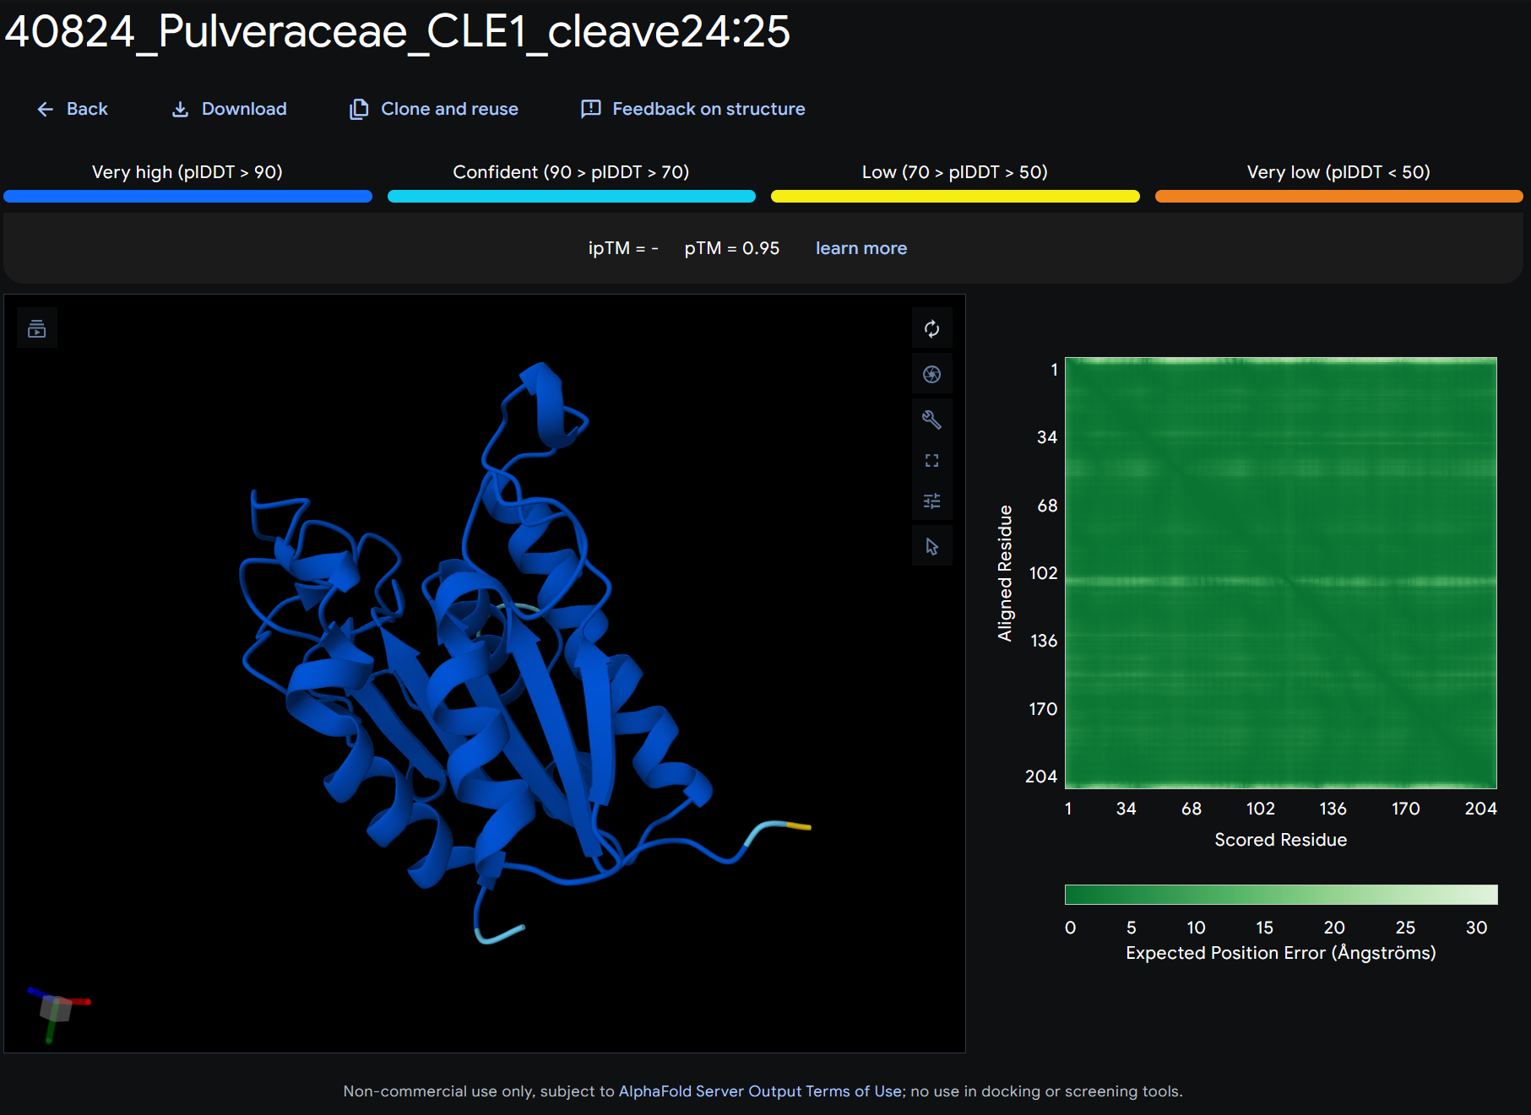
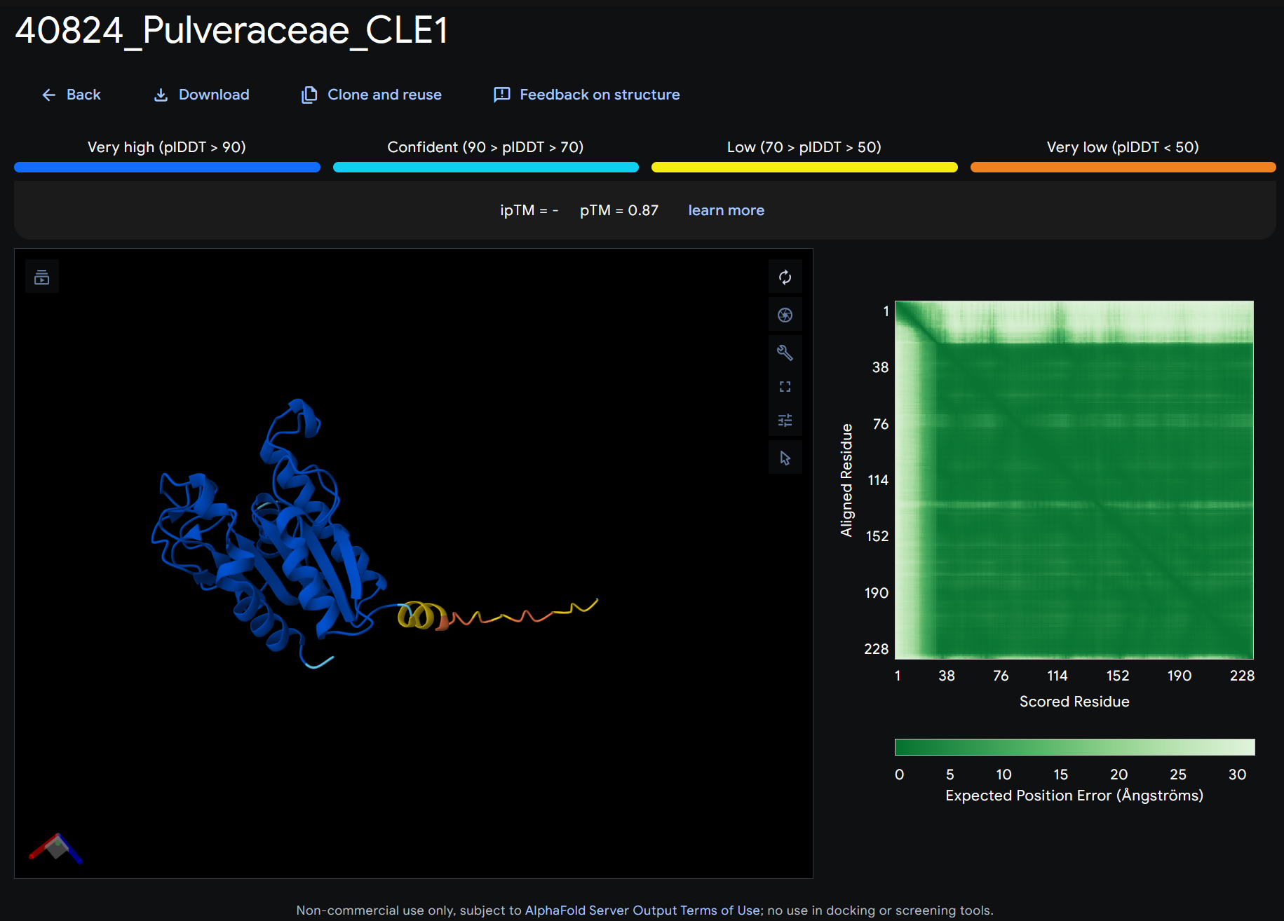
SignalP-6.0: between pos. 24 and 25
TargetP-2.0: cleavage site pos. 16-17
DeepSig: no signal peptide, likely localization somewhere within cytoplasm
PrediSi: signal peptide, cleavage site pos. 21
Cleavage below done at SignalP-6.0 site

Slide 4
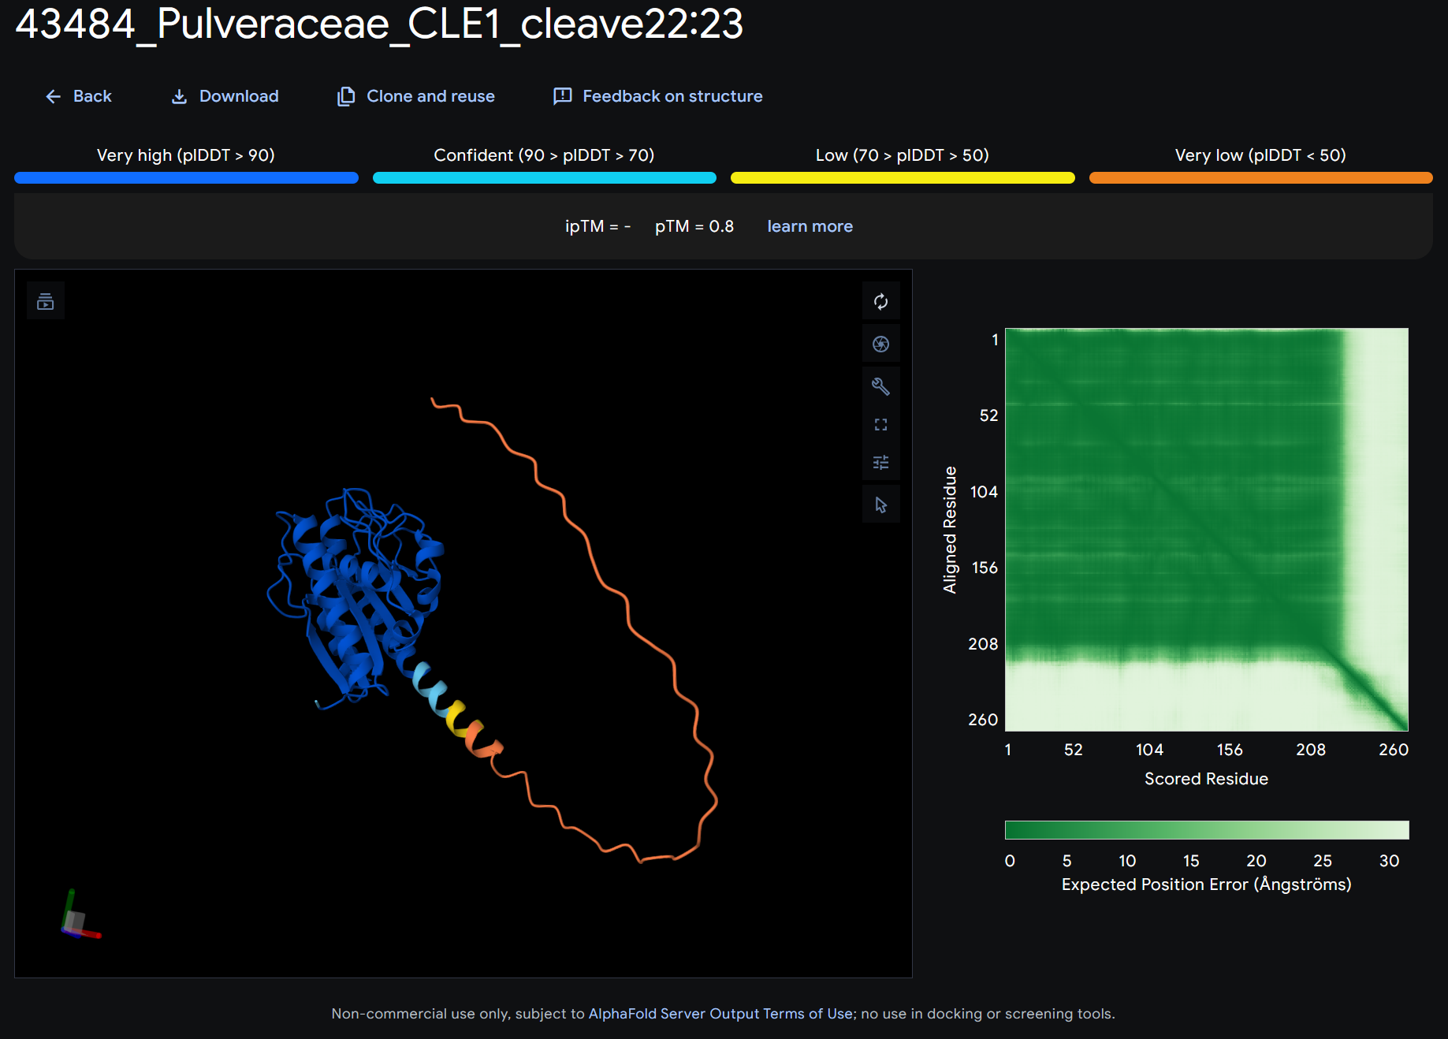
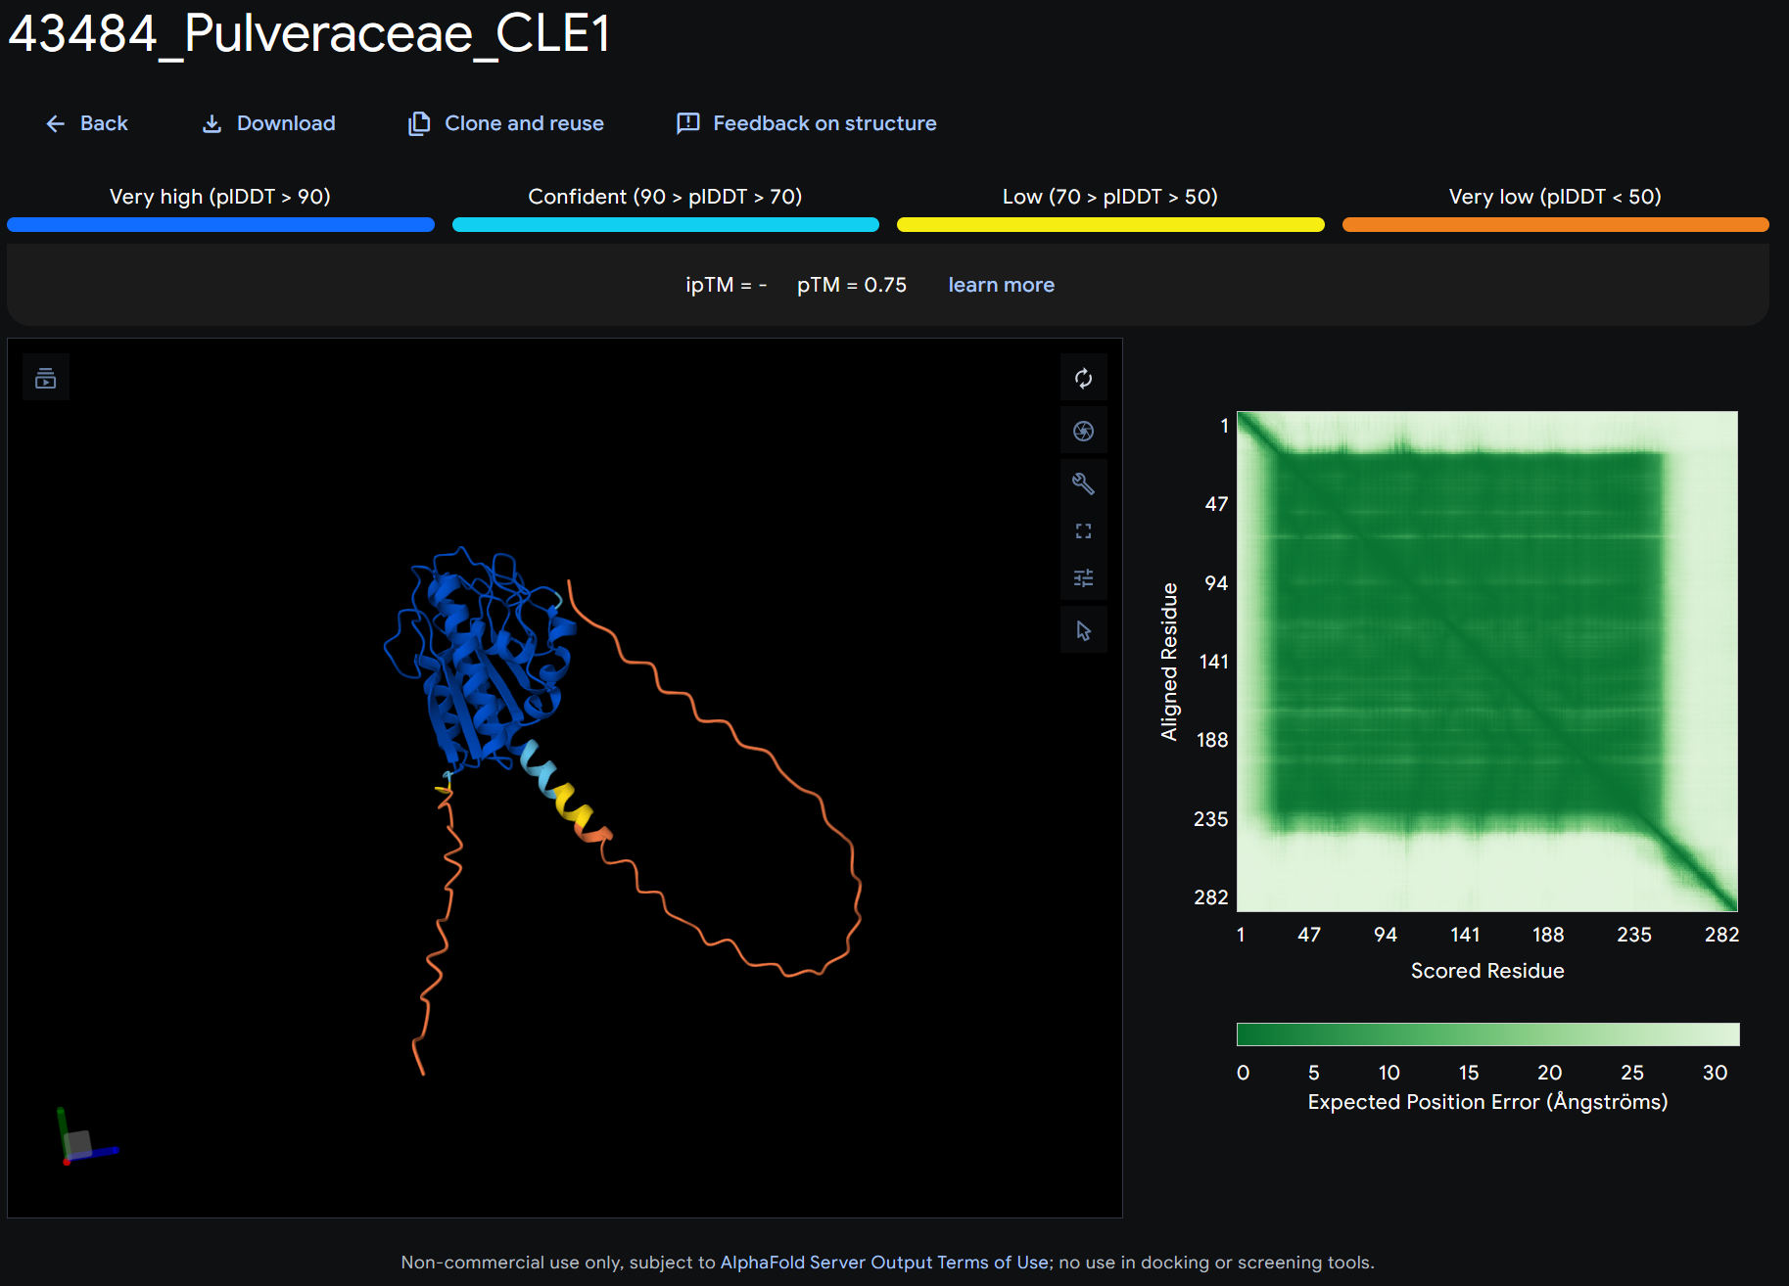
SignalP-6.0: between pos. 22 and 23
TargetP-2.0: cleavage site pos. 22-23
DeepSig: signal peptide 1-22
PrediSi: signal peptide, cleavage site pos. 22

Slide 5
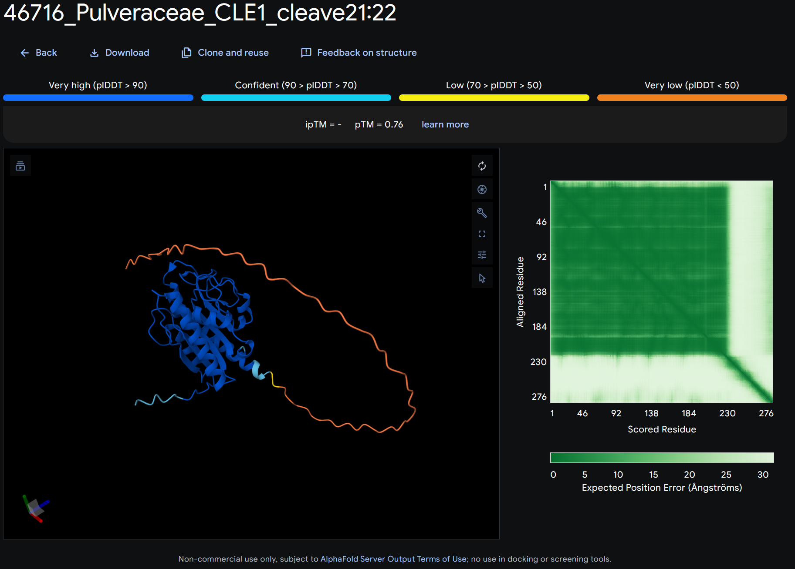
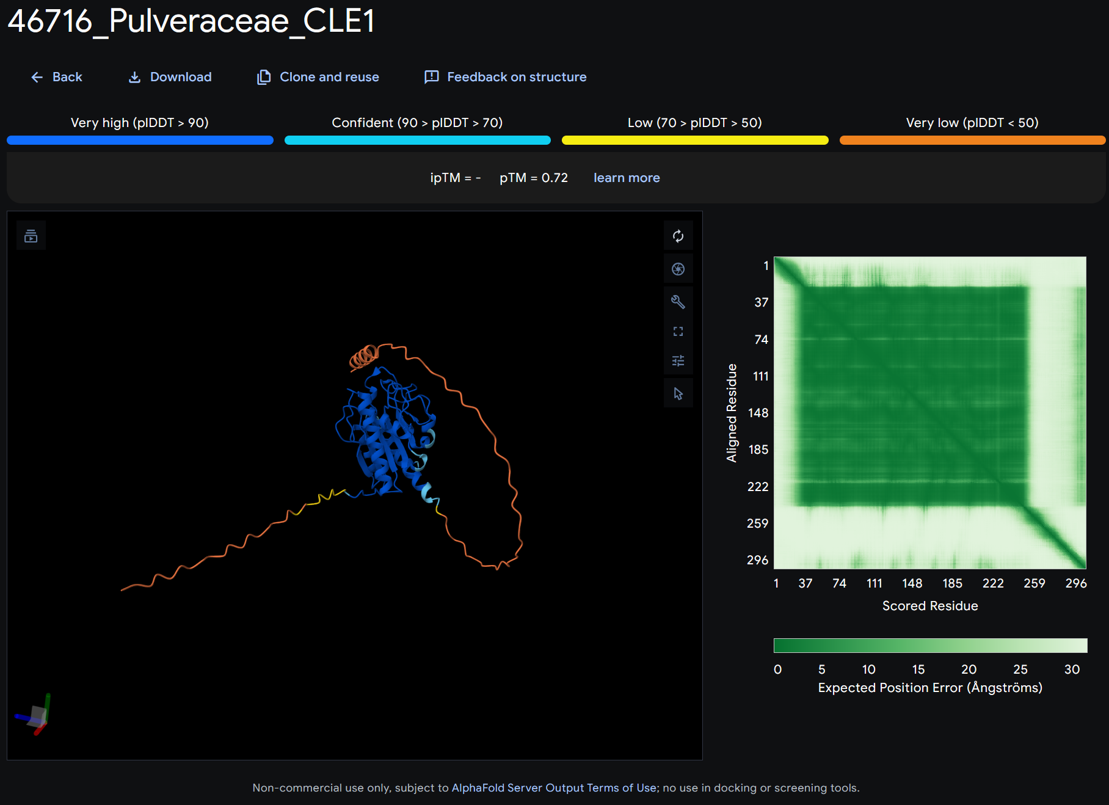
SignalP-6.0: between pos. 21 and 22
TargetP-2.0: cleavage site pos. 21-22
DeepSig: signal peptide 1-21
PrediSi: signal peptide, cleavage site pos. 21

