Slide 1
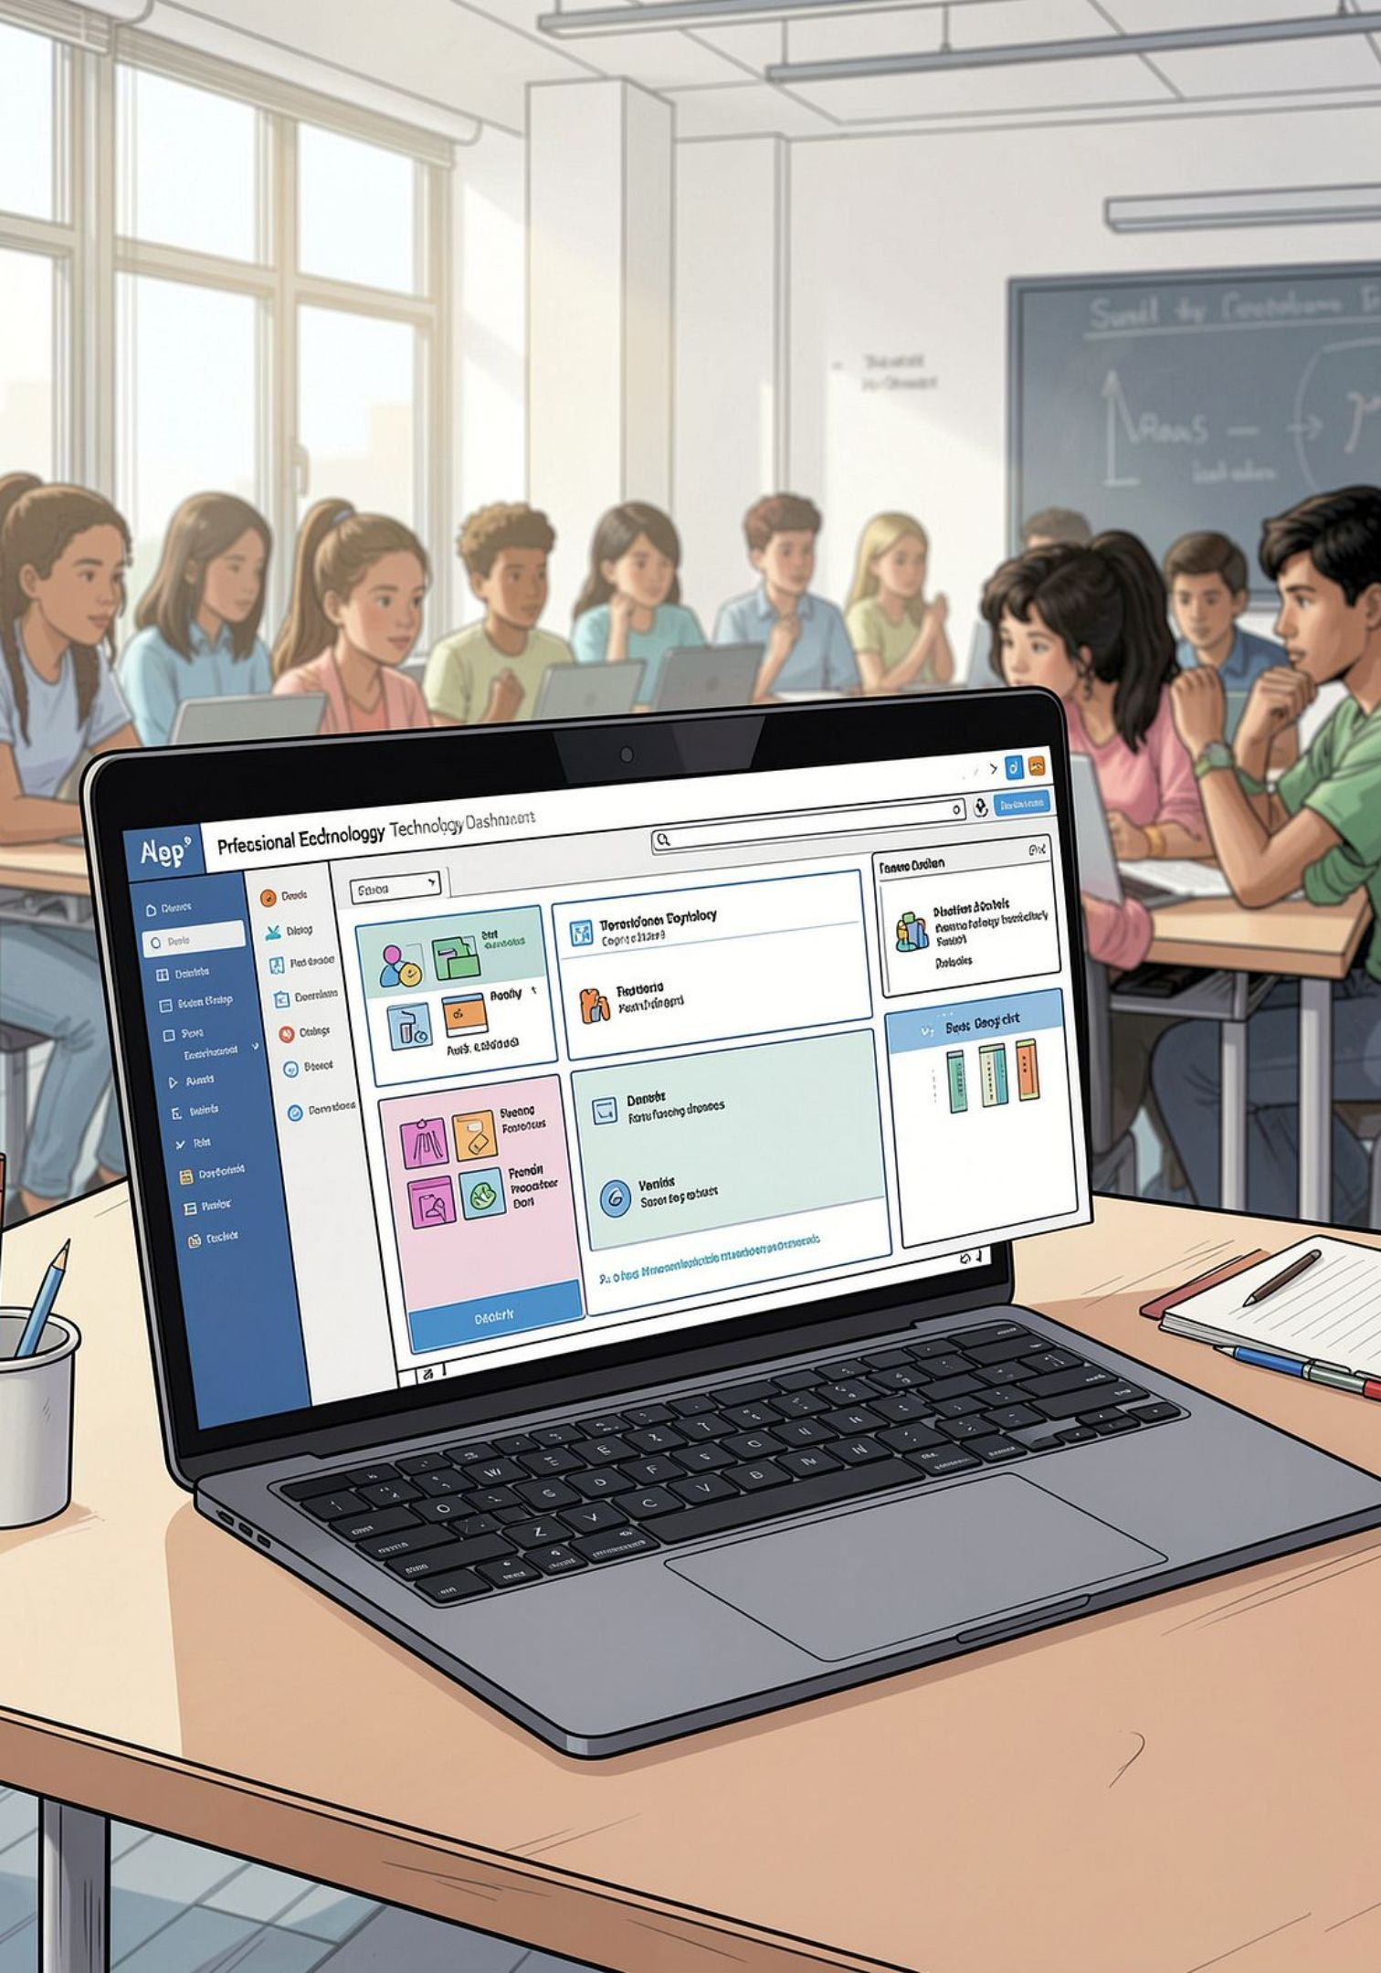
LearnIQ — Adaptive Learning, Reimagined
Learn differently. Learn better. A focused adaptive learning MVP that personalizes content, pace, and support for every student. Built for clear demos and reliable classroom impact.
Team: Mysuru Crew • Demo: https://learniq-nrwt.onrender.com

Slide 2



The Problem: One Size Doesn’t Fit All
1
2
Different learners
Different levels
Students learn visually, verbally, or by doing — one lesson rarely serves them all.
Beginners need foundations; advanced students need application and challenge.
3
Delayed intervention
Without continuous checks, gaps stay hidden until they widen.
Who is affected? School students receiving identical content despite diverse needs.

Slide 3



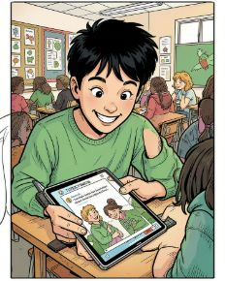
Target Users — Designed for Real Students
Explorer
Visualizer
Challenger
Storyteller
Likes figuring things out; learns by discovery. Benefit: open-ended tasks and exploratory modules.
Prefers pictures & examples. Benefit: diagrams, mind maps, and visual guides.
Wants problems to solve. Benefit: scaffolded challenges and application tasks.
Likes explanations as stories. Benefit: narrative examples and contextualized problems.
Accessibility choices: English / Kannada, variable video durations, text or voice questions.

Slide 4
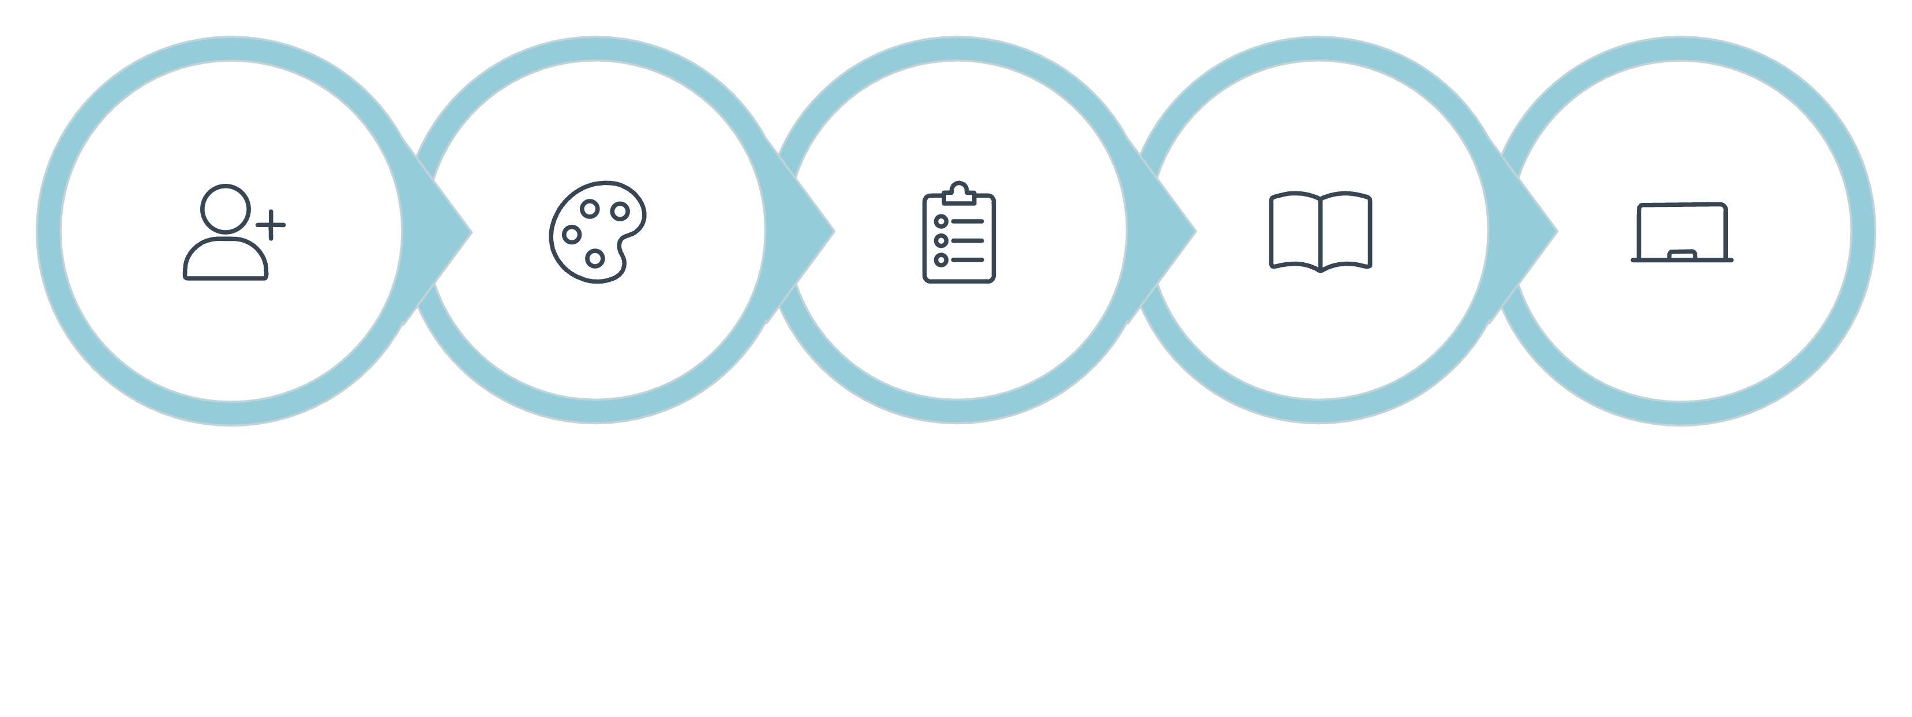
Solution: A Guided, Adaptive Journey
Diagnostic Quiz
Personalized Lesson
Tutor + Final Quiz
Register
Choose Style
Each checkpoint updates the student profile—style + diagnostic score determine level and content. Deliverables for Trigonometry MVP: Video, PDF notes, mind map, and visual guide.

Slide 5
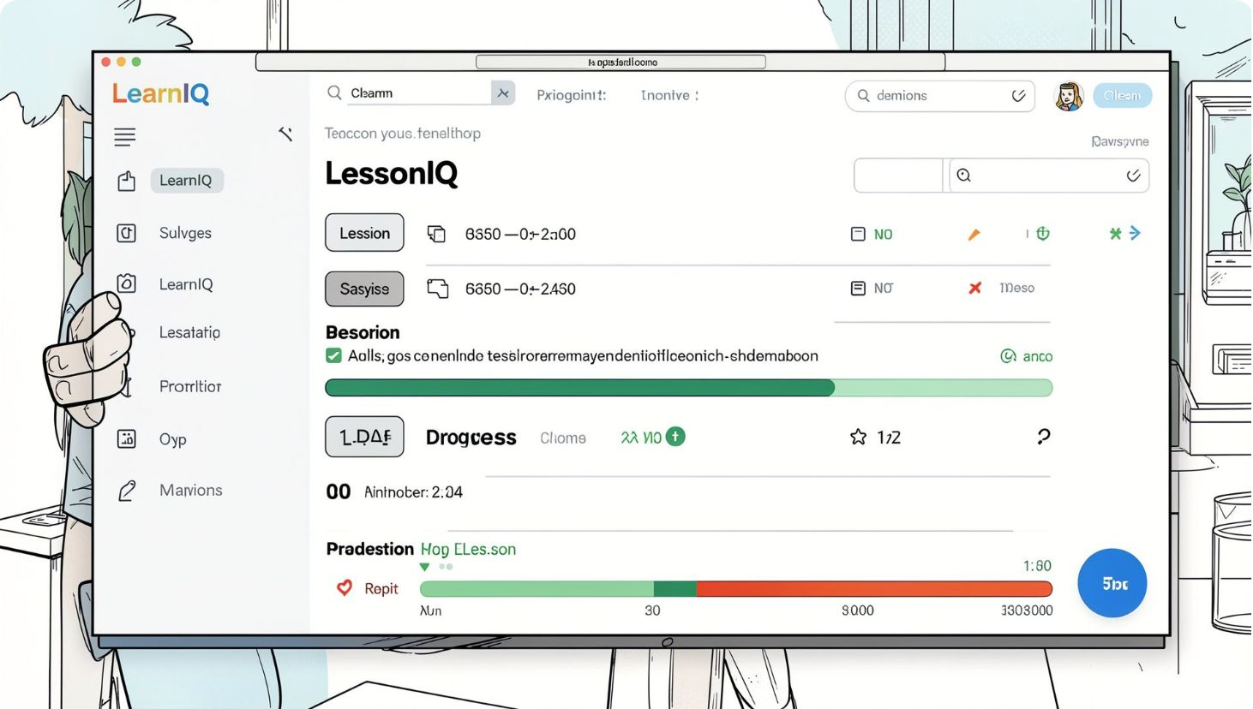
Architecture — Simple, Demonstrable MVP
Student data flow: Registration → Style → Topic → Diagnostic → Level → Lesson → Tutor → Quiz → Progress.
Frontend
Backend
AI Layer
HTML • CSS • JavaScript — lightweight and deployable offline for core flows.
Flask routes • quiz logic • SQLite for simple, fast storage.
Constrained prompts + topic-limited generation for personalized explanations and tutor responses.

Slide 6

Hard Constraints — Clear MVP Boundaries
AI Hallucination
1
Mitigation: Topic-limited prompts + school-level explanations. Status: Partial — monitoring required.
Bad Input
2
Mitigation: Input validation and restricted prompts. Status: Partial — refine validation rules.
Personalization
3
Approach: Style + diagnostic score drives lesson selection. Status: ✅ Handled for MVP flows.
Offline Access
4
Core frontend loads locally; AI features require network. Status: Partial — explore caching for offline resources.

Slide 7
Key Decision: Focus the MVP
Scope
One subject: Trigonometry — deeper, reliable demos beat shallow multi-subject breadth.
Personalization
Rule-based level + constrained AI content for explainability and speed.
Content
Curated videos for reliability; LLMs generate structured text and tutor prompts under tight guardrails.
Deployment
SQLite storage and Flask backend for simple, low-cost demos and easy hosting.

Slide 8

Proof It Works — Where We Are
Registration
Name and settings persist across the session.
Adaptive Path
Style + diagnostic score map to a level and lesson sequence.
Learning Hub & Tutor
Format, duration, and language choices are captured; topic-specific queries return contextual demo responses.
Next proof point: Generate AI-produced PDF + mind map + fully personalized lesson for a demo classroom.

Slide 9




Limits & Scale — Engineering Challenges Ahead
Content scale
Scale path highlights: topic pipelines, caching + prompt engineering, and longitudinal analytics to surface subtle learning gaps.
Many subjects increase validation and review needs; build topic-specific pipelines.
AI cost & latency
Plan caching, batching, and structured prompts to reduce calls and delay.
Student signals
Simple rules may miss subtle gaps; invest in richer assessment and longitudinal analytics.

Slide 10

What’s Next & Disclosure
Pilot
1
Deploy a focused pilot: one school or ward to validate engagement and outcomes.
Content Expansion
2
Add validated subjects, Kannada content, and curated videos reviewed by educators.
Real-time Intervention
3
Voice input, reminders, and stronger progress analytics for timely teacher actions.
Disclosure: AI outputs are constrained, topic-limited, and reviewed before classroom use. Visit the working demo at learniq-nrwt.onrender.com.
Focused scope now → stronger, demonstrable impact sooner. Ready to pilot.

