Slide 1

A3-PS027-TC489
IPv6 Website and Dependency Readiness Auditor
NAKSHATHRA M
SURESSVAR B
nakshathram@karunya.edu.in
suressvarb@karunya.edu.in
AIORI Hackathon 3
October 14, 2026

Slide 2
AIORI 3
Abstract
Problem Description
• Readiness checks that focus only on the root domain can overlook problems in supporting services and third-party dependencies.
• DNS records, transport connectivity, HTTPS configuration, and application-level dependencies provide different kinds of evidence and should not be treated as interchangeable.
• Manual troubleshooting requires users to combine outputs from multiple tools and interpret them consistently.
• A raw list of technical warnings does not always explain the evidence, practical impact, or recommended order of remediation. • Audit results must clearly communicate uncertainty: an unobserved or blocked endpoint should not automatically be labelled IPv6-incompatible.
J. Doe · A3-PS001-TC001 · October 5, 2026

Slide 3
AIORI 3
Background
Background
Internet Protocol version 6 (IPv6) was developed to expand the Internet's addressing capability and support continued growth. IPv4 and IPv6 can coexist during a transition period, which means websites and their supporting infrastructure may operate in mixed environments. A website's practical readiness therefore depends on more than the presence of one DNS record. DNS can publish IPv6 addresses through AAAA records, while actual reachability depends on routing, firewall rules, server configuration, and the network path between client and service. HTTPS introduces additional checks, including whether a TLS connection can be established and whether the certificate and hostname validation succeed. External scripts, APIs, content delivery networks, and other referenced services may have independent network configurations. NETSCOPE treats readiness as a collection of observable signals rather than a single binary property. The audit should record the target, test performed, timestamp, outcome, and evidence for each finding. Where a test cannot be completed—for example, because of rate limits, access controls, timeouts, or an endpoint that could not be discovered—the result should be marked inconclusive instead of being reported as a confirmed failure.
J. Doe · A3-PS001-TC001 · October 5, 2026

Slide 4
AIORI 3
Literature & RFC Review
Literature & RFC Review
The following standards are relevant foundations for designing and interpreting NETSCOPE's checks. They define protocol behaviour; they do not, by themselves, provide a complete website-readiness scoring method. RFC 8200 — Internet Protocol, Version 6 (IPv6) Specification Defines IPv6 packet format and core protocol behaviour. It provides the protocol baseline for IPv6-related checks. RFC 3596 — DNS Extensions to Support IP Version 6 Defines DNS support for IPv6, including AAAA records. A valid AAAA record indicates published address information, not guaranteed end-to-end reachability. RFC 8305 — Happy Eyeballs Version 2 Describes techniques that help applications connect efficiently when IPv4 and IPv6 are both available. It highlights that connection behaviour can depend on client and network conditions. RFC 9110 — HTTP Semantics Defines the semantics of HTTP. NETSCOPE can use HTTP-level observations as supporting context, while avoiding assumptions that an HTTP response alone proves full IPv6 readiness. RFC 8446 — The Transport Layer Security (TLS) Protocol Version 1.3 Specifies TLS 1.3. HTTPS checks should distinguish connection failures from certificate, hostname, and protocol-validation issues..
J. Doe · A3-PS001-TC001 · October 5, 2026

Slide 5
AIORI 3
Proposed Solution
Proposed Solution
NETSCOPE is organized as a staged audit pipeline. The user submits a domain or website URL. The input is validated and normalized before the audit begins. The system then performs the checks supported by the implementation, collects evidence, discovers dependencies that can be safely observed, and correlates the results into a structured report
Expected output:
The report should show an overall readiness summary alongside individual check statuses, affected hostnames, evidence, timestamps, and limitations. The interface should distinguish passed checks, confirmed issues, warnings, and inconclusive results. A recommendation must be traceable to a finding; any AI-generated explanation should summarize recorded evidence rather than inventing test results.
J. Doe · A3-PS001-TC001 · October 5, 2026

Slide 6
AIORI 3
Solution Optimization
Optimization Proposed
Optimization priorities • Use asynchronous or parallel checks only where safe and supported, with explicit timeouts and concurrency limits. • Cache DNS or endpoint results only for an appropriate period and display the audit timestamp to avoid implying stale results are live. • Use consistent status categories and deterministic priority rules so users can understand why a finding is ranked. • Keep a clear audit trail between raw evidence, derived findings, and recommendations. • Measure audit duration, successful check rate, false-positive rate, and repeatability during evaluation before claiming performance gains
J. Doe · A3-PS001-TC001 · October 5, 2026

Slide 7
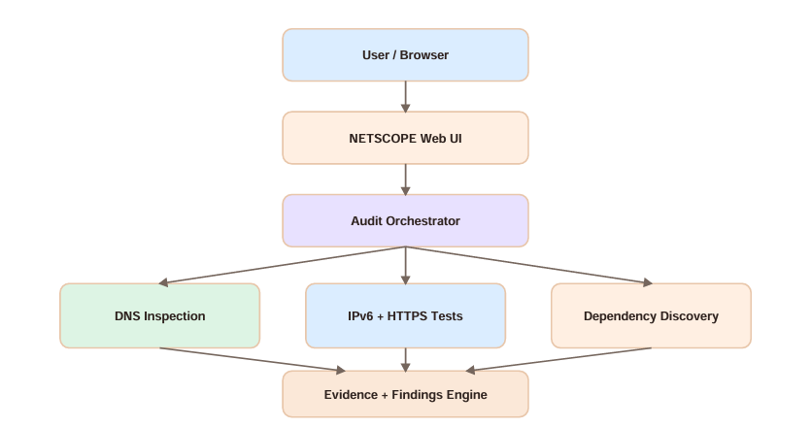
AIORI 3
Solution Architecture & Design
Architecture Design (UML Diagram)
J. Doe · A3-PS001-TC001 · October 5, 2026

Slide 8
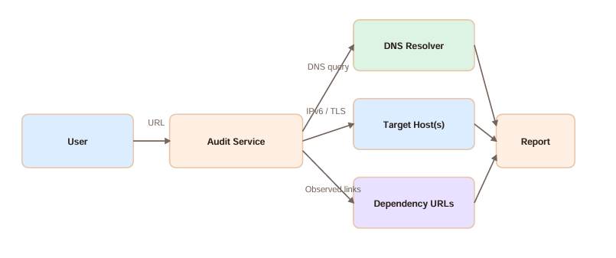
Data Flow Diagram
Overview of the architecture. Include the flow chart diagram created earlier. Visual: Diagrams or architecture visuals.
AIORI 3 Data Flow Diagram
J. Doe · A3-PS001-TC001 · October 5, 2026

Slide 9
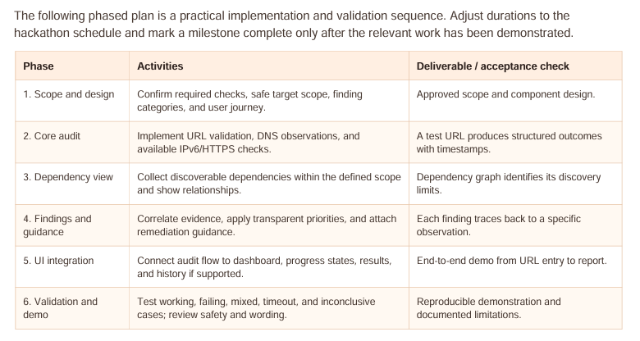
AIORI 3
Deployment Timeline
Deployment Timeline
J. Doe · A3-PS001-TC001 · October 5, 2026

Slide 10
Bibliography I
Bibliography
Conclusion:
NETSCOPE proposes a practical way to understand IPv6 readiness beyond a single DNS lookup or connectivity test. By organizing observable protocol checks, dependency context, evidence, and remediation guidance into one workflow, it aims to help developers investigate potential problems more efficiently. Its central design principle is transparency: every important finding should explain what was checked, what was observed, what remains uncertain, and what action the user can take next.
J. Doe · A3-PS001-TC001 · October 5, 2026

Slide 11
Thank You

