Slide 1

Real-Time Hand Gesture Recognition using SVM and Computer Vision
Submitted To
SVKM’s NMIMS,
Mukesh Patel School of Technology Management & Engineering,
Shirpur Campus (M.H.)
Submitted By:
Nakshatra Paliwal Enrollment No: 70012400197
Under The Supervision Of:
Under the Supervision Of: Dr. Suyog Pande
(Artificial Intelligence and Machine Learning Dept.)
DEPARTMENT OF INFORMATION TECHNOLOGY
Mukesh Patel School of Technology Management & Engineering
ACADEMIC SESSION: 2025-26

Slide 2
OUTLINE
The presentation covers the following sections:
Introduction
Description of Project
Objectives
Implementation
Problem Statement
Conclusion
Methodology Used
References
All topics are aligned with the report and supported by the demonstration shown in the project.
2

Slide 3
INTRODUCTION
Hand gesture recognition is a branch of computer vision that enables machines to detect and interpret human hand movements.
It is useful in human-computer interaction, assistive technology, virtual reality, and smart interfaces where touchless control is preferred.
This project demonstrates a simple real-time pipeline that detects hand landmarks and classifies gestures using Support Vector Machine (SVM).
Why this matters
Contactless interaction
Real-time input
Easy to demonstrate
Useful for accessibility
3

Slide 4
OBJECTIVES
The main objectives of the project are:
Expected outcome
A compact system that can recognize a few basic gestures such as fist, open palm, and thumbs up with minimal delay.
To detect a hand in a webcam frame using computer vision techniques.
To extract hand landmark coordinates as features.
To train an SVM model for gesture classification.
To display the predicted gesture in real time.
Project scope
Single-hand detection
3 gesture classes
Webcam-based demo
Python implementation
4

Slide 5
PROBLEM STATEMENT
Traditional input devices such as the mouse and keyboard are not always suitable for natural and touch-free interaction.
No physical contact
Need for real-time AI
Need for feature extraction
Needs natural and
intuitive interaction
System should recognize
hand gestures instantly
Convert hand landmarks
into numeric features
Problem to solve: build a low-cost real-time gesture recognition system using computer vision and machine learning.
5

Slide 6
METHODOLOGY USED
Pipeline for real-time gesture recognition
Webcam Input
Hand Detection
(MediaPipe)
Feature Extraction
(21 landmarks)
SVM
Classification
Gesture
Output
How it works
Tools used
The camera captures live frames.
MediaPipe detects the hand and returns 21 landmarks.
The landmark coordinates are flattened into a feature vector.
The trained SVM predicts the gesture class.
The result is displayed on the screen.
Python • OpenCV • MediaPipe • scikit-learn
Dataset approach
A small custom dataset can be created by capturing gesture samples from the webcam and labeling them before training the classifier.
6

Slide 7
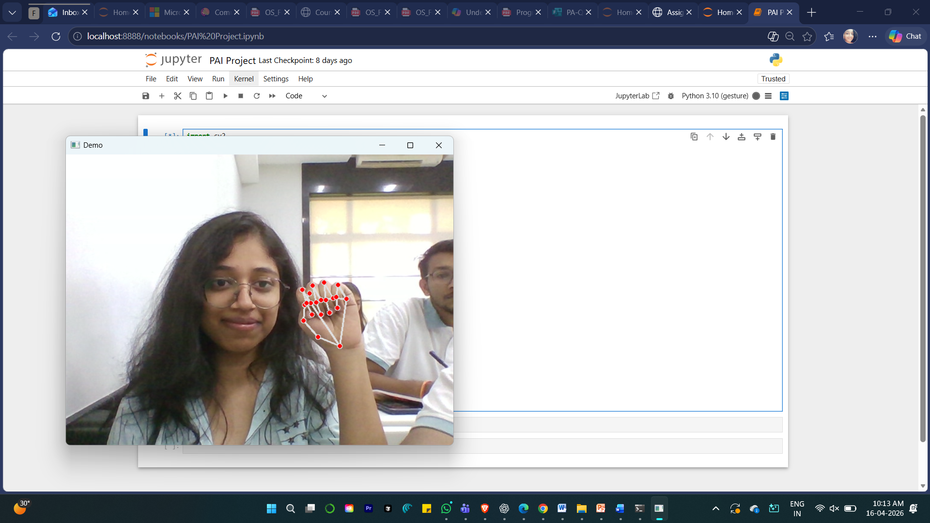
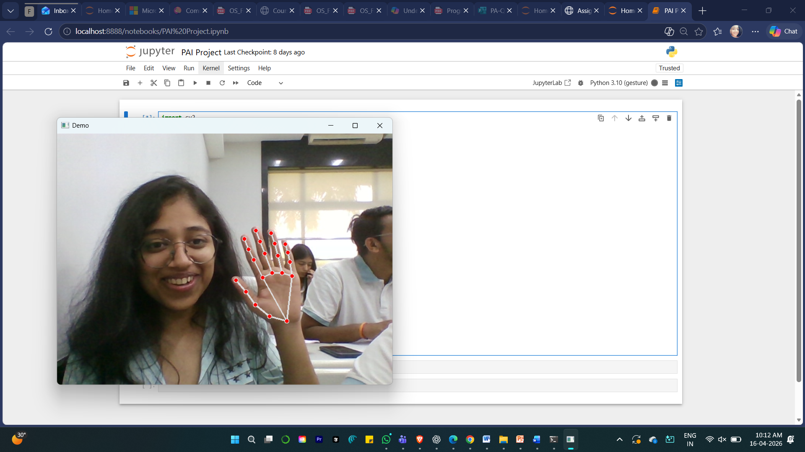
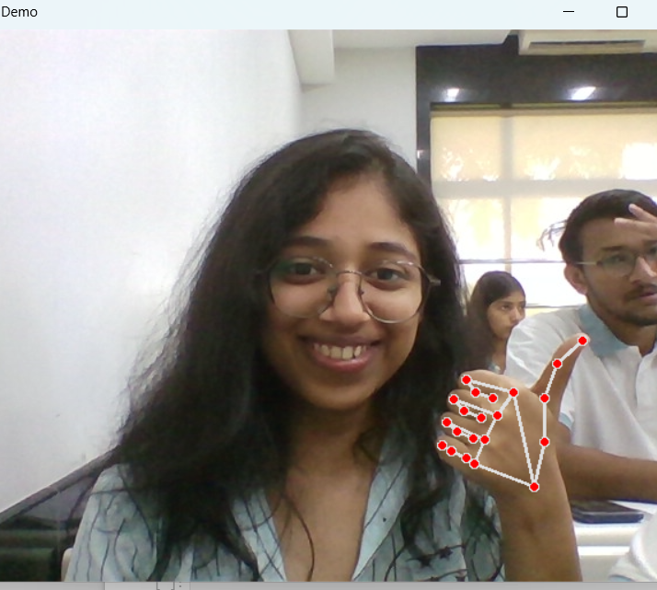
DESCRIPTION OF PROJECT
The system is designed to recognize a small set of gestures in real time and can be expanded later for more gestures.
Fist
Open Palm
Thumbs Up
Closed hand
Visible fingers and hand pose
Distinct positive gesture
Label 0
Label 1
Label 2
Project features
Real-time gesture detection from live webcam feed.
Landmark-based representation instead of raw pixels.
Simple SVM classifier suitable for a quick academic prototype.
Can be scaled to additional gestures and applications.
7

Slide 8
IMPLEMENTATION
Implementation steps
Software stack
Capture sample gestures using a webcam.
Extract 21 hand landmark coordinates with MediaPipe.
Store the coordinates and labels for training.
Train a Support Vector Machine classifier.
Use the model to predict gestures on live frames.
Python
Main programming language
OpenCV
Camera input and display
MediaPipe
Hand landmark detection
scikit-learn
SVM model training
The demo can be shown with a live webcam, or with a static image/video backup if hardware support is limited.
8

Slide 9
CONCLUSION
The project successfully demonstrates that hand gestures can be recognized in real time using computer vision and SVM.
The system is simple, efficient, and suitable for a student project.
It demonstrates the use of AI for touchless interaction.
The current scope can be extended by adding more gestures, better datasets, and improved classifiers.
Future scope
Support more gestures, improve robustness in different lighting conditions, and explore advanced models for higher accuracy.
9

Slide 10
REFERENCES
OpenCV Documentation — https://opencv.org/
MediaPipe Hand Tracking Guide — https://developers.google.com/mediapipe
scikit-learn Documentation — https://scikit-learn.org/
Research papers on hand gesture recognition and landmark-based classification.
10

Slide 11
Thank You
Real-Time Hand Gesture Recognition using SVM and Computer Vision
Presented by Nakshatra Paliwal
Under the guidance of Dr. Suyog Pande

