Slide 1
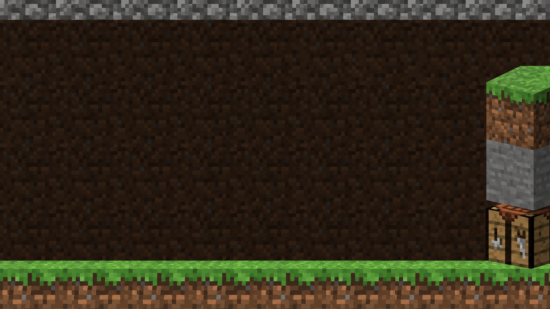
BITTENSOR BUILDERS HOUSE / NAKSHATRA GOEL
TENSORCRAFT
Turn a sentence
into a world you can play.
AI world-building for creators and players.
Chutes / Bittensor Subnet 64 integration.
Prototype: live gameplay, subnet activation pending.
01
Notes:
0:00–0:15. Opening: What if building a world started with describing it? TensorCraft turns a sentence into editable voxel structures you can explore. We are building a consumer application for Bittensor inference. Be explicit if asked: the demo currently uses centralized inference; the Chutes adapter is implemented but awaits funded credits. This is an independent ecosystem prototype.

Slide 2
01 / THE PLAYER PROBLEM
Less placing.
More creating.
Start with an idea, not hundreds of clicks.
For players and creators sketching a new world.
Manual building asks them to place every detail.
A text answer alone is not a playable structure.
TensorCraft turns intent into an editable first build.
02
Notes:
0:15–0:35. Frame this as a product hypothesis, not validated market research. Our target user is a player or creator who wants to prototype structures quickly and retain creative control. AI produces the first draft; players explore and modify it. Do not claim measured time savings, traction, retention, or market size.

Slide 3
02 / SHOW THE GAME
Prompt. Build.
Step inside.
“Build a stone tower with glowing windows.”
1 Open the AI Builder and describe the tower.
2 Watch the returned plan become voxel blocks.
3 Walk around it and edit the result yourself.
4 Give the builder a follow-up instruction.
03
Notes:
0:35–1:10 including a short live demo. Open https://tensorcraft-bittensor.vercel.app/play and unlock the AI Builder before presenting; never place the password on the slide. Use the tower prompt, walk around the result, and manually edit a block. A follow-up request is supported by world context but is not guaranteed to produce a perfect edit. If generation is slow, explain the pipeline without presenting a cached or deterministic build as a live subnet response. The demo currently runs centralized inference.

Slide 4
03 / HOW AN IDEA BECOMES A BUILD
From intent
to execution
A structured plan connects AI to game state.
01 / CONTEXT
02 / INFERENCE
03 / CHECKS
04 / WORLD
Prompt + world state
>
Structured AI plan
>
Shape + operations
>
Apply + explore
04
Notes:
1:10–1:35. Read the four steps from left to right: the game packages the prompt and current world context; the configured provider returns structured operations; the adapter and engine perform structural and operation checks; the engine applies the plan. The Chutes path targets SN64. Structural checks do not establish that every spatial or semantic constraint is satisfied. Automatic feedback and regeneration after validation failures are future work.

Slide 5
04 / WHY BITTENSOR
A game creates
inference demand
Chutes / Subnet 64 is our chosen integration.
Independent GPU operators serve model requests.
Chutes exposes that compute through an API.
Each build or edit can become an inference request.
Players get a creative tool without learning subnets.
05
Notes:
1:35–1:55. Source: https://www.chutes.ai/docs/guides/starter-guide . Chutes documents decentralized serverless inference on Bittensor SN64. TensorCraft is a demand-side application consuming this service, not a miner, validator, or registered subnet. Other inference providers could support the same mechanics; our deliberate integration direction is Bittensor. Do not assert lower cost, superior latency, guaranteed demand, or TAO rewards. Live Chutes activation remains pending.

Slide 6
05 / WHAT WE BUILT + WHAT IS PROVEN
A playable
subnet client
Integration work on an existing voxel engine.
Added: Chutes adapter, response metadata, deployment.
Verified: live AI plans and six provider/demo tests.
Pending: successful funded Chutes generation.
Foundation: the existing PromptCraft engine.
06
Notes:
1:55–2:20. Distinguish original work from inherited work. PromptCraft supplies the voxel engine, world context, construction operations, multiplayer, and agent foundations. This adaptation adds the Chutes provider path, provider provenance, explicit quota handling, hosted demo isolation, tests, and TensorCraft branding. Six tests cover provider behavior and demo plans; mocked Chutes tests do not establish successful live subnet inference. The centralized provider completed live plan generation. Chutes returned HTTP 402 for zero balance. Hosted gameplay is single-player; the full Node backend supports shared worlds.

Slide 7
06 / NEXT MILESTONE
Prove the
creative loop
A small, measurable path to subnet-backed play.
Activate Chutes and verify end-to-end builds.
Track latency, valid plans, and edit accuracy.
Add validation feedback and corrected plans.
Test whether creators keep and reuse their builds.
07
Notes:
2:20–2:40. These are planned milestones, not completed results. First fund the Chutes account and verify actual request provenance and in-game execution. Next measure latency, valid-plan rate, semantic edit accuracy, and user acceptance using a consistent prompt set. Explore automatic correction only after reliable validation feedback is available. Creator testing should determine whether the product solves a real problem.

Slide 8
07 / THE ASK
HELP US MAKE
BITTENSOR PLAYABLE
Seeking Chutes credits, technical feedback, testers.
Describe an idea. Watch it become a world.
tensorcraft-bittensor.vercel.app
github.com/Nakshatra05/tensorcraft-bittensor
08
Notes:
2:40–3:00. Close with a specific ask: inference credits to activate the implemented Chutes path, feedback from subnet builders, and early creators to test the experience. Invite judges to try the world. Recommended positioning is Bittensor applications / AI gaming and creative tools; this is not a verified official track title. No official endorsement. Handbook: https://moonshotcommons.notion.site/bittensor-builders-house-handbook . Attribution: ATTRIBUTION.md in the repository.

