Slide 1
[Document Title]
NOTICE
The information contained in this document is not to be used for any purpose other than the purposes for which this document is furnished by GENPACT, nor is this document (in whole or in part) to be reproduced or furnished to third parties or made public without the prior express written permission of GENPACT.
Version Control
Version No. | Date | Type of Changes | Owner/ Author | Date of Review/Expiry
1.1 | 19-06-2018 | MES Clock ON/OFF issue Analysis Document | MES Team | As soon as Superseded

Slide 2
Node Server Restart Issue

Slide 3
Issue Observation
RCA:
UI services getting down due to this error preparing requestnode:
../deps/uv/src/unix/core.c:881: uv__io_stop: Assertion `loop->watchers[w->fd] == w' failed.
Due to this error node server shutting down.
2) Null exception encounter continuously, Due to that application down.
Reference Links
https://github.com/joyent/libuv/issues/1348
https://github.com/joyent/libuv/issues/838

Slide 4
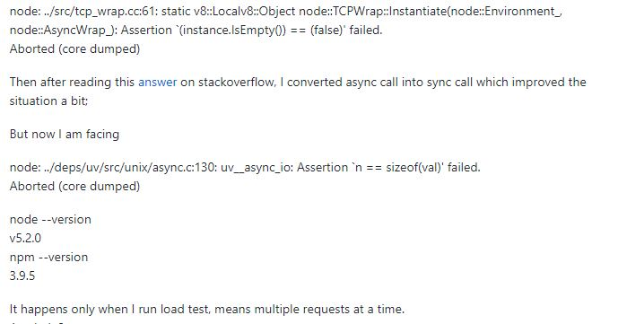
Analysis
This issue occurred when multiple requests at a time

Slide 5
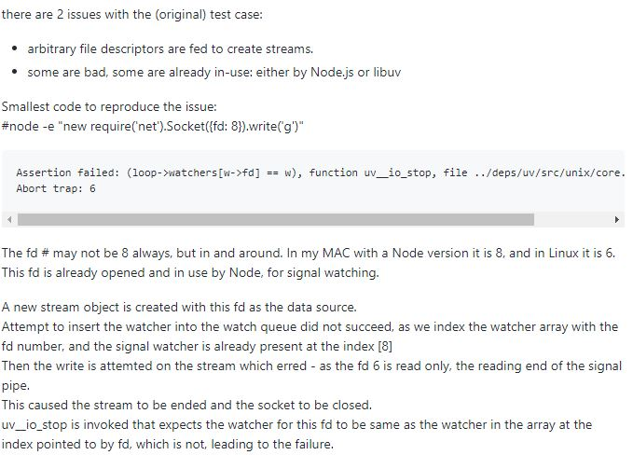

Slide 6
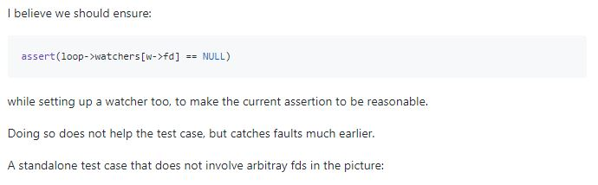

Slide 7
Thankyou

