Slide 1
OpenApi

Slide 2
About
An open API (often referred to as a public API) is a publicly available application programming interface that provides developers with programmatic access to a proprietary software application or web service. APIs are sets of requirements that govern how one application can communicate and interact with another. Analysts and software vendors classify the product around Open API as “API Management”.
Open APIs have three main characteristics:
They are available for use by developers and other users with relatively few restrictions. Restrictions might include the necessity to register with the service providing the API.
They are typically backed by open data . Open data is freely available for everyone to use and republish as they wish, without restrictions from copyright, patents or other mechanisms of control. An Open API may be free to use but the publisher may limit how the API data can be used.
They are based on an open standard.

Slide 3
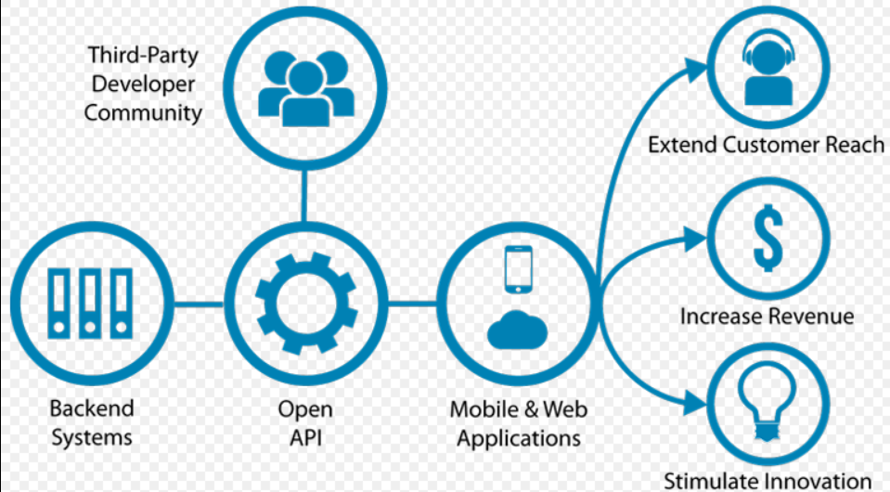
Open API Business Chart

Slide 4
Open API on Web
With the rise in prominence of HTML5 and Web 2.0, the modern browsing experience has become interactive and dynamic and this has, in part, been accelerated through the use of open APIs. Some open APIs fetch data from the database behind a website and these are called Web APIs. For example, Google's YouTube API allows developers to integrate YouTube into their applications by providing the capability to search for videos, retrieve standard feeds, and see related content . Web APIs are used for exchanging information with a website either by receiving or by sending data. When a web API fetches data from a website, the application makes a carefully constructed HTTP request to the server the site is stored on. The server then sends data back in a format your application expects (if you requested data) or incorporates your changes to the website (if you sent data).

Slide 5
Open API is a word used to describe sets of technologies that enable websites to interact with each other by using REST, SOAP, JavaScript and other web technologies. While its possibilities aren’t limited to web-based applications, it’s becoming an increasing trend in so–called Web 2.0 applications.” This definition should be endorsed by clarifying that Open API is also used for automated machine–to–machine (M2M) communication more and more. It is not just used for communicating with web browsers and mobile apps).
Drivers for Open API
The introduction of Open API establishes several benefits:
Enable New Business Models: Increase revenue from existing services through partner ecosystems, and extend presence to social and mobile platforms serving digital customers.
Deliver High Performance: Accelerate edge services performance through load balancing, caching, and a high- performance event- driven architecture.
Secure Internal Services for External Exposure: Standardize authentication and authorization across the enterprise and through to partners, and protect services from attack through security policies, message verification, and adaptive throttling.
Map Business Agreements to Enforceable Policies: Use throttles to enforce SLAs for service consumers, and monetize by metering or charging for systems integration.
Federate Disparate Enterprise Applications: Unify cloud and mobile platforms through service aggregation, content -based routing, protocol bridging, mediation, and lightweight orchestration.
Rapidly On-Board Partners: Create new channels with hot deployment of partners, services, and policies.The benefits generate several opportunities for business. Without IT, Open API would not be possible. However, Open API initiatives usually are driven by the line-of-business, not IT . Business can increase revenue, reduce costs and improve efficiency by introducing Open API.

Slide 6
Important Links
https://jaxenter.com/a-new-front-for-soa-open-api-and-api-management-as-a-game-changer-part-i-108031.html
Refer other links:
https://youtu.be/Pkv6QR3_Rj8
https://youtu.be/00DByVAVKV4
https://github.com/Techprimers
https://github.com/OAI/OpenAPI-Specification
https://app.swaggerhub.com/help/tutorials/openapi-3-tutorial

