Slide 1
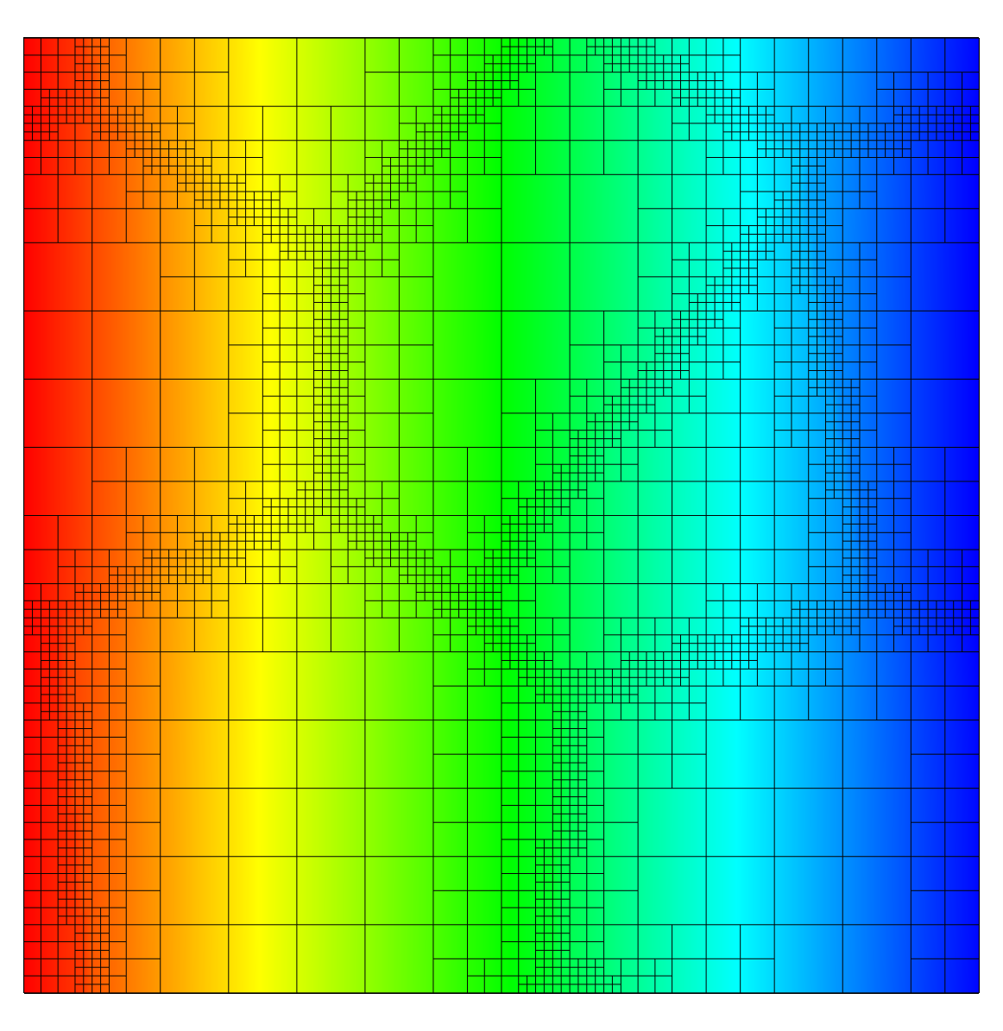
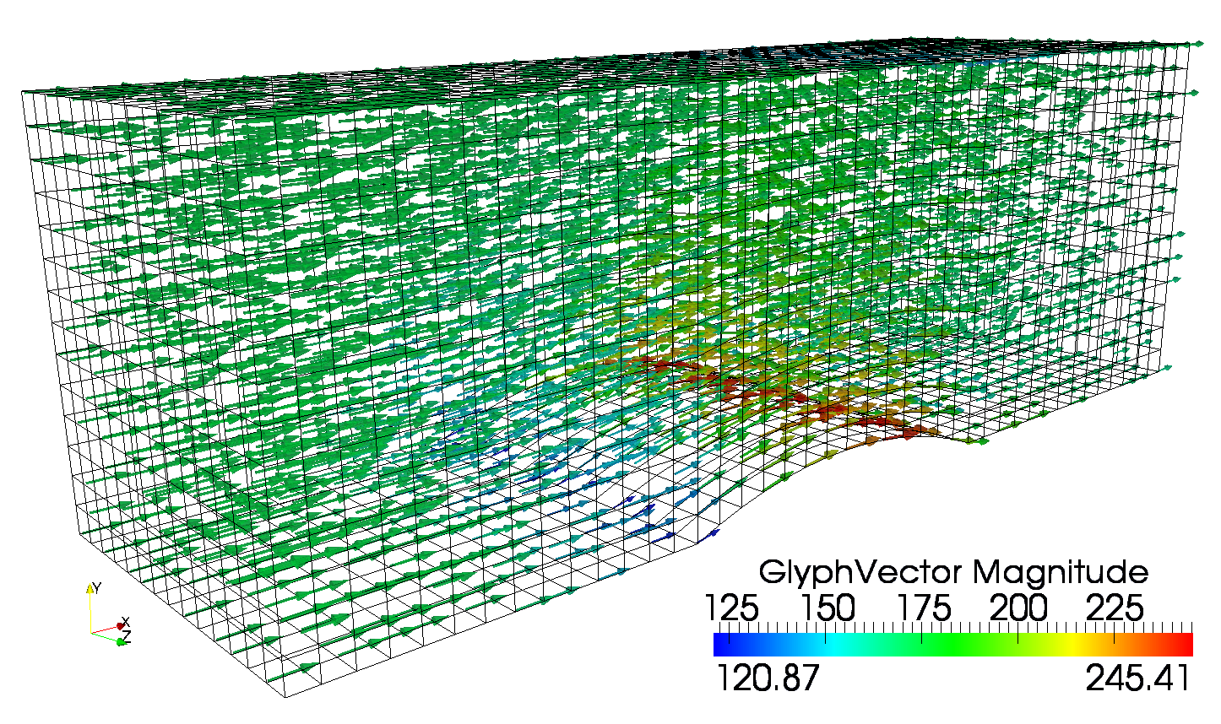
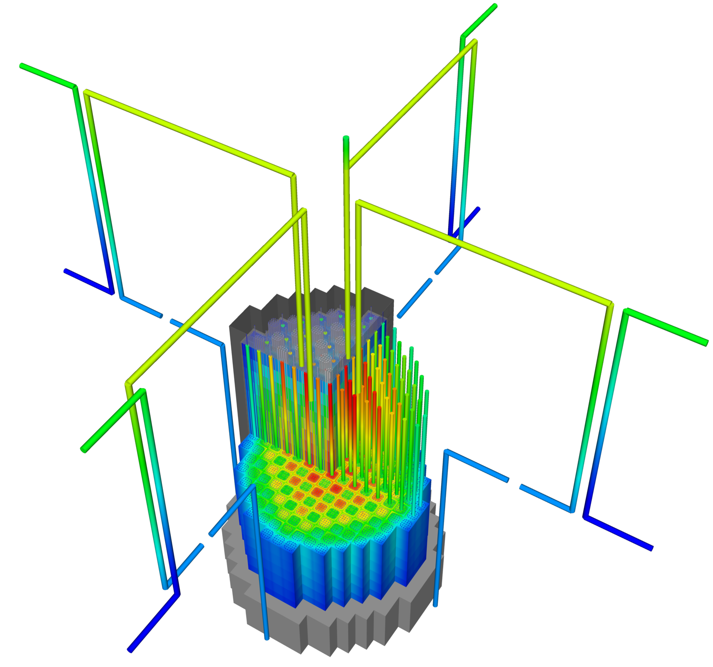

√
Notes:
Generic open-source finite element framework designed for solving systems of equations
Designed to minimize, not eliminate, the programming needed to be performed by engineers
Aims to separate developers (engineers) from the computer science: the user handles the science we handle the computation
Every MOOSE application is capable of running on your laptop and the largest supercomputers
Image: Demonstration of the capability of MOOSE
Shows how a engineer could utilize MOOSE to couple heat, solid mechanics, and fluid flow in a single model, in this case a complete reactor
Includes life cycle analysis with a fuel shuffle after 1-year of operation
Demonstrates the ease at which applications develop by completely separate teams may be linked together
It works on a laptop and supercomputer
Approved for nuclear applications: NQA1 certified

