Slide 1
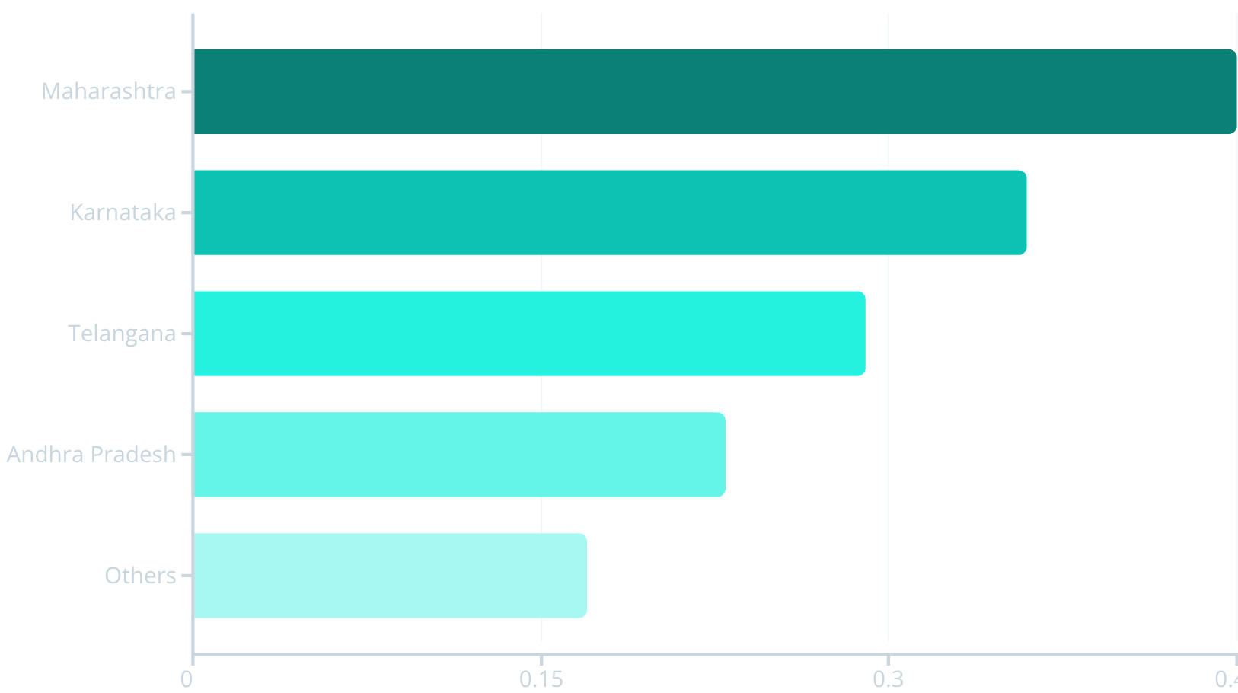
DIGITAL PAYMENTS LANDSCAPE
Total Users by State
1.5B
Top 5 States
Contributing 65-70% of total users
<0.05B
Bottom States
NE states & UTs show minimal penetration
Retention Strategy
Aggressive Acquisition
Vernacular Approach
Focus on loyalty programs and subscriptions in Maharashtra & Karnataka
Target mid-tier states like AP, Telangana, Rajasthan to close the gap
Lightweight onboarding with local language UX for low-penetration states

Slide 2
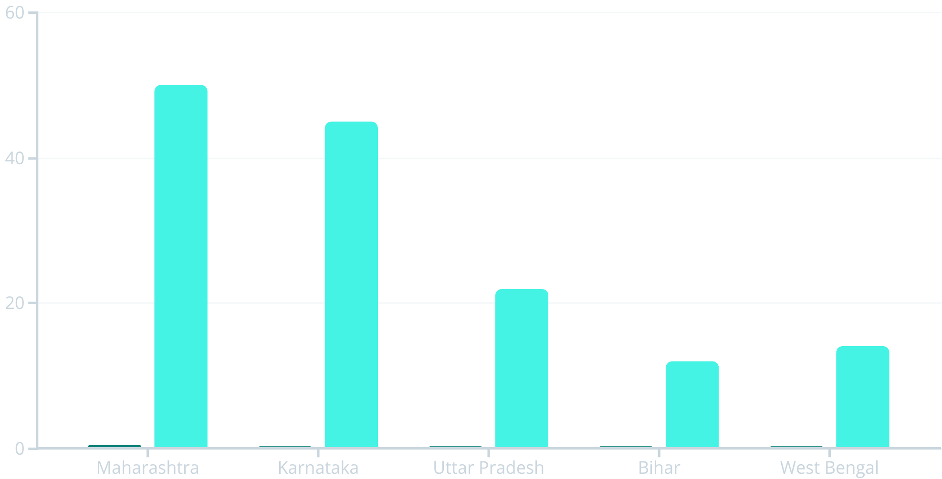

Transaction Value vs User Base
Analyzing monetization efficiency across states reveals significant disparities in user engagement and transaction behavior.
Users (Billions)
Transaction Value (Trillions)
Monetization Gap
Under-Engaged Clusters
Action Plan
UP shows 40% lower monetization vs Maharashtra despite similar user base
Push repeat-use incentives, bill pay, and merchant cashback in UP, Bihar, WB
Bihar & West Bengal: High users but transaction value <15 T indicates untapped potential
Key Metric: Introduce state-level transaction-per-user KPI and track quarterly. Test credit, insurance, and premium services in high-value states.

Slide 3


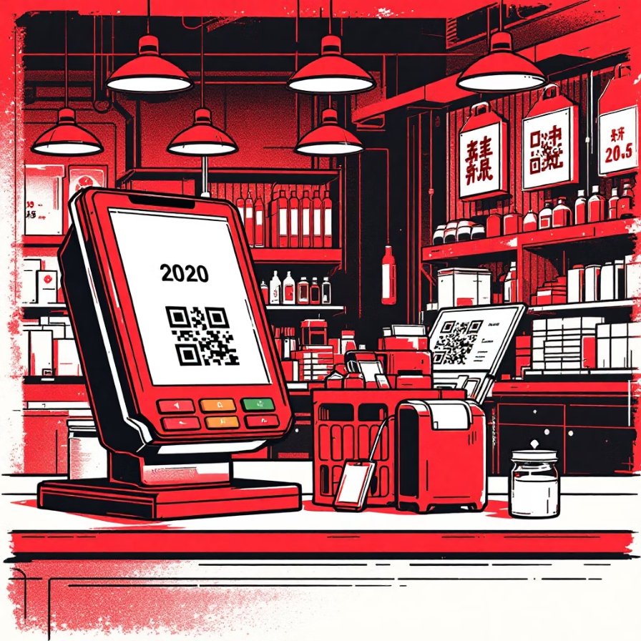





TRANSACTION ANALYSIS
Transactions by State & Type
70-80%
Merchant Transactions
Primary driver in top states
15-20%
Minimal share across states
50T
50T
45T
Telangana
Maharashtra
Karnataka
P2P Transfers
Merchant-led growth
Highest transaction value
Strong merchant ecosystem
Secondary contribution
Strategic Recommendations
5-7%
Invest in Merchants
P2P as Funnel
Bundle Low-Value
SME onboarding and QR penetration are primary revenue drivers
Use for activation, not revenue focus
Consolidate categories instead of standalone push
Others + Financial

Slide 4
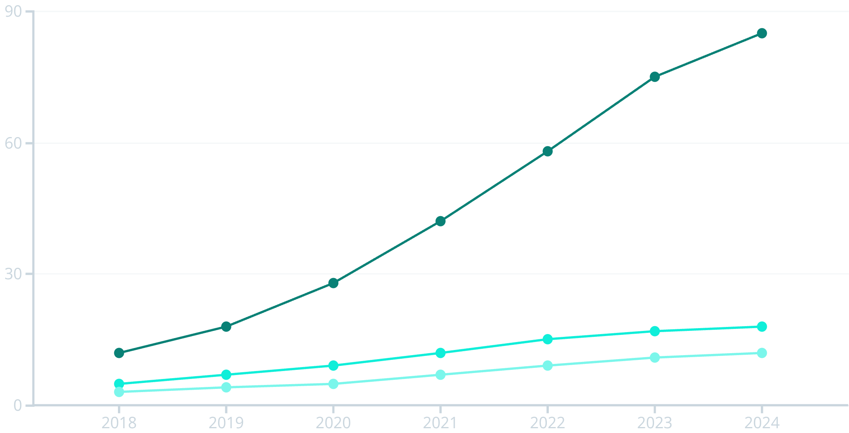
Transaction Growth Over Time
Six-year trajectory reveals merchant-driven expansion as the dominant growth engine.
Merchant
P2P
Others
Total Growth
Merchant Surge
Other Categories
From ~20T (2018) to ~100T (2024)
6× growth from 2019 to 2024
Remain <15T combined in 2024
Strategic Imperative: Capacity planning must assume merchant-led growth continues. Product roadmap should prioritize merchant analytics, settlement speed, and credit offerings.

Slide 5

Insurance Transaction Acceleration
Early Adoption
Insurance transactions show clear acceleration in last 2 years
2024 Dominance
40% of total insurance transactions occurred in 2024 alone
2020-2021
2022
2023
2024
Momentum Building
2022-2023 combined contribute 45-50% of total volume
Capitalize on Growth Momentum
Bundle Strategy
Geographic Focus
Early Mover Advantage
Integrate insurance with high-frequency flows: travel, devices, health
Launch insurance campaigns first in top 5 user states for maximum scale
Adoption is early but accelerating—position for leadership now

Slide 6
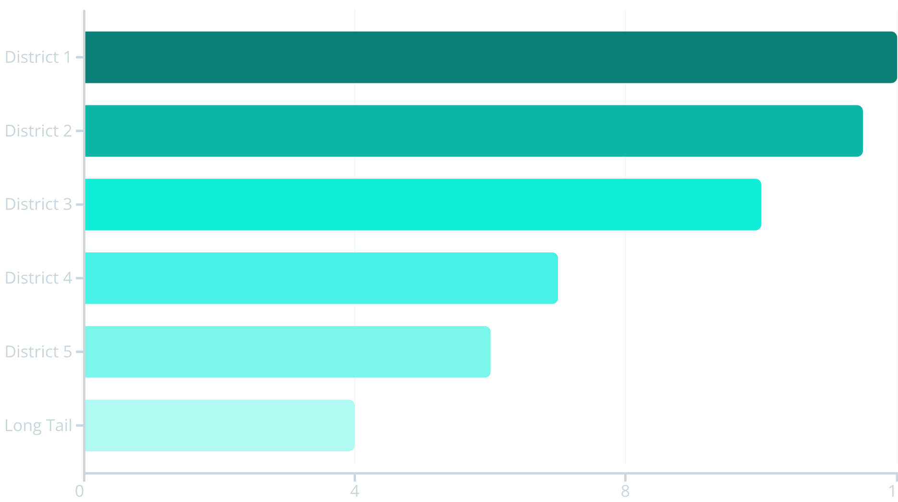
GEOGRAPHIC CONCENTRATION
Top Geo Entities by Transaction Value
Transaction value shows extreme geographic concentration, with top districts driving disproportionate share.
Sharp Drop-off
Top 3 Districts
Long Tail
Significant decline after top 5 entities
Each contributes >10-12T transaction value
Individual districts contribute <5T each
01
02
03
1
2
3
Fraud & Compliance Priority
Replicate Success Models
Geo-Weighted Budgets
Apply learnings from top districts to similar Tier-1/Tier-2 cities
Allocate marketing spend proportionally, not evenly distributed
Top districts require enhanced monitoring and security measures

Slide 7
Transaction Value by Category
Clear separation emerges between value-generating and utility categories across user segments.
1
2
3
Merchant Category
Financial Services
Others
Highest transaction value even at similar user counts
Low transaction value despite user presence
Minimal value contribution across segments
Value-Generating
Utility Categories
Merchant Ecosystem
Financial Services
Core monetization engine driving platform revenue
Requires UX redesign or repositioning as supporting feature
Resource Allocation Framework
Allocate engineering and marketing bandwidth proportionally to value contribution. Merchant category deserves majority focus as the primary revenue driver.
Merchant Priority
Financial Services Pivot
Value-Based Planning
Treat as core monetization engine with dedicated resources
Redesign UX or reposition as complementary offering
Align team bandwidth with revenue contribution metrics

