Slide 1
Interactive Sales Dashboard
Task 4 – Dashboard Design (Elevate Labs Internship)
By Nakul Virmani

Slide 2
Objective
To provide business stakeholders with an interactive view of sales & profit trends.
Enable quick decision-making through visual insights.

Slide 3
Dataset Information
Dataset: Superstore Sales Dataset (Kaggle)
Rows: ~10,000+ Columns: 20+
Key columns: Order Date, Sales, Profit, Quantity, Category, Region

Slide 4
KPIs Used
Total Sales
Total Profit
Total Orders

Slide 5
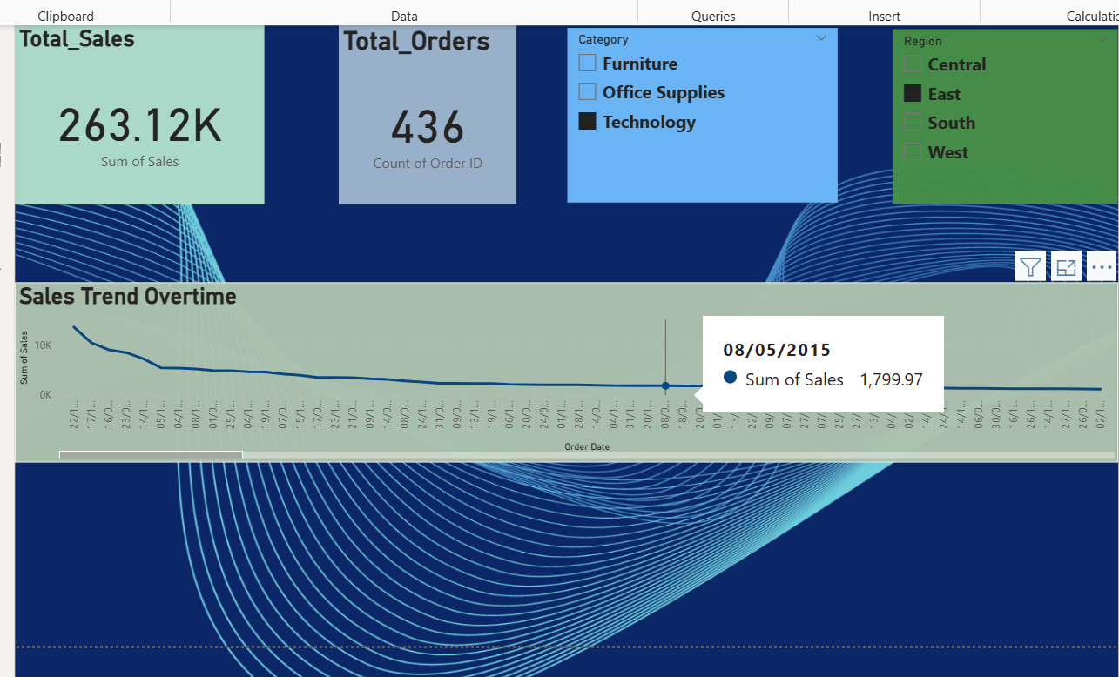
Key Visuals in Dashboard
Bar chart – Category-wise Sales & Profit
Line chart – Monthly Sales Trend
Map – Region-wise Sales
Cards – Summary totals
Slicers – Year, Category, Region
[Insert Dashboard Screenshot Here]

Slide 6
Key Insights / Story
Technology category generates highest profit margin.
East region shows steady growth while South lags behind.
Furniture category has lower profitability despite high sales.

Slide 7
Conclusion
The dashboard enables quick filtering & comparison of sales metrics.
Helps managers identify top-performing products and regions.

