Slide 1
CSE 350 Network Security
Programming Assignment Number 1
Project Number 1
Poly-Alphabetic Substitution Cipher
Akshat Saini
2020019
Nakul Thureja
2020528

Slide 2
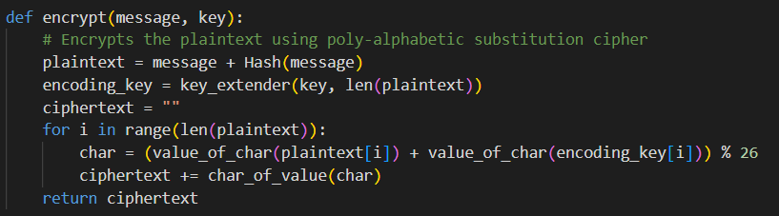
Encrypt
To encrypt, we first generate a new plaintext of the format p = (string, Hash(string))
After this, we expand the key such that the new key is equal in length with the plaintext
Finally, for encryption, we use the following function to calculate and return the ciphertext -
((p0 + k0) mod26)( (p1 + k1) mod26 )((p2 + k2) mod26)((p3 + k3) mod26 )((p4 + k0) mod26 ) ((p5 + k1) mod26) …………… till pn-1

Slide 3
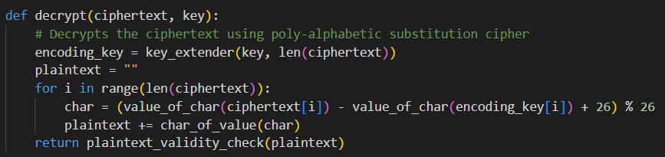
Decrypt
To decrypt, we first expand the key such that the new key is equal in length with the plaintext .
Finally, for decryption, we use the following function to reverse the encryption method -
( (c0 - k0 + 26) mod26 ) ( (c1 - k1 + 26) mod26 ) ( (c2 - k2 + 26 ) mod26 ) ( ( c3 - k3 + 26) mod26 ) ( (c4 - k0 + 26) mod26 ) ( (c5 - k1 + 26) mod26 ) …………… till cm-1

Slide 4
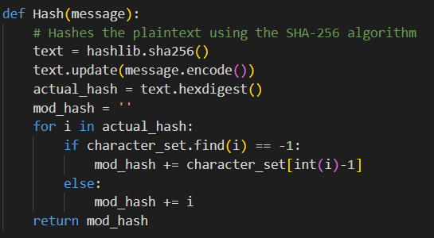
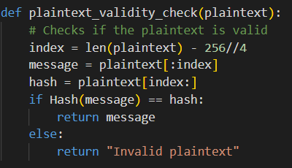
Plaintext Validity Check
Hash
To check if the plaintext is in recognizable form, we divide the text into two parts, the message and the hash.
Now we hash the message and compare it with the original hash.
We have used the implementation of SHA256 from the hashlib library.
We have replaced the numbers with their corresponding character in the alphabet

Slide 5
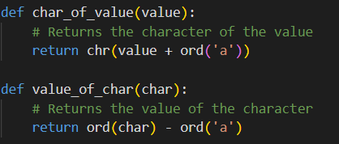
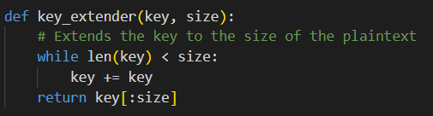
Some helper functions
char_of_value - Returns the English letter corresponding to an integer value.
value_of_char - Return the integer value corresponding to an English letter.
key_extender - Expands the key to make it equal in length to the plaintext.

Slide 6
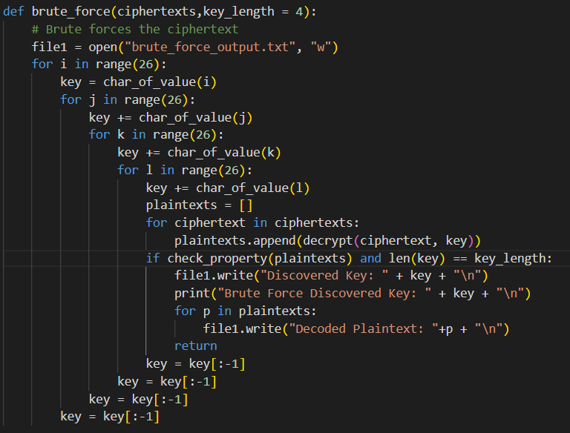
Brute Force
To perform the attack, we have used nested for loops to iterate through all the possible keys of length 4.
For each trial key, we decrypt the ciphertexts and check if the key is valid for all by using the function check_property().

Slide 7
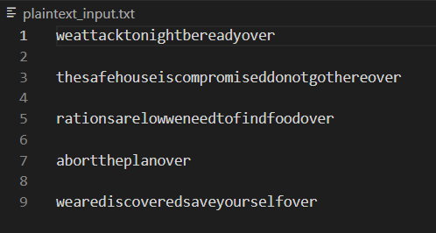
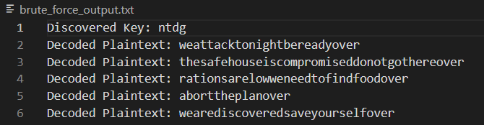
Sample Input
Sample Output
The sample input includes a file named plaintext_input.txt which contains all the plaintexts in lowercase letters without any spaces.
The sample input also includes the 4-letter key. (Sample Key used : ntdg)
A file named brute_force_output.txt which contains the discovered key through the attack and the resultant plaintexts after using the key to decode.

Slide 8
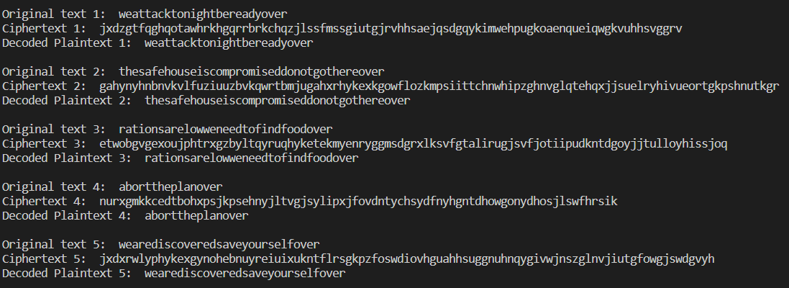
Sample Output
Visual output on the terminal to check if the encryption and decryption functions run properly for the 5 input messages

