Slide 1
CSE 350 Network Security
Programming Assignment Number 3
Project Number 1
RSA-based Public Key Distribution Authority (PKDA)
Akshat Saini
2020019
Nakul Thureja
2020528

Slide 2
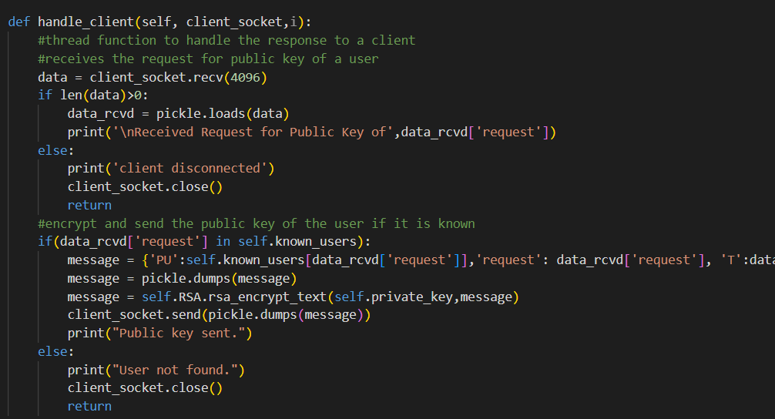
PKDA
The PKDA consists of a socket that waits for any client request for a public key. If a request arrives, a new thread is created. Based on the request sent, the PKDA goes through its saved public keys. The response of PKDA consists of the requested public key, along with the time of the client request and also the duration. This message as a whole is encrypted using RSA and sent back.

Slide 3
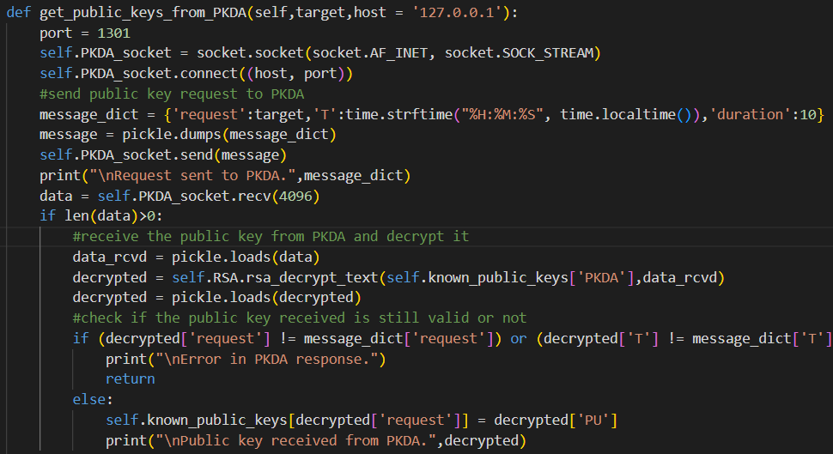
ClientA and ClientB
This function is responsible for getting the public key from PKDA.
The function first generates a request containing the ID of the client for whom the public key is required and also the current time and duration of the message. After that, the function waits for the PKDA to respond. Once the response is received, the data is decrypted, and the received public key is stored for future use.

Slide 4
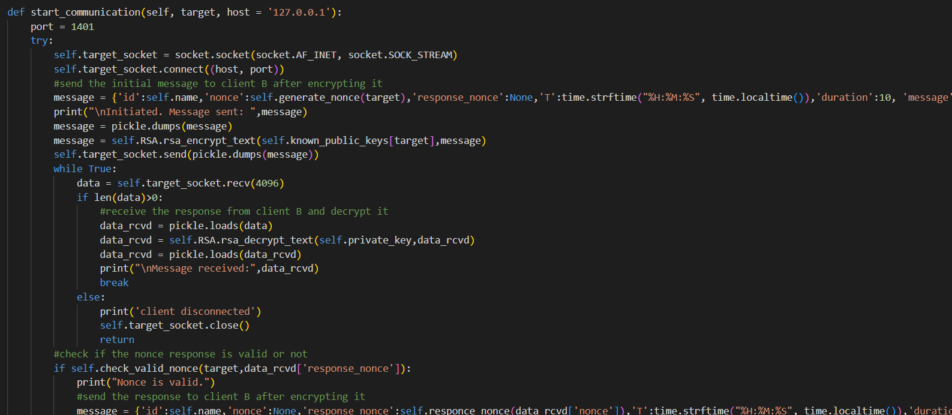
ClientA and ClientB
Client A sends a message to Client B encrypted with B's public key. B decrypts the message using its private key, gets A's public key from PKDA, and sends a response to A with A's nonce and its own nonce, encrypted with A's public key. A decrypts the message using its private key, checks the nonce validity, and sends a response to B. B receives the message, checks for nonce validity, and once the process is complete, A and B can communicate.

Slide 5
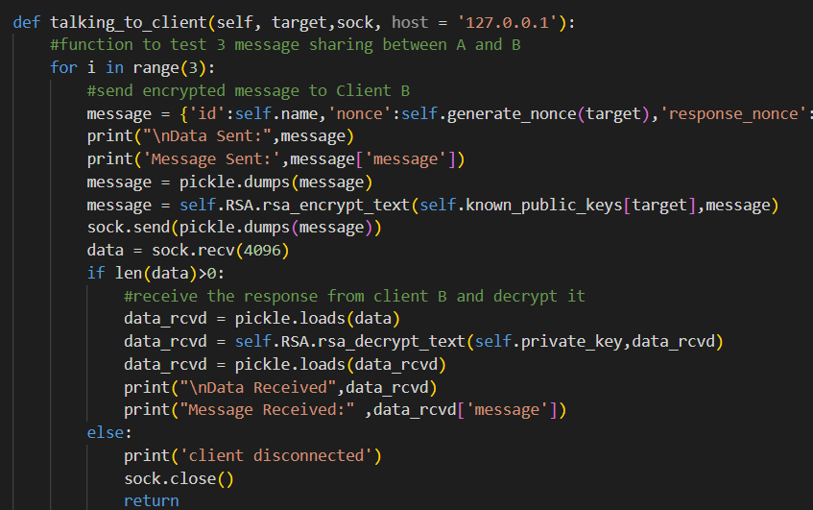
ClientA and ClientB
This is the test function that sends three messages from ClientA and three responses from ClientB. All the messages are encrypted using the public key of the other client and then decrypted using their own private key. Each message contains the nonce, time and duration along with the message - Hi/Got-it. Nonce validity checks are also maintained for each response.

Slide 6
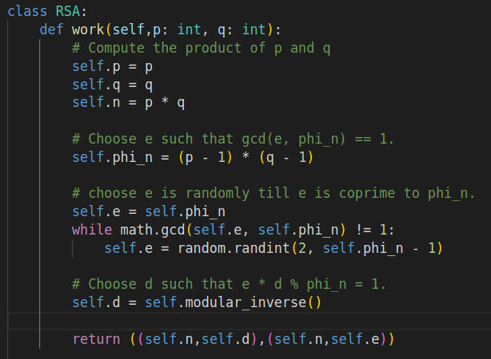
RSA
We have created an RSA class which takes p and q as inputs, assuming p and q are different prime numbers. Now we find n = p*q and phi_n = p-1*q-1. We find e such that it is co prime to n. Then we find d such that e*d mod n = 1. Now to encrypt a string we iterate over the characters and convert it into int (m) and then find encryption by m^e mod n and convert it into characters again. Similarly to decrypt a string we iterate over the characters and convert it into int (c) and then find decryption by m^d mod n and convert it into characters again.

Slide 7
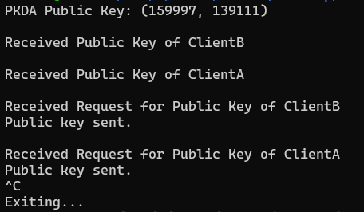
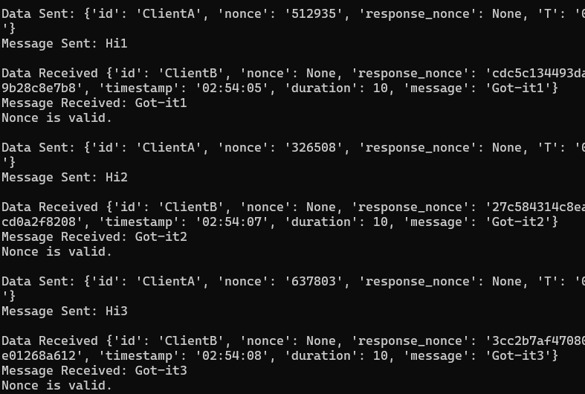
Sample Output
PKDA
Client A

Slide 8
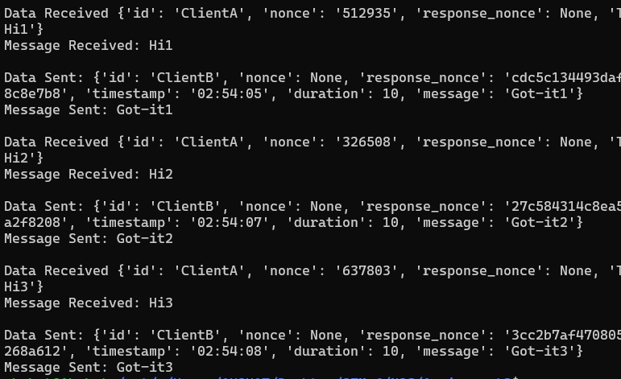
Sample Output
Client B

