Slide 1
CSE 350 Network Security
Programming Assignment Number 2
Project Number 1
Advanced Encryption Standard (AES)
Akshat Saini
2020019
Nakul Thureja
2020528

Slide 2
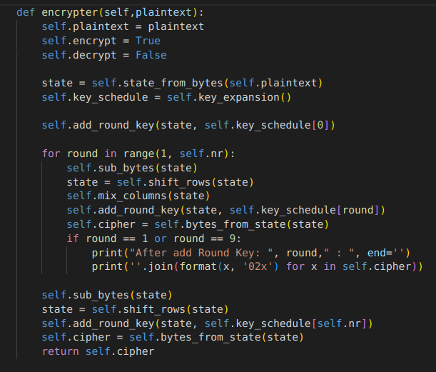
Encrypter
To encrypt, we first generate a new plaintext of the format of a 128 bit bytearray = bytearray.fromhex('0123456789abcdeffedcba9876543210')
Similarly generate a 128 bit key.
We can get the ciphertext by:
ciphertext = AES(key).encrypter(plaintext)

Slide 3
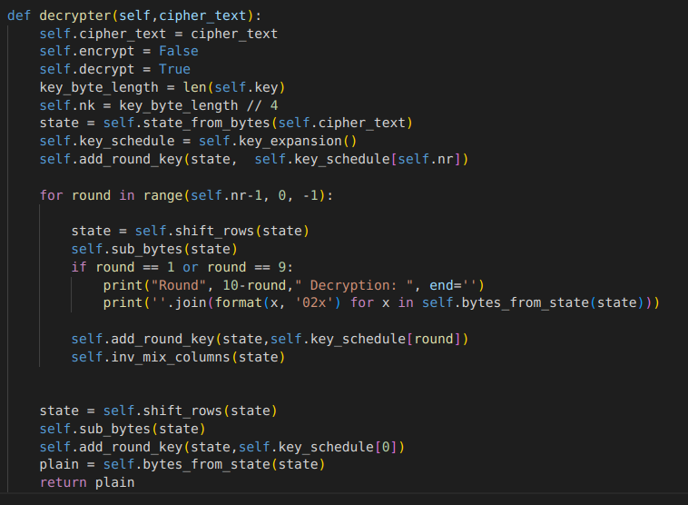
Decrypter
To encrypt, we first get our ciphertext of the format of a 128 bit bytearray.
Similarly we need our 128 bit key.
We can get the ciphertext by:
recovered_plaintext = AES(key).decrypter(ciphertext)

Slide 4
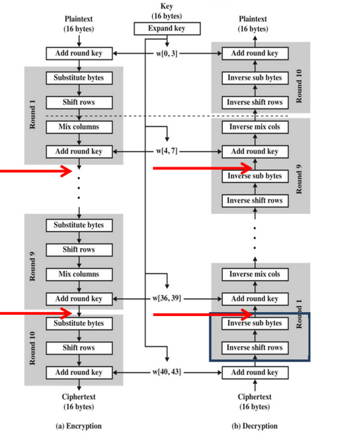
Flowchart for Encryption and Decryption

Slide 5
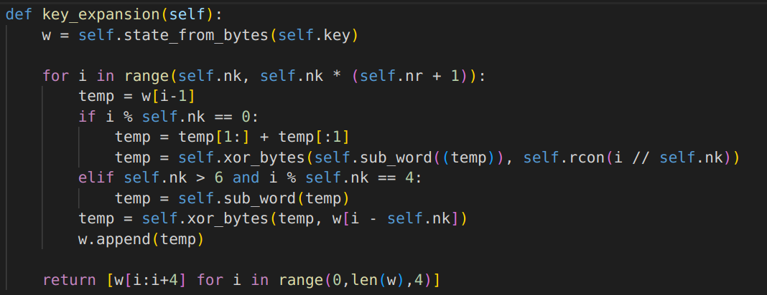
Some helper functions
key_expansion: The function to generate 10 round keys for AES algorithm using the initial key. The function will return an array with 11 keys. - Returns the English letter corresponding to an integer value.

Slide 6
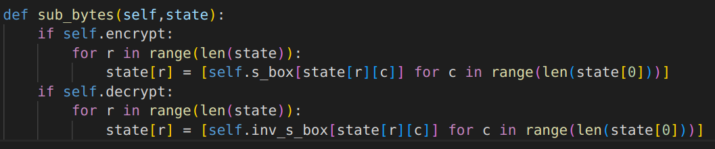
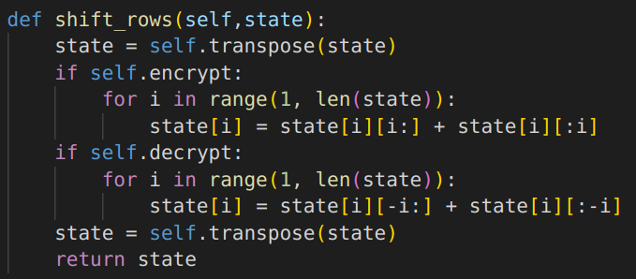
Some helper functions
add_round_key: Function to take XOR of the plaintext with round key.
sub_bytes: function to replace the bytes from the s_box lookup table for encryption and replace the bytes from the inverse_s_box lookup table for decryption.

Slide 7
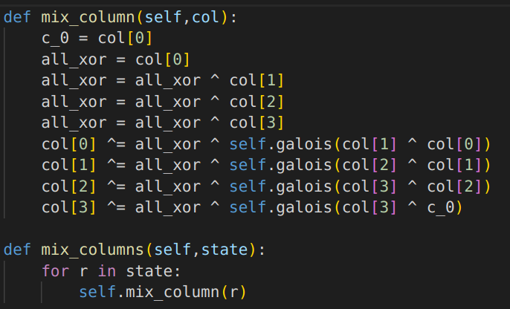
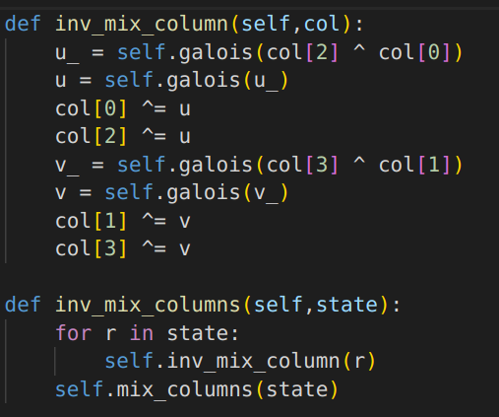
Some helper functions
mix columns: function to multiply the matrix with MC matrix, but since I have stored the matrix row wise rather than column wise I am able to simplify the multiplication for each column.
inverse mix columns: function to multiply the matrix with inverse MC matrix, but since I have stored the matrix row wise rather than column wise I am able to simplify the multiplication for each column as given below.

Slide 8
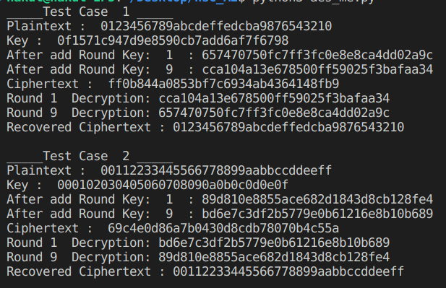
Sample Input - Output
Visual output on the terminal to check if the encryption and decryption functions run properly for the 128 bit <plaintext, ciphertext>
Have taken 2 known sets of plaintext, key, ciphertext.
We encrypt it using our AES class with the given key and get the ciphertext.
We then decrypt it using our AES class with the given key and get the recovered plaintext.
Finally, we assert the recovered plaintext is same as the initial plaintext, and assert that expected_ciphertext is same as the ciphertext generated therefore the encryption and decryption are working fine.

