Slide 1
SUMMER TRAINING ON RASPBERRY PI
Prepared By: NAKUL CHAUHAN
Reg no:11714912
Section:E1704
Group-1

Slide 2
What is Raspberry PI?
The Raspberry Pi is a series of small single-board computers developed in the United Kingdom by the Raspberry Pi Foundation to promote teaching of basic computer science in schools and in developing countries.
Its neither a microcontroller nor Microprocessor it’s a SoC. Broadcom is the SoC used in it.
Family of Raspberry Pi is huge with Different Versions.

Slide 3
Family of Raspberry Pi:
Raspberry Pi A
Raspberry Pi A+
Raspberry Pi B
Raspberry Pi B+
Raspberry Pi Zero
Note: Each member has its own different versions.

Slide 4
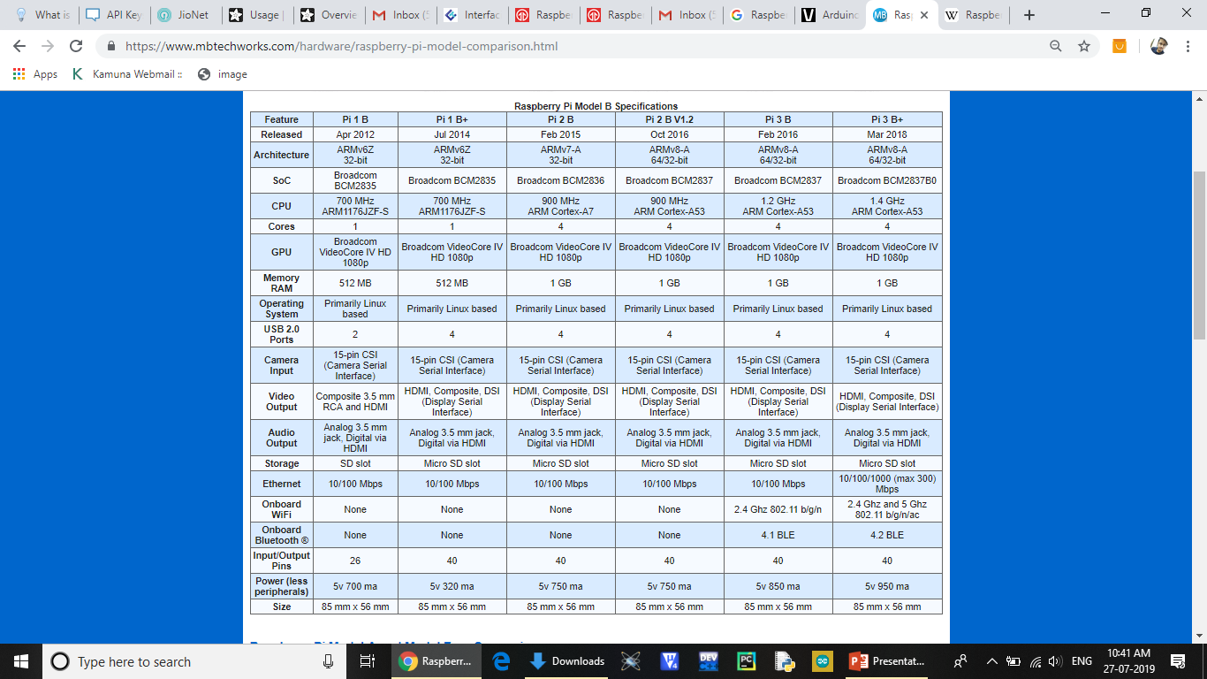

Slide 5
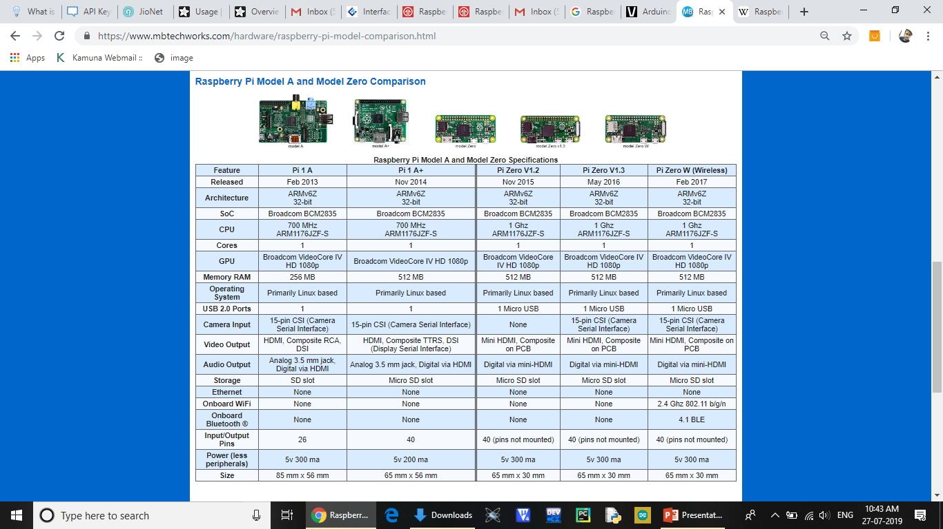

Slide 6
Arduino Uno vs Raspberry Pi 3 B+
No OS in Arduino
Less Processing Power in Arduino
Less Memory in Arduino
Less GPIO
Less ports in Arduino
No inbuilt Wifi and Bluetooth in Arduino
No Ethernet port is available in Arduino Uno
No Analog pins in Raspberry Pi (major drawback with Pi)

Slide 7
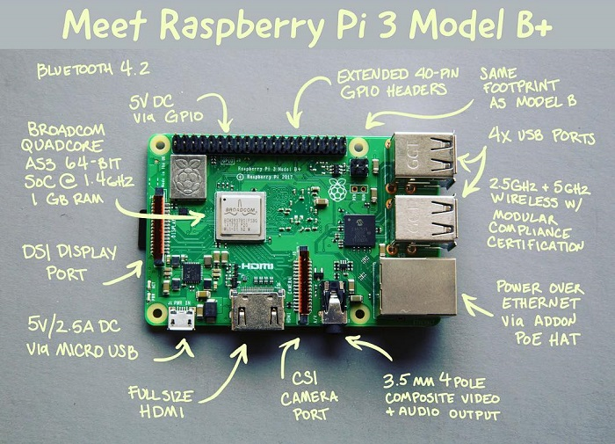
Raspberry Pi(model 3B+):

Slide 8
Specifications
SOC: Broadcom BCM2837B0, Cortex-A53 (ARMv8) 64-bit SoC
CPU: 1.4GHz 64-bit quad-core ARM Cortex-A53 CPU
RAM: 1GB LPDDR2 SDRAM
WIFI: Dual-band 802.11ac wireless LAN (2.4GHz and 5GHz ) and Bluetooth 4.2
Ethernet: Gigabit Ethernet over USB 2.0 (max 300 Mbps). Power-over-Ethernet support (with separate PoE HAT). Improved PXE network and USB mass-storage booting.
Thermal management: Yes
Video: Yes – VideoCore IV 3D. Full-size HDMI
Audio: Yes
USB 2.0: 4 ports
GPIO: 40-pin
Power: 5V/2.5A DC power input
Operating system support: Linux and Unix (Raspbian OS is official OS)

Slide 9
Key Improvements from Pi 3 Model B to Pi 3 Model B+
Improved compatibility for network booting
New support for Power over Ethernet
Processor speed has increased from 1.2Ghz on Pi 3 to 1.4Ghz
New dual band wireless LAN chip, 2.4Ghz and 5Ghz with embedded antenna
Bluetooth 4.2 Low Energy
Faster onboard Ethernet, up to 300mbps speed

Slide 10

Introduction to Python Programming
Python is a widely used general-purpose, high level programming language. It was initially designed by Guido van Rossum in 1991 and developed by Python Software Foundation. It was mainly developed for emphasis on code readability, and its syntax allows programmers to express concepts in fewer lines of code.
Python is a programming language that lets you work quickly and integrate systems more efficiently.
Python uses an interpreter to interpret and run the programs.

Slide 11
Python Language advantages:
Advantages :
No Curly Brackets
Easy to learn
User-friendly data structures
High-level language
Dynamically typed language(No need to mention data type)
Object-oriented language

Slide 12
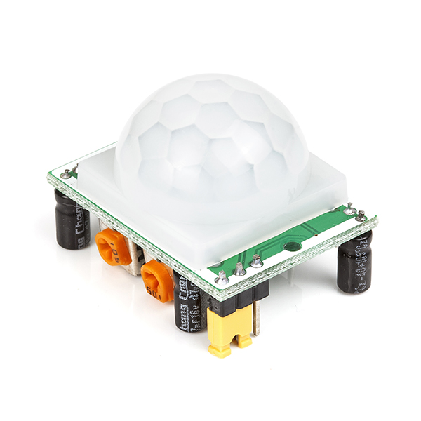
Sensors and their working
PIR sensor: A PIR or a Passive Infrared Sensor can be used to detect presence of human beings in its proximity. The output can be used to control the motion of door.
Basically motion detection use light sensors to detect either the presence of infrared light emitted from a warm object or absence of infrared light when a object interrupts a beam emitted by another part of the device.
A PIR sensor detects the infrared light radiated by a warm object. It consists of pyro electric sensors which introduce changes in their temperature (due to incident infrared radiation) into electric signal. When infrared light strikes a crystal, it generates an electrical charge.
Thus a PIR sensor can be used to detect presence of human beings within a detection area of approximately 14 meters.

Slide 13
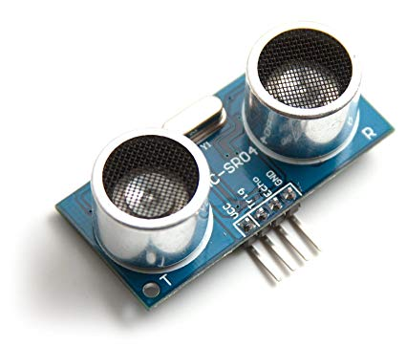
Ultrasonic sensor:
The Ultrasonic transmitter transmits an ultrasonic wave, this wave travels in air and when it gets objected by any material it gets reflected back toward the sensor this reflected wave is observed by the Ultrasonic receiver module
Now, to calculate the distance using the above formulae, we should know the Speed and time. Since we are using the Ultrasonic wave we know the universal speed of US wave at room conditions which is 330m/s. The circuitry inbuilt on the module will calculate the time taken for the US wave to come back and turns on the echo pin high for that same particular amount of time, this way we can also know the time taken. Now simply calculate the distance using a microcontroller or microprocessor.

Slide 14
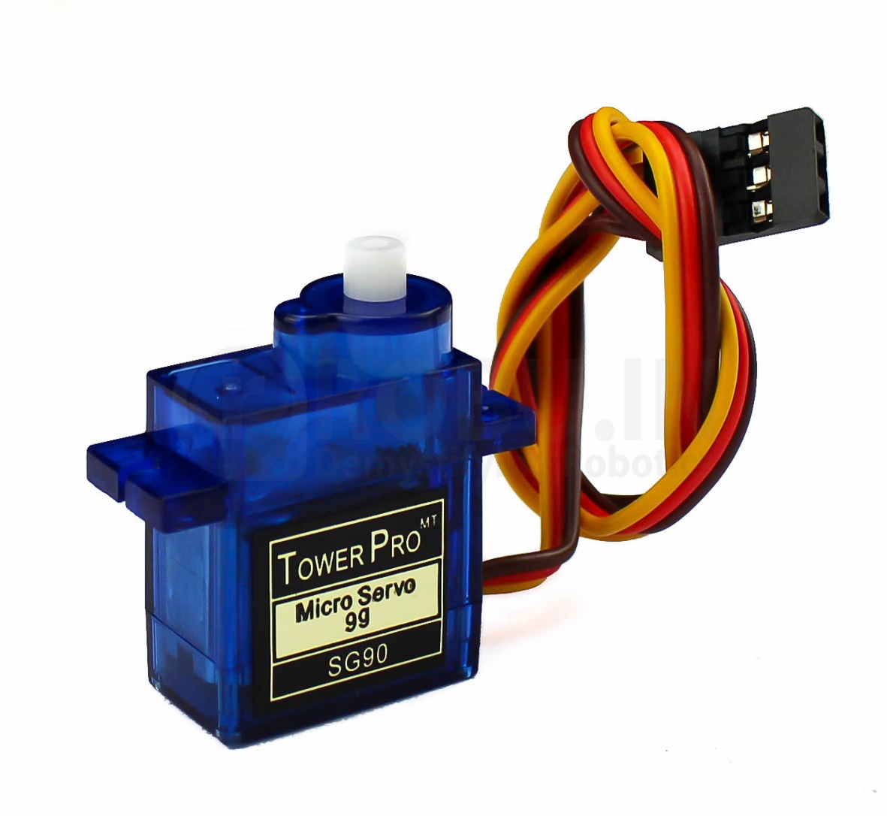
Servomotor:
A servo consists of a Motor (DC or AC), a potentiometer, gear assembly and a controlling circuit. First of all we use gear assembly to reduce RPM and to increase torque of motor. Say at initial position of servo motor shaft, the position of the potentiometer knob is such that there is no electrical signal generated at the output port of the potentiometer. Now an electrical signal is given to another input terminal of the error detector amplifier. Now difference between these two signals, one comes from potentiometer and another comes from other source, will be processed in feedback mechanism and output will be provided in term of error signal. This error signal acts as the input for motor and motor starts rotating. Now motor shaft is connected with potentiometer and as motor rotates so the potentiometer and it will generate a signal. So as the potentiometer’s angular position changes, its output feedback signal changes. After sometime the position of potentiometer reaches at a position that the output of potentiometer is same as external signal provided. At this condition, there will be no output signal from the amplifier to the motor input as there is no difference between external applied signal and the signal generated at potentiometer, and in this situation motor stops rotating.

Slide 15
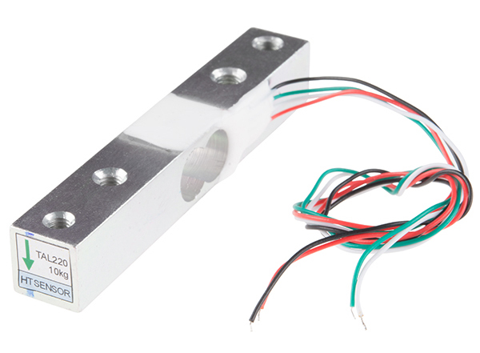
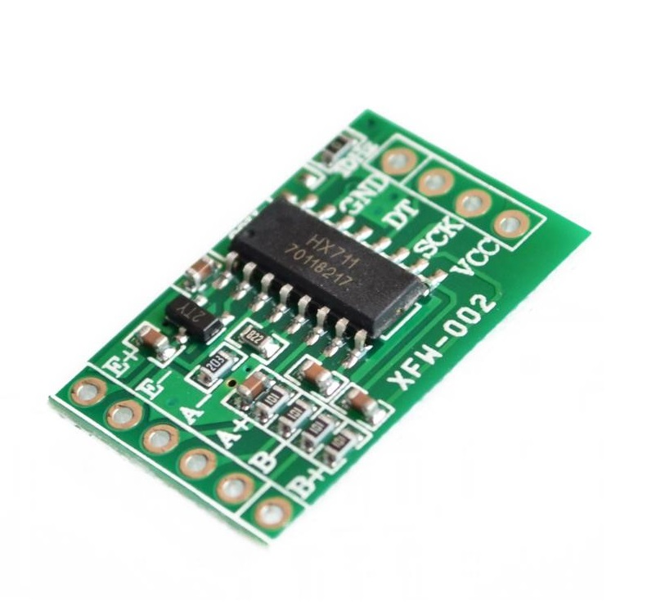
Load Cell:
A load cell is a type of force gauge. It consists of a transducer that is used to create an electrical signal whose magnitude is directly proportional to the force being measured. The various load cell types include hydraulic, pneumatic, and strain gauge.
Hx711(Load cell Amplifier):
This Load Cell Amplifier is a small breakout board for the HX711 IC that allows you to easily read load cells to measure weight. By connecting the amplifier to your microcontroller you will be able to read the changes in the resistance of the load cell and with some calibration you'll be able to get very accurate weight measurements.

Slide 16
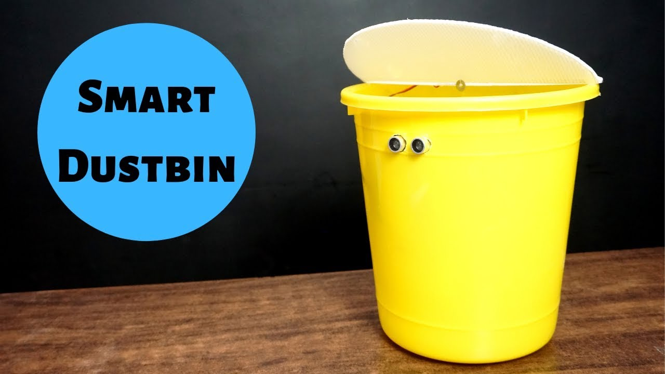
Project: ”Smart Dustbin”
Concept behind Smart Dustbin using Arduino
The main concept behind the Smart Dustbin using Raspberry project is Object Detection. The Ultrasonic Sensor is placed in front of the dustbin and when the sensor detects any object like a human hand, it will trigger Raspberry pi to open the lid. It will also keep a check on the amount of garbage in the dustbin and will display a message when the dustbin is full (email is sent so that the garbage could be collected from that location)

Slide 17
Components Used:
2 Ultrasonic sensors
1 servo motor
1 LCD Display
Bucket
Raspberry Pi 3 B+

Slide 18
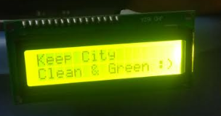
When no one is there then it does not open the lid and shows the message “Keep City Clean and Green”.

Slide 19
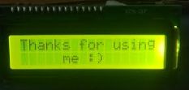
When someone throws garbage, then it gives “Thank you for using me” message.

Slide 20
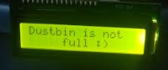
When dustbin is full then it sends the mail to Concerned Authorities to pick up the Bin so that it is available for further use. It also shows “Dustbin is Full” message and permanently close the lid until it is emptied.
When bin is not full then, then it shows the Message “Dustbin is not full” and opens the lid when someone comes near to it.

Slide 21
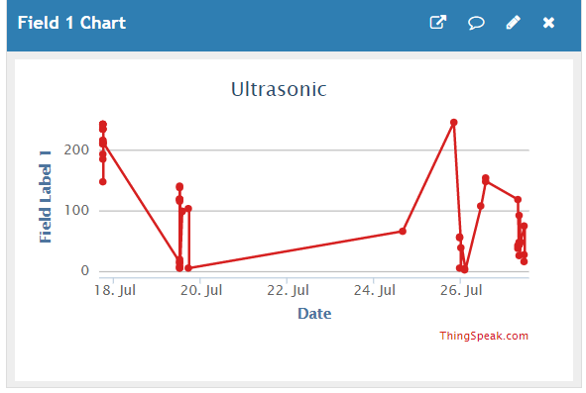
Garbage Level Detector Graph:

Slide 22
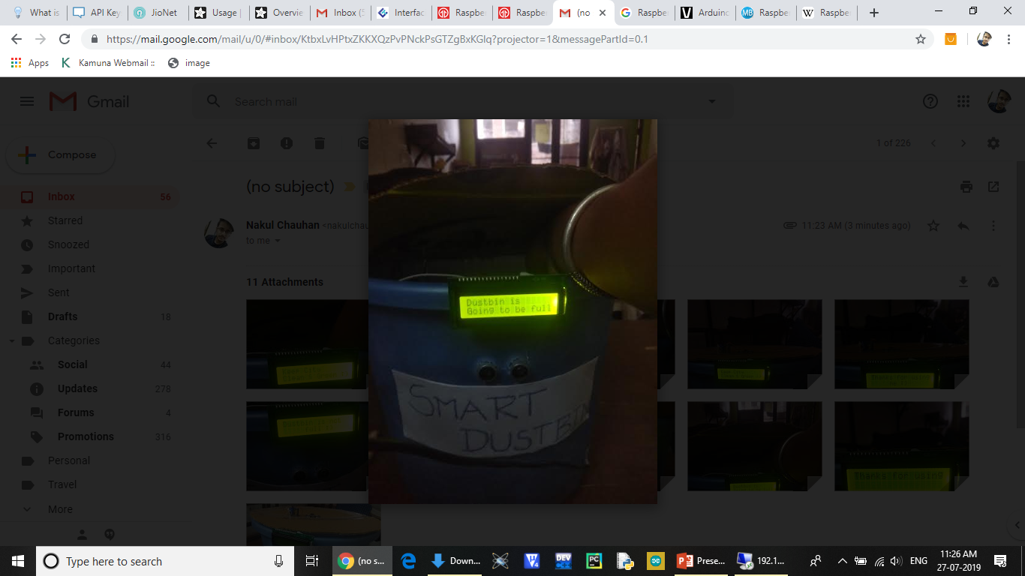
When bin is going to be full then it shows the message regarding it.

Slide 23
Challenges Faced
The servomotor was constantly flickering even when there was nothing in front of the dustbin.
Problems were faced in connecting Raspberry pi with different sensors as Raspberry Pi is expensive and a little bit of irresponsibility could damage its GPIO pins.
The Ultrasonic sensor showing false values at some instant of time.
LCD interfacing was a big challenge due to it large number of pins

Slide 24
Applications:
Smart City
Smart Home

Slide 25
Future Work:
Dustbin Location tracker
Autonomous Dustbin

Slide 26
Conclusion
A simple but useful project called Smart Dustbin using Raspberry Pi is designed and developed here. Using this project, the lid of the dustbin stays closed, so that waste is not exposed (to avoid flies and mosquitos) and when you want dispose any waste, it will automatically open the lid. It also let the user to know the status of the dustbin wheather it is full or partially full. And also the dustbin won’t be let full of garbage for a long time as the concerned authority would be informed as soon as the Dustbin is full of garbage.

Slide 27


