Slide 1

Group No:03
PID Controller by Using MATLAB
Guided By:-
Prof.Smita Ingawle
Presented By:-
1.501_ AGUNDE SUYASH TANAJI
2.510_ DANDEKAR NAKUL HARBAN
3.511_ DAVE ANTARA PRAGNESH
4.514_ DISALE YOGITA BIBHISHAN
5.517_ GURME SWAPNIL SHRIDHAR
Department of Electronics & Telecommunication Engineering
Smt. Kashibai Navale College of Engineering, Pune - 41.

Slide 2
CONTENTS
Title | Page No.
1. Aim | 03
2. Objectives | 04
3. Introduction | 05
4. The Design of Control System | 06
4. Block Diagram | 08
5. Implementation | 09
6. Results | 17
7. Conclusion | 18
8. References | 19

Slide 3
AIM
To simulate Proportional-integral derivative {PID} controller using MATLAB software.

Slide 4
OBJECTIVES
PID controller it consists of three terms, that are proportional, integral, and derivative control. The combined operation of these three controllers gives a control strategy for process control. It manipulates the process variables like pressure, speed, temperature, flow and so on

Slide 5
INTRODUCTION
What is PID controller?
A controller is a device that generates an output signal based on the input signal it receives.
The input signal is actually an error signal, which is the difference between the measured variable and desired value, to convert this error term/signal into suitable actuated commands so that overtime the error is driven to 0 we use controller.
It is also known as three term controller.
It is a control look feedback mechanism widely used in industrial control system and variety of applications requiring continuously modulated control.
A PID controller continuously calculates an error value e(t) as difference between a desired set points and a measured process variable and applies a correction based on proportional,integral,derivative terms which gives controller its name.
P depends on present error
I on the accumulation on past error
D is prediction of future errors, based on current rate of change

Slide 6
The Design of the Control System:
In accordance with the needs of the system, this study was designed a method of PID components optimizing based on ant colony logic. PID equation e = r – y;
Where, e= input error; r= reference input; y = output
U(t) is output so,
U(t) ∝ e(t) , ∫e(t) , d/dt [e(t)]
U(t) = kp e(t) +kI ∫e(t) +kD [d/dt e(t)]
Where,
Kp=proportional controller path; kI= integral component; kD = derivative component

Slide 7
Lets take laplace transform on both sides
U(s) = kp E(s)+ ki/S E(s)+ kD S E(s)
= E(s) [kpS+kI/S+kDS]
u(s)/E(s) =kp+kI/s+kDs
=kp[1+ki/kps+kD/kp *s]
=kp[1+1/Tis+TDs]…….. Obtained by ziegler-nichole
TI=kp/kI
TD=kD/kp

Slide 8
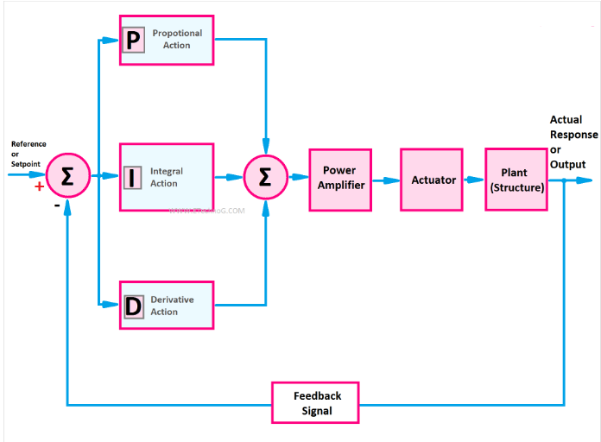
BLOCK DIAGRAM

Slide 9
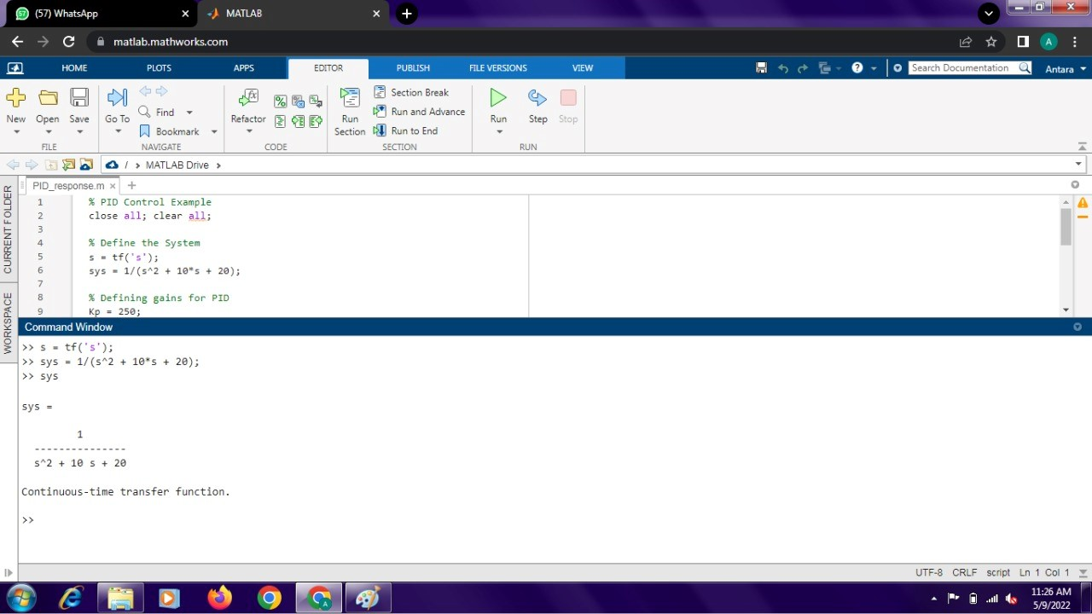
IMPLEMENTATION

Slide 10
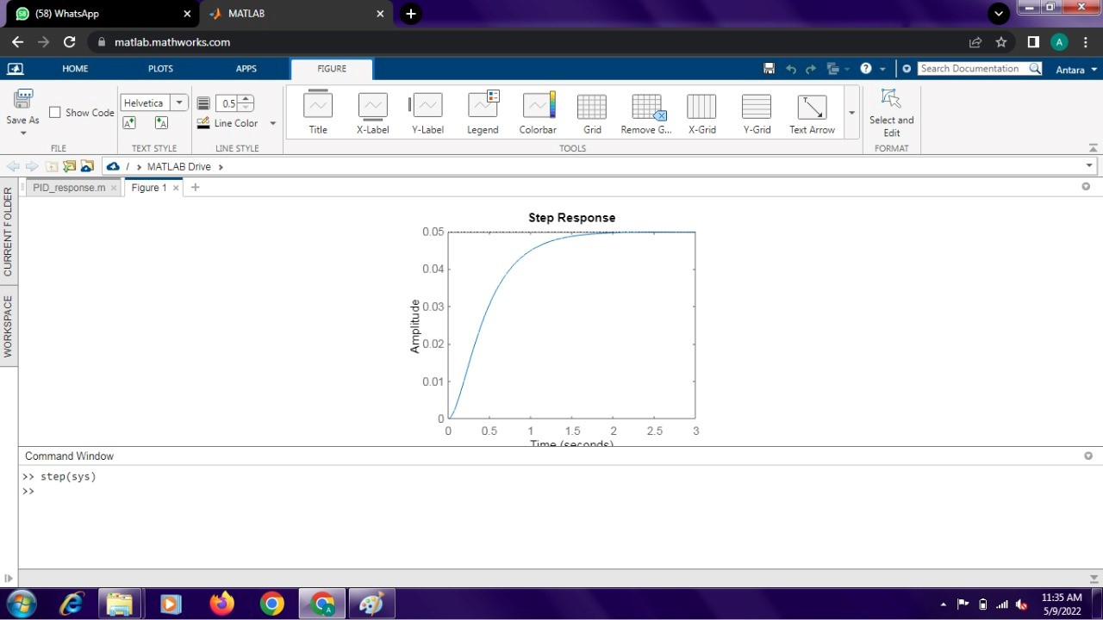

Slide 11
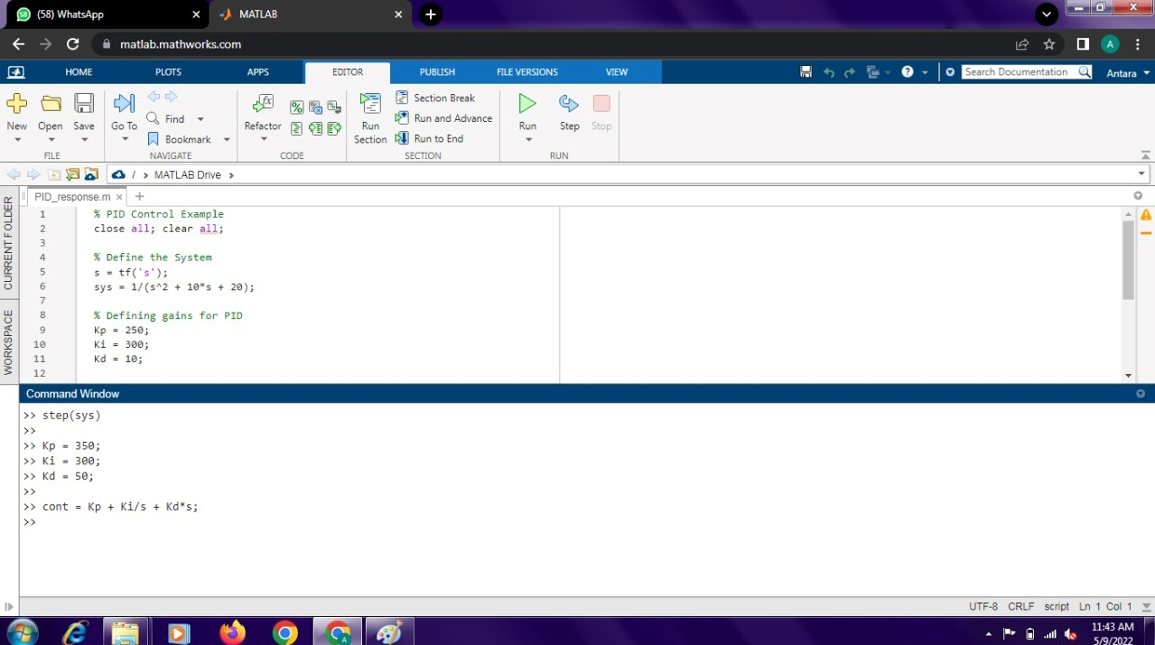

Slide 12
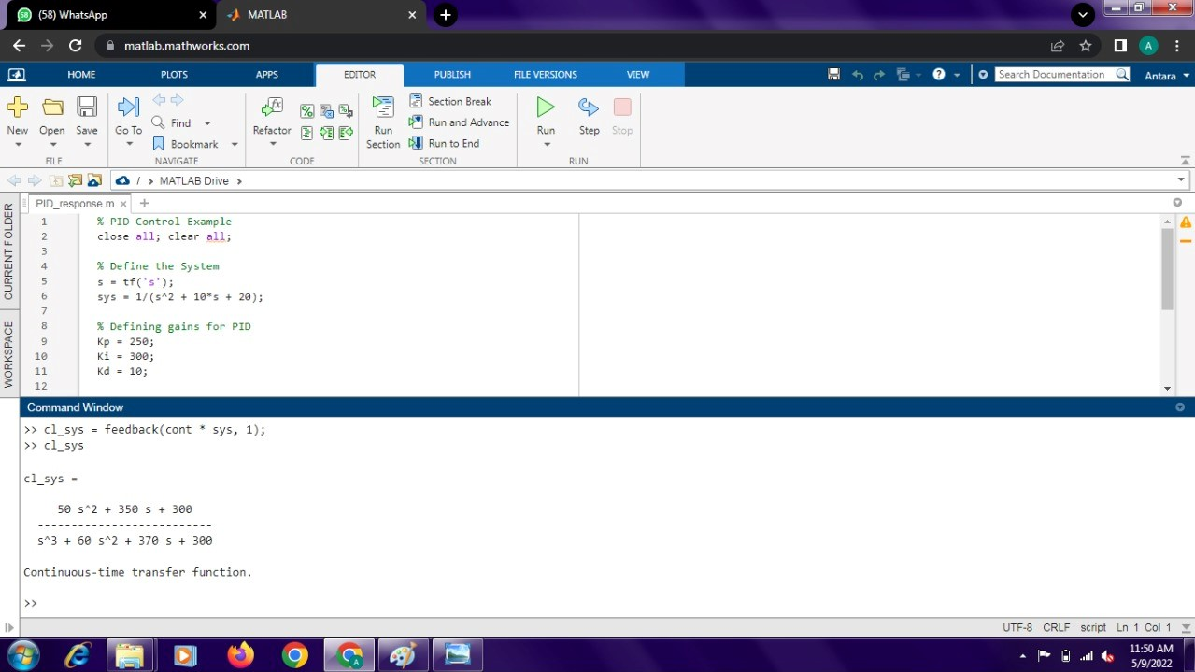

Slide 13
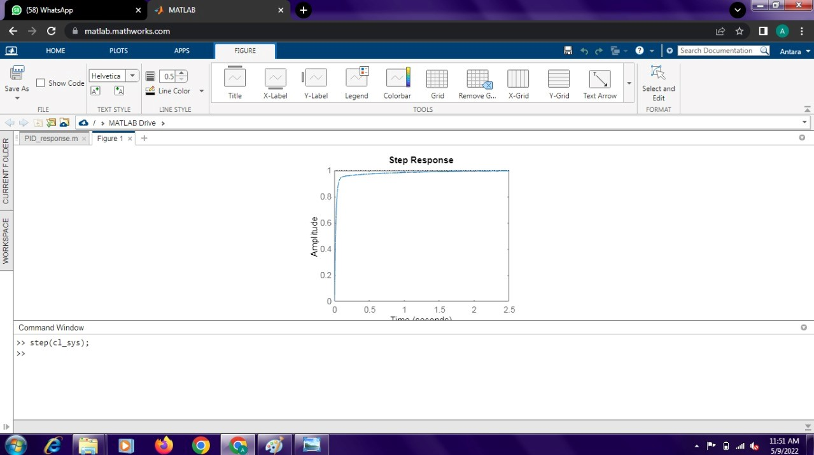

Slide 14
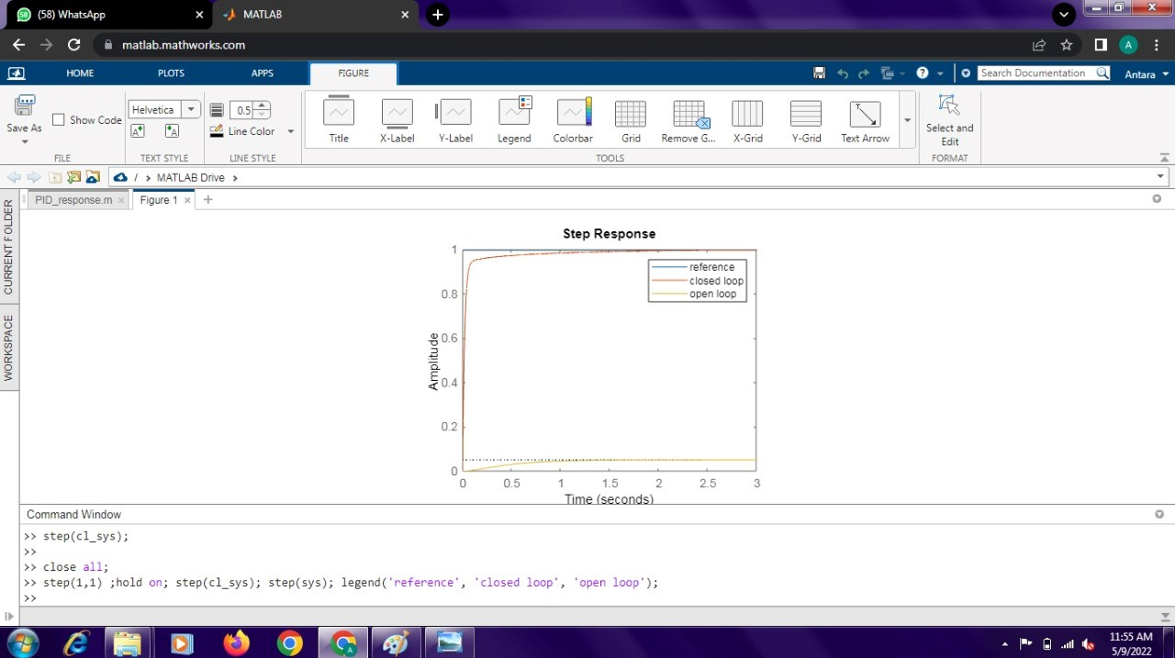

Slide 15
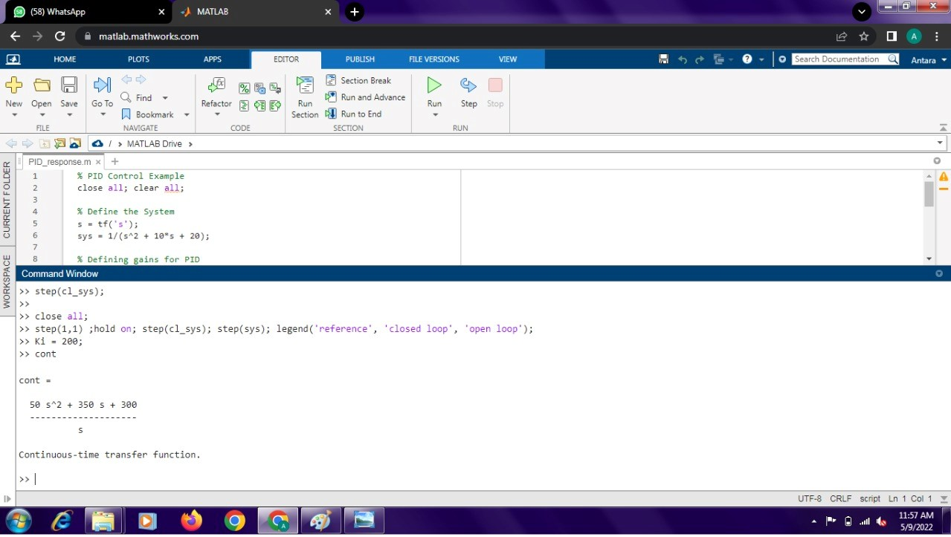

Slide 16


Slide 17

RESULTS

Slide 18
CONCLUSION
We have performed PID controller simulation using MATLAB software
Modern process control systems cannot exist without PID controllers, all control functions and also it is the simplest controller which uses present, past and future errors.

Slide 19
REFERENCES
M. Lee, M. Shamsuzzoha, and T.N. Luan Vu, ―IMC-PID Approach: An Effective way to get an Analytical Design of Robust PID Controller,‖ International Conference on Control, Automation and Systems, Seoul, Korea, pp. 2861–2866, 2008.
Zwe-Lee Gaing, “ A particle swarm optimization approach for optimum design of PID controller in AVR system”, IEEE transactions on energy conversion,November 6,(2002).
Jihong Li and Pingkang Li, “Stability Region Analysis of PID Controllers for Time-delay Systems”, Proceeding of the 6thWorld Congress on Intelligent Control and automation, June 21-23, 2219-2223, © 2006 IEEE.
Ang, K.H.; Chong, G.; Li, Y. PID control system analysis, design, and technology. IEEE Trans. Control Syst. Technol. 2005, 13, 559–576. [CrossRef]
Meshram, P. M., and Rohit G. Kanojiya, "Tuning of PID cont roller using Ziegler-Nichols method for speed control of DC motor," Advances in Engineering, Science and Management (ICAESM), 2012 International Conference on, pp. 117-122. IEEE, 2012

Slide 20
Thank You For Watching This Project !!!

