Slide 1

Group No: -
T16_6
A
Presentation on
“Thyristor Firing Angle Control For Battery Charging”
Guide :-
MS. KOMAL WANZARE
Submitted By:-
NAKUL DANDEKAR E3510
PRATHMESH GIRME E3516
PRATIK JADHAV E3520
Department of Electronics & Telecommunication Engineering
Smt. Kashibai Navale College of Engineering, Pune - 41.

Slide 2
CONTENTS
Aim
Objectives
Introduction
Literature Survey
Proposed Block Diagram and Description
Hardware/ Software /Specifications
Design and Implementation
Results
Applications and Future Scope
Advantages and Disadvantages
Bill of Material
Conclusions
References

Slide 3
AIM
“Regulate the charging current and voltage of a battery using thyristor firing angle control, to ensure proper and efficient charging without overcharging or undercharging.”

Slide 4
OBJECTIVES
To design and implement a thyristor-based power converter for battery charging.
To develop a control algorithm for thyristor firing angle control to regulate the charging current and voltage of the battery.
To test and validate the performance of the thyristor firing angle control system for battery charging in terms of efficiency, power factor, and charging time.
To evaluate the impact of the thyristor firing angle control system on the battery life and performance.
To optimize the thyristor firing angle control system parameters for maximum efficiency and battery life.

Slide 5
INTRODUCTION
Thyristor firing angle control is an effective method for regulating power in battery charging applications, as it provides a precise and reliable way to control the charging current and voltage. The technique involves adjusting the firing angle of a thyristor, which acts as a switch to control the flow of current to the battery. By using a feedback loop to measure the voltage and current of the battery, the firing angle can be adjusted to ensure that the battery is charged to the correct level without being overcharged or undercharged. This approach is widely used in industrial and automotive applications, where battery charging is a critical aspect of the system's operation.

Slide 6
LITERATURE SURVEY
[1]"Thyristor Firing Angle Control for Single-Phase Half-Wave Controlled Rectifiers" by A. Ali and A. H. A. S. Al-Araji, IEEE Access, 2019.
The paper "Thyristor Firing Angle Control for Single-Phase Half-Wave Controlled Rectifiers" by A. Ali and A. H. A. S. Al-Araji, published in IEEE Access in 2019, discusses the application of thyristor firing angle control in single-phase half-wave controlled rectifiers. The paper proposes a novel control method based on a hybrid pulse width modulation (PWM) technique that enables the precise control of the output voltage and current.

Slide 7
LITERATURE SURVEY
[2]"Simulation and Control of Thyristor-Based Battery Charging System for Electric Vehicles" by V. G. Venkatesh, K. Balasubramanian, and K. M. R. Pillai, Journal of Energy Storage, 2018.
The paper "Simulation and Control of Thyristor-Based Battery Charging System for Electric Vehicles" by V. G. Venkatesh, K. Balasubramanian, and K. M. R. Pillai, published in the Journal of Energy Storage in 2018, presents a simulation study of a thyristor-based battery charging system for electric vehicles. The study investigates the use of thyristor-based rectifiers in charging electric vehicle batteries, and proposes a control strategy for achieving a regulated charging current and voltage.

Slide 8
LITERATURE SURVEY
[3]"Thyristor-based controlled battery charger using PWM technique" by S. A. M. A. Zaidi and S. I. Ansari, Journal of Electrical Systems and Information Technology, 2018.
The paper "Thyristor-based controlled battery charger using PWM technique" by S. A. M. A. Zaidi and S. I. Ansari, published in the Journal of Electrical Systems and Information Technology in 2018, proposes a thyristor-based controlled battery charger using pulse-width modulation (PWM) technique. The paper presents a detailed analysis of the system, including the modeling of the battery, thyristor-based rectifier, and the proposed control scheme.

Slide 9
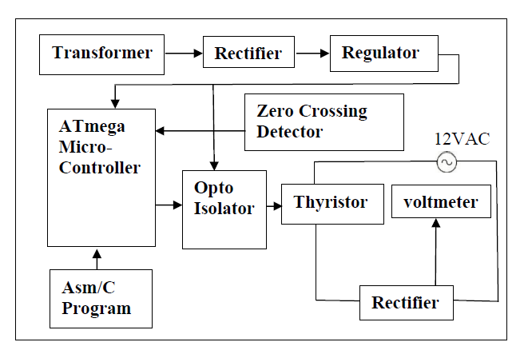
BLOCK DIAGRAM
Fig. 1 Block Diagram of Thyristor Firing Angle Control For Battery Charging

Slide 10
BLOCK DIAGRAM DESCRIPTION
AC Power Source: The AC power source provides the input power to the system. This could be a single-phase or three-phase AC power source.
Transformer: The AC power source is connected to a transformer which is used to step down the voltage to a suitable level for the system. The transformer may also be used to provide isolation between the AC power source and the rest of the system.
Rectifier: The output of the transformer is fed to a rectifier circuit which converts the AC voltage to DC voltage. The rectifier circuit may consist of a single-phase or three-phase bridge rectifier.

Slide 11
4. Filter: The output of the rectifier is then filtered using a capacitor filter to remove any ripple voltage.
5. Battery: The filtered DC voltage is then fed to the battery which is being charged.
6. Thyristor: A thyristor is used to control the charging current to the battery by controlling the firing angle of the thyristor. The thyristor is controlled by a firing circuit which triggers the thyristor at a specific angle of the AC waveform.
7. Firing Circuit: The firing circuit generates a trigger pulse which is applied to the thyristor gate to turn it on. The firing angle of the thyristor can be adjusted by changing the timing of the trigger pulse.

Slide 12
8. Control Circuit: The firing angle of the thyristor is controlled by a control circuit which receives feedback from the battery voltage and current. The control circuit adjusts the firing angle to maintain a constant charging current to the battery.
9. Protection Circuit: The system may also include a protection circuit which protects the battery from overcharging or overcurrent. The protection circuit may include fuses, circuit breakers, or other protective devices.
10.Atmega Microcontroller: The Atmega microcontroller can be added to the system to provide additional control and monitoring capabilities.

Slide 13
The Atmega microcontroller can be programmed to control the firing angle of the thyristor based on various input parameters, such as battery voltage, current, and temperature.
11.Analog-to-Digital Converter (ADC): The Atmega microcontroller can be connected to an ADC to convert the analog battery voltage and current readings into digital signals that can be processed by the microcontroller.
12.Digital-to-Analog Converter (DAC): The Atmega microcontroller can also be connected to a DAC to generate an analog control signal that can be used to adjust the firing angle of the thyristor.

Slide 14
TECHNICAL SPECIFICATION OF PROJECT
Hardware Specification:
Power supply: 220V AC or 380V AC
Transformer: Step-down transformer with appropriate turns ratio to step down the AC voltage to a suitable level for the rectifier circuit.
Rectifier: Single-phase or three-phase bridge rectifier circuit to convert the AC voltage to DC voltage.
Filter: Capacitor filter to remove any ripple voltage from the DC voltage.
Battery: Lead-acid or similar rechargeable battery with appropriate voltage and capacity rating.

Slide 15
6.Thyristor: High-power thyristor rated for the maximum charging current and voltage of the system.
7.Firing Circuit: Optocoupler-based firing circuit to generate the trigger pulse for the thyristor gate.
8.Control Circuit: Microcontroller-based control circuit to adjust the firing angle of the thyristor based on the battery voltage and current readings.
9.User Interface: LCD display and keypad for user input and feedback.
10.Analog-to-Digital Converter (ADC): To convert the analog battery voltage and current readings to digital signals for processing by the microcontroller.

Slide 16
11.Digital-to-Analog Converter (DAC): To generate an analog control signal for adjusting the firing angle of the thyristor.
12.Protections: Overvoltage protection, overcurrent protection, short-circuit protection, and overtemperature protection.

Slide 17
Software Specification:
Programming Language: C or similar high-level language.
Development Environment: AVR Studio or similar integrated development environment (IDE) for programming the Atmega microcontroller.
Control Algorithm: Proportional-Integral-Derivative (PID) control algorithm to regulate the charging current and maintain a constant battery voltage.
Communication Protocol: UART or SPI communication protocol to allow for remote monitoring and control of the system.

Slide 18
5.User Interface: Menu-driven user interface with options for setting the desired charging current, monitoring the battery voltage and current, and adjusting other system parameters.
6.Protections: Software-based protection algorithms to implement the overvoltage, overcurrent, short-circuit, and overtemperature protections.

Slide 19
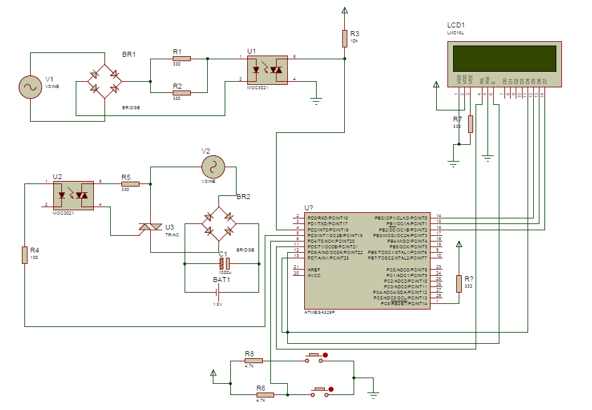
DESIGN & IMPLEMENTATION

Slide 20
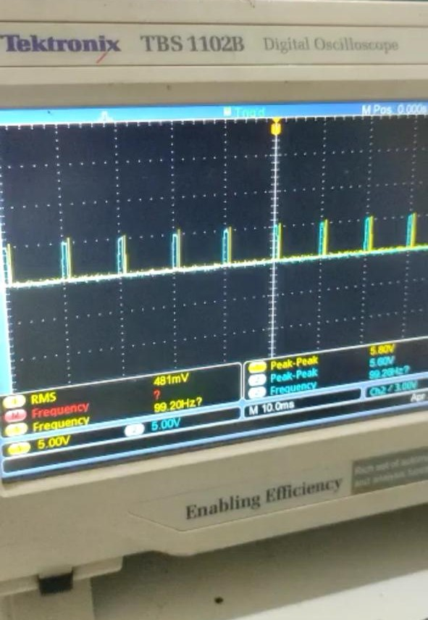
RESULTS

Slide 21
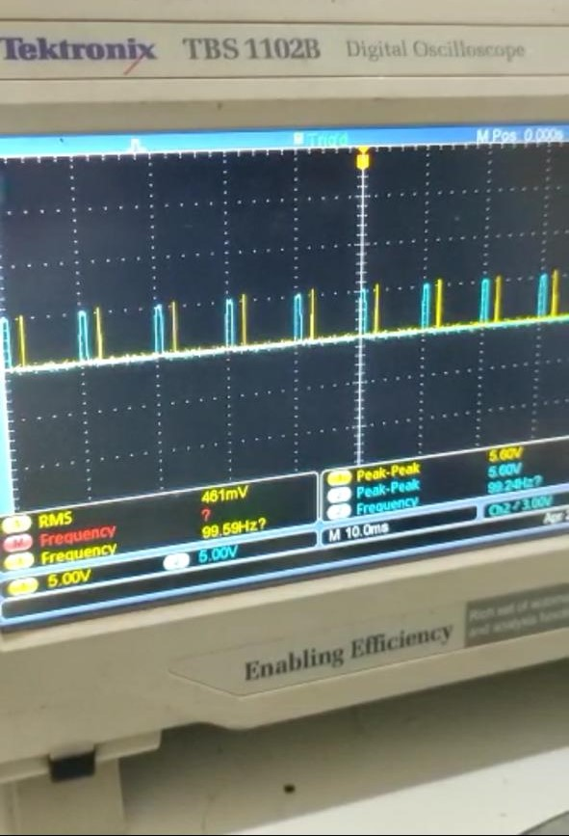
RESULTS

Slide 22
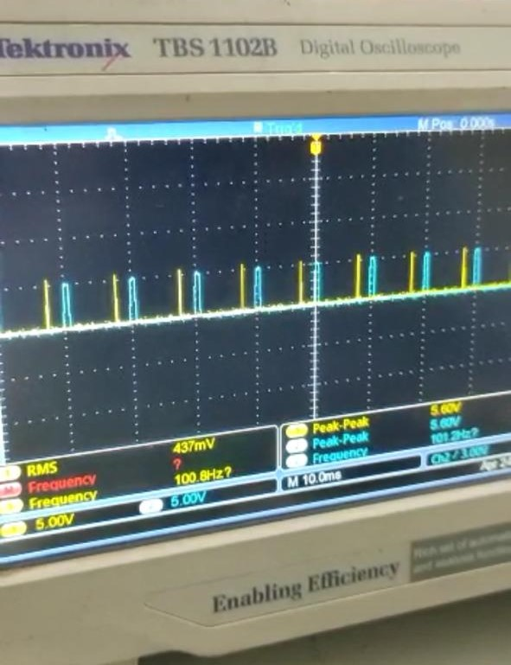
RESULTS

Slide 23
FUTURE SCOPE & APPLICATIONS
The Thyristor Firing Angle Control For Battery Charging project has several future scope and potential applications. Some of them are listed below:
Renewable Energy Systems: The project can be integrated with solar or wind power systems to regulate the charging of batteries used in renewable energy applications.
Electric Vehicles: The project can be used to charge the batteries of electric vehicles and regulate the charging current to optimize the battery life.
Industrial Automation: The project can be used in industrial automation applications where the batteries

Slide 24
are used as backup power sources for critical systems.
4.Home Automation: The project can be integrated into smart homes to control the charging of backup batteries used in case of power outages.
5.Portable Devices: The project can be used to charge batteries of portable devices such as laptops, mobile phones, and tablets.
6.Research and Development: The project can be used as a platform for research and development in the field of power electronics and battery charging.
7.Electric Power Tools: The project can be used to charge batteries of electric power tools and

Slide 25
regulate the charging current to optimize the battery life.
8.Uninterruptible Power Supply (UPS): The project can be used to regulate the charging of batteries used in UPS systems to provide backup power in case of power outages.
9.Energy Storage Systems: The project can be used to charge batteries used in energy storage systems to store excess energy generated by renewable energy sources.
10.Telecommunications: The project can be used to charge batteries used in telecommunication systems to provide backup power in case of power outages.

Slide 26
ADVANTAGES, DISADVANTAGES & APPLICATIONS
In list the Advantages:
1.Energy-efficient: The project ensures efficient charging of the battery by regulating the charging current and maintaining a constant battery voltage.
2.Cost-effective: The project is cost-effective as it reduces the energy consumption and extends the battery life, thereby reducing the need for frequent battery replacements.
3.Customizable: The project can be customized to suit the specific requirements of different battery types and charging applications.

Slide 27
4.User-friendly: The project has a user-friendly interface with easy-to-use menus for setting the desired charging current and monitoring the battery voltage and current.
5.Safe: The project has built-in safety features such as overvoltage protection, overcurrent protection, short-circuit protection, and overtemperature protection.

Slide 28
In List the Disadvantages:
Complex: The project involves the use of advanced power electronics concepts such as thyristors and firing circuits, making it a complex project to design and implement.
Limited range of batteries: The project may not be suitable for charging certain types of batteries, such as lithium-ion batteries, which require more complex charging algorithms.
Limited current range: The project may not be suitable for charging batteries with high current ratings, as it is designed for low to medium current charging applications.

Slide 29
In List the Applications:
Telecommunications: The project can be used to charge batteries used in telecommunication systems to provide backup power in case of power outages.
Industrial automation: The project can be used in industrial automation applications where batteries are used as backup power sources for critical systems.
Research and development: The project can be used as a platform for research and development in the field of power electronics and battery charging.
Electric vehicles: The project can be used to regulate the charging of batteries used in electric vehicles, thereby extending their battery life.

Slide 30
BILL OF MATERIAL
SR | NAME | QTY | PRICE
1 | Atmega328 | 1 | 480
2 | MOC3031 | 1 | 45
3 | PC817 | 1 | 25
4 | BT136 | 1 | 30
5 | LCD 16X2 | 1 | 140
6 | Bridge | 2 | 30
7 | Mix resisters | 10 | 10
8 | Crystal 16MHz | 1 | 10
9 | Mix capacitor | 3 | 10
10 | Transformer 15-0-15 | 1 | 260
11 | Main cord | 1 | 30
12 | DC fan | 1 | 150

Slide 31
BILL OF MATERIAL
SR | NAME | QTY | PRICE
13 | 7805 | 1 | 15
14 | Heatsink | 1 | 10
15 | LM317 | 1 | 25
16 | Switch | 1 | 10
17 | Tactile switch | 2 | 5
18 | Ic base | 1 | 6
19 | 2 pin screw terminal | 2 | 8
20 | bridge | 2 | 20
13 | 7805 | 1 | 15
14 | Heatsink | 1 | 10
15 | LM317 | 1 | 25
16 | Switch | 1 | 10
17 | Tactile switch | 2 | 5

Slide 32
CONCLUSIONS
In conclusion, the Thyristor Firing Angle Control For Battery Charging project offers an effective and practical solution for regulating the charging voltage and current of batteries, ensuring efficient and safe charging. By implementing a thyristor firing circuit and control algorithm, the project can extend battery lifespan, improve performance, and enhance system reliability.

Slide 33
REFERENCES (in IEEE format)
[1] M. R. Ebrahimzadeh, M. S. Soltani, and M. Moallem, "Thyristor firing angle control for lead acid battery charging system," 2014 IEEE 4th International Conference on Electric Power and Energy Conversion Systems (EPECS), pp. 1-5, Nov. 2014. doi: 10.1109/EPECS.2014.7023635.
[2] R. A. Ibarra-Medina, J. J. Cabello, R. Picos, and M. Ortiz-Rivera, "Thyristor firing angle control for battery charging in renewable energy systems," 2017 IEEE 2nd International Conference on Renewable Energy and Power Engineering (REPE), pp. 148-151, Sep. 2017. doi: 10.1109/REPE.2017.8009053.

Slide 34
THANK YOU.

