Slide 1
Darshan University Presentation
Enrollment No: 24010101116
Name: Nakul Kachhava
Department: CSE
Semester: 3
Subject: Office Automation Tools (2301DU004)

Slide 2
About University
Darshan University established in 2009.
Converted to University in 2021.
Motto: Performing duty excellently with devotion and skill.
Vision: Provide quality education and skill development.
Mission: Academic excellence and social values.

Slide 3
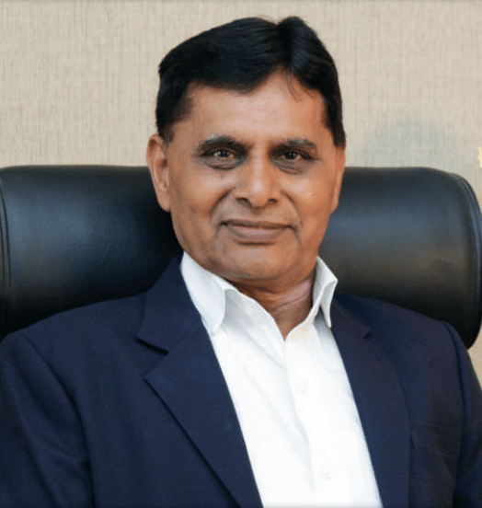
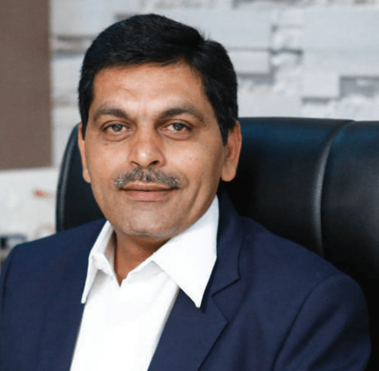
Administrative Leadership
Dr. Ramnik G. Dhamsaniya - President
Prof. Manish V. Sanghani – Provost

Slide 4
Academic Leadership
Dr. Nilesh M. Gambhava - Vice Provost
Dr. Krunal B. Khiraiya - Registrar

Slide 5
University Authority (BoS – Mechanical Engineering)
Dr. Jignasa Mehta Dean,DIET (Chairperson)
Dr. Hiren Joshi Associate Professor, Government Engineering College, Rajkot
Dr. Dipesh Kundaliya Assistant Professor, VVP Engineering College, Rajkot
Mr. Abhishek Suchak Scientist-C & Centre In-charge
Mr. Mukeshkumar Vekariya HoD, Mechanical Engineering Department, DIETDS
Mr. Bhavin Vegada Mechanical Engineering Department, DIET
Mr. Sagar Kanjiya Mechanical Engineering Department, DIET (Member Secretary)

Slide 6
Programs Offered
UG, PG, Diploma, Ph.D.
B.Tech, BCA, BBA, B.Com
Admission 2025
Diploma Engineering (After 10th)

Slide 7
Why Darshan University?
1. Dedicated Faculty
2. Disciplined Environment
3. Skill Development
4. Industry Interaction
5. Excellent Placement
6. Extra-curricular Activities

Slide 8
Scholarships
MYSY Scholarship
Scholarships for SC/ST Students
Post-Metric Scholarship
Tuition Fee Waiver Scheme

Slide 9
Placement Records (CSE - Last 3 Years)
2023-24: 160/167 Placed, Highest 30 LPA, Avg 4.65 LPA
2024-25: 161/172 Placed, Highest 7 LPA, Avg 3.78 LPA

Slide 10
Placement Records (CSE - 2024)
Placed: 161 (93.6%)
Not Placed: 11 (6.4%)

Slide 11
Placement Summary (2025)
Total Registered: 268, Placed: 244 (91%)
CSE: 172/161, Civil: 15/15, Mechanical: 5/5,
B.Com: 2/2, BBA: 24/21, MBA: 50/40
Darshan Placement 2025

