Slide 1
🩸 JeevanLink AI 🤖
CAPSTONE PROJECT
Presented By:
Student Name-Nakul Mehra
College Name-Tuls’s Institute
Department - MCA
4. AICTE ID - STU623c3d91ed7161648115089

Slide 2
OUTLINE
Problem Statement (Should not include solution)
Proposed System/Solution
System Development Approach (Technology Used)
Algorithm & Deployment
Result
Conclusion
Future Scope
References

Slide 3
Problem Statement
PROBLEM STATEMENT
• Emergency blood and organ donation requires fast coordination between recipients and suitable donors.
• Manually searching for compatible donors can be slow and inefficient during critical situations.
• Donor availability, blood compatibility, donation type and location must be considered together.
• Lack of centralized and persistent donor/request records can make coordination difficult.
• Verification and status tracking are important to maintain reliable donor information.
• Administrators need a clear way to monitor requests, donors, matches and platform activity.

Slide 4
Proposed Solution
🩸 JeevanLink AI
JeevanLink AI is a Streamlit-based intelligent donor–recipient matching platform designed to simplify emergency blood and organ donation coordination.
KEY FEATURES
• 👤 Donor Registration
• 🚨 Emergency Donation Requests
• 🔗 Automated Donor Matching
• 🩸 Blood Compatibility Checking
• 📍 Location-based Prioritization
• 📊 Real-time Analytics Dashboard
• 🤖 Gemini-powered AI Assistant
• 🛡️ Donor & Request Verification
• 👨‍💼 Admin Portal
• 🗄️ Persistent Supabase Database

Slide 5
System Approach
System Development Approach
1. Donor Registration
Donors provide their blood group, location, donation type, availability and other required information.
2. Request Creation
Recipients can submit requests based on their blood, organ and donation requirements.
3. Verification
Administrators verify donor information and manage submitted requests.
4. Intelligent Matching
The system evaluates compatibility, location, availability and verification status.
5. Match Ranking
Suitable donors are assigned a match score and ranked according to relevance.
6. Result & Tracking
Users can view suitable matches while administrators can monitor the complete process.

Slide 6
TECHNOLOGIES USED
Category | Technology | Purpose
Programming Language | Python | Core application logic and backend processing
Frontend / UI | Streamlit | Interactive web application interface
Database | Supabase PostgreSQL | Persistent storage of donors, requests, matches and activity
AI | Google Gemini API | AI-powered assistant and contextual guidance
Data Processing | Pandas | Data handling, filtering and analysis
Data Visualization | Plotly | Interactive charts and dashboard analytics
Version Control | Git & GitHub | Source code management and collaboration
Deployment | Streamlit Community Cloud | Hosting and deployment of the application

Slide 7
Algorithm & Deployment
Matching Algorithm
Input:
Donor details
Blood group
Donation type
Organ type
City / Location
Availability
Verification status
Matching Factors:
Blood compatibility
Location
Availability
Donation type
Donor verification
Output:
Match Score → Ranked Suitable Donors
Matching Process
Donor / Recipient Request
↓
Check Donor Availability
↓
Check Donation Type
↓
Check Blood Compatibility
↓
Check Organ Compatibility
↓
Check Location
↓
Verify Donor Status
↓
Calculate Match Score
↓
Rank Suitable Donors
↓
Display Matches

Slide 8
Result
The JeevanLink AI platform successfully demonstrates:
✅ Donor registration and availability management
✅ Emergency blood and organ request creation
✅ Blood and donation-type compatibility checking
✅ Location-based donor prioritization
✅ Match scoring and donor ranking
✅ Donor and request verification
✅ Admin portal for system management
✅ Persistent data storage using Supabase
✅ Interactive dashboard and analytics
✅ Gemini-powered AI assistance
✅ Activity tracking and match management
Expected Outcome
The system reduces manual donor searching and provides a structured, intelligent and centralized platform for identifying suitable donors quickly.

Slide 9
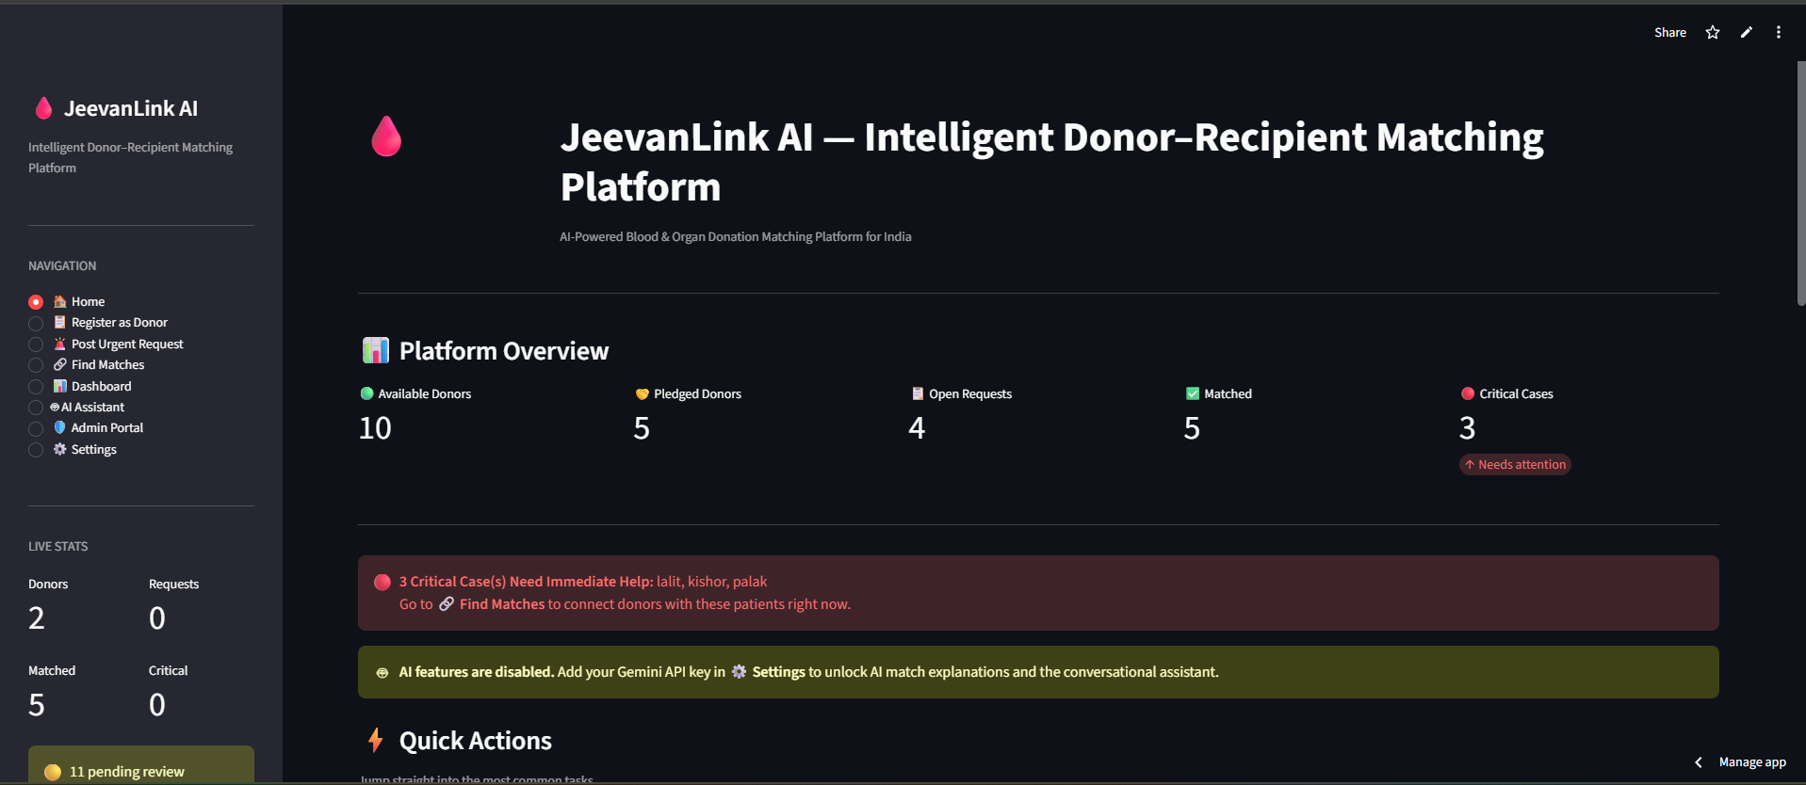
Result

Slide 10
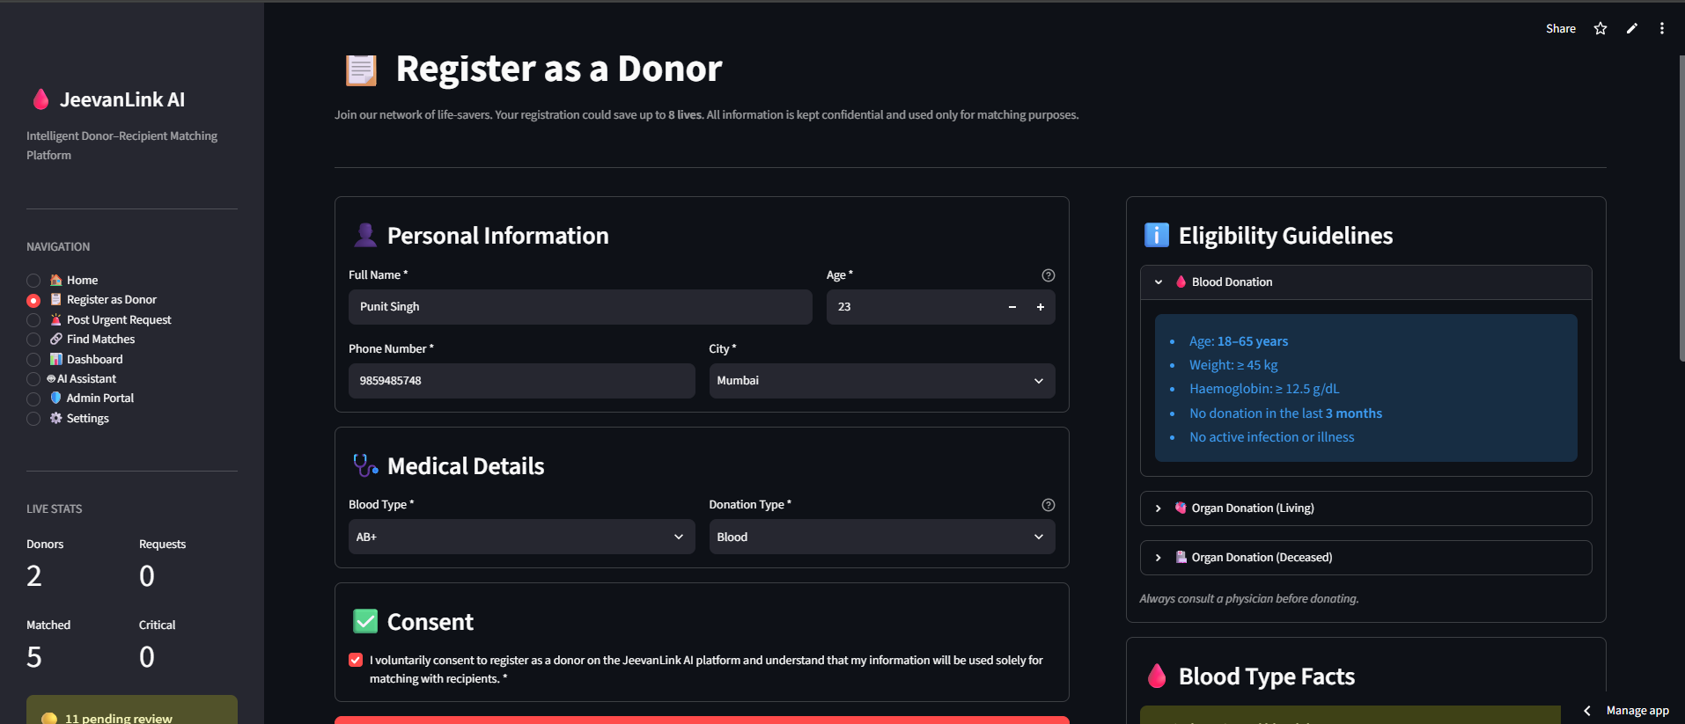
Result

Slide 11
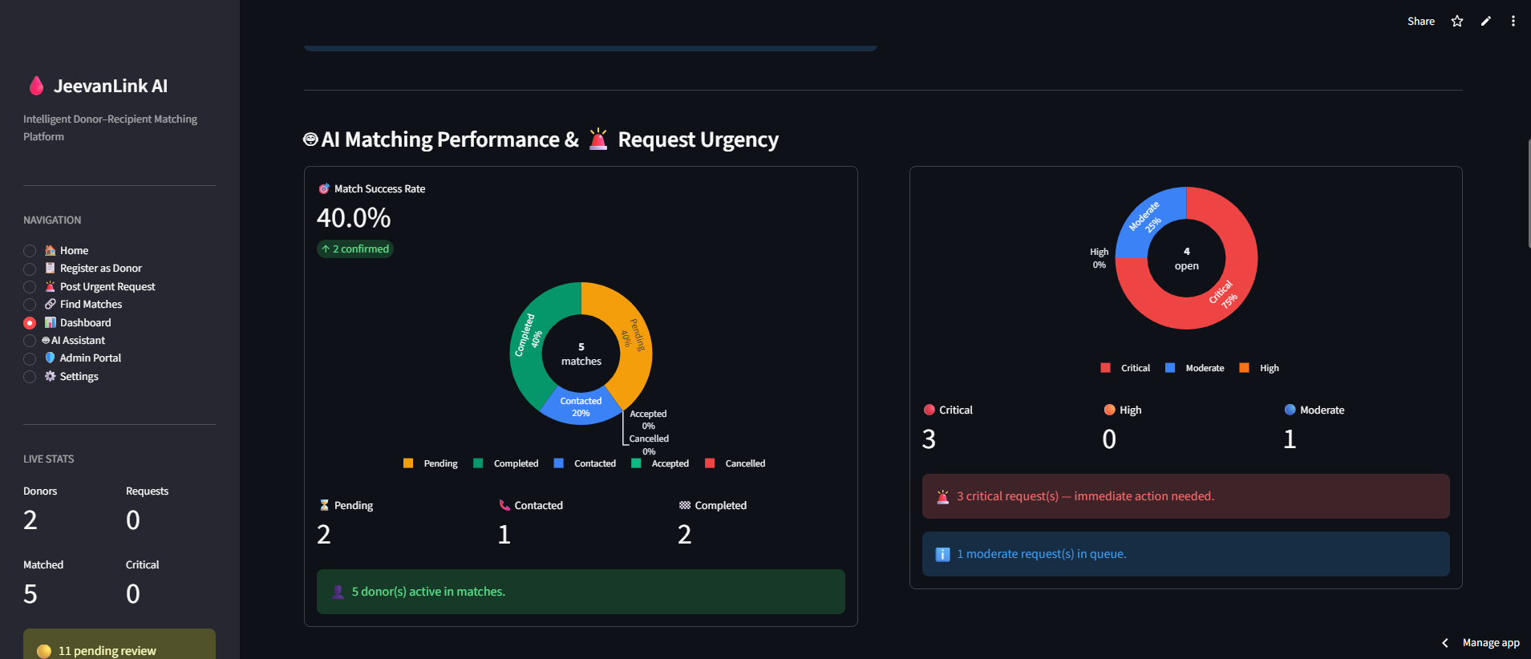
Result

Slide 12
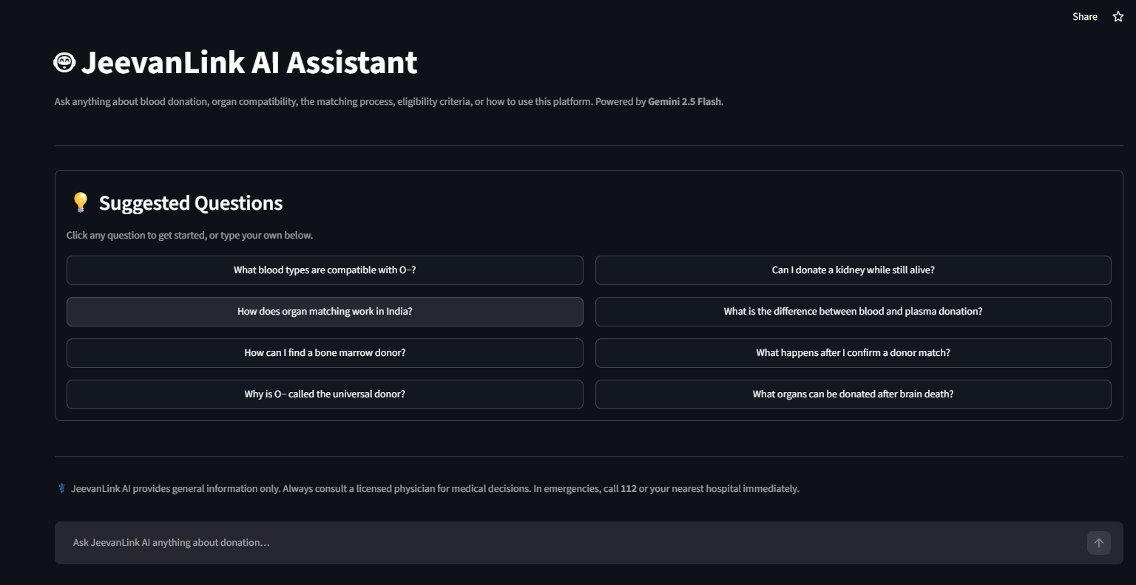
Result

Slide 13
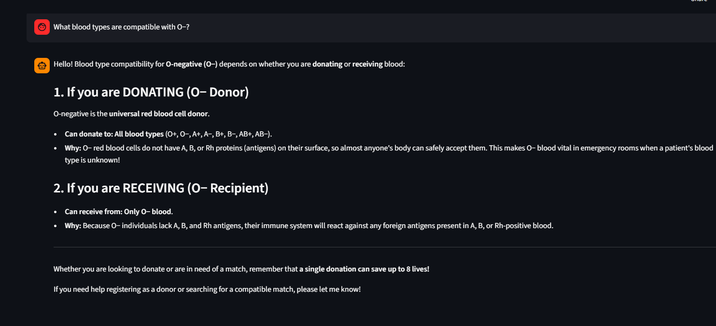
Result

Slide 14
Conclusion
JeevanLink AI successfully provides an intelligent and centralized platform for donor–recipient matching.
Enables quick and organized donor registration and emergency request management.
Identifies suitable donors using blood compatibility, location, availability and verification.
Uses match scoring and ranking to prioritize relevant donors.
Provides Supabase-based persistent data management for donors, requests and matches.
Offers Admin Portal for verification, monitoring and request management.
Integrates Gemini AI Assistant for intelligent user assistance.
Provides an interactive dashboard for analytics and activity monitoring.
Final Statement--:
JeevanLink AI demonstrates how AI, automation and data-driven matching can make donation coordination more efficient, reliable and organized.

Slide 15
Future scope
▪️ 📍 Real-time GPS-based distance calculation
▪️ 🔔 SMS / Email / Push notifications
▪️ 👤 Advanced donor verification system
▪️ 🔐 Improved authentication and data security
▪️ 📱 Mobile application
▪️ 🏥 Hospital and blood bank integration
▪️ 📊 Advanced analytics and reporting
▪️ 🤖 Improved AI-based donor recommendation
▪️ 🌐 Nationwide donor network expansion

Slide 16
References
▪️ Python Documentation
▪️ Streamlit Documentation
▪️ Google Gemini API Documentation
▪️ Supabase Documentation
▪️ Pandas Documentation
▪️ GitHub Documentation
▪️ Blood Group Compatibility References
▪️ AICTE SkillBuild / Project Requirements Documentation

Slide 17
Deployment link / github link
Github Link : https://github.com/Nakulmehra19/jeevanlink-ai
Deployment : https://jeevanlink-ai.streamlit.app/
Platform : Streamlit Community Cloud

Slide 18
THANK YOU

