Slide 1
VINGEL
Market Simulator & On-Chain Analytics
Team Members: 1) Sumit kumar 2) Aman Mishra 3) Nakul Varshney

Slide 2
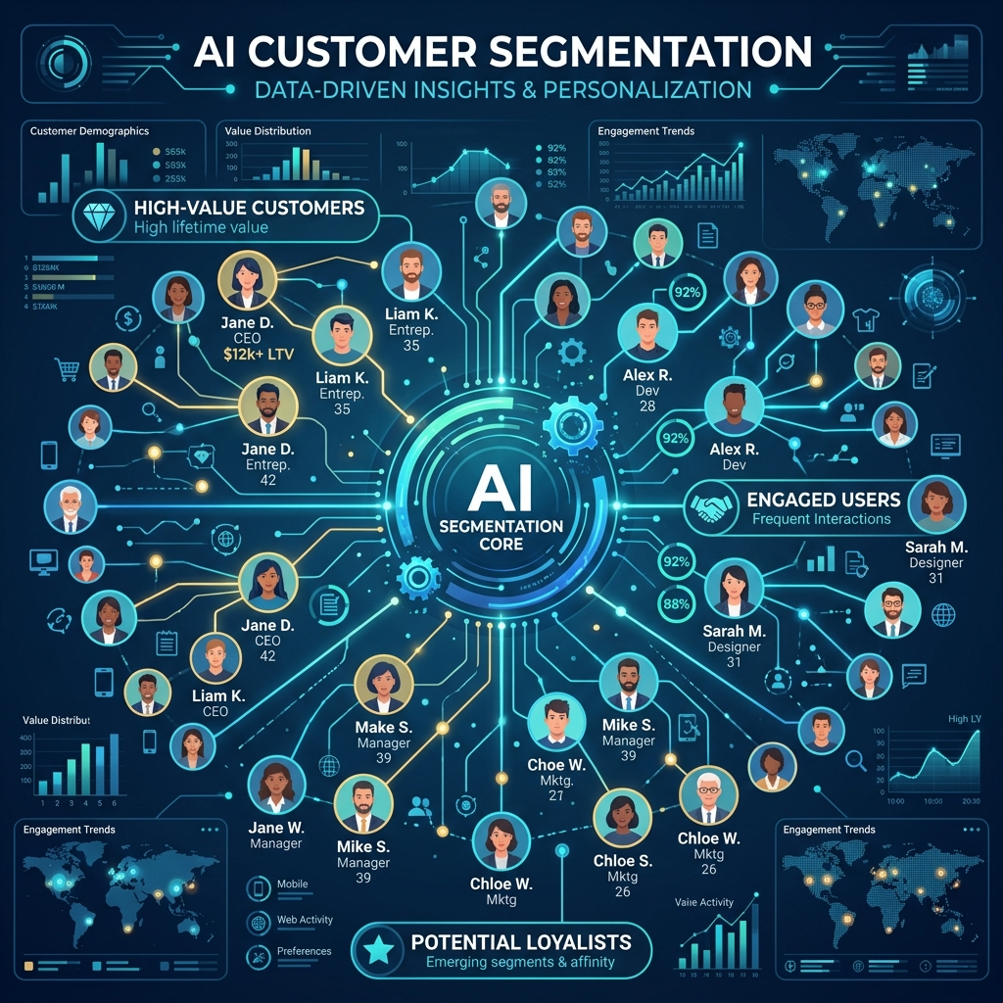
AI-Powered Market Segmentation
• Vingel uses advanced AI to generate distinct customer archetypes. • Captures dynamic behavioral parameters like price sensitivity and tech affinity. • Replaces static guesses with realistic data points.

Slide 3
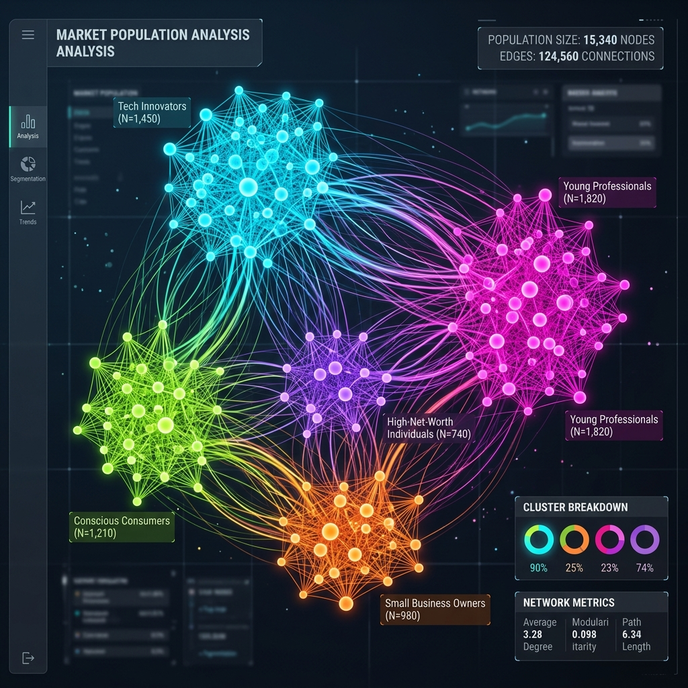
Real-Time Population Visualization
• Synthetic populations modeled as connected network graphs. • High-performance interactive clustering with vibrant visuals. • Visualizes real-time conversion and churn events.

Slide 4

On-Chain Blockchain Anchoring
• Immutable proof-of-simulation stored on the Monad testnet. • End-to-end cryptographic integrity via SHA-256 block chains. • Secure, decentralized, and gated by wallet balances.

Slide 5
Thank You!

