Slide 1


Portfolio Project-Pizza Sales Analysis
By Nakul Sharma

Slide 2




Tools Used
We utilized MS Word 2019, Microsoft SQL Server 2019, and MS Excel 2019 for this portfolio project. See how these tools bring insights to life.

Slide 3

The Dataset
Get familiar with the dataset. We used the "pizza_sales.csv" file, containing columns like pizza_id, order_id, quantity, order_date, and more.
🍕 pizza_id, order_id, pizza_name_id, quantity, order_date, order_time, unit_price, total_price, pizza_size, pizza_category, pizza_ingredients, and pizza_name.

Slide 4
Data Extraction with SQL
Unleash the power of SQL! Discover the insights we extracted using Microsoft SQL Server:
1
Total Revenue
2
Average Order Value
Calculate the overall revenue generated from pizza sales.
Analyze the average value of each pizza order.
3
Total Pizza Sold
4
Daily and Hourly Trends
Count the total number of pizzas sold.
Explore the trends in total orders on a daily and hourly basis.
5
Sales by Pizza Category and Size
6
Top 5 Best and Worst Sellers
Identify the top 5 best and worst selling pizzas.
Discover the percentage of sales for each pizza category and size.

Slide 5
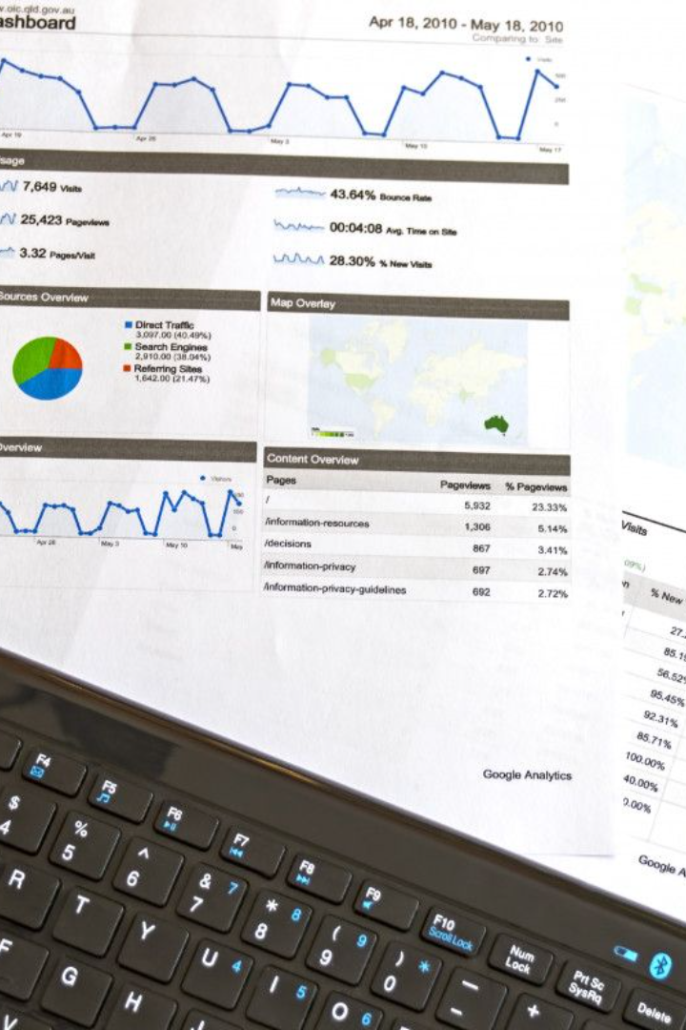
Creating an Interactive Dashboard
Visualize the data using MS Excel's powerful features. We built an interactive dashboard with pivot tables, KPIs, and charts.
📊 Explore insightful trends and patterns. Insert slicers to easily filter data by Order Date, making the dashboard interactive.

Slide 6

Conclusion
Experience the valuable insights from our analyzed dataset. The interactive dashboard provides a captivating visualization.
📈 Discover trends, make data-driven decisions, and unlock the potential of your pizza sales data.

