Slide 1
Top 10 challenges in data science
@rafalab

Slide 2
Schedule
Introduction to R and Rstudio - September 27 at 1pm with Rafael Irizarry
Data visualization with ggplot2 - October 9 at 1pm
Data visualization principles and plots to avoid - November 6 at 1pm
Design of clinical trials basics - December 11 at 1pm
Correlation: you are probably using it wrong - January 15 at 1pm
Culprits of the reproducibility crisis: multiple testing and p-hacking - February 12 at 1pm
Brief introduction to machine learning - March 12 at 1pm
Batch effects - April 9 at 1pm
Experimental Design: How many size and should I pool? - May 14 at 1pm
Detecting differentially expressed genes with RNA-seq - June 11 at 1pm

Slide 3
http://bcb.dfci.harvard.edu/index.php/calendar/top-ten-seminar
mailing

Slide 4
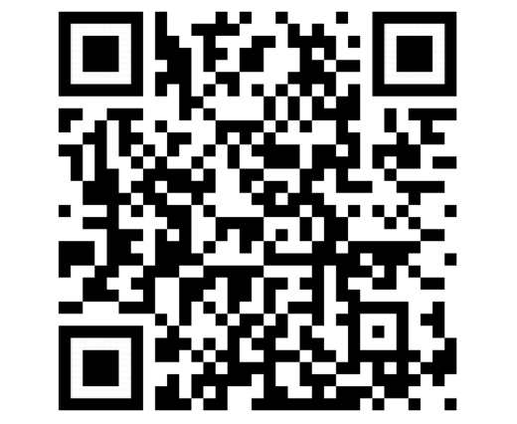
Mailing list
https://bit.ly/2xRv5Nn
https://bit.ly/2xVeAjr

Slide 5
Introduction to R and RStudio

Slide 6
Outline
Why R is better than Python (don’t @ me)
Why R is better than SAS
Why R is better than Excel or Prism
Install and try out

Slide 7
Resources
https://rafalab.github.io/dsbook/
http://r4ds.had.co.nz/
https://www.edx.org/course/data-science-r-basics
https://www.datacamp.com/
R-bloggers
Stackoverflow

Slide 8
Why is R better than Python
It’s not
But it is easier to learn
More readily available statistical tools
Data exploration and making nice graphs is easier
tidyverse helps with the last two points

Slide 9
Why is R better than SAS
R is free
R is open source
New methods come out in R first
Large helpful online community
With tidyverse R syntax not as hard to learn
RStudio
R markdown
Shiny apps
gganimate
Interoperable: Rcpp, reticulate, htmlwidgets

Slide 10
Why is R better than excel and Prism
Reproducible research
Much easier to automatize repetitive tasks
Many more powerful tools
More flexibility

Slide 11
Install
Google CRAN
Google RStudio

Slide 12
Example
p-value = 0.04

Slide 13
Example
https://github.com/rafalab/top-10

Slide 14
We learn
https://www.rstudio.com/wp-content/uploads/2016/01/rstudio-IDE-cheatsheet.pdf
Install packages: example tidyverse
RStudio projects
Importing data
Repetitive tasks
R markdown
R presentations

