Slide 1


Deep Learning Based Unsupervised and Semi-supervised Classification for Keratoconus (Nicole Hallett et. al, 2020)
Study of
Edvonaldo Horácio dos Santos (edvonaldohs@ic.ufal.br)

Slide 2
Introduction
Keratoconus (KC) is a bilateral, asymmetric, progressive corneal disease, affecting some 1 in 2,000 patients worldwide
The most effective intervention currently available to halt the progression of KC is corneal cross-linking (CXL)
Objectives:
To use supervised and unsupervised models to classify different stages of KC
To compare the accuracy of the supervised and unsupervised models in the classification of KC

Slide 3
Patient Corneal Dataset
124 patients was collected from Vision Eye Institute Chatswood between 2014- 2017
29 categorical variables
Four degrees of KC stage

Slide 4
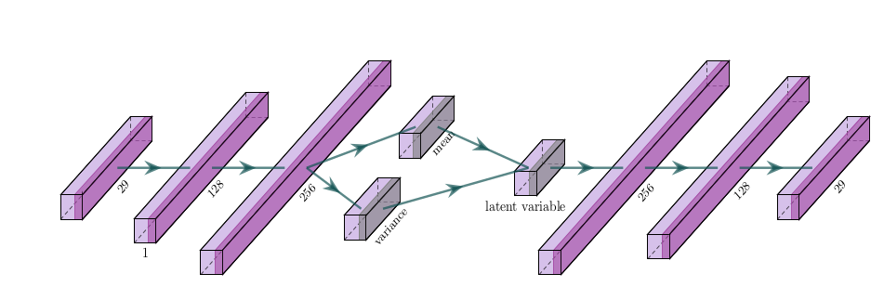
Clustering for Corneal Data by Variatonal Autoenconder (VAE)
Figure 1: MLP with VAE
Variational autoencoder (VAE) is a Bayesian deep neural network
Bayesian inference in VAE
Encoder and decoder as multilayer perceptron (MLP) models
X: input | Y: output | Z: encoder

Slide 5
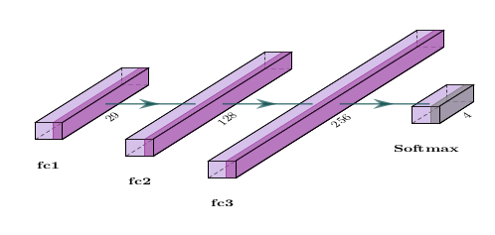
MLP model
Figure 2: MLP Model

Slide 6
Methodology
Get dataset and select variables
Construct the model to NN with VAE
Make the clustering
Make the classification
Obtain accuracy in both methods
Attention
Hyperparemeters in models!

Slide 7
Expected results
The unsupervised VAE model resulted in higher accuracy than the MLP model.
Accuracy levels of 73% and 80% for supervised and unsupervised models respectively
MLP model aprox. 73% accuracy

Slide 8
Results and conclusions
Classification accuracy
76.74%
Clustering accuracy
62.44%
MLP model
62.92%

Slide 9
Results and conclusions
NN with VAE is promising
New NN model
Variatonal Autoenconder (VAE)
Hyperparameters adjusting
Limited dataset
Grid search and random search

Slide 10
References
HALLETT, Nicole et al. Deep learning based unsupervised and semi-supervised classification for keratoconus. In: 2020 International Joint Conference on Neural Networks (IJCNN). IEEE, 2020. p. 1-7.
Github: https://github.com/NaldoHoracio/CornealAIPaper
Vídeo: https://drive.google.com/file/d/14WC4y0NPKI9yeFoLz78NeY6bR_AthLVM/view

