Slide 1
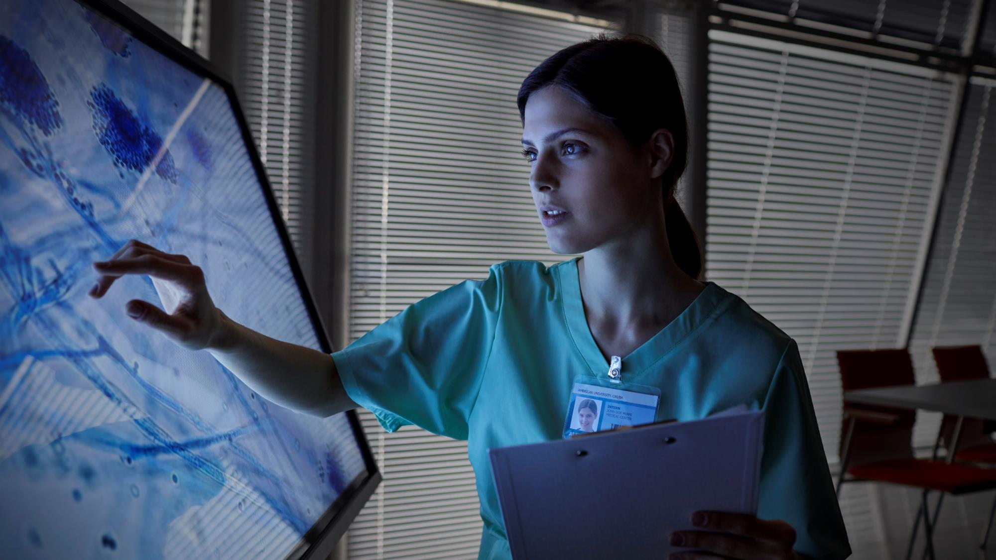
CUREFIND healthcare REMINDER APPLICATION
AI SOLUTION FOR INDUSTRIES

Slide 2

OUR BIG IDEA
Project Members
T.B Mokoena - 222314249 (Leader)
M. Naledi - 222028750
T.G Molokwane - 221874895
S Mngomeni - 222328436
K.Z Mahlangu -221977015
T Motaung - 222197897
K.T Nkhatho - 222071338
K.C Koza - 221415920
T. Tlhatlha - 222329890
K. Lehoko - 222445777

Slide 3
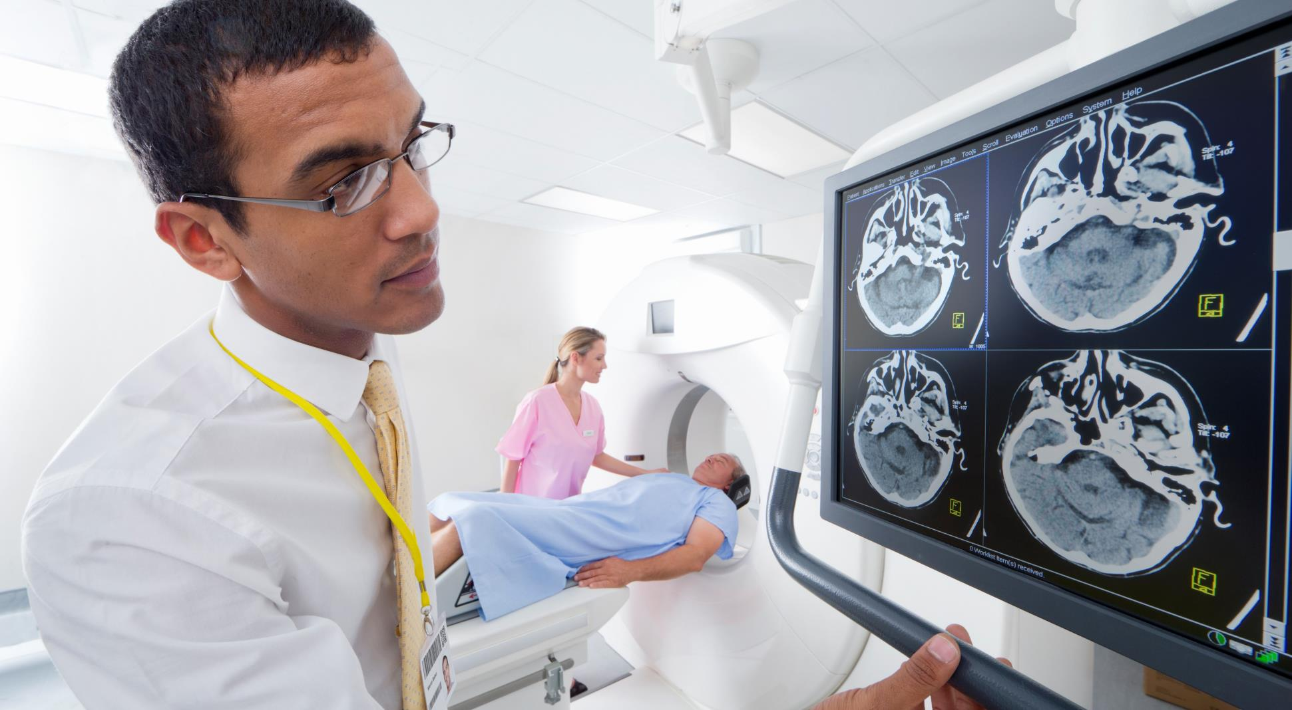





CONTENT
Ai Solution &
Business objectives
Problem definition
&
poster
Ml approach, data & model
Time series analysis on data &
Solution techniques
Nlp, speech recognition or speech synthesis, deep learning &
Other features
*

Slide 4
Ai Solution
CUREFINED APP ORIGIN
AI Project in Python: An AI Project called Curefind App will assist patients in taking their medication at the correct time by reminding them through alarms and depicting a graphic schedule or timetable of how their week is supposed to be.

Slide 5
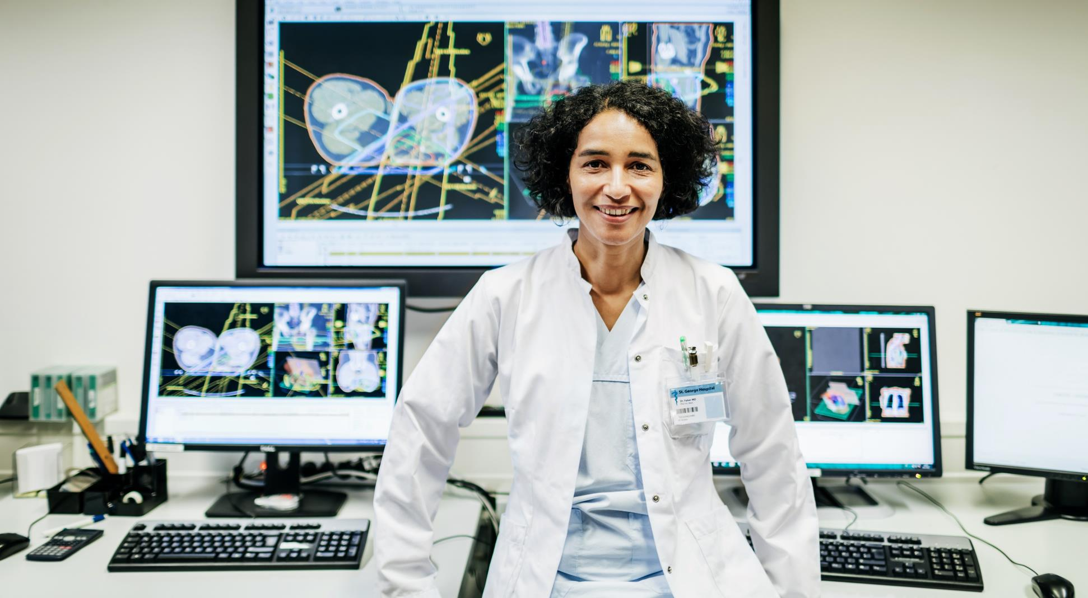
Business objectives
Business Background:
Managing medication compliance among elders has been a growing concern.
Many elders live independently and do not have a caregiver to remind them daily to take their medication on time.
The project aims to develop a medication reminder app to assist elderly people in managing their medical schedules and reducing missed medication collection dates.
Business Objectives:
Provide personalized medication reminders to users.
Assisting users in managing their medical schedules
Reduce missed medication collection dates
Provide conversational AI to automatically do what the user requests it to do.

Slide 6


Problem definition
.
The problem is the need for a simple app that helps people stick to their medication schedules.
Some people need this because of their health conditions they can use the app to help manage their condition.
The application would allow for example crisis management tools that address one’s condition and provide resources for that matter and an addition of pictures or audio that helps users through the hard times.

Slide 7
POSTER

Slide 8

Machine learning approach, data & model
A well-planned, appropriate set of algorithms.
Data capturing: The Curefind app will first require the data (names, age, health condition, etc., etc.) and credentials (username and password) for registration and login of the User to store in its database.
Database linking: The Curefind app will also link with the User data at the doctor or hospital database with authorization from the state through their ID number to record the prescription and changes made by the doctor.
Medical background checks and prediction: Along with the assistance from the database linking the Curefind app will be able to check the User's medical history and be able to predict relevant outcomes
Reinforcement and updates: The application is programmed to continuously update its system, enforce security.

Slide 9
Time series analysis on data
A sample/description of this analysis exists and is appropriate.
The time series analyst on data of the application model will work with scheduling reminders or timestamps for when the user will take the medication and show when the medication was collected.
It will show when the user didn't take their medication all this series analysis and predictions are based on 84% of the user’s medical history and 16% on the doctor’s current diagnosis.

Slide 10
Solution techniques
Solutions to supervised machine learning.
The software uses supervised machine learning, natural language processing (NLP), and integration with electronic health records (EHR) to manage drug scheduling.
Supervised Machine Learning: Analysis of Behavioural Patterns:
The software examines past data on drug adherence, mood swings, and behavioral trends using supervised artificial intelligence.
Adaptive Reminders:
The software continually adjusts the number and duration of reminders to better meet user needs through learning from interactions and responses.

Slide 11
Nlp, speech recognition or speech synthesis, deep learning
Curefind – 10 MILE
Natural Language Processing (NLP):
Individualized Notices:
NLP algorithms produce tailored and contextually appropriate alerts for recalling medications.
Voice Recognition and Synthesis:
Speech Recognition Speech Synthesis
EHR Integration:
Medical History Access:
Through integration with EHR systems, the app may retrieve and utilize current, precise medical data to customize reminders and assistance according to the user's unique medical needs and prescription regimen.
Deep Learning
For our MR application, we will be using Convolutional Neural Networks (CNNs)
This deep learning network will help us in processing and making predictions from different types of data including text, images, and audio.

Slide 12
Other features (Chatbot/ softbot)
The app facilitates connection and care through advanced communication features.
Users can engage with a sophisticated chatbot for mood tracking, symptom reporting, and crisis support, while also receiving personalized guidance (Check-up date reminders and so on).
Specifically, elderly users benefit from:
Access to medical professionals
Reducing hospitalization
Emergency visits.

Slide 13

Conclusion
The Curefind App leverages AI, supervised machine learning, and natural language processing (NLP) to enhance medication adherence for older adults and individuals with chronic illnesses.
The app addresses medication compliance challenges, especially for users with mental health conditions like autism and bipolar disorder.
With real-time monitoring, data security, and user-friendly design, the app aims to reduce missed medication collection dates and improve overall patient care.

Slide 14

Thank you
Tebogo Molokwane
HEALTHCARE REPRESENTATIVE
curefind@healthcare.com
016-445-7677

