Slide 1

SMART INDIA HACKATHON 2026
TITLE PAGE
Problem Statement ID –
Problem Statement Title- Generative AI-Based Cloud Removal & Reconstruction for Satellite
Theme- Space & Technology
PS Category- Software
Team ID-
Team Name (Registered on portal) - Antelope

Slide 2
CLEAR - Generative AI-Based Cloud Removal & Reconstruction
Antelope
Problem Statement:
Proposed Solution:
Cloud coverage significantly degrades the utility of satellite imagery for:
Environmental Monitoring - Land cover changes, deforestation tracking
Disaster Response - Affected area assessment post-events
Agricultural Assessment - Crop health monitoring, yield prediction
Urban Planning - Infrastructure development, land-use planning
Climate Research - Temporal analysis, climate pattern study
CLEAR - Cloud Removal & Reconstruction for Satellite Imagery
AI-native cloud removal solution that learns to reconstruct obscured satellite imagery through:
Supervised Learning - On paired cloudy-clear satellite images
Transfer Learning - Using RICE1 & RICE2 datasets
U-Net GAN Architecture - For high-quality reconstruction
Innovation and uniqueness:
Hybrid U-Net + GAN architecture combining pixel-level accuracy with photorealistic texture generation for superior cloud removal
Two-stage transfer learning strategy pre-training on RICE1 and fine-tuning on RICE2 for handling diverse cloud patterns with limited data
Real-time deployment via Streamlit web interface with GPU-optimized inference (1-2 seconds per image) and batch processing capability
Cost-effective solution requiring no specialized hardware while increasing usable satellite data by ~70% with 25+ dB PSNR quality

Slide 3
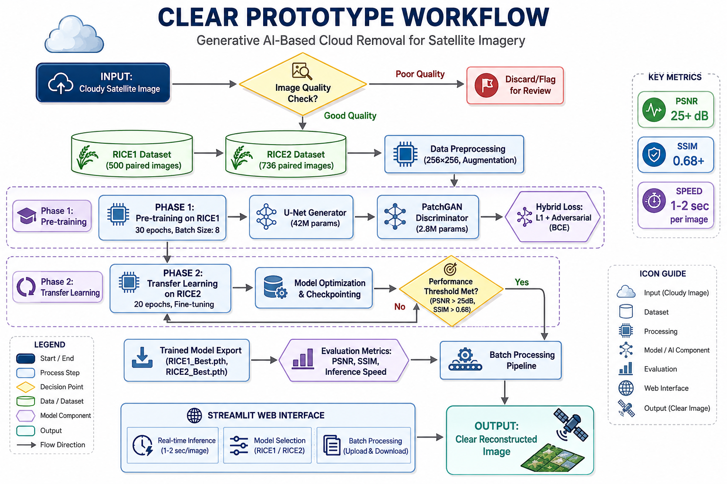



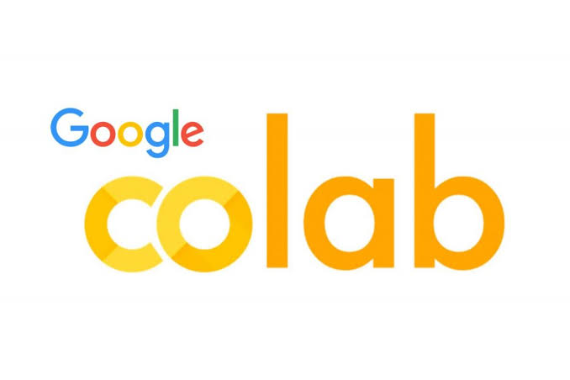
TECHNICAL APPROACH
Antelope
Technologies to be used

Slide 4
FEASIBILITY AND VIABILITY
Antelope
Analysis of the feasibility of the idea:
Proven Technology: U-Net + GAN is established for image-to-image translation
Quality Data: RICE dataset provides paired cloudy-clear images for training
Manageable Resources: Single GPU training, lightweight deployment
Cost-Effective: No specialized hardware required
Potential challenges & Mitigation:
Challenge: Model may not generalize to completely new satellite sensors (e.g., LISS-IV).
    Mitigation: Implement a fine-tuning pipeline where users can adapt the model with their own domain-specific data.
Challenge: Handling images larger than the training resolution (256x256).
    Mitigation: Develop a multi-resolution inference strategy (e.g., patch-based processing) to handle various image sizes.
Challenge: Potential for hallucination or inaccurate reconstruction in complex scenarios.
    Mitigation: Integrate uncertainty estimation to flag low-confidence reconstructions for manual review.

Slide 5
IMPACT AND BENEFITS
Antelope
Potential impact on the target audience
Disaster response teams receive clear satellite imagery within seconds after floods, cyclones, and earthquakes, enabling faster and more accurate life-saving decisions
Farmers and agricultural agencies access uninterrupted crop health monitoring and yield predictions, strengthening food security and rural livelihoods
Environmental researchers track deforestation, glacier retreat, and land-use changes consistently without weather-related data gaps
Urban planners and government bodies obtain clear views for infrastructure development, resource allocation, and smart city planning
Climate scientists access 70% more usable satellite data for accurate long-term climate modeling and policy recommendations
.
Benefits of the solution
Delivers high-quality cloud-free images in just 1-2 seconds per image
Increases usable satellite data availability by up to 70%
Achieves 25+ dB PSNR and 0.68+ SSIM for reliable reconstruction accuracy
Makes advanced AI technology accessible through a user-friendly web interface
Reduces dependency on expensive commercial satellite services with a cost-effective solution
Supports India's climate action, disaster management, and sustainable development goals

Slide 6
RESEARCH AND REFERENCES
Antelope
Details / Links of the reference and research work
Dataset:
RICE1 & RICE2: A dataset for cloud detection and removal in satellite images.
Link: https://drive.google.com/drive/folders/1qlAi-33iSQyhBXHumpQQRv_ojq67JkqQ?usp=drive_link
Core Architecture:
Phillip Isola, et al., "Image-to-Image Translation with Conditional Adversarial Networks" (pix2pix).
Olaf Ronneberger, et al., "U-Net: Convolutional Networks for Biomedical Image Segmentation".
Code & Frameworks:
PyTorch: https://pytorch.org/

