Slide 1
Simulated Control of a 3DoF Mobile Robot Arm
Nathan Park

Slide 2
Goals
Set up simulation based on 3DoF example
Implement 3 massless links to allow movement of the base
Implement PID control to track goal state
Input arbitrary path waypoints and test tracking

Slide 3
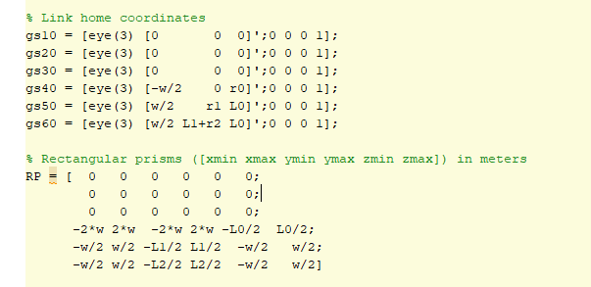
Mobile Robot Implementation
Add 3 massless DoFs for base motion in X, Y, Z direction
Extend syms code and Simulink model to accommodate 6 degrees of freedom
Use prismatic joints for new massless joints
Test it!

Slide 4
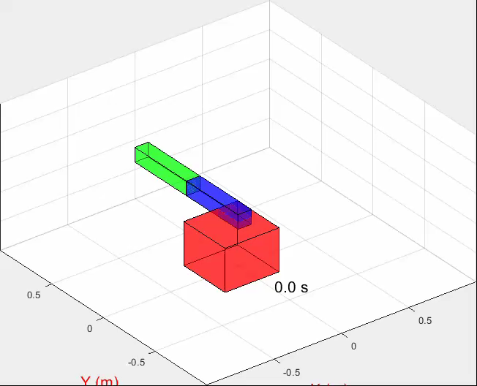
Oops.

Slide 5
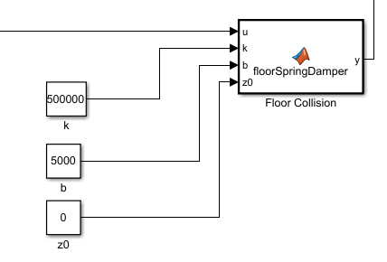
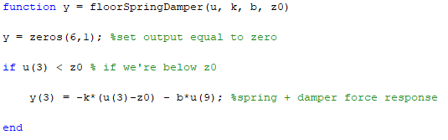
Floor Collision!
Tried two approaches:
Clamp position to > 0
Flip velocity sign when pos < 0
Simulink doesn’t like the discontinuous behavior, and this doesn’t represent the physical phenomenon
Spring + Damper implementation
Good model of the dynamics of ground collision/bouncing
Need a really stiff spring constant
Played with values until it looked good

Slide 6
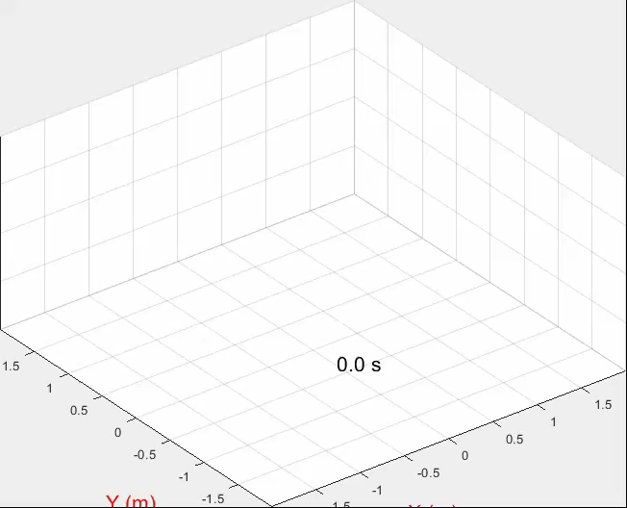
Fixed!

Slide 7
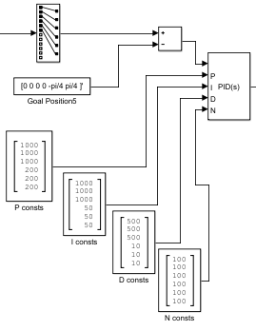
PID Implementation
Need to tell the robot where to go
Use Simulink PID block to implement
Calculate error of current position to goal position
Break out P, I, D, N constants into 6x1 vectors for tweaking individual DoFs

Slide 8
PID Implementation
Not particularly experienced with PID control
Just played with the values
Improved prediction with larger D constant
Error correction over time improved with larger I constant
P increased “stiffness” causing lots of jerky movements

Slide 9
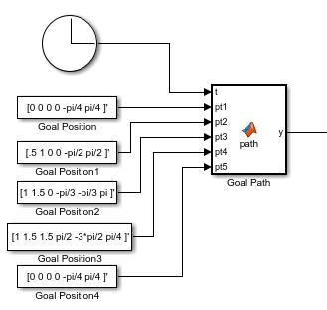
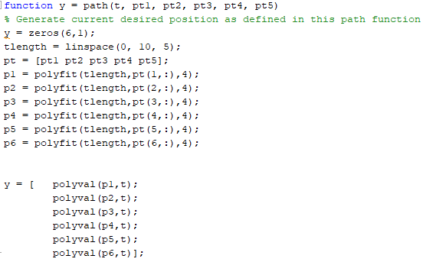
Path Generation from Waypoints
Simple code
Clock input for time varying function
Takes in 5 waypoints
Each waypoint traveled to over 2 sec (10 sec sim / 5 positions)
Polyfit to generate a fit for each theta

Slide 10
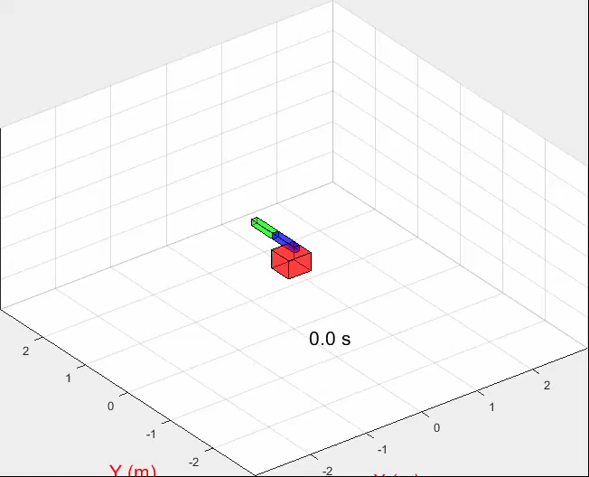
Path Generation from Waypoints

Slide 11
Tracking Analysis
Low PID constant values struggle to overcome gravity
Hard to tune because of the system complexity, mostly a guessing game

Slide 12
Tracking Analysis
Z-direction force starts very high due to the IC being away from the initial goal
Floor collision force is very large from initial drop and final drop

Slide 13
Improvements
Improve PID tuning
Extend path generation capabilities
Create IK solution
Add floor collision to links
PID control of XYZ position rather than joint angles
Robot self collision?
More links on arm?

