Slide 1







IT Job Market Analysis (2019)
Name: Nalin Malla
Date: 2023-12-21

Slide 2



OUTLINE
Executive Summary
Introduction
Methodology
Results
Visualization – Charts
Dashboard
Discussion
Findings & Implications
Conclusion
Appendix

Slide 3

EXECUTIVE SUMMARY
This project aims to analyzing job market data from various sources like job postings, training portals and surveys to help identify relevant skills and technologies which are currently being used or have a high chance of being popular in the future.
The result of this project can be helpful for everyone part of the IT space.
Throughout the duration of this project I performed various activities such as: Data Collect, Data Wrangling, Exploratory Data Analysis, Data Visualization, Dashboard creation and Documentation.
The experience from this project has provided valuable insights into the nuances of the data analysis process. The culmination of these efforts has led to the growth in my technical skills.

Slide 4

INTRODUCTION
Project background and context
This project was done to fulfill requirements of the IBM : Data Analyst Capstone Project Certification.
Here, I was to play the role of a data analyst in a international IT firm. In order to keep pace with changing technologies and remain competitive, I was tasked with analyzing job market data to help identify future skill requirements.
An old dataset (2019) was used for this project.
Questions to be answered:
What are the popular skills & technologies currently being used in the IT market?
What are the skills & technologies which have a high chance of being famous in the future?

Slide 5

METHODOLOGY
During this project I performed the following operations:
• Data Collection using APIs and Web Scraping.
• Data Wrangling:
Duplicate Values were identified and removed.
Missing values were identified and replaced.
Normalized data in the dataset.
Exploratory Data Analysis in order to better understand the data
Visual Data Analysis to identify relationship among variables.
Dashboard Creation to present key information in an interactive, centralized and easy to understand manner.

Slide 6
RESULTS GitHub: https://github.com/NalinMalla/IT-JobMarket Analysis.git

Slide 7
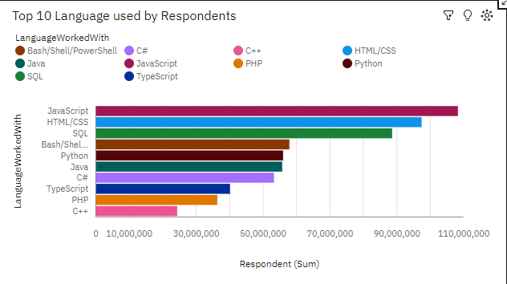
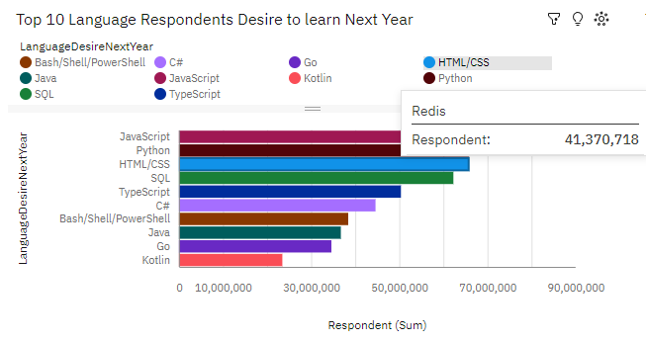
PROGRAMMING LANGUAGE TRENDS
Current Year
Next Year

Slide 8
PROGRAMMING LANGUAGE TRENDS - FINDINGS & IMPLICATIONS
Findings
Web programming languages like JavaScript, HTML & CSS were very popular in 2019 they are also predicted to be popular in 2020.
Python which was the 5th popular language in 2019 was predicted to be 2nd most popular in 2020.
Implications
Web Development is the dominant field in IT market and will continue to be so for the near future.
The expected rise of python seem to indicate the rise of Data Science & Analytics field.

Slide 9
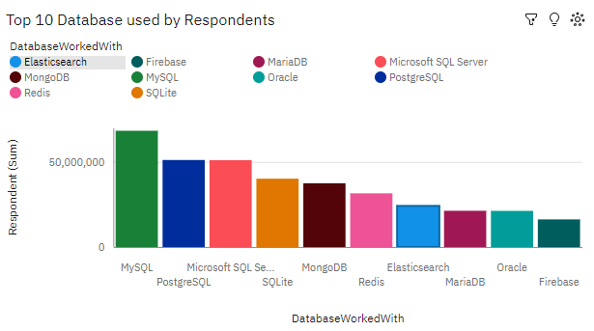
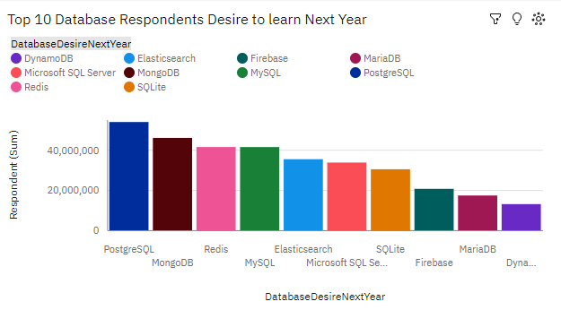
DATABASE TRENDS
Current Year
Next Year

Slide 10
DATABASE TRENDS - FINDINGS & IMPLICATIONS
Findings
The NoSQL databases like MongoDB and Firebase was predicted to have a significant rise in popularity in the short period between 2019 to 2020.
Relational Databases was the market leader is 2019 and was expected to remain so in 2020 too.
Implications
This may be due the expected rise of the web development and data science industries which both need a scalable data base to handle the large volume of data and traffic that would expected with the growth of those fields.
Relational Databases are still a solid technology and would be widely used in both web development and data science.

Slide 11

DASHBOARD
https://ap2.ca.analytics.ibm.com/bi/?perspective=dashboard&pathRef=.my_folders%2FIt-Job-Market-Analysis%2FIt-JobMarket-Analysis-Dashboard&action=view&mode=dashboard&subView=model0000018c8850ad4f_00000000
This link is not likely to work. The Dashboard was to be shared using IBM Cloud Pak for Data but it needed credit card details which I didn’t have.

Slide 12
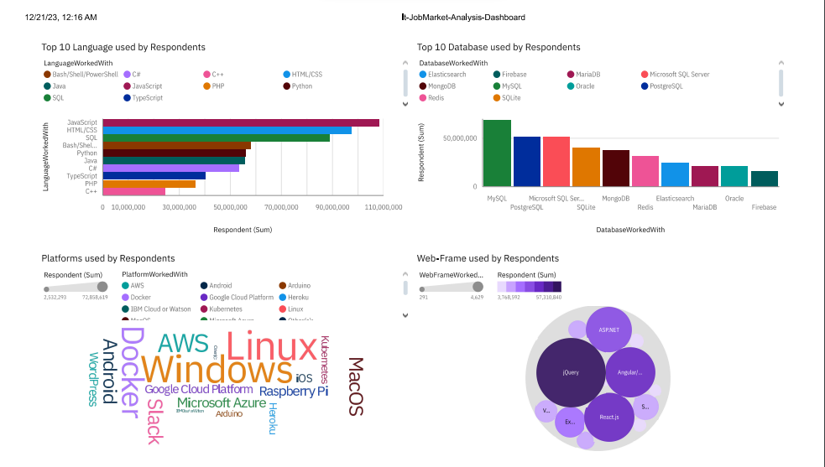
DASHBOARD TAB 1

Slide 13
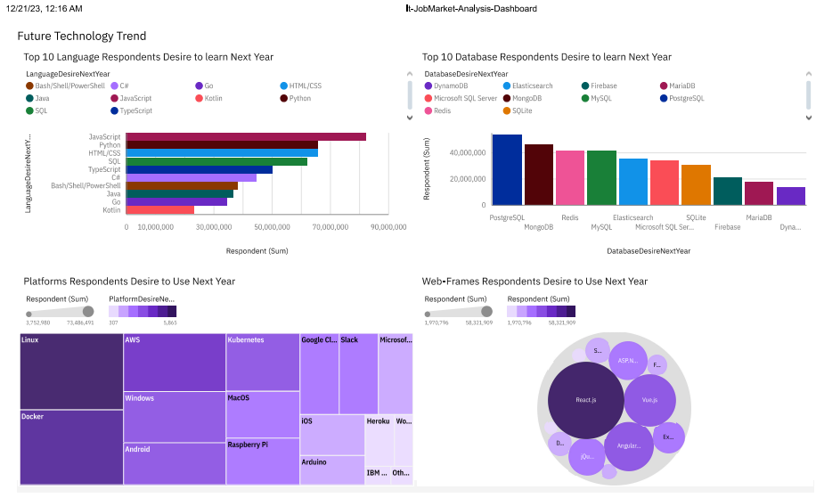
DASHBOARD TAB 2

Slide 14
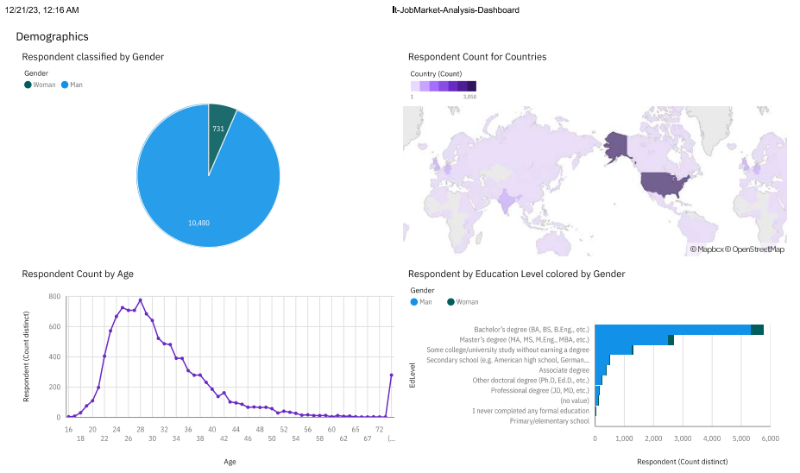
DASHBOARD TAB 3

Slide 15
DISCUSSION
Popularity of Platforms used in Servers like Linux & Docker are expected to rise due to the expected growth of the Web Development Industry.
Web frameworks like React.js, Vue.js and Angular.js are also expected to rise due to similar reasons.
The majority of worker in IT industry seem to be Male.
Most workers in the IT industry seem to have a Bachelor’s Degree.

Slide 16
OVERALL FINDINGS & IMPLICATIONS
Findings
Annual Salary has a positive relation with age.
Time spent on code review has a negative relation with age.
Web programming languages like JavaScript, HTML & CSS were very popular in 2019 they are also predicted to be popular in 2020.
Python which was the 5th popular language in 2019 was predicted to be 2nd most popular in 2020.
Implications
Annual Salary increases with experience.
As one becomes more experienced they do less mistakes resulting in less time spent on reviewing code.
Web Development is the dominant field in IT market and will continue to be so for the near future.
The expected rise of python seem to indicate the rise of Data Science & Analytics field.

Slide 17
Findings
The NoSQL databases like MongoDB and Firebase was predicted to have a significant rise in popularity in the short period between 2019 to 2020.
Relational Databases was the market leader is 2019 and was expected to remain so in 2020 too.
Linux and Docker were expected to be more popular than Windows moving from 2019 to 2020.
React.js, Vue.js and Angular.js were expected to overtake jQuery as the most popular framework.
Only 6.5% of the survey respondents were female, the remaining 93.5% were male.
Most respondents had a Bachelor’s degree.
Implications
This may be due the expected rise of the web development and data science industries which both need a scalable data base to handle the large volume of data and traffic that would expected with the growth of those fields.
Relational Databases are still a solid technology and would be widely used in both web development and data science.
Popularity of Platforms used in Servers like Linux & Docker are expected to rise due to the expected growth of the Web Development Industry.
Web frameworks like React.js, Vue.js and Angular.js are also expected to rise due to similar reasons.
The majority of worker in IT industry seem to be Male.
Most workers in the IT industry seem to have a Bachelor’s Degree.

Slide 18

CONCLUSION
Web Development and Data Science Industries are expected to rise in popularity.
Annual pay and age has positive relation where as time spent on code review and age are negatively related. This makes sense as people with more experience have less mistakes and are paid more.
Most people in the IT field are men and have a bachelor’s degree.

Slide 19

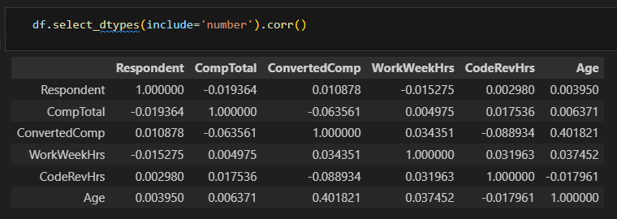
APPENDIX
Correlation Between Variables

Slide 20
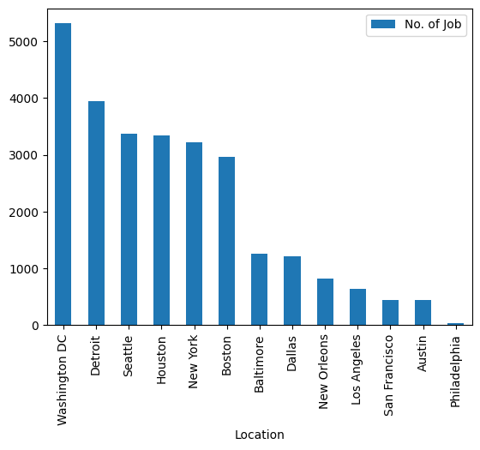
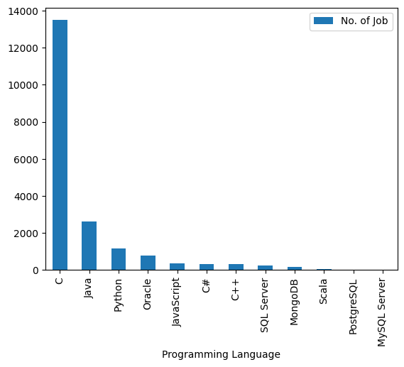
JOB POSTINGS

Slide 21
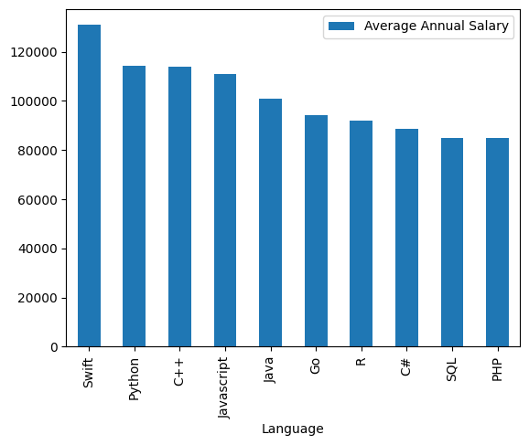
POPULAR LANGUAGES

