Slide 1

Methods
Chapter 8

Slide 2
Objectives
Students should:
Be able to define new methods and use them correctly.
Understand the process of method invocation.
Chapter 8
Notes:
คุ้นเคยกับองค์ประกอบของระบบคอมพิวเตอร์และหน้าที่ของมัน
เพื่อให้ได้แนวคิดเกี่ยวกับการแก้ปัญหาโดยการทำโปรแกรมคอมพิวเตอร์

Slide 3
The problems
Source Code
?
Hard-to-understand
Redundant
hard to get it right
less productive to debug
unmaintainable

Slide 4
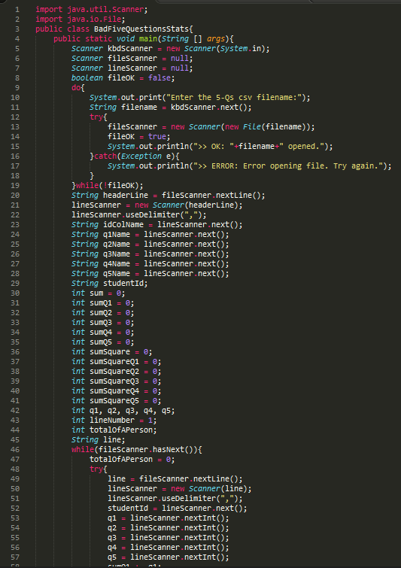
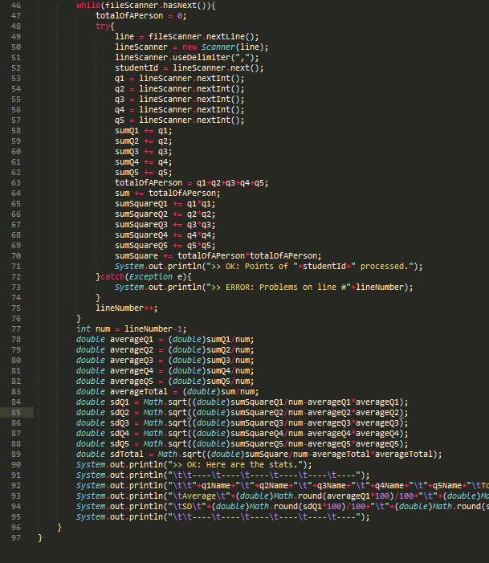
This program lets the user pick
a CSV file containing student’s
exam scores, finds related stats,
and print the results out.

Slide 5
Better?
public static void main(String [] args){
Scanner fileScanner = getFilenameAndtryOpenFile();
calculateAndShowStats(fileScanner);
}
This program lets the user pick
a CSV file containing student’s
exam scores, finds related stats,
and print the results out.
(Hands-on Exp # 6)

Slide 6
Factorize source code
to several subprograms
for better readability
Subprogram 1
Subprogram 2
Subprogram 3

Slide 7
Reuse the source code
for repeating algorithms
Subprogram 1
Subprogram 2
Subprogram 2
Similar

Slide 8

Example
Compute f(x,n) for x = 1.5, 2.5, 3.5, and 4.5 where n = 3.
MethodDemo1.java
MethodDemo2.java
Notes:
Demo2: call function 4 times (repeating code)
public static void main(String[] args)
{
double x1,x2,x3,x4;
x1 = 1.5;
System.out.println(f(x1,3));
x2 = 2.5;
System.out.println(f(x2,3));
x3 = 3.5;
System.out.println(f(x3,3));
x4 = 4.5;
System.out.println(f(x4,3));
}

Slide 9
Subprograms in OOP
YourProgram
Subprograms are provided
in Java as “Static methods”
defined in your program.
static main()
static method1()
static method2()
static method3()
Java calls this method to start
executing your program
These methods can be called in
your programs (or in others)
Notes:
Static method can be called in your program “without creating any object”.
For example, comparing to MyRobo
MyRobo robo1 = new MyRobo(“Toon”);
robo1.walk();

Slide 10
Defining New Methods
What to do with the each input in the argument list.
2
Input
a method
Output
1
What the input argument list must be.
3
What the (type of) output will be like.
Notes:
To create a method, there are 3 things to think of:
Inputs (arguments)
What to do?
Output

Slide 11
Defining a Method
Method header
syntax
public static [Return Type] [Method Name](Argument List){
[Method Body]
}
Method body

Slide 12

Public and static
public and static
are Java keywords.
public identifies that this method can be used by any classes.
static identifies that this method is a class method (static method).
We are writing “Static” methods
to be used by anyone.
Notes:
Public = this method can be used by any classes.
Static = this method is a class method (belong to class)
Math.pow()

Slide 13

Return Type
The data type expected to be returned by the method.
When a method
returns something
When a method
is NOT designed
to return a value
The return type is the
data type
of the expression invoking
the method.
only
void
ONE
keyword
value
is used as the return type
can be returned.

Slide 14
Method Name
methodName
be replaced with the name (identifier) you give for the method.
Java naming rules apply to the naming of methods as well as other identifiers.
Recommendations for Method Naming
Choose meaningful name
Start with an “action” (Verb)
Do not capitalize the first letter
Eg.
getUserInput()
killTheDrone()
launch()
doItAgain()
Notes:
Method is “action”, so the name should be “verb”
The method name starts with “lower letter” similar to “variable name”; however,
Variable name is “noun”
While, method name is “verb”

Slide 15
Input Argument List
syntax
(Type1 arg1, Type2 arg2, … , TypeN argsN)
consisting of parameters expected to be input to the method.
When the method does not need any input parameters, do not put anything in the parentheses.
Notes:
Input arguments are separated by “comma”

Slide 16
Method Signature
Method Name
Method
+
Signature
Types in
Argument List
[Method Name]( Type1 , Type2 , … , TypeN)
Notes:
Method signature = “method name” + “input arguments”

Slide 17
Method Body
Method Body
is the list of statements to be executed once the method is called.
The body of the method might contain return statements
the keyword return is placed in front of the value wished to be returned to the caller of the method.
the value returned is of the same type as, or can be automatically converted to, what is declared as Return Type in the method header.
Notes:
“Method body” is “what is inside the parentheses”. It is the list of statements to be executed.
Return = it is a command that is placed in front of “the output value” from the method.
The type of return variable must be similar to the type of method!!!

Slide 18
Return statements
Return statements
mark terminating points of the method.
Whenever a return statement is reached
the program flow is passed from the method back to the caller of the method.
If there is nothing to be returned
i.e. Return Type is void
the keyword return cannot be followed by any value.
the program flow is still passed back to the caller but there is no returned value.
Notes:
Return is a terminating point or where the method is “ended”.
If there is nothing to be returned, the method type is “void”.
It is just an action without any return value.

Slide 19
Return type
Method name
public static double f(double x, int n){
double y = 0;
for(int i=1;i<=n;i++){
y += i*Math.pow(x,i);
}
return y;
}
Argument list
Method body
Method Signature
f( double , int )

Slide 20
Examples of method definition
public static boolean isOdd(int n){
return (n%2 != 0)? true : false;
}
public static int unicodeOf(char c){
return (int)c;
}
Notes:
isOdd → checking whether or not the input number is “odd”
unicodeOf → return the ascii code of a character

Slide 21
Examples of method definition
public static
String longer(String s1, String s2){
return ((s1.length() > s2.length())?s1:s2);
}
public static int factorial(int n){
int nFact = 1;
for(int i=1;i<=n;i++){
nFact *= i;
}
return nFact;
}
Notes:
Longer → returns the longer string
Factorial → return the factorial of n (1 * 2 * 3 * … * n)

Slide 22
Examples of method definition
public static void printGreetings(String name){
System.out.println("Hello "+name);
System.out.println("Welcome to ISE mail system.");
System.out.println("---------------------------");
}
Notes:
printGreetings → there is no return value, so the method type is “void”. It is just an action to print the greetings

Slide 23
Scopes of Variables
Variables declared in the
argument list
inside the method
are only available to the method and destroyed once the method is terminated.
Variables declared
in a method are
Local
to that method.

Slide 24
Scopes of Variables
x is declared in a block of code (surrounded by {} ).
x is only available inside the block (including block nested deeper) after it is declared.
{
int x = 0;
:
:
{
:
:
}
}
x is not known
x is known
Notes:
Normally, the variable can be seen only “within its parenthesis block”

Slide 25
Cannot Find Symbol !?!
public class ScopeError
{
public static void main(String[] args)
{
int x=0, y=0, z;
z = f(x,y);
System.out.println("myMultiplier = "+myMultiplier);
System.out.println("z="+z);
}
public static int f(int a, int b)
{
int myMultiplier = 256;
return myMultiplier*(a+b);
}
}
Notes:
Compile error!!!!
Where is the variable “myMultiplier” declared?

Slide 26
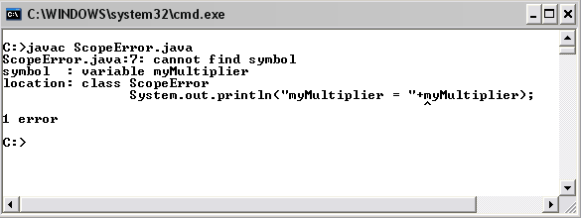
Cannot Find Symbol !?!

Slide 27
Method Invocation Mechanism
public class MethodInvokeDemo 1
{ 2
public static void main(String[] args) 3
{ 4
double x = 6.0, y = 8.0, z; 5
z = f(x,y,2); 6
System.out.println(z); 7
} 8
public static double f(double a,double b, int n) 9
{ 10
double an = Math.pow(a,n); 11
double bn = Math.pow(b,n); 12
return Math.pow(an+bn,1.0/n); 13
} 14
} 15
Notes:
The number in the last column is a line number
There is a method “f”
*** Note that the program always starts from “the main method”
*** Also, the program ends when “the main method” is finished”

Slide 28
Method Invocation Mechanism
main()
public class MethodInvokeDemo 1
{ 2
public static void main(String[] args) 3
{ 4
double x = 6.0, y = 8.0, z; 5
z = f(x,y,2); 6
System.out.println(z); 7
} 8
public static double f(double a,double b, int n) 9
{ 10
double an = Math.pow(a,n); 11
double bn = Math.pow(b,n); 12
return Math.pow(an+bn,1.0/n); 13
} 14
} 15
x
6.0
y
8.0
z
-

Slide 29
Method Invocation Mechanism
main()
public class MethodInvokeDemo 1
{ 2
public static void main(String[] args) 3
{ 4
double x = 6.0, y = 8.0, z; 5
z = f(x,y,2); 6
System.out.println(z); 7
} 8
public static double f(double a,double b, int n) 9
{ 10
double an = Math.pow(a,n); 11
double bn = Math.pow(b,n); 12
return Math.pow(an+bn,1.0/n); 13
} 14
} 15
x
6.0
y
8.0
z
-
copy
f()
a
6.0
b
8.0
n
2

Slide 30
Method Invocation Mechanism
main()
public class MethodInvokeDemo 1
{ 2
public static void main(String[] args) 3
{ 4
double x = 6.0, y = 8.0, z; 5
z = f(x,y,2); 6
System.out.println(z); 7
} 8
public static double f(double a,double b, int n) 9
{ 10
double an = Math.pow(a,n); 11
double bn = Math.pow(b,n); 12
return Math.pow(an+bn,1.0/n); 13
} 14
} 15
x
6.0
y
8.0
z
-
f()
a
6.0
b
8.0
n
2
an
36.0
bn
64.0
Notes:
We call this process as “pass by value”

Slide 31
Method Invocation Mechanism
main()
public class MethodInvokeDemo 1
{ 2
public static void main(String[] args) 3
{ 4
double x = 6.0, y = 8.0, z; 5
z = f(x,y,2); 6
System.out.println(z); 7
} 8
public static double f(double a,double b, int n) 9
{ 10
double an = Math.pow(a,n); 11
double bn = Math.pow(b,n); 12
return Math.pow(an+bn,1.0/n); 13
} 14
} 15
x
6.0
y
8.0
z
-
f()
a
6.0
b
8.0
n
2
an
36.0
bn
64.0
10.0

Slide 32
Method Invocation Mechanism
main()
public class MethodInvokeDemo 1
{ 2
public static void main(String[] args) 3
{ 4
double x = 6.0, y = 8.0, z; 5
z = f(x,y,2); 6
System.out.println(z); 7
} 8
public static double f(double a,double b, int n) 9
{ 10
double an = Math.pow(a,n); 11
double bn = Math.pow(b,n); 12
return Math.pow(an+bn,1.0/n); 13
} 14
} 15
x
6.0
y
8.0
z
10.0
copy
f()
a
6.0
b
8.0
n
2
an
36.0
bn
64.0
10.0

Slide 33
Method Invocation Mechanism
main()
public class MethodInvokeDemo 1
{ 2
public static void main(String[] args) 3
{ 4
double x = 6.0, y = 8.0, z; 5
z = f(x,y,2); 6
System.out.println(z); 7
} 8
public static double f(double a,double b, int n) 9
{ 10
double an = Math.pow(a,n); 11
double bn = Math.pow(b,n); 12
return Math.pow(an+bn,1.0/n); 13
} 14
} 15
x
6.0
y
8.0
z
10.0
f()
destroyed
a
6.0
b
8.0
n
2
an
36.0
bn
64.0
10.0

Slide 34
Example
public static void main(String[] args){
int x=1,y=1,w;
w = add(x,y);
System.out.println(x+“,”+y);
}
public static int add(int x,int y){
int z = x + y;
x = 0;
y = 0;
return z;
}
What is the output?
(0,0)
(1,1)
Notes:
>> MethodInvokeDemo2.java
The output is B (1,1)

Slide 35
Method Overloading
Method overloading
Different methods can have the same name as long as their argument lists are different.
Why is it useful?
It is useful when we need methods that perform similar tasks but with different argument lists
i.e. argument lists with different numbers or types of parameters.
Different method signatures
Notes:
Method overloading is the concept that there can be more than one method with “the same method name but different method signature”
This means that they have “different method arguments”

Slide 36
Method Overloading(2)
How Java know which method to be called?
comparing the number and types of input parameters with the argument list of each method definition.
Note that methods are overloaded based on the difference in the argument list, not their return types.
Notes:
Is it ok to have “two overloading methods with the same signature” but different return type?

Slide 37
Method Overloading
public class OverloadingDemo 1
{ 2
public static void main(String[] args) 3
{ 4
System.out.println(numericAdd(1,2)); 5
System.out.println(numericAdd(1,2,3)); 6
System.out.println(numericAdd(1.5,2.5)); 7
System.out.println(numericAdd(1.5,2.5,3.5)); 8
System.out.println(numericAdd('1','2')); 9
} 10
Notes:
OverloadingDemo.java
There are 5 overloading methods. They have different method signatures!!!!

Slide 38
Method Overloading
public static int numericAdd(int x,int y) 12
{ 13
return x + y; 14
} 15
public static double numericAdd(double x, double y) 16
{ 17
return x + y; 18
} 19
public static int numericAdd(int x, int y, int z) 20
{ 21
return x + y + z; 22
} 23
Signature
numericAdd(int,int)
Signature
numericAdd(double,double)
Signature
numericAdd(int,int,int)

Slide 39
Method Overloading
public static double numericAdd
(double x,double y, double z) 24
{ 25
return x + y + z; 26
} 27
public static int numericAdd(char x, char y) 28
{
int xInt = x - '0'; 29
int yInt = y - '0'; 30
return xInt+yInt; 31
} 32
Signature
numericAdd(double,double,double)
Signature
numericAdd(char,char)

Slide 40
Wrong Method Overloading
public static void f(int x, int y){
…
};
public static void f(int a, int b){
…
};
Signature
f ( int , int )
Notes:
Same method signatures!!!!

Slide 41
Wrong Method Overloading
public static void f(int x, int y){
…
};
public static int f(int x, int y){
…
};
Signature
f ( int , int )
Notes:
Still the same method signature although they have different “return types”

Slide 42
Automatic Type Conversion
A
Signature
h( int , int )
B
Which one will be called
if the statement
h(1,1.0)
is executed?
Signature
h( double , double )
Notes:
OverloadingDemo2.java
Answer:
h(double, double)
Step1: look for h( int, double ) first
Step2: If cannot find, It try to convert “int to double” → h( double, double )
----
OverloadingDemo3.java
It works only “upcasting” (int → double), but doesn’t work with “downcasting” (double → int)
g(1.0, 1.0) CANNOT be called by g( int, int)
g(1, 1)
It can be called by g( double, double )
There is still error since g(1, 1) can be called by MANY METHODS: g(int, double), g(double, int), g(double, double)

