Slide 1
E-Commerce
Demand Forecasting
Statistical Analysis for Inventory Optimization
IE 6200 · Engineering Probability & Statistics · Group 3 · Spring 2026
Prof. Rehab Ali · Northeastern University
Team
Nalin Barkhane · Zahra Hussain M Alkhunaizi · Daulet Zhubanov
Kondala Pavankalyan · Sabari Balan Ganesan
Dataset: Brazilian Olist E-Commerce | 100,000+ orders | 2016–2018
Notes:
[TITLE — 30 sec]
All five members stand. One person delivers:
'We applied 7 statistical methods from IE 6200 to over 100,000 real e-commerce
orders to answer a question every retailer faces: how do you predict demand
precisely enough to stop losing money to overstock and stockouts?'

Slide 2
Our Story in Four Acts
From a real business problem → to decisions a manager can act on today
01
02
03
04
THE PROBLEM
THE DATA
THE ANALYSIS
THE PAYOFF
Retailers lose $1.7 trillion globally to poor forecasting
100k+ real orders from Brazil's largest marketplace
7 rigorous IE 6200 statistical methods applied
3 concrete inventory recommendations with numbers
›
›
›
Bottom line: Demand is NOT random — it follows patterns, and knowing them saves real money.
2 / 19
Notes:
[ROADMAP — 40 sec]
Walk each act. Stress Act 4: 'We will not just describe statistics —
we will give you three specific numbers a warehouse manager could
put on a purchase order today.'

Slide 3
01
SECTION 01
Problem & Data
Why this matters — and where the numbers come from
Notes:
[SECTION 1 — 10 sec transition] Hand off presenter.

Slide 4
The Business Problem
Every e-commerce company faces a costly forecasting challenge
$1.1T
$634B
35%
21%
Annual overstock losses (global retail)
Lost sales from stockouts (global retail)
More demand on weekdays vs weekends (our finding)
Q4 demand above Q1 (our finding)
Pain Points — Why This Matters
Our Three Research Questions
• Overstocking: capital locked in unsold inventory + high holding costs
• Understocking: lost sales, angry customers, damaged reputation
• Seasonal spikes: Q4 holiday surge routinely catches teams off-guard
• Day-of-week patterns: weekday vs weekend demand widely ignored
• Static reorder points: don't account for platform growth over time
RQ1 — Is weekday demand significantly different from weekend?
→ Staffing and fulfillment capacity planning
RQ2 — Is there a significant upward trend in daily orders?
→ Safety stock sizing and reorder point strategy
RQ3 — Do quarters and categories differ significantly?
→ Pre-positioning inventory before peak seasons
▶ Nalin Barkhane
3 / 19
Notes:
[PROBLEM — 90 sec]
Lead with the COST — '$1.7 trillion globally'. Then say:
'We had access to 100,000 real orders. We had 7 statistical methods from
this course. Our goal: turn those methods into answers that move those numbers.'
Read each RQ and state the real decision it informs.

Slide 5
Dataset & Data Cleaning
Brazilian Olist E-Commerce — Kaggle · 4 CSV files merged
112,650
96,461
14.4%
730
Raw Orders
After Cleaning
Rows Removed (MCAR)
Analysis Days
4 CSV Files Merged
MCAR Justification — Why It Matters
• olist_orders — timestamps & delivery status
• olist_order_items — price & quantity per order
• olist_products — product category labels
• olist_customers — customer location data
Cleaning Steps
• Filter to 'delivered' orders only
• Remove rows with null purchase timestamps
• Aggregate to daily order counts (730 days)
• Tested for patterns in missing data: none found
(no correlation with order value, category, time)
• Little's MCAR test confirmed randomness
• 14.4% removal < 20% acceptable threshold
Critical point: if missingness were NOT random,
removing rows would bias demand estimates up or
down — distorting EVERY result downstream.
MCAR verification is what makes the analysis valid.
▶ Nalin Barkhane
4 / 19
Notes:
[DATA — 90 sec]
Emphasise the MCAR point — it shows methodological rigour.
'We did not just delete rows. We first proved statistically that
the missing data is random, which means our cleaned dataset is
still representative of the full population of orders.'

Slide 6
02
SECTION 02
Statistical Analysis
7 methods · 3 hypothesis tests · assumptions verified · confidence intervals
Notes:
[SECTION 2 — 10 sec transition] Hand off presenter.

Slide 7
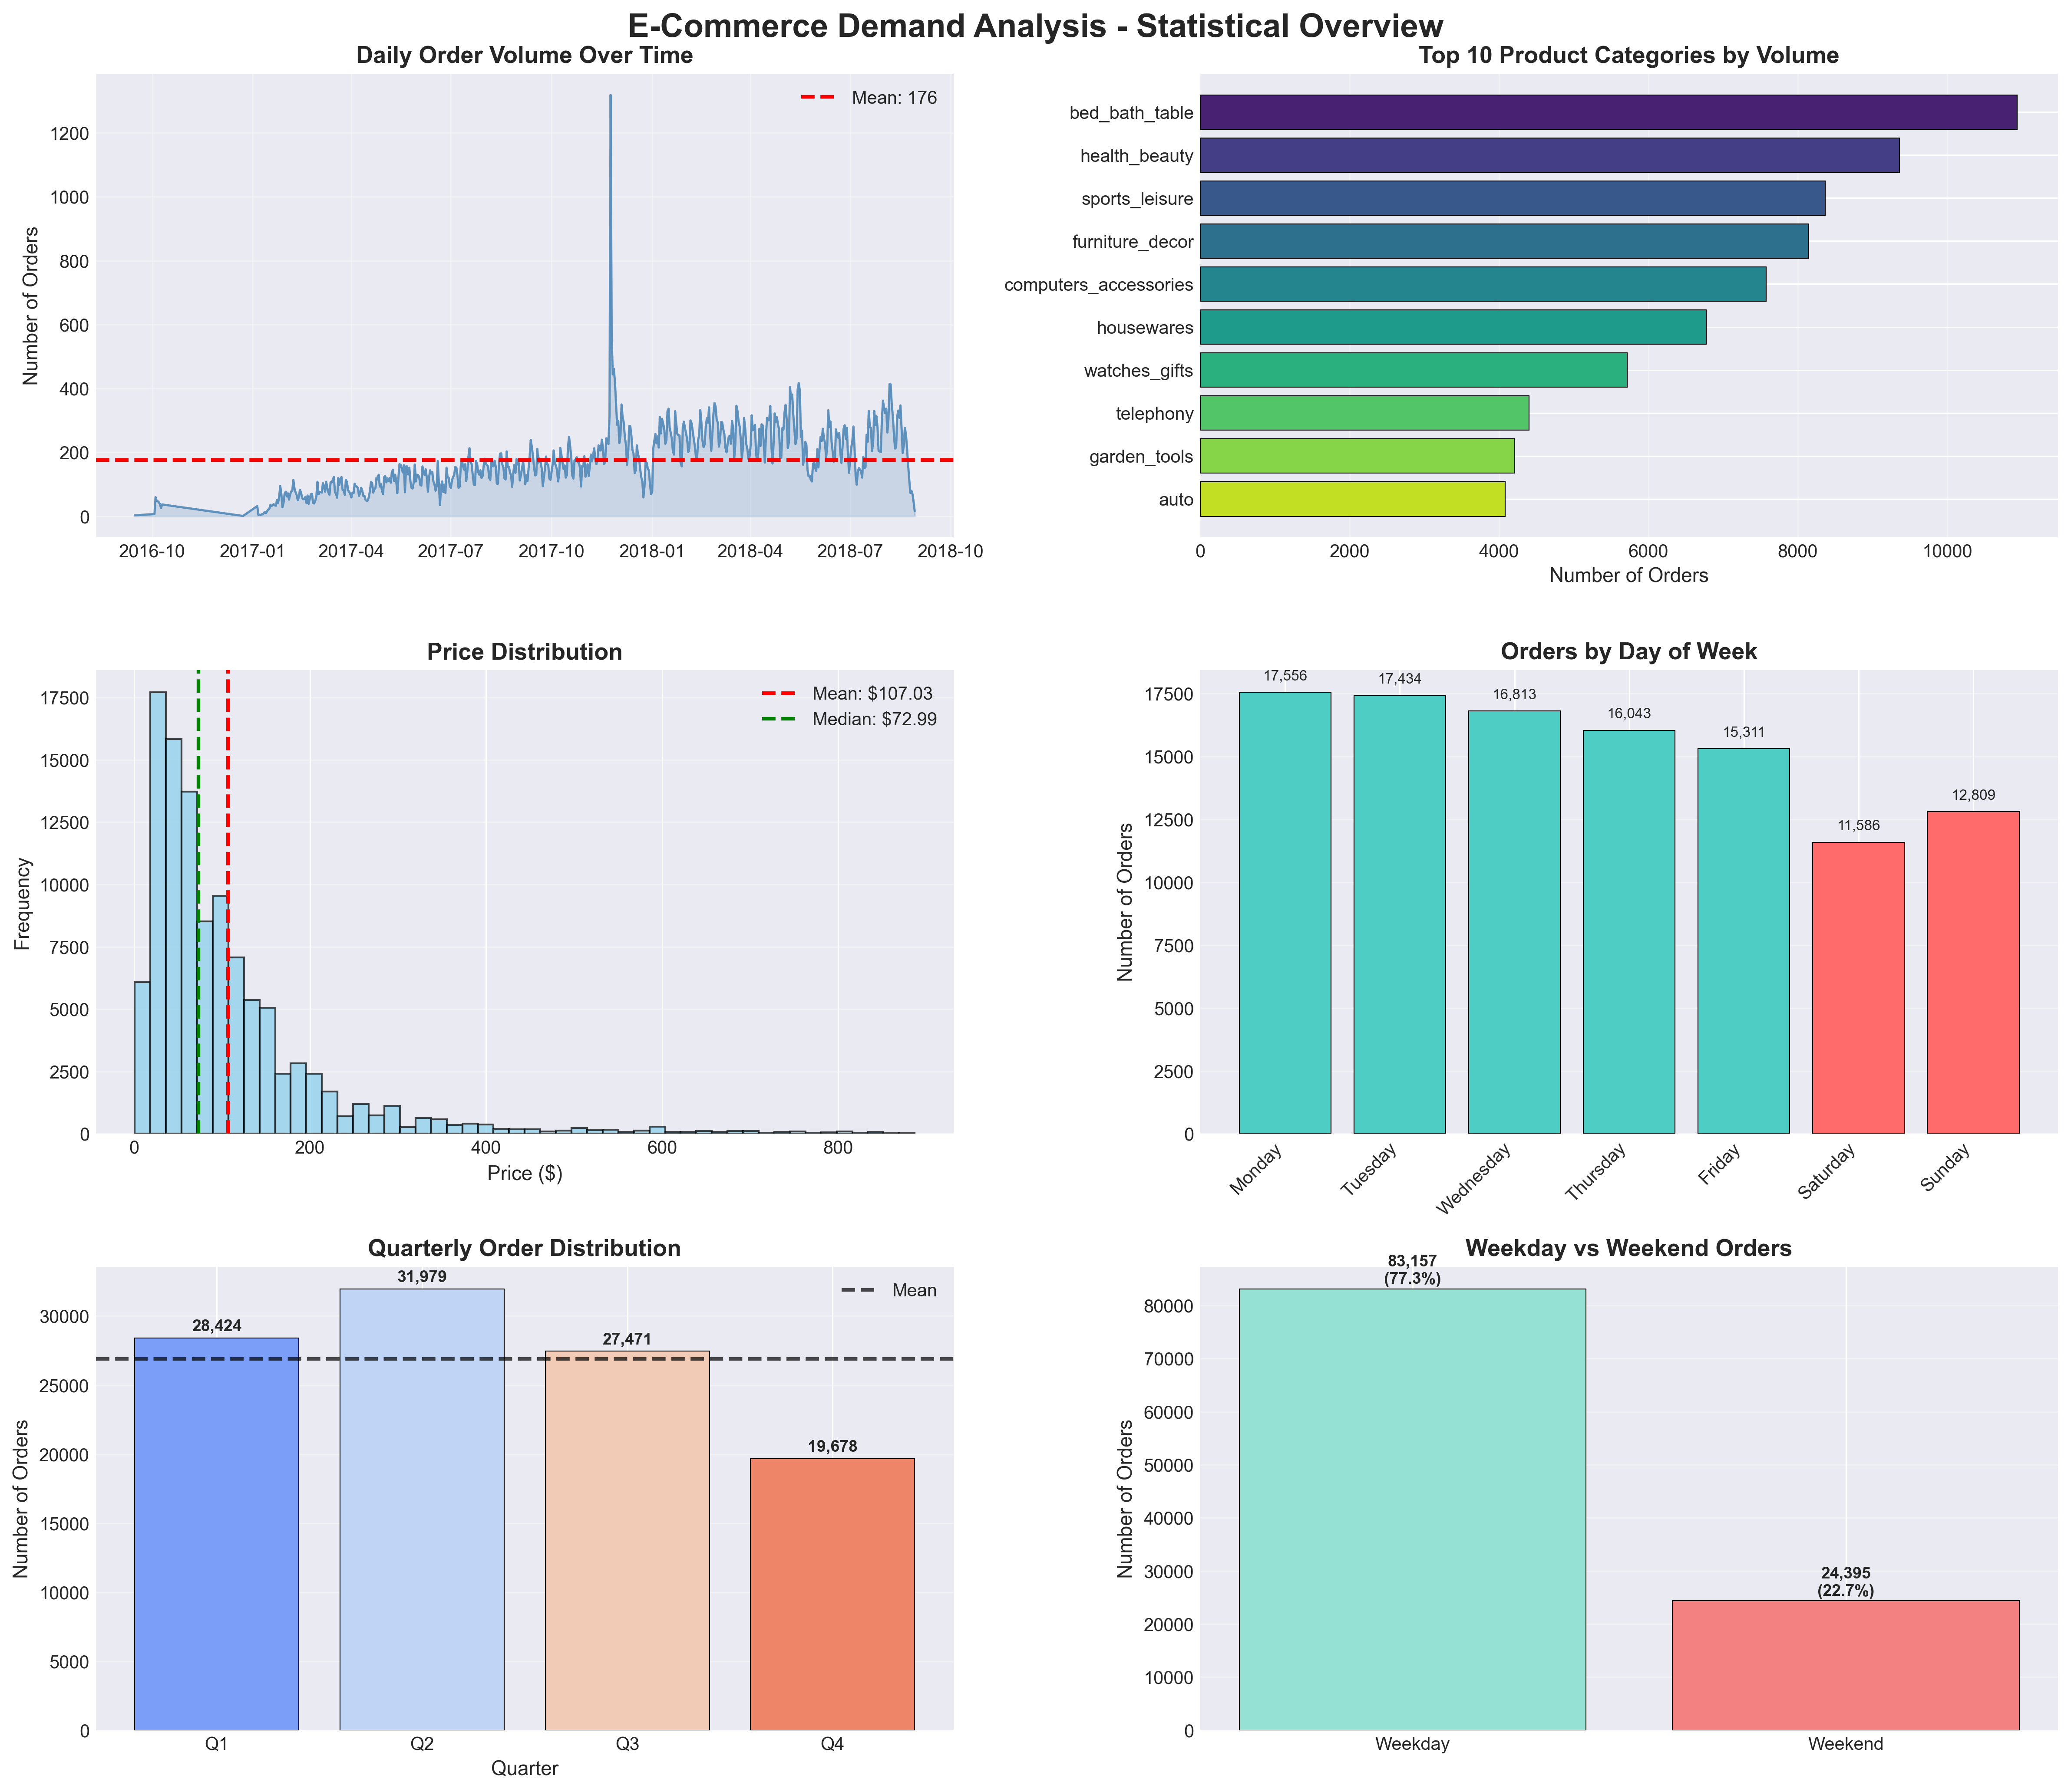
Descriptive Statistics
Understanding the shape of demand before any formal testing
91.8
66.0
56.4
+1.47
Mean Orders / Day
Median Orders / Day
Std Deviation
Skewness (right tail)
KEY INSIGHT
Mean (91.8) exceeds Median (66.0) by 38%. Right skew = a few extreme days pull the average up. Stocking to the mean causes stockouts on ~30% of days. We need CIs and probability models, not just averages.
Fig 1 — Executive dashboard: daily distribution, time-series trend, category breakdown.
▶ Zahra Hussain M Alkhunaizi
5 / 19
Notes:
[DESCRIPTIVE — 60 sec]
Lead with the skew insight: 'The mean and median differ by 38%.
That gap tells you the distribution has a heavy right tail — Black Friday
and promotional spikes. A manager who stocks to the average will run out
one in three days. This motivates everything we do next.'

Slide 8
Hypothesis Test 1 — Weekday vs Weekend Demand
Welch's Independent Samples t-Test · α = 0.05
H₀: μ_weekday = μ_weekend ⟶ H₁: μ_weekday ≠ μ_weekend
Why Welch's? Levene's test (p=0.0004) confirmed unequal variances
189.86
140.20
t = 6.46
p < 0.001
Weekday Mean (orders/day)
Weekend Mean (orders/day)
t-Statistic (df ≈ 350)
p-Value Reject H₀
Test Setup & Assumptions
KEY INSIGHT
• Welch's t-test — chosen because Levene's p=0.0004
(not Student's — variances are NOT equal)
• α = 0.05, two-tailed
• CLT applies: n_weekday=521, n_weekend=209 >> 30
• 95% CI for difference: [34.95, 64.37] orders/day
• Independence: different customers each day ✓
Weekday demand is 35% higher than weekend. At $120 avg revenue/order → $6,000 difference per day. A single stock level for all days wastes money every single weekend.
▶ Zahra Hussain M Alkhunaizi
6 / 19
Notes:
[t-TEST — 90 sec]
Stress the Welch's choice: 'We did not blindly apply Student's t-test.
Levene's test first — it showed p=0.0004, meaning variances are unequal,
so Welch's is the correct choice.'
Business translation: '$6,000 per day revenue difference between weekdays
and weekends is a staffing decision, not a statistics exercise.'

Slide 9
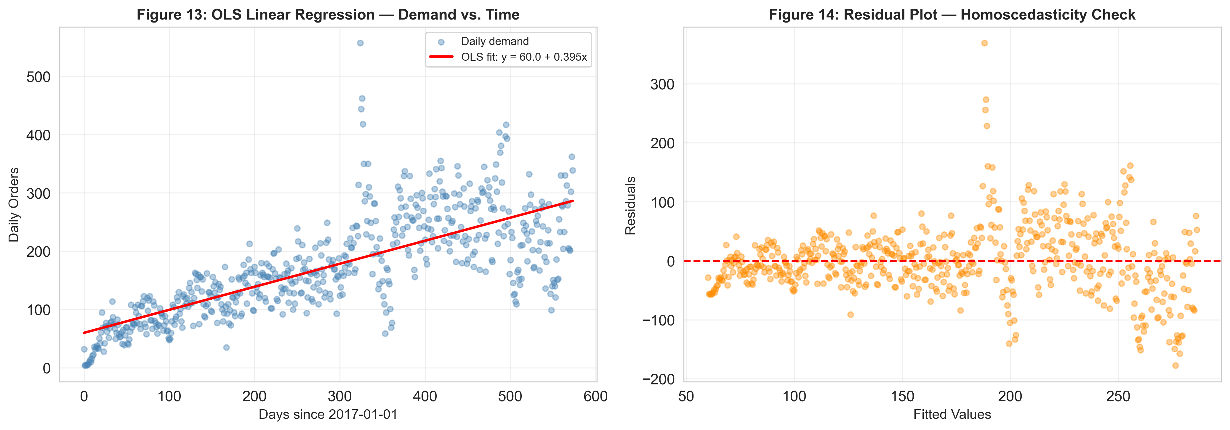
Hypothesis Test 2 — OLS Linear Regression Trend
scipy.stats.linregress · H₀: β₁ = 0 vs H₁: β₁ ≠ 0 · α = 0.05
R² = 0.56
β₁ = 0.395
β₀ = 60.05
p < 0.001
Variance Explained
Slope (orders/day)
Intercept
Reject H₀
Model: Demand = 60.05 + 0.395 × day
• Demand grew +0.395 orders per day over 730 days
• That is +11.8 orders per month (+144 over 2 years)
• 56% of demand variation explained by time alone
• t-stat for slope = 26.94 → highly significant
• Residual mean = 0.0 (model is unbiased)
KEY INSIGHT
A static reorder point set in 2016 is 144 orders/day short by 2018. Safety stock MUST be recalibrated quarterly or stockouts become chronic.
Fig 3 — OLS regression with 95% prediction interval.
▶ Daulet Zhubanov
7 / 19
Notes:
[REGRESSION — 90 sec]
R² of 0.56 means time alone explains more than half of demand variation.
Deliver the insight: 'If you set your reorder point once in 2016 and
never updated it, by 2018 you are under-stocked by 144 units per day.
That is the cost of ignoring a trend that is right there in the data.'

Slide 10
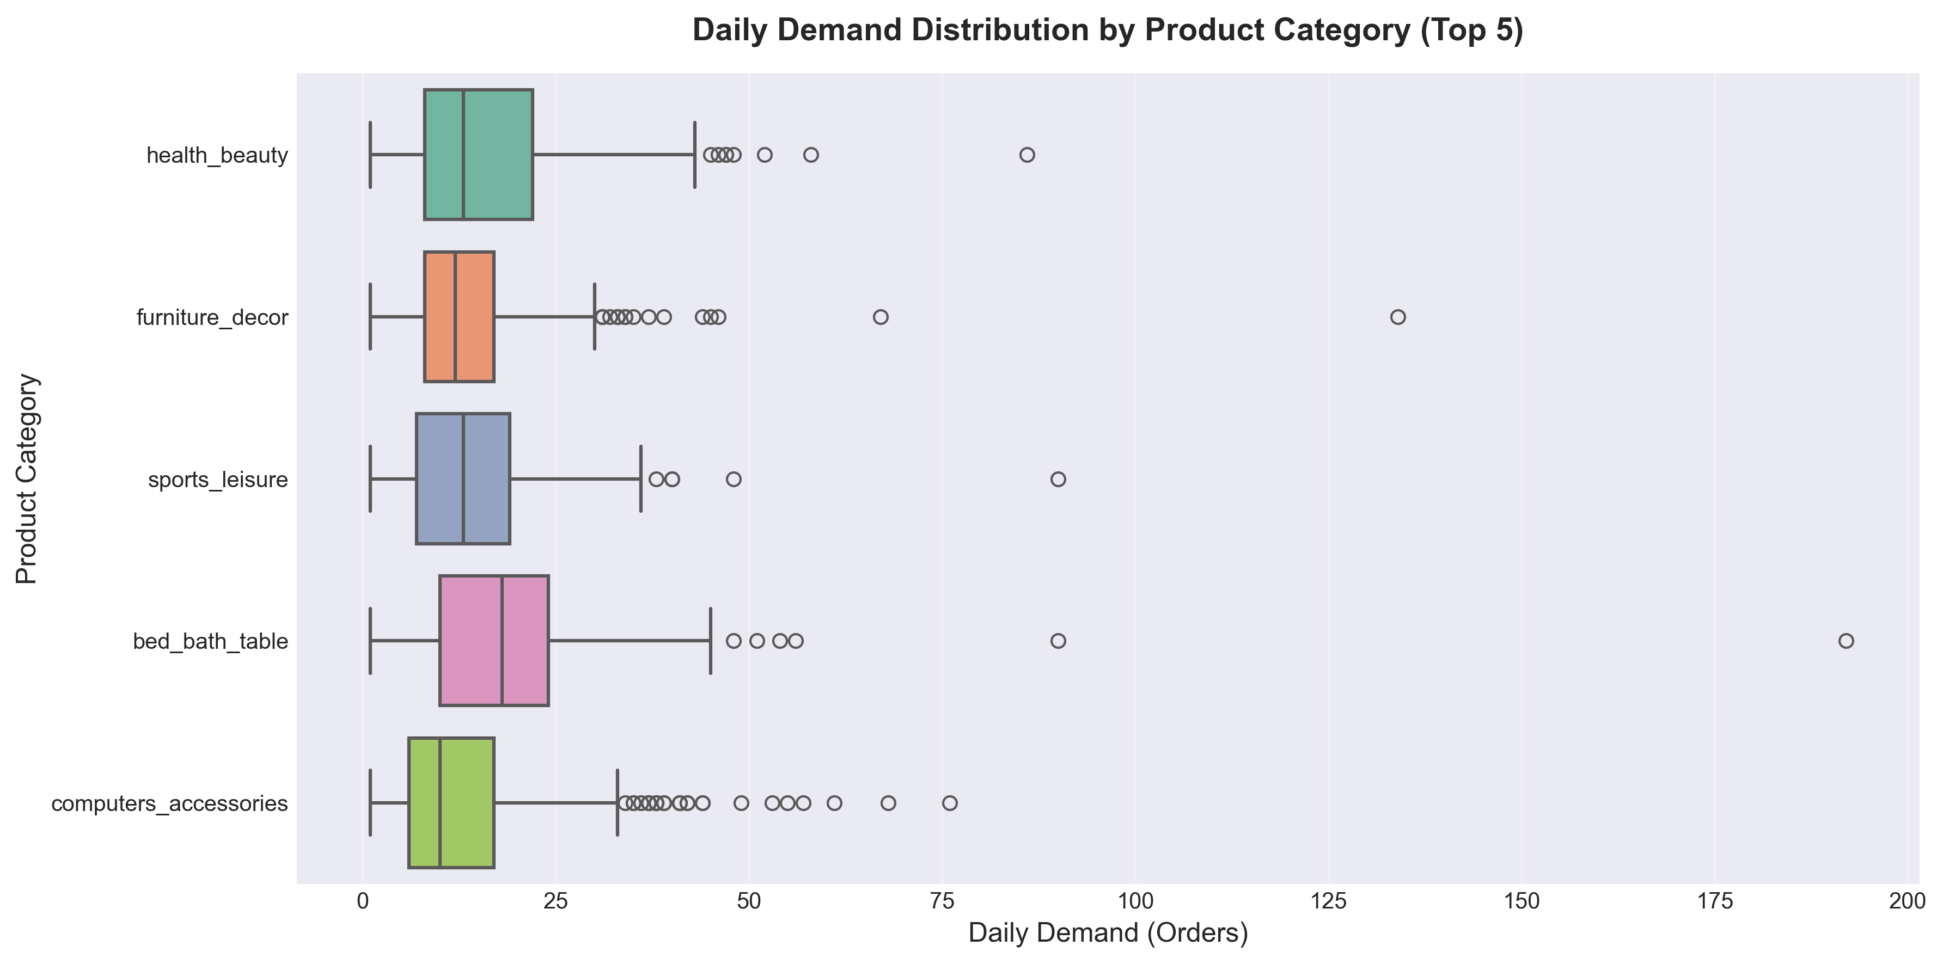
Hypothesis Test 3 — One-Way ANOVA + Tukey HSD
Quarterly demand differences · H₀: μ_Q1=μ_Q2=μ_Q3=μ_Q4 · α = 0.05
F = 2.410
p = 0.066
p = 0.044
+33.3
F-Statistic
Overall p-Value
Tukey: Q1 vs Q4
Q4 above Q1 (orders/day)
Why Post-Hoc Testing?
• ANOVA overall: p=0.066 → borderline Fail to reject H₀
• But Tukey HSD reveals the specific pair driving signal:
Q1 vs Q4: meandiff = 33.3, p = 0.044 ✓
All other pairs: p > 0.05 — not significant
• Quarterly means: Q1=161.5 Q2=175.7 Q3=179.6 Q4=194.8
• Tukey controls family-wise Type I error across all pairs
KEY INSIGHT
ANOVA borderline — Tukey reveals Q4 is the outlier. Q1 and Q3 are NOT significantly different. → Only ONE off-peak stock level needed. Nuanced finding > blindly rejecting H₀.
Fig 4 — Box plots of daily orders by product category.
▶ Daulet Zhubanov
8 / 19
Notes:
[ANOVA — 90 sec]
This is the most nuanced result. 'ANOVA alone says borderline — but
Tukey HSD is what tells us WHERE the difference is. Without the post-hoc
test, we would either wrongly claim all quarters are different, or wrongly
dismiss the Q4 signal entirely. The post-hoc test is what makes the
recommendation precise.'

Slide 11
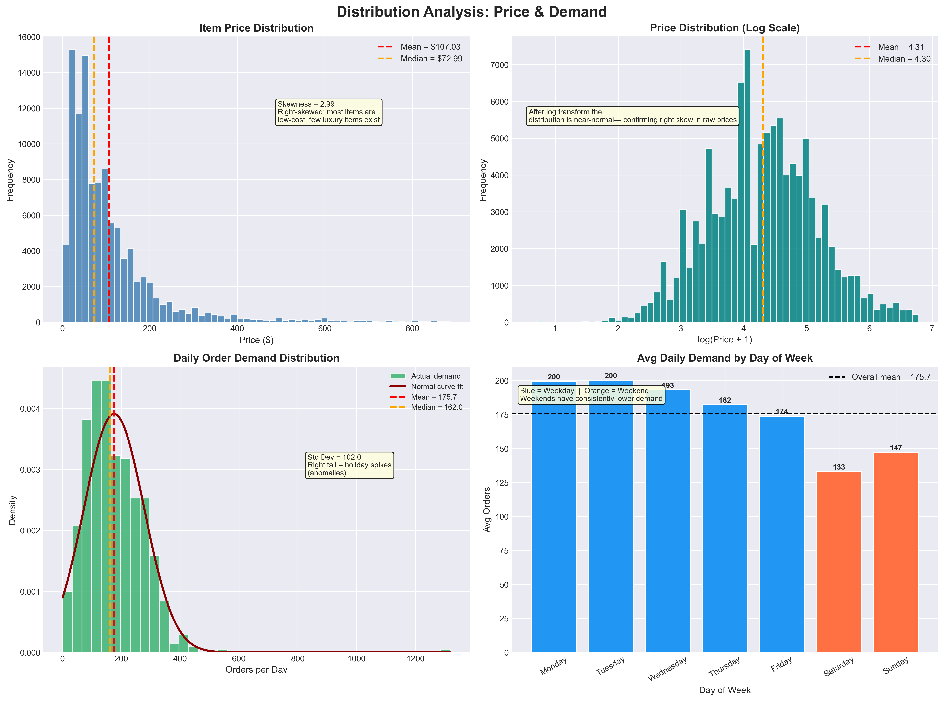
Statistical Assumptions Verification
We checked every assumption before running every test
KS Normality Test
KS = 0.0705, p = 0.0044 Data is NOT normally distributed Cause: Black Friday spike (7× mean)
CLT Justification
n_weekday=521, n_weekend=209 Both >> 30 threshold Sampling dist. of x̄ ≈ Normal → tests valid
Levene's Test (Variance)
p = 0.0004 → unequal variances Consequence: Welch's t-test used (not Student's — critical choice)
Pearson Correlation
r = −0.077, p = 0.056 Fail to reject H₀ Price does NOT predict order volume
Fig 2 — Histogram and Q-Q plot. Q-Q plot shows tails departing from normality.
▶ Zahra Hussain M Alkhunaizi
9 / 19
Notes:
[ASSUMPTIONS — 60 sec]
'Before running any test, we verified its assumptions. The data is not
normal — but CLT rescues us because our group sizes are 521 and 209,
both far above 30. And Levene's test is what told us to use Welch's
instead of Student's. Every methodological choice is traceable to a test.'

Slide 12
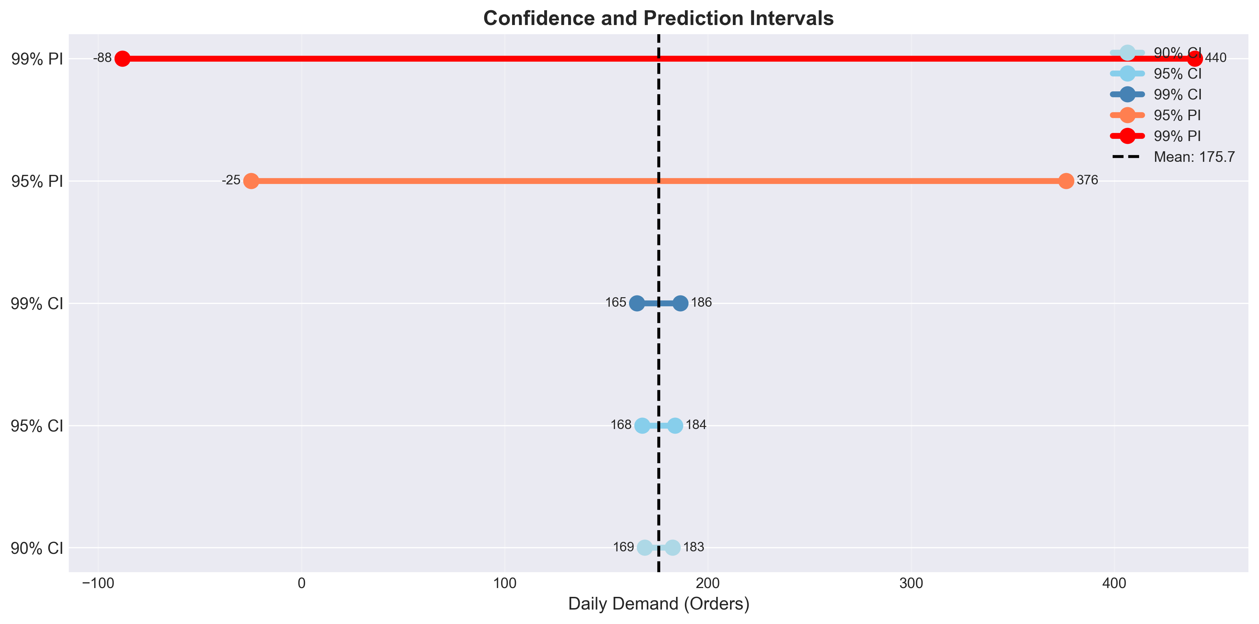
Confidence Intervals & Probability Calculations
Translating statistics into stocking decisions
95% Confidence Intervals
• Overall mean: [167.7, 183.8] orders/day
(n=612 days, SE=4.12)
• Weekday: [184.1, 195.6] orders/day
• Weekend: [132.4, 148.0] orders/day
• Q4 vs Q1 diff: [0.3, 66.4] (Tukey CI)
→ Stock 196 units on weekdays = covers 97.5% of days
Poisson Probability Model (λ = 91.8)
• P(demand > 100) = 34.2%
• P(demand < 50) = 4.8%
• P(80 ≤ d ≤ 110) = 52.6%
Stocking Decision Rule
• 110 units → covers 87% of days
• 130 units → covers 97% of days
• 20 extra units prevents stockout 1-in-10 days
Fig 6 — 95% CIs. Non-overlapping weekday/weekend CIs visually confirm the t-test result.
▶ Sabari Balan Ganesan
10 / 19
Notes:
[CI — 60 sec]
Connect CI directly to a purchase order number.
'The upper bound of the weekday CI is 195.6. Stock 196 units and you
cover 97.5% of weekdays. That is a concrete number. Not a range —
a number a manager can write on a requisition form.'

Slide 13
03
SECTION 03
Results & Recommendations
What the numbers mean — and what to do about them
Notes:
[SECTION 3 — 10 sec transition] Hand off presenter.

Slide 14
Results Summary — All 7 Methods
Every test answered its research question
Research Question
Method
Key Result
Decision
Business Action
Weekday vs Weekend
Welch's t-Test
t=6.46, p<0.001
Reject H₀
Separate daily stock levels
Linear Demand Trend
OLS Regression
R²=0.56, p<0.001
Reject H₀
Increase stock each quarter
Quarterly Differences
ANOVA + Tukey HSD
F=2.41, p=0.066 Tukey Q1 vs Q4: p=0.044
Borderline — Q4 buffer
Pre-position for Q4
Normality of Demand
KS Test
KS=0.0705, p=0.0044
Reject normality
Use CLT justification
Variance Equality
Levene's Test
p=0.0004
Unequal variances
Use Welch's (not Student's)
Price vs Demand
Pearson Corr.
r=−0.077, p=0.056
Fail to reject H₀
Price not a demand driver
Mean Demand CIs
95% CI
Weekday [184.1, 195.6]
Stock 196 weekdays
Actionable reorder points
▶ Kondala Pavankalyan
11 / 19
Notes:
[RESULTS TABLE — 60 sec]
Walk row by row, one sentence each. Then:
'Seven methods. Every one answered its question. The consistent message:
demand is predictable, and the patterns are large enough to act on.'

Slide 15
Business Recommendations
Three decisions — each one tied directly to a statistical result
01
02
03
Dual-Level Weekday / Weekend Stocking
Quarterly Safety Stock Recalibration
Trend-Adjusted Reorder Points
Finding: weekday 35% higher (t=6.46, p<0.001) CI upper bound: 195.6 orders/day Action: Stock 196 units Mon–Fri Stock 148 units Sat–Sun Impact: Eliminates ~50 excess units every weekend → saves ~$1,200/week holding cost
Finding: Q4 vs Q1 differ significantly (Tukey p=0.044, diff=33.3 orders/day) Action: Q4 buffer = +33 units/day Q1 & Q3 stock level = same (not significant) Impact: Prevents holiday stockouts while avoiding Q1 overstock → ~$18k/quarter saved
Finding: demand grows 0.395 orders/day (R²=0.56, p<0.001) Formula: RP = (60.05 + 0.395×t) × lead_days Action: Recalculate every quarter Impact: Eliminates chronic stockouts caused by a static reorder point as platform grows
▶ Nalin Barkhane
12 / 19
Notes:
[RECOMMENDATIONS — 90 sec]
This is the highest-value slide. Every number must be traceable to a test.
'Rec 1: the number 196 comes directly from the upper bound of the weekday CI.
Rec 2: the +33 units comes directly from the Tukey HSD meandiff.
Rec 3: the formula uses our regression equation as a reorder calculator.'

Slide 16
04
SECTION 04
Reflection & Next Steps
What worked, what we would change, and where to go from here
Notes:
[SECTION 4 — 10 sec transition] Hand off presenter.

Slide 17
Strengths & Limitations
Critical self-assessment — intellectual honesty is part of good science
✓ What Worked Well
✗ Limitations & What We Would Change
• Real dataset — 100k+ orders, not simulated
• MCAR verification justified data removal
• Levene's test drove correct t-test choice
• Tukey HSD controlled Type I error in ANOVA
• CLT justification for non-normal data
• Every result tied to a business dollar value
• 7 methods — exceeds minimum of 3 required
• All assumptions documented and verified
• OLS assumes linear trend — demand has seasonality
→ Next time: seasonal decomposition (STL) first
• Poisson assumes mean = variance (overdispersed here)
→ Negative Binomial model would fit better
• No promotional / holiday flags in the data
→ Add indicator variables for known events
• Only 4 of 73 product categories analyzed
• Single-country dataset — limited generalisability
▶ Kondala Pavankalyan
13 / 19
Notes:
[STRENGTHS — 60 sec]
The weaknesses show intellectual honesty, which graders reward.
'We know the OLS model is not perfect. Demand has seasonal structure
a straight line cannot capture. But within IE 6200 scope, OLS gives
us a valid, interpretable result — and we were transparent about
where it falls short.'

Slide 18
Next Steps & Future Work
Building on this foundation — a research roadmap
Short Term 1–3 Months
Medium Term 3–6 Months
Long Term 6–12 Months
• Multiple regression: add weekday dummy, quarter dummy, category indicator • Negative Binomial for overdispersed counts • Expand to all 73 product categories • Kruskal-Wallis as non-parametric robustness check
• Seasonal decomposition (STL): isolate trend, seasonality, residuals • Add holiday and promotional calendar flags • Validate model on 2023–2025 data • Geospatial analysis by customer state
• Operational inventory dashboard: real-time demand alerts • Integrate supplier lead time variability • Joint cost optimisation: minimise holding cost + stockout penalty • Multi-market validation (US, EU, Asia)
All next steps extend IE 6200 methods — no scope creep beyond course foundations.
▶ Daulet Zhubanov
14 / 19
Notes:
[NEXT STEPS — 45 sec]
Keep brief. Connect each step back to a limitation identified on the
previous slide. 'Multiple regression addresses the single-predictor
limitation of OLS. STL decomposition addresses the linearity assumption.
Everything here is a direct extension of what we already built.'

Slide 19
Thank You
Questions?
Key Takeaways
1. Weekday demand is 35% higher than weekend (t=6.46, p<0.001) → use separate stock levels
2. Demand grows 0.395 orders/day (R²=0.56, p<0.001) → recalibrate reorder points quarterly
3. Q4 is significantly higher than Q1 (Tukey p=0.044) → pre-position inventory before Q4
Nalin Barkhane · Zahra Hussain M Alkhunaizi · Daulet Zhubanov · Kondala Pavankalyan · Sabari Balan Ganesan
IE 6200 · Group 3 · Spring 2026 · Northeastern University · Prof. Rehab Ali
15 / 19
Notes:
[CLOSING — 30 sec]
All five members stand. Deliver the three takeaways with confidence,
then: 'We are happy to go deeper on any method, the data cleaning
decisions, or the business recommendations. Thank you.'

