Slide 1
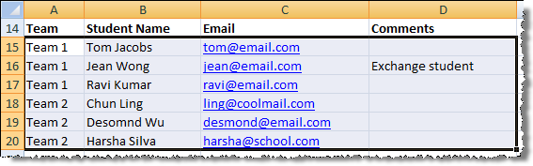
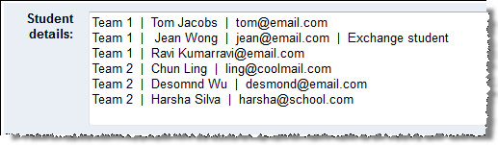
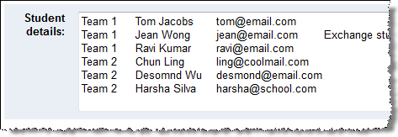
OR
You can simply copy-paste from existing spreadsheets … … type directly in the text box
Use ‘|’ or TAB as the separator
Column order: Team id, Student name, Email, Comments (optional)

