Slide 1
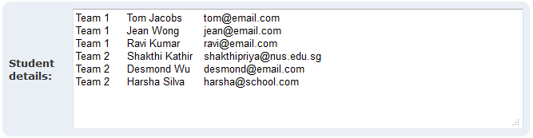
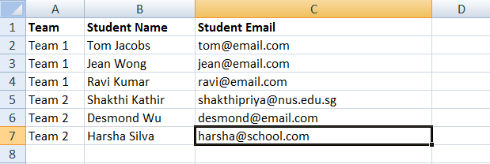
Easily copy-paste your student data from Excel spreadsheets!
2. Enroll your students in the course

