Slide 1
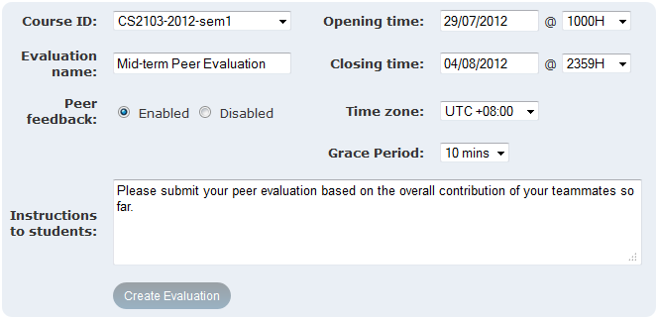
3. Create a new Evaluation
A hidden buffer to cater for last minute submissions

