Slide 1
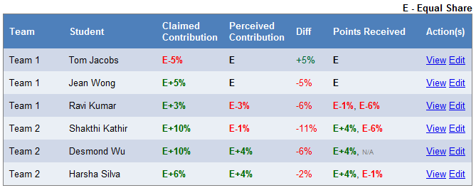

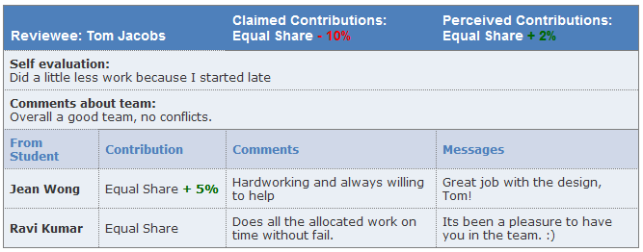
You can view a summary report of the evaluation
It is easy to detect contribution issues in the summary report
6. View reports and summaries, moderate and publish
You can view a detailed report too.
Feedback can be moderated before publishing it for the students to view

