Slide 1
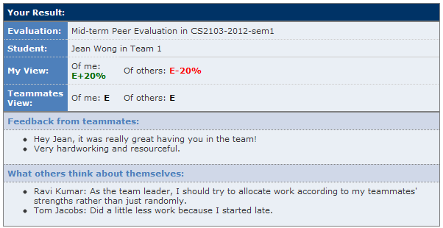

7. Allow students to view results and feedback
Easy to detect mismatches between team expectations and own expectations
This gives students a qualitative comparison between work done be each.

