Slide 1
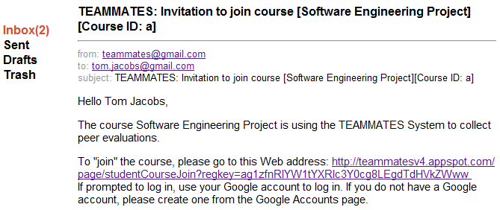
Students
Notifications and reminders make it easy for students to follow the workflow
4. Your students will receive instructions

