Slide 1
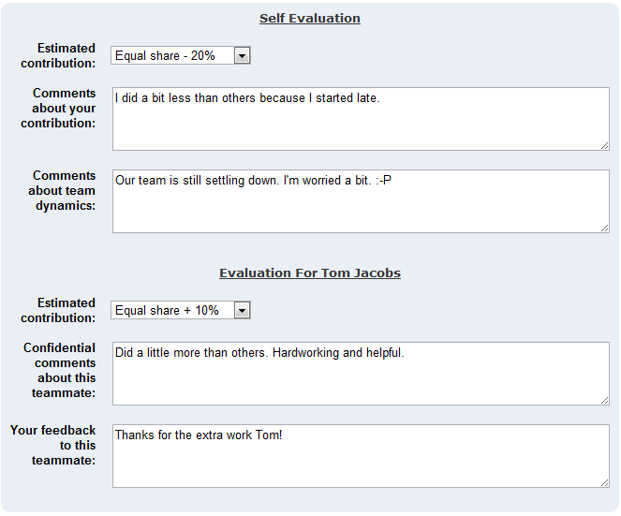
Students rate themselves as well as their peers
Comments about the team dynamics
5. Submit peer feedback and peer evaluations
Confidential comments from the student to the teacher
Anonymous peer feedback for the team

