Slide 1
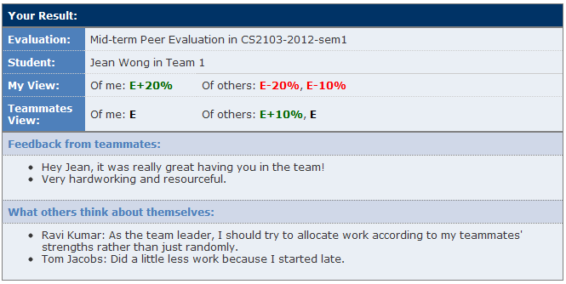
Easy to detect mismatches between team expectations and own expectations
7. Allow students to view results and feedback
This gives students a qualitative comparison between work done by each.

