Slide 1
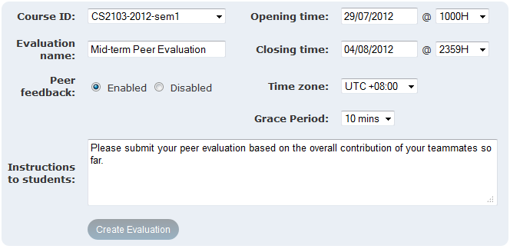
3. Create a new session
A hidden buffer to cater for last minute submissions

