Slide 1
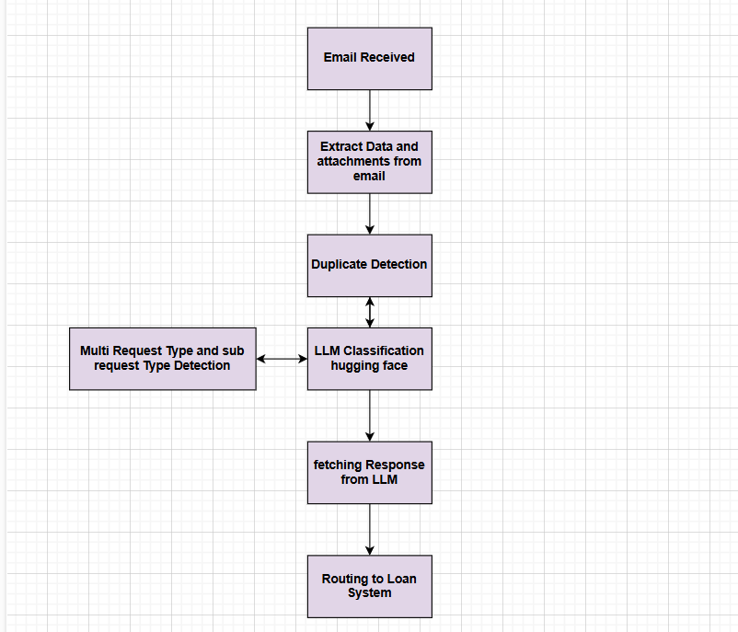
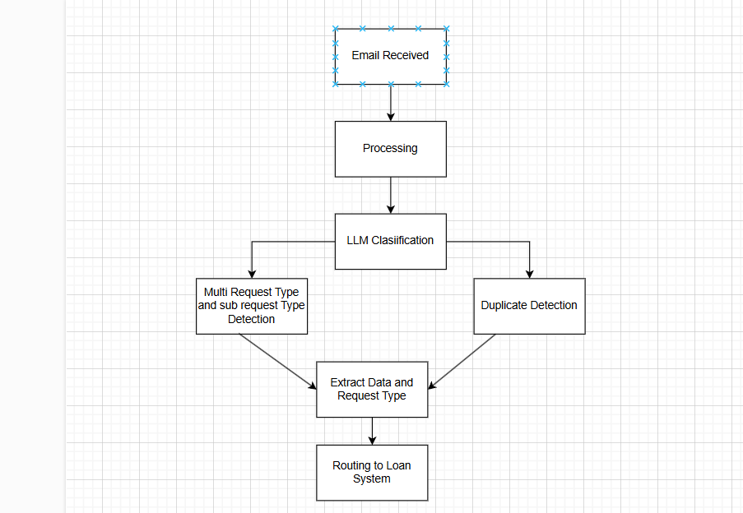
Architecture

Slide 2
Flow
The flow consists of:
Email Ingestion – Receiving emails and attachments.
Preprocessing – Applying OCR and extracting text from emails and documents.
Duplicate Detection – Identifying and handling redundant emails.
LLM Classification – Identifying request types and extracting key fields.
Priority & Routing – Assigning priority and directing emails based on request type.
Final Output & Integration – Structuring the extracted data and routing it into the servicing workflow.

