Slide 1

DYNAMIC USAGE OF MACHINE LEARNING FOR EARLY DETECTION OF DIABETES
TEAM MEMBERS (BATCH-1):
Abdur Rahman Basil A H (1st Year)
Bala Umesh (3rd Year)
Kamalesh (2nd Year)
Rohan (1st year)

Slide 2
ABSTRACT
The project aims to develop a machine learning model using logistic regression to predict the likelihood of a person having diabetes based on certain health indicators.
Logistic regression is a statistical method used for binary classification problems, making it suitable for predicting the presence or absence of diabetes.
The Project will be made as a web application utilizing the Model-View-Template of the Django framework.
User Interface (UI) will be developed using bootstrap, HTML and CSS
Python will be used as the main language for this Logistic Regression Model

Slide 3
LITERATURE SURVEY
TITLE : Prediction of diabetes using logistic regression and ensemble techniques
AUTHOUR NAME: Priyanka Rajendra and Shahram Latifi
NAME OF THE BOOK: Computer methods and programs in biomedicine update
Published Year: 2021

Slide 4
HIGHLIGHTS OF THE PAPER
The predictive model was first designed with only the Logistic Regression algorithm after pre-processing the null values and eliminating the missing values.
The feature selection techniques were later employed to help improve the accuracy and execution time. For Dataset 1, new features were created from existing ones and a correlation heat map was plotted to select the best eight features.
For Dataset 2, Univariate feature selection using chi-square test, was employed, choosing eight top-scoring features. Ensemble methods were further used to try and boost performance. Max/Majority Voting and Stacking methods were tested on both the datasets. The former method proved to be a best method among all, by showing a significant improvement in performance.
The latter performed well after cross- validation was incorporated.

Slide 5
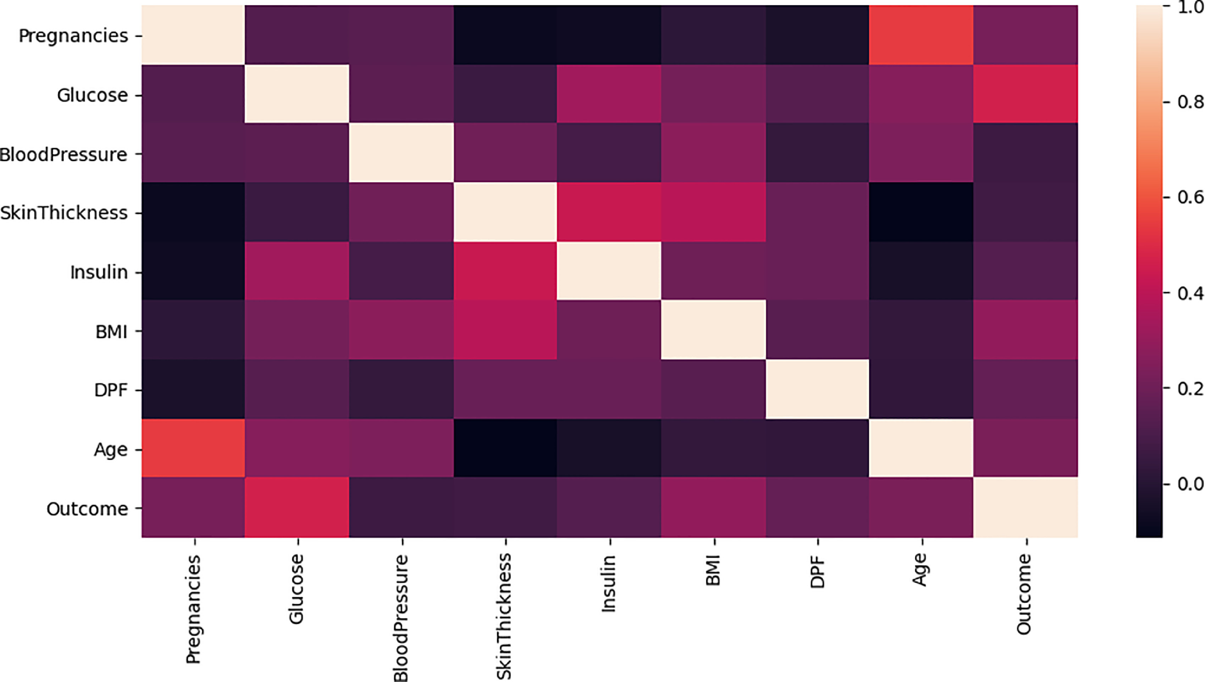

Slide 6
LITERATURE SURVEY
TITLE : Prediction of Diabetes using Classification Algorithms
AUTHOUR NAME: Deepti Sisodia, Dilip Singh Sisodia
NAME OF THE BOOK: Procedia Computer Science
Published Year: 2018

Slide 7
HIGHLIGHTS OF THE PAPER
Diabetes is a serious health issue that requires early detection for effective management. Traditional diagnosis methods are often cumbersome and time-consuming, leading to delays in treatment.
The study aims to leverage machine learning algorithms, specifically Decision Tree, Support Vector Machine (SVM), and Naive Bayes, to predict the likelihood of diabetes in patients. These algorithms are chosen for their effectiveness in classification tasks.
The experiments are conducted using the Pima Indians Diabetes Database (PIDD) from the UCI Machine Learning Repository. This dataset contains diagnostic measurements and outcomes related to diabetes, making it suitable for training and evaluating the models.
Naive Bayes emerges as the top-performing algorithm, achieving the highest accuracy of 76.30% compared to Decision Tree and SVM. The evaluation metrics used include Precision, Accuracy, F-Measure, and Recall, providing a comprehensive assessment of the models' performance. Additionally, Receiver Operating Characteristic (ROC) curves are employed to validate the results in a systematic manner.

Slide 8
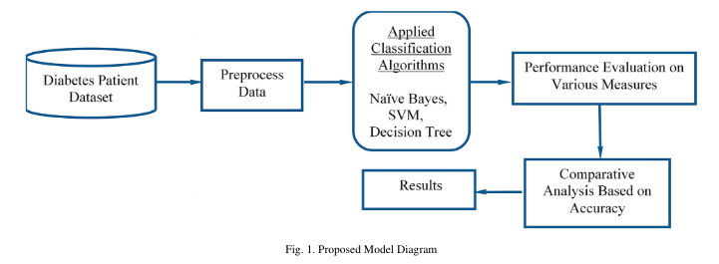

Slide 9
LITERATURE SURVEY
TITLE : Diabetes Prediction Using Machine Learning
AUTHOUR NAME: G. Parimala , R. kayalvizhi ,S. Nithiya
CONFERENCE: International Conference on Computer Communication and Informatics (ICCCI)
Published Year: 2023

Slide 10
HIGHLIGHTS OF THE PAPER
Diabetes is highlighted as one of the most severe illnesses, attributed to factors such as obesity, high blood glucose levels, and other causes. It disrupts insulin hormone function, leading to irregular metabolism and elevated blood sugar levels.
The primary goal of the program is to reduce the risk of individuals developing diabetes by using forecasting techniques. It aims to encourage people to be more mindful of their diet and lifestyle choices to prevent diabetes.
The research focuses on developing and implementing a method for predicting diabetes using machine learning techniques. It utilizes various classification and ensemble learning algorithms such as K-Nearest Neighbors (KNN), Label Encoder, and train-test split to achieve this goal.
The results of the research are expected to provide valuable information for medical professionals to make more accurate early predictions and judgments, leading to better diabetes management and potentially saving lives. The use of machine learning, data visualization, and data interpretation is highlighted as essential in this context.

Slide 11
ARCHITECURE AND CONCEPTS
LOGISTIC REGRESSION:
Logistic regression is a statistical method used for binary classification tasks, where the outcome variable has two possible values, such as "yes" or "no," "0" or "1." It predicts the probability of occurrence of an event by fitting data to a logistic function. Unlike linear regression, which predicts continuous values, logistic regression predicts the probability that a given input belongs to a particular category.

Slide 12
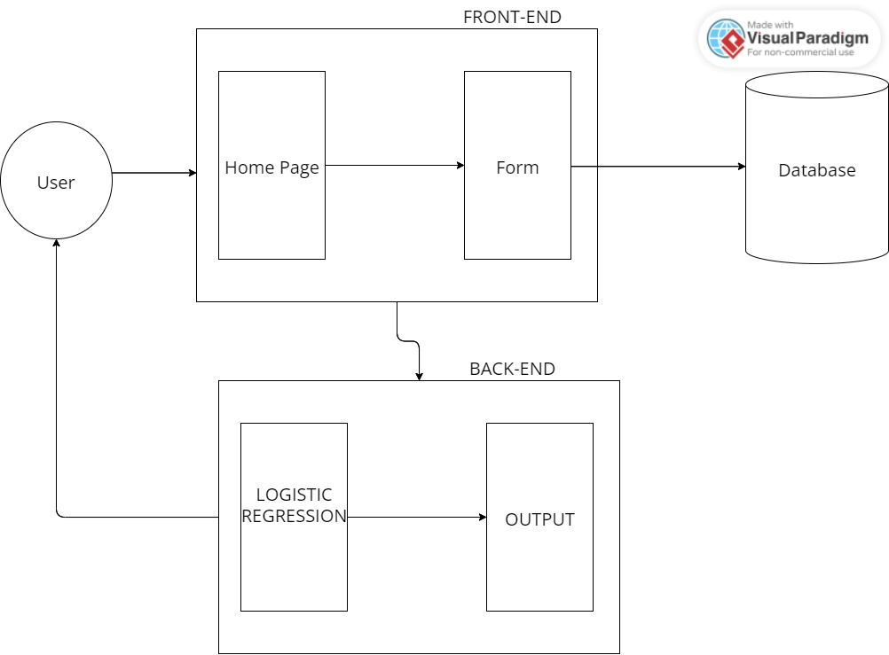

Slide 13
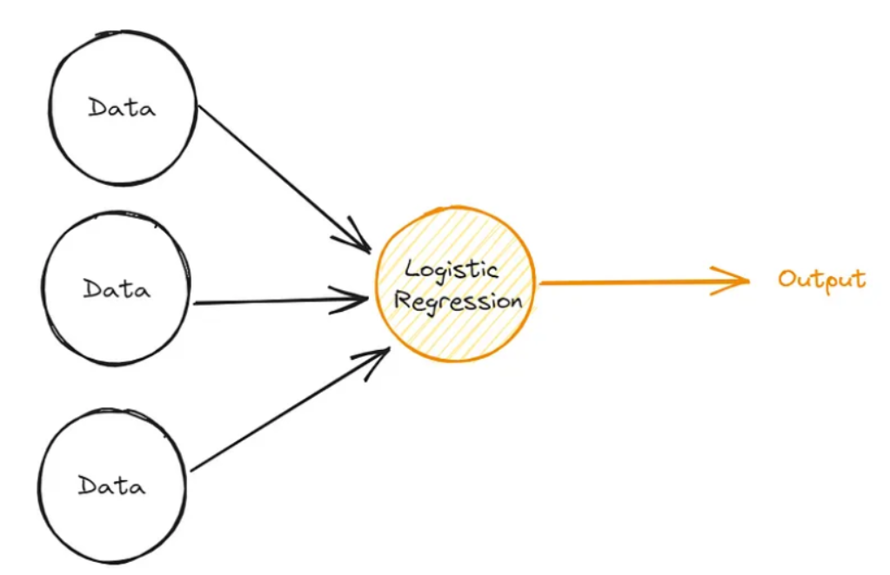

Slide 14
TOOLS USED
VS CODE: Visual Studio Code (VS Code) is a free source-code editor developed by Microsoft for Windows, Linux, and macOS. It includes support for debugging, embedded Git control, syntax highlighting, intelligent code completion, snippets, and code refactoring.
DJANGO : Django is a high-level Python web framework that encourages rapid development and clean, pragmatic design. It follows the model-template-views (MTV) architectural pattern, emphasizing reusability and "pluggability" of components
BOOTSRAP: Bootstrap is known for its ease of use and flexibility, allowing developers to create sleek and responsive designs with minimal effort. Its pre-built components and responsive grid system make it a popular choice for building modern websites and web applications.

Slide 15
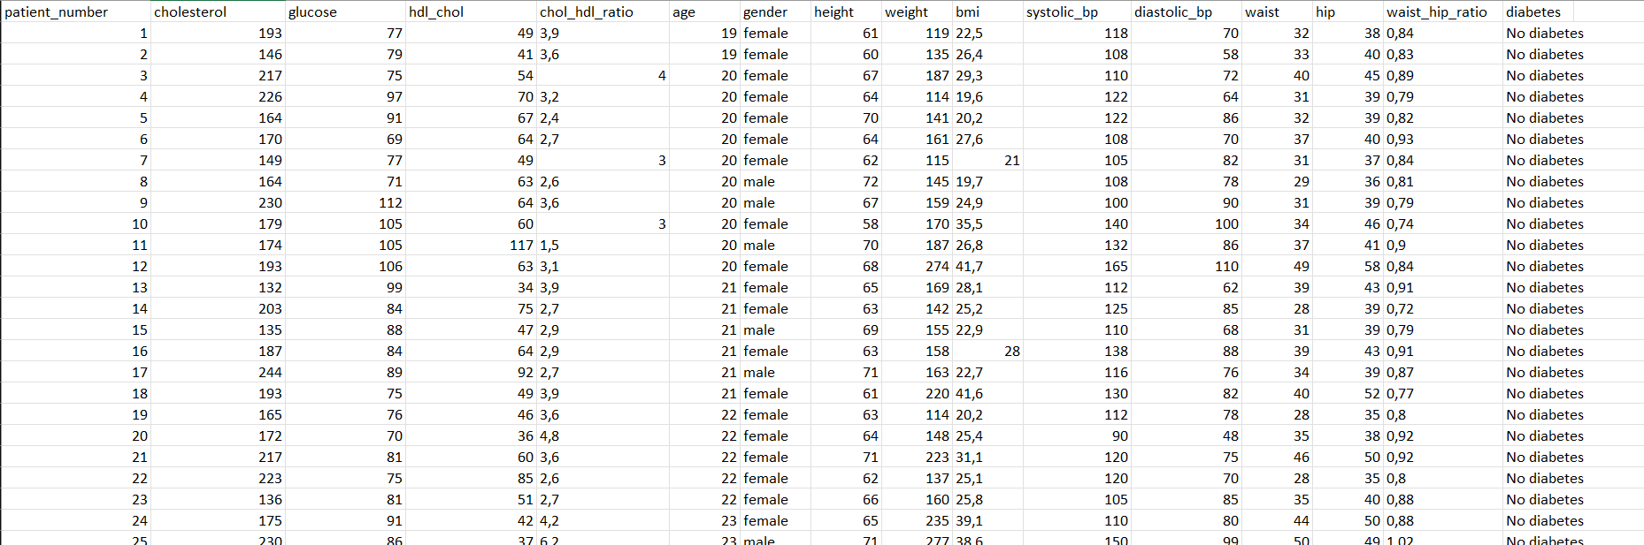
DATASET

Slide 16
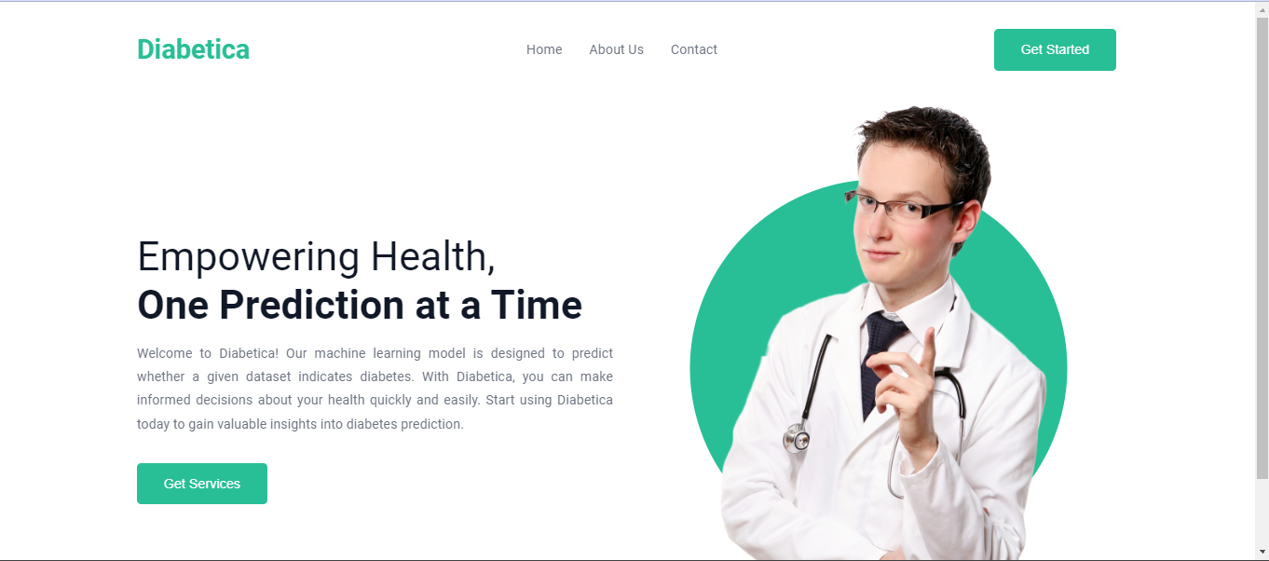
OUTPUT- HOME PAGE

Slide 17
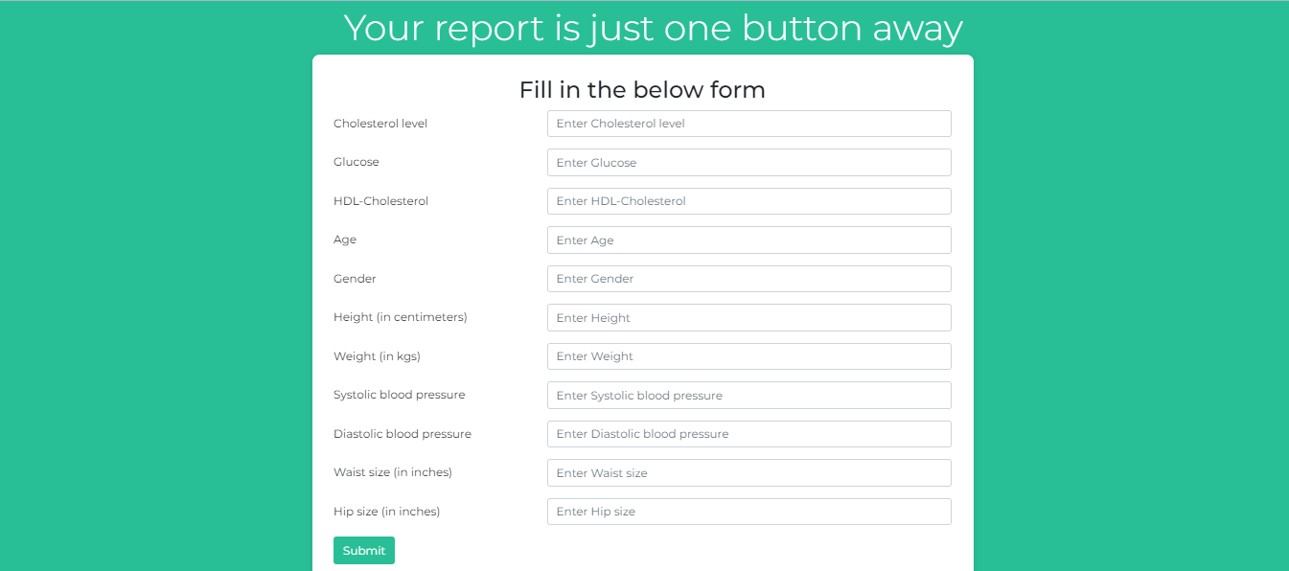
OUTPUT

Slide 18
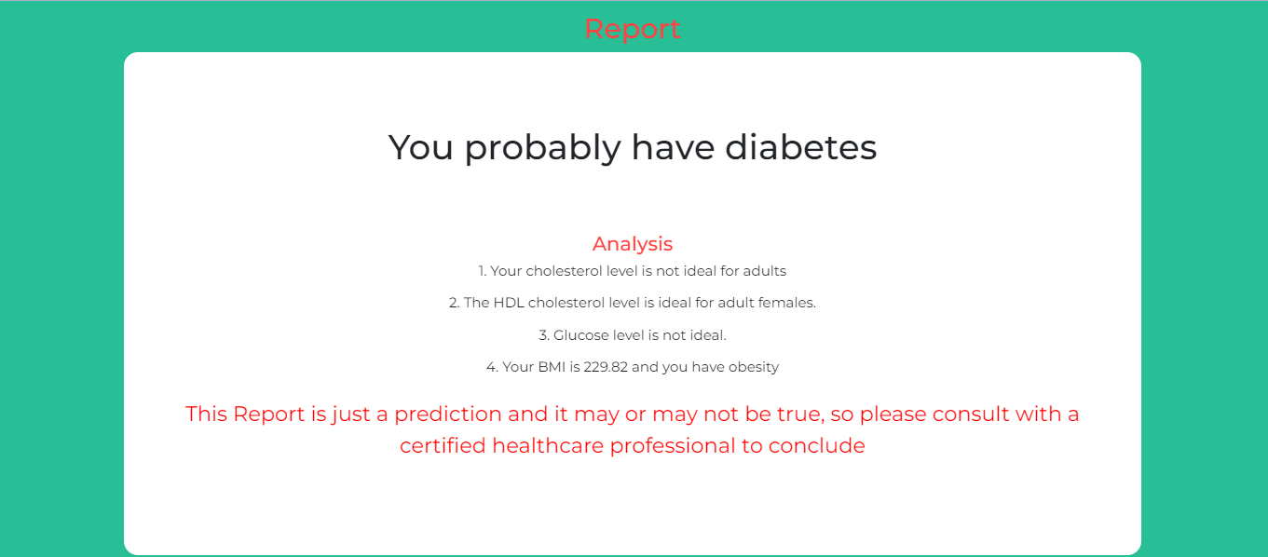

Slide 19
REFERENCES
[Diabetes prediction using machine learning (https://ieeexplore.ieee.org/document/10128216/authors#authors)]
[Machine learning techniques to predict diabetes mellitus (https://ieeexplore.ieee.org/document/8679365)]
[Intelligible support vector machines for diagnosis of diabetes mellitus(https://scholar.google.com/scholar?as_q=Intelligible+support+vector+machines+for+diagnosis+of+diabetes+mellitus&as_occt=title&hl=en&as_sdt=0%2C31)]
[Diabetes prediction using logistic regression in python (https://medium.com/@pragya_paudyal/diabetics-prediction-using-logistic-regression-in-python-e51b90630f2f)]
[Diabetes prediction using Logistic Regression (https://www.springerprofessional.de/en/diabetes-prediction-using-logistic-regression/26996038)]
[A Comprehensive review of various diabetic prediction models (https://www.hindawi.com/journals/jhe/2022/8100697/)]

Slide 20
THANK YOU

