Slide 1
Case Study on Unemployment in Africa
Ifeoluwa Oduwaiye

Slide 2
Tools Used
Microsoft Excel: For data manipulation
Microsoft Power BI: For data cleaning, manipulation and visualization

Slide 3
Outline
Introduction to the Problem Statement
Data Preprocessing
Exploratory Data Analysis
Factors affecting unemployment in Africa
Data-driven solutions to unemployment in Africa
Conclusion

Slide 4
Problem Statement

Slide 5
Problem Statement
Unemployment is still one of the major societal challenges facing people all over the world and more commonly in Africa. 10Alytics organized this hackathon in aid to solve the unemployment issue facing Africa.
The main goal of this hackathon is to use data analytical tools and knowledge to investigate the key factors contributing to unemployment in Africa and to proffer solutions to the issue.

Slide 6
Data Preprocessing

Slide 7
Data Preprocessing
The first data preprocessing step I performed was to merge the 6 datasets into a single Excel worksheet. This was done using Microsoft Excel
I then uploaded the merged dataset to Microsoft Power BI and transformed it using Power Query. I removed missing columns and created some new columns to aid my analysis.
I also removed the “Continent” column as it contained too many missing values.

Slide 8
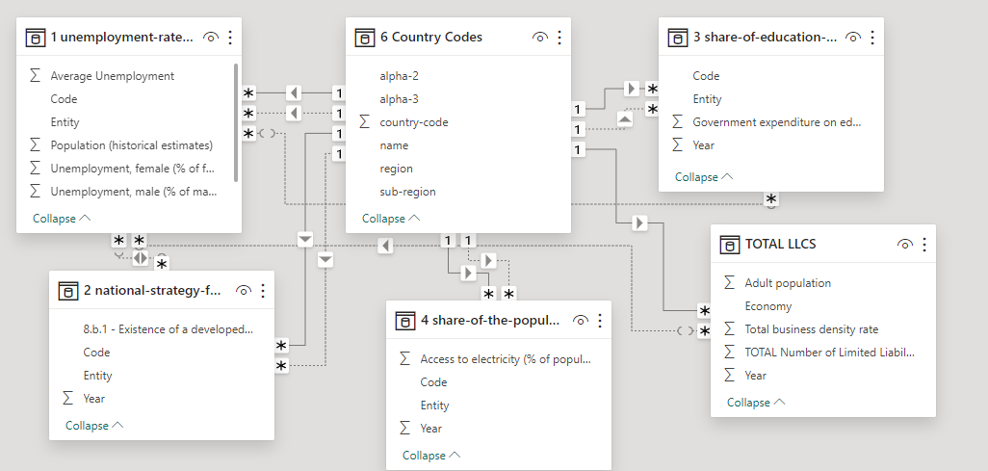
Data Modeling

Slide 9
Exploratory Data Analysis

Slide 10
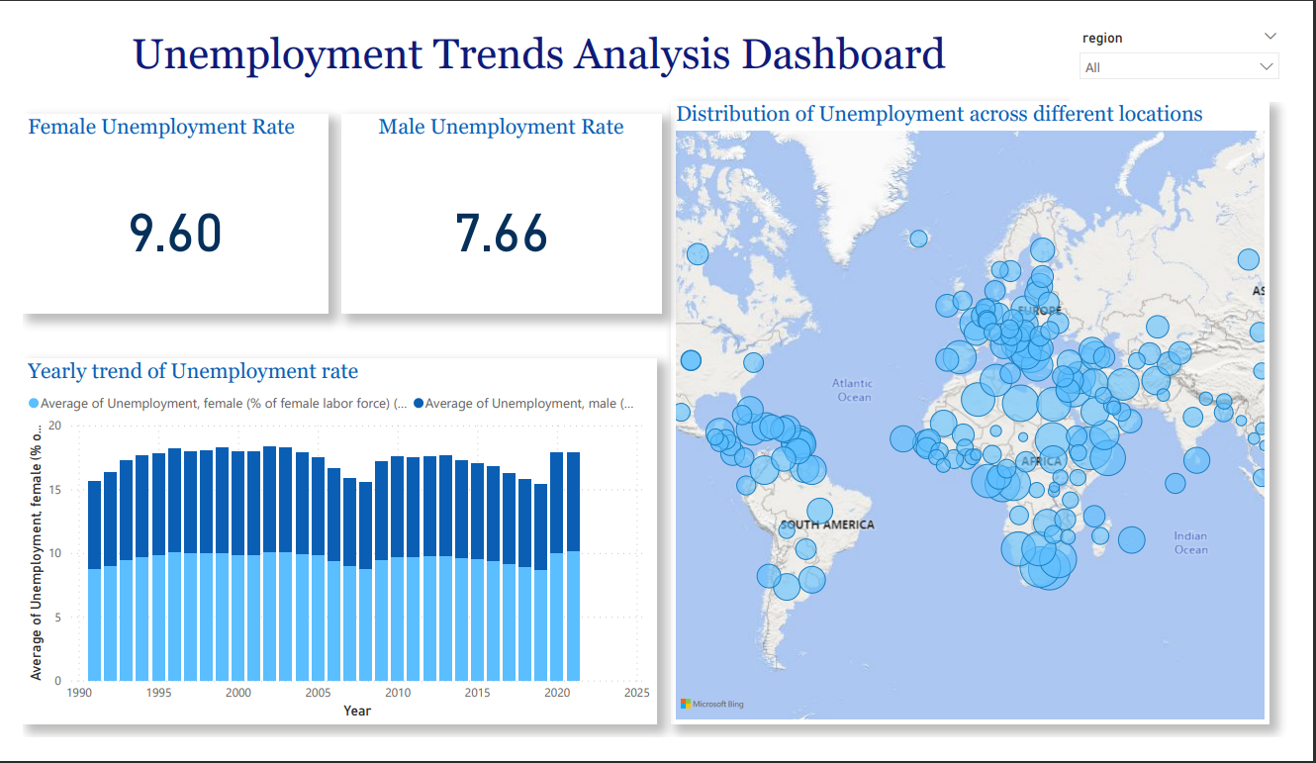
Unemployment Trends Analysis
This dashboard shows that:
Female unemployment rate is higher than that of males
There has a been a spike in the yearly trend of unemployment at 2020 (this was probably due to the COVID crisis)
There is a concentration of unemployment in Africa

Slide 11
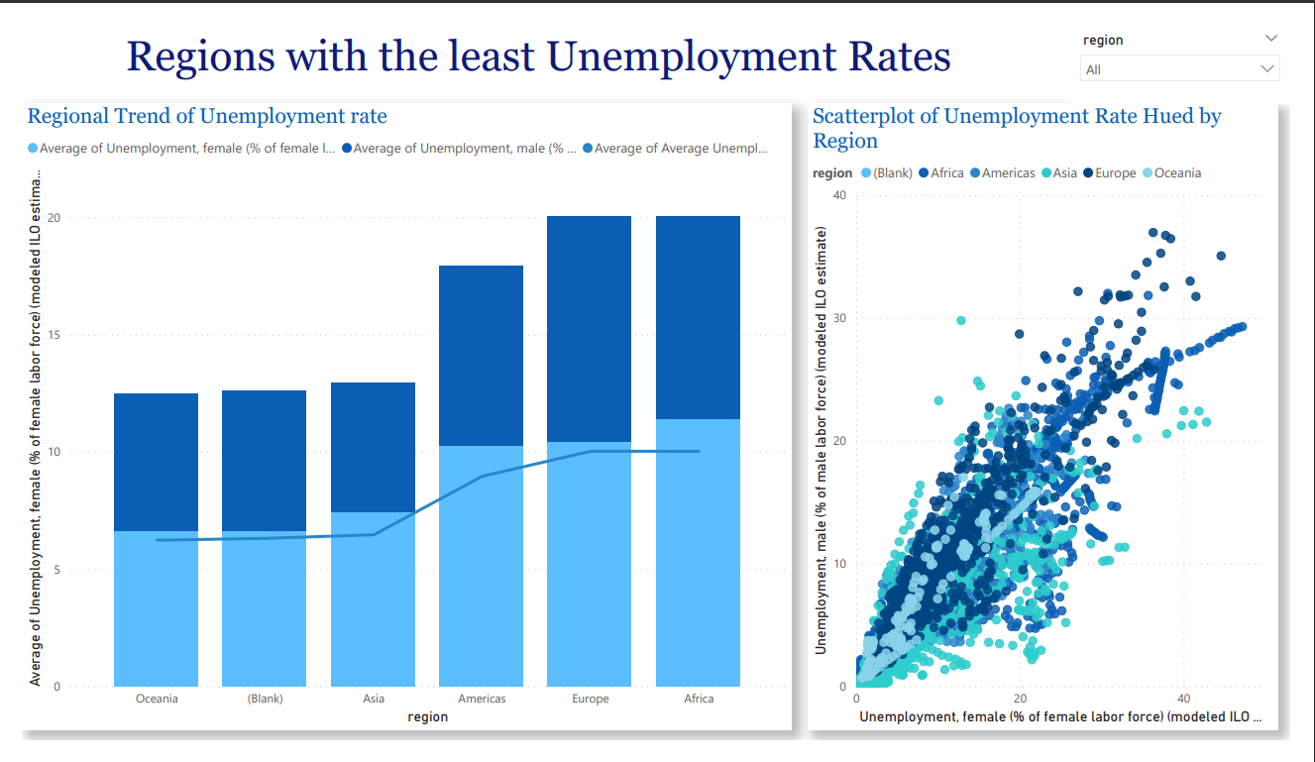
Unemployment Trends Analysis Cont’d
This dashboard shows that:
The regions with the lowest unemployment rates are Oceania and Asia.
There is a direct, positive correlation between the female unemployment rate and the male unemployment rate.

Slide 12
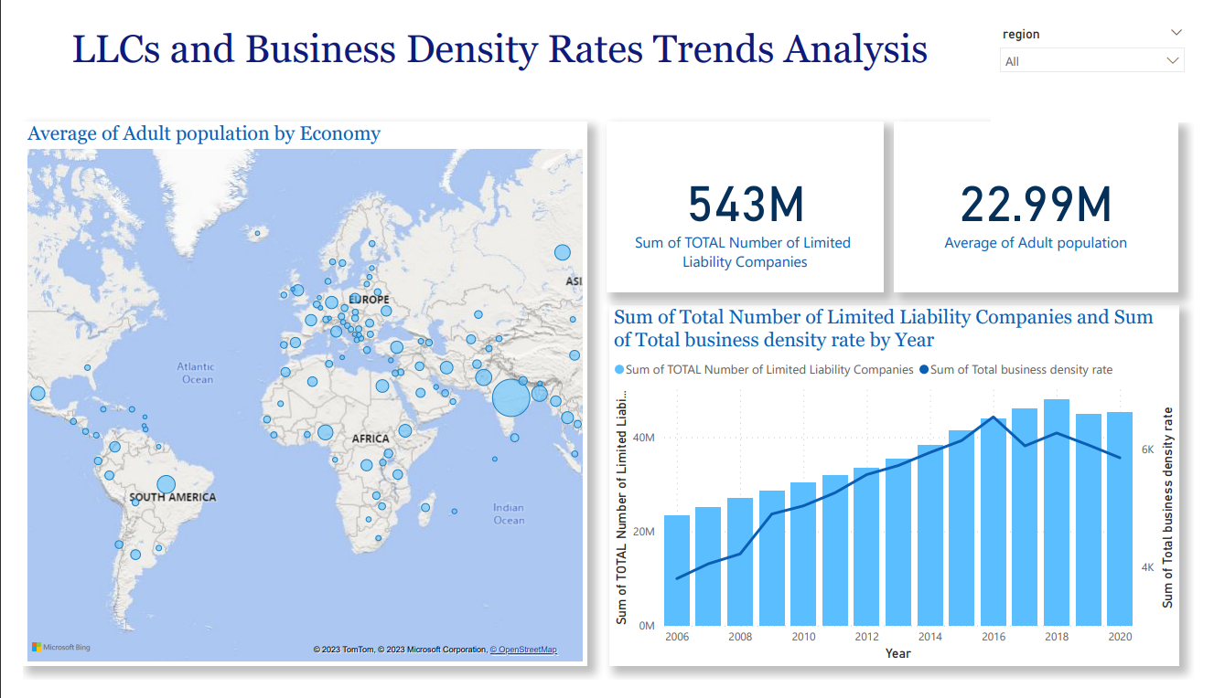
LLCs and Business Density Rates Trends Analysis
This dashboard shows that:
The number of LLCs has a direct correlation with the business density, that is; excluding the last two years.
There are 543 million LLCs and 22.99 million adults.

Slide 13
Factors Affecting Unemployment Rate in Africa

Slide 14
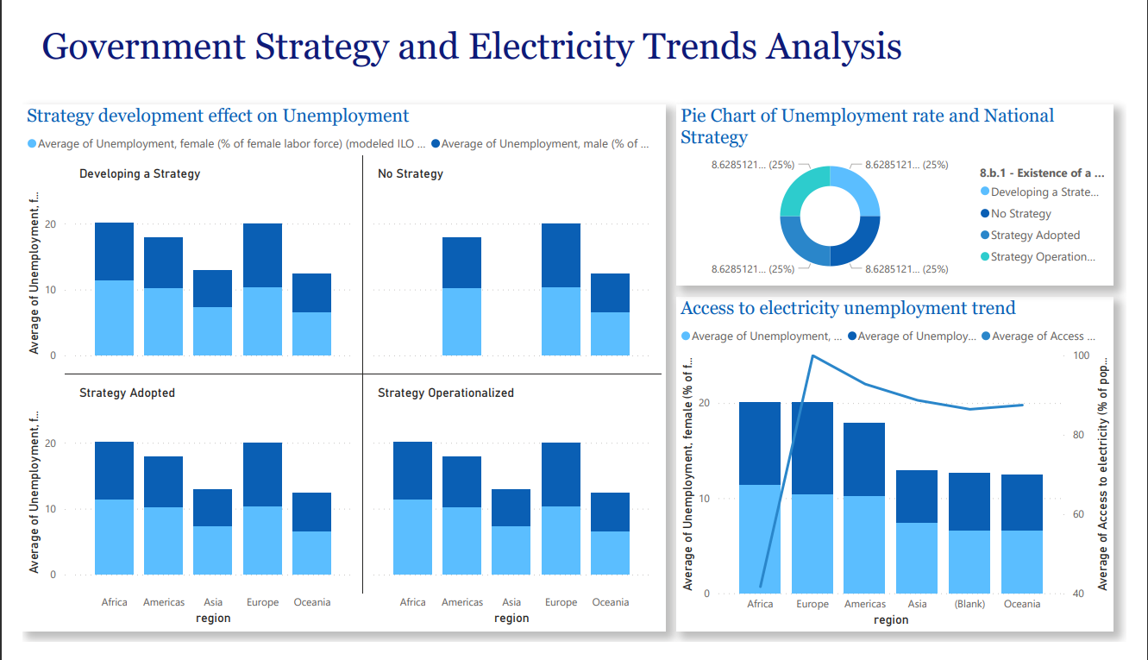
Government Strategy and Electricity Access Trends Analysis
Due to the equal distribution between the various government strategies, it is clear that there is no correlation between government strategies and unemployment rates.
Excluding Africa, the rate of unemployment varies directly with access to electricity.

Slide 15
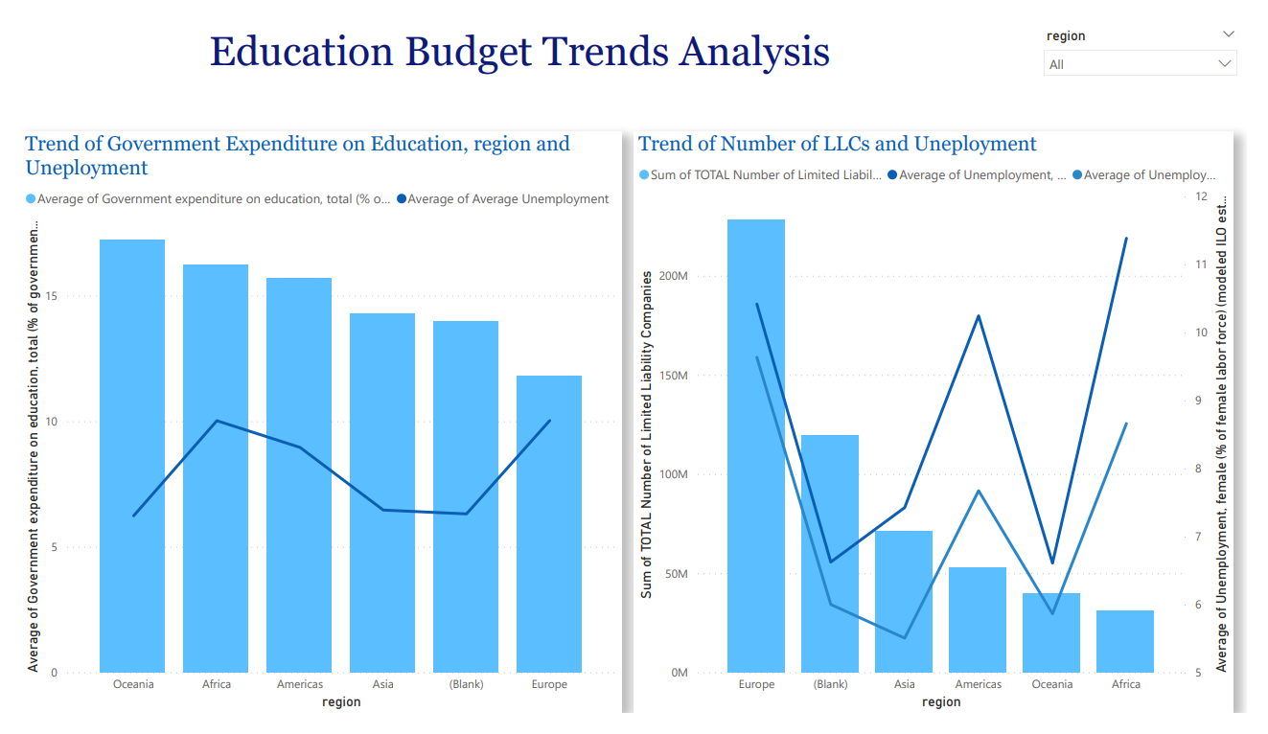
Education Budget and LLCs Trends Analysis
This dashboard shows that:
There is little or no correlation between the education budget and the unemployment rate.
Excluding Africa and the Americas, there is a direct correlation between unemployment rate and the number of LLCs.

Slide 16
Data-driven solutions to unemployment in Africa

Slide 17
Comparative Analysis
I will be doing a comparative analysis between the two regions with the lowest unemployment ratios to identify areas where Africa can improve
Asia
Oceania

Slide 18
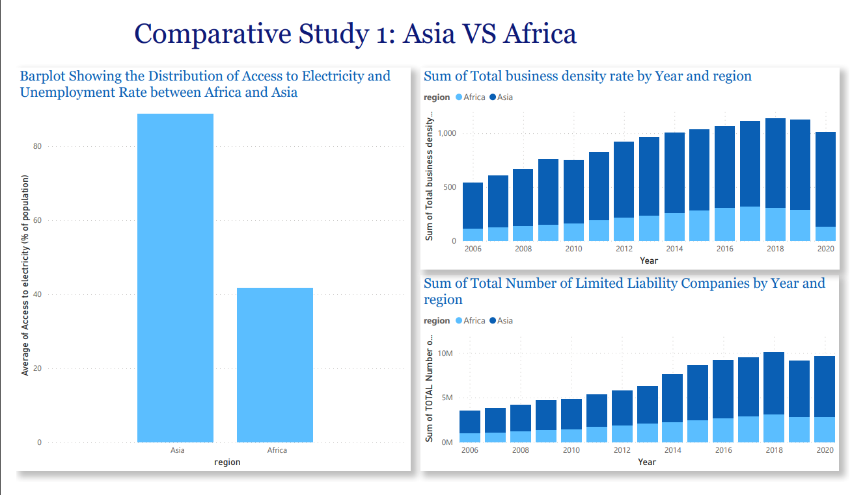
Comparative Study 1: Asia VS. Africa
The first bar plot shows the difference between Asia’s access to electricity and that of Africa
The other two bar charts show a significant difference between the business density and number of LLCs in Africa and Asia.

Slide 19
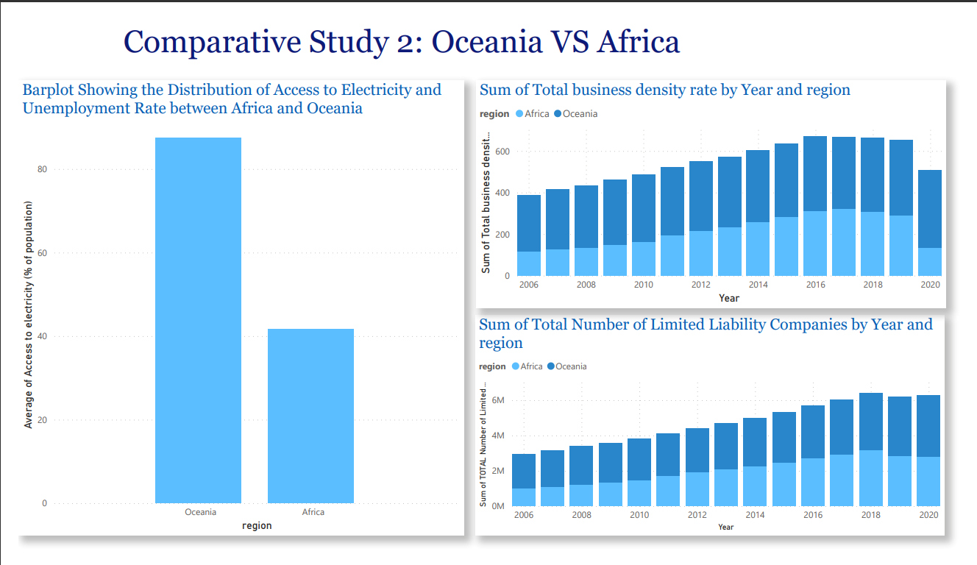
Comparative Study 2: Oceania VS. Africa
The first bar plot shows the difference between Oceania’s access to electricity and that of Africa
The other two bar charts show a significant difference between the business density and number of LLCs in Africa and Asia. Although this difference is lesser in Asia.

Slide 20
Conclusion

Slide 21
Conclusion
Africa should to imitate Asia and Oceania by doing the following:
Increasing the number of LLCs in the continent: Doing this will inevitable increase the business density rates in the continent and provide more jobs for Africans. Startups and business owners should be encouraged to grow and expand, the government should implement policies that would favour business owners.
Improving access to electricity: Both Oceania and Asia had a significant difference in their access to electricity when compared to Africa. Improving the continent’s access to electricity would help businesses thrive and ultimately reduce the unemployment rate in the continent.

Slide 22
Thank you

