Slide 1

A
MINI PROJECT ON
WORD TRACKER
Under guidance of
Mr. U. Sairam
Assistant professor
IT Department
BY
-J. Vinathi Reddy(160122737007)
-M. Sai Varshitha (160122737015)
-N. Manvika(160122737017)

Slide 2
ABSTRACT
This project aims to provide an innovative online platform for students enrolled at CBIT (Chaitanya Bharathi Institute of Technology) The platform offers access to a comprehensive collection of academic books spanning across various departments. One of the distinguishing features of this platform is its integrated exploration tool designed to enhance the reading experience. When encountering unfamiliar terms or concepts while perusing the texts, students can simply highlight the word or phrase. In doing so, a contextual tab dynamically appears, furnishing a concise yet informative explanation of the selected term or concept. This feature serves to alleviate comprehension barriers, facilitating a smoother learning process for students. The online book store caters specifically to the academic needs of CBIT students, housing an extensive repository of textbooks covering diverse subjects ranging from engineering to humanities. With the convenience of digital access, students can easily navigate through their required course materials at any time and from anywhere. This digital platform not only mitigates the logistical challenges associated with physical textbooks but also offers an interactive reading experience. Furthermore, the integration of the exploration tool elevates the platform's utility by providing immediate assistance to students encountering unfamiliar terminology or complex concepts within the texts. For instance, if a student encounters a technical jargon or a specialized term while studying, they can simply double-click on the term to summon a succinct yet comprehensive explanation. This feature not only aids in comprehension but also fosters a deeper understanding of the subject matter by providing contextual clarity. By amalgamating accessibility, convenience, and enhanced learning tools, this online book store seeks to empower CBIT students in their academic pursuits. Through seamless access to educational resources and innovative features like the exploration tool, this platform endeavors to cultivate a conducive learning environment conducive to academic excellence.

Slide 3
INTRODUCTION
Motivation
Embarking on the project of highlighting words for their meanings within genre fiction, horror, and educational novels offers a rich tapestry of benefits. Not only does this endeavor expand your vocabulary, but it also deepens your comprehension of the texts you engage with. By actively seeking out and defining words within their narrative contexts, you're not merely learning isolated definitions; you're gaining a nuanced understanding of how language shapes storytelling. This process stimulates cognitive functions, reinforcing memory, attention, and reasoning skills. Moreover, integrating educational goals with leisure reading underscores the practical application of learning, making it both enjoyable and sustainable. Through this project, you explore complex themes within literature while fostering personal growth and self-improvement. Sharing your insights and discoveries through a project report contributes to the collective knowledge base and may inspire others to engage in similar pursuits. Ultimately, completing such a project is a celebration of your dedication, curiosity, and passion for learning, reflecting your commitment to intellectual exploration and academic excellence.
Problem statement
WORD TRACKER
This project addresses the challenge of vocabulary acquisition by integrating contextual learning into genre fiction, horror, and educational novels. It aims to enhance comprehension and retention by highlighting and defining words within their narrative contexts. The effectiveness of this approach across different genres and reader demographics is underexplored. By investigating its impact on language proficiency, cognitive skills, and reading experience, the project seeks to provide insights into effective pedagogical strategies for promoting lifelong learning and literacy development.

Slide 4
EXISTING SYSTEM
The current system for vocabulary acquisition typically involves traditional methods such as memorization exercises, flashcards, and dictionary definitions. While these methods may be effective to some extent, they often lack engagement and fail to provide meaningful context for learners. Educational initiatives may incorporate vocabulary instruction, but they rarely integrate it with leisure reading or explore the nuanced meanings of words within narrative contexts. As a result, learners may struggle to retain newly acquired vocabulary or apply it effectively in real-world scenarios. The existing system overlooks the potential benefits of integrating contextual learning into leisure reading, especially within genre fiction, horror, and educational novels, thus limiting opportunities for holistic language development and comprehension.

Slide 5
PROPOSED METHODOLOGY
SYSTEM SPECIFICATIONS
Operating System
Chrome Browser Version
Hardware Requirements
Memory Usage
Internet Connection
PDF Viewer Compatibility
User Interface
Security

Slide 6
SYSTEM DESIGN:
User Interface
Backend
PDF Viewer
Word Tracking Feature
Integration with Wikipedia
Data Storage
Security
User preferences and Settings
Error Handling and Logging
Testing and Quality Assurance

Slide 7
LITERATURE SURVEY
Online Bookstores
Language Processing and Word Meaning Lookup
User Experience and Interaction Design
E-commerce and Information Retrieval
Privacy and Security

Slide 8
DATASETS and ALGORITHMS/ MODELS
Word meanings and synonyms
Link:
https://chromewebstore.google.com/detail/wordweb-dictionary-lookup/ilikenhndcpmliapkmmhoimckaokmihm.html
PDF Books
Books that we have used which are downloaded from chrome are:
JAVA
OPERATING SYSTEMS
PYTHON
ELECTRONIC DEVICES AND CIRCUIT THEORY
ELECTRONIC DEVICES
INTRODUCTION TO MECHANICAL ENGINEERING
THERMODYNAMICS

Slide 9
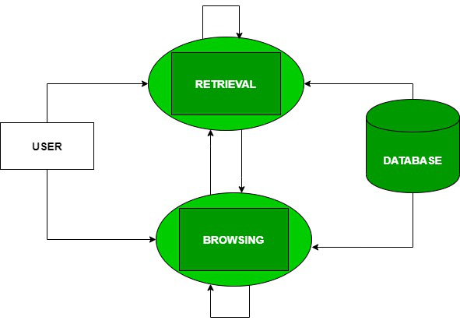
ALGORITHMS OR MODELS

Slide 10
STEPS
Step 1: Word Embeddings
Step 2 : Named Entity Recognition (NER)
Step 3: Text Summarization
Step 4: Word Sense Disambiguation
Step 5: PDF Parsing
Step 6: Information Retrieval

Slide 11
IMPLEMENTATION AND RESULTS
IMPLEMENTATIONS
Set Up Development Environment
Design User Interface
Implement Chrome Extension
Integrate PDF Viewer
Implement Word Tracking Feature
Implement Backend Services (if necessary)
Data Storage and Management
Testing and Debugging
User Documentation and Feedback
Deployment

Slide 12

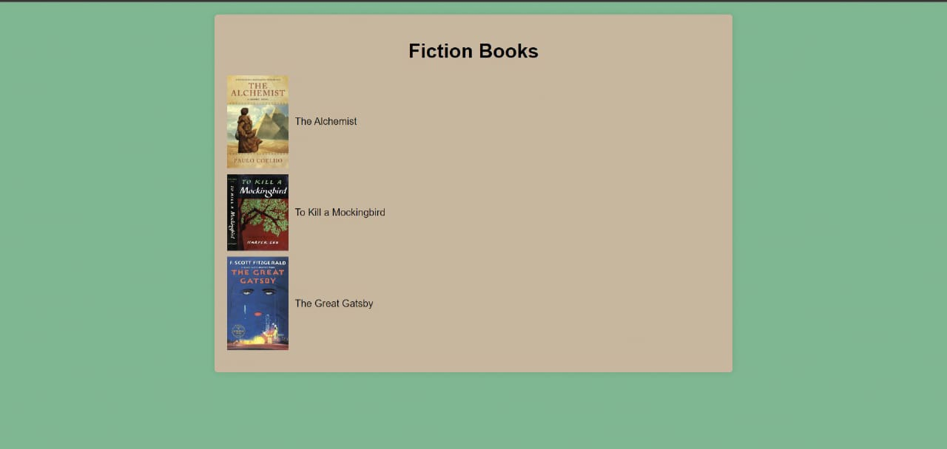
RESULTS

Slide 13
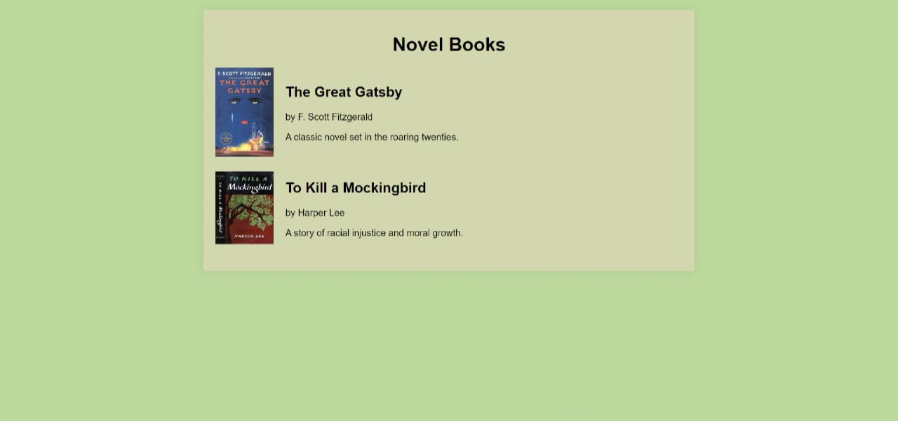
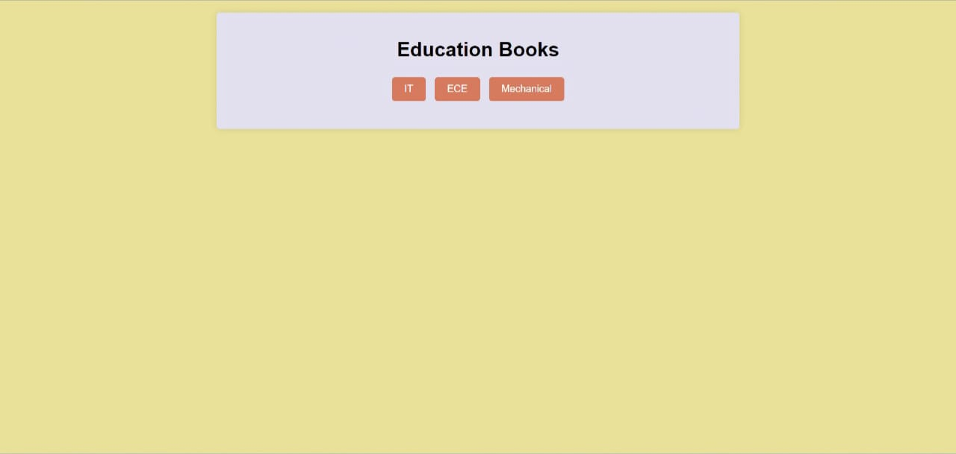

Slide 14
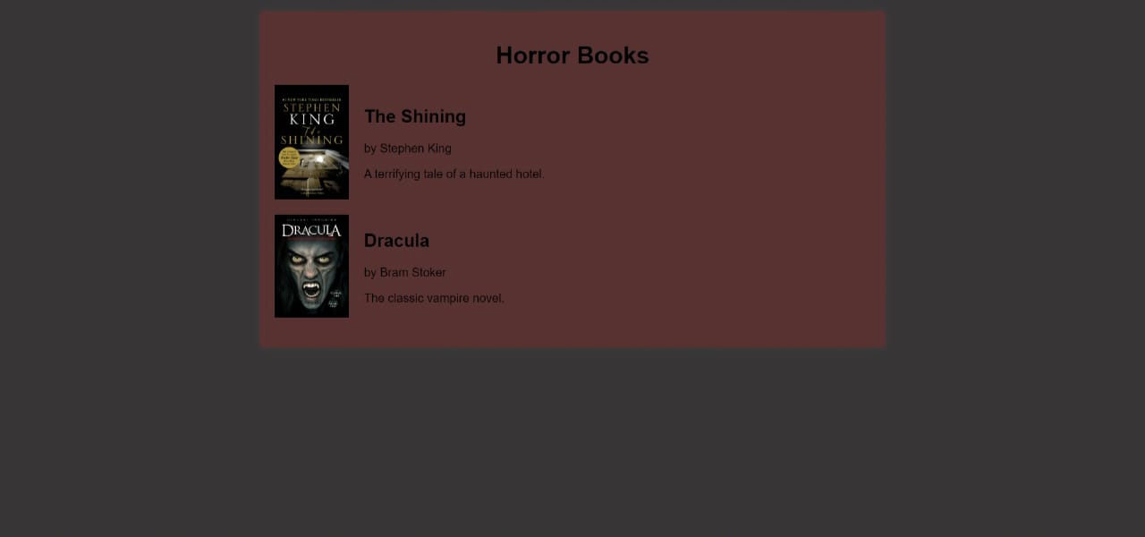
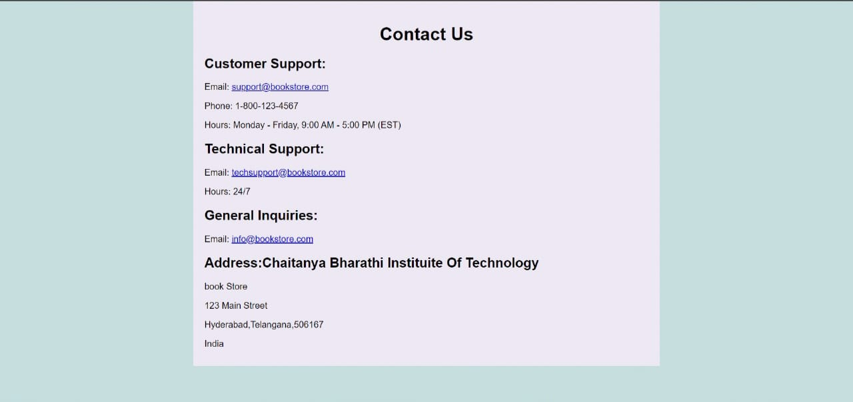

Slide 15
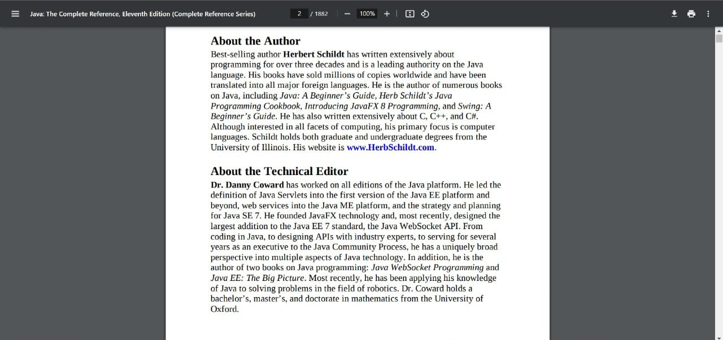

Slide 16
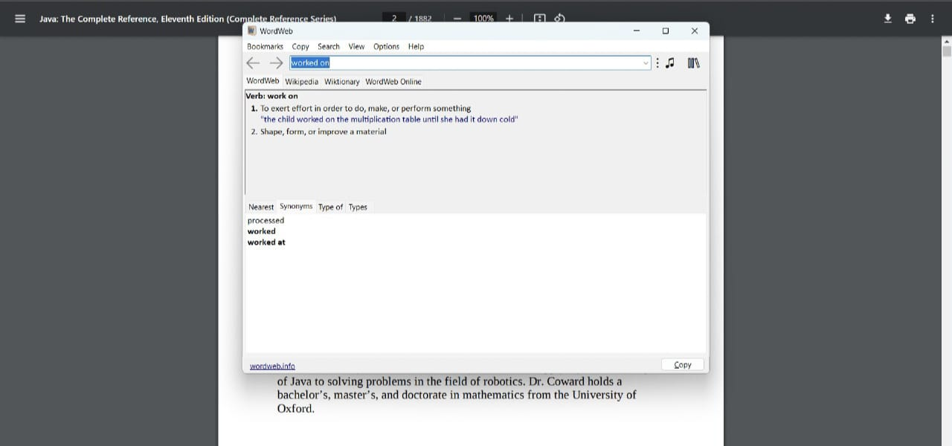

Slide 17
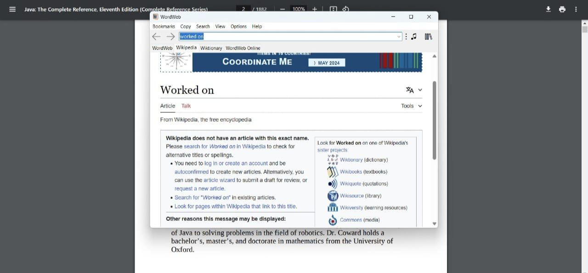

Slide 18
CONCLUSION and FUTURE SCOPE
CONCLUSION
The proposed project aims to investigate the effectiveness of integrating contextual vocabulary learning into genre fiction, horror, and educational novels. By highlighting and defining words within their narrative contexts, the project seeks to enhance language proficiency, reading comprehension, and overall engagement with the text. Through a rigorous experimental design and comprehensive data analysis, the project has provided valuable insights into the potential benefits of this innovative approach to vocabulary acquisition. In conclusion, the proposed project represents a significant step towards advancing our understanding of effective vocabulary acquisition strategies within the context of leisure reading. By building on the findings and exploring future research directions, educators and researchers can continue to innovate and enhance literacy instruction for the benefit of learners worldwide.
FUTURE SCOPE
Long-term Effects.
Adaptation for different genres
Technology Integration
Cross Cultural Studies
Teacher Training Programs
Intervention Optimization

Slide 19
REFERENCES
[1] National Reading Panel. (2000). Report of the National Reading Panel:
Retrieved from https://www1.nichd.nih.gov/publications/pubs/nrp/Documents/report.pdf
[2] Reading Rockets. (n.d.). Vocabulary. Retrieved from https://www.readingrockets.org/teaching/reading101-course/modules/vocabulary/
[3] Vocabulary.com.(n.d.).Learn Words-English Dictionary. Retrieved from https://www.vocabulary.com/
[4] Scholastic.(n.d.). Vocabulary and Spelling. Retrieved from https://www.scholastic.com/teachers/teaching-tools/expert-articles/vocabulary-spelling.html

