Slide 1
🚗
PRO
ParkSmart
Smart Parking Solution for Telangana
20+
1000
Submitted by: Madhuvani Nallala
Branch: CSE-AIML
Project: ParkSmart Pro — Web Application
Tech: HTML · CSS · JavaScript
Locations
Total Slots
4
24/7
Cities
Uptime
© 2025 ParkSmart Pro · Built for Telangana

Slide 2
🚗 Introduction
About ParkSmart Pro
🔍
🎫
ParkSmart Pro is a web-based smart parking management system designed specifically for Telangana.
Live Availability
Instant Booking
Real-time slot tracking
Reserve in seconds
It enables users to find, book, and pay for parking in real-time across 4 major cities.
The system supports two user roles: Customers (book/cancel/pay) and Admins (manage & monitor).
💳
🛡️
Built using pure HTML, CSS, and JavaScript — fully functional in any modern browser.
Easy Exit Pay
Admin Control
Addresses the growing urban parking congestion problem with a digital-first approach.
Pay for time used only
Full staff dashboard
ParkSmart Pro · Smart Parking Solution

Slide 3
🎯 Objectives
01
Real-Time Slot Visibility
02
Seamless Booking System
Provide live parking availability data to users before they arrive at the location, reducing traffic and wait times.
Enable customers to instantly book, confirm, and receive digital parking tickets within seconds.
03
Hassle-Free Exit & Payment
04
Multi-City Coverage
Allow users to pay only for the actual duration they parked — no pre-payments or overpayments.
Expand smart parking to Hyderabad, Warangal, Karimnagar, and Nizamabad — 20+ locations.
05
Admin & Staff Management
06
Reduce Urban Parking Chaos
Provide Main Admin and Location Admin dashboards to monitor bookings, slots, and revenue in real time.
Digitise the parking process to cut congestion, save fuel, and improve urban mobility in Telangana.
ParkSmart Pro · Smart Parking Solution

Slide 4
👥 Stakeholders
👤
🛡️
📍
🏙️
End Customers
Main Admin
Location Admin
Telangana Cities
Primary Users
madhu / System Owner
Per-Location Staff
Geographic Scope
Book parking slots in real-time
Full dashboard access
Manage single assigned location
Hyderabad — 5 Locations
Receive instant digital tickets
Monitor all 20+ locations
View local slot availability
Warangal — 5 Locations
Pay only for time used
View total revenue & stats
Track bookings at their site
Karimnagar — 5 Locations
Cancel bookings when needed
Search any vehicle booking
Monitor location revenue
Nizamabad — 5 Locations
ParkSmart Pro · Smart Parking Solution

Slide 5
⚙️ Programming Languages, Tools & Software
LANGUAGES & FRONTEND
TOOLS & ENVIRONMENT
🟠
HTML5
💻
VS Code
Structure & layout of all web pages
Primary code editor & IDE
🌐
Chrome / Browser
🔵
CSS3
Live testing & debugging platform
Styling, animations & responsive design
💾
LocalStorage API
🟡
JavaScript
Client-side data persistence layer
Logic, interactivity & data handling
🎨
Unsplash Images
🅰️
High-quality free imagery for UI
Poppins (Google Fonts)
Modern typography for clean UI
📦
No Frameworks
Pure vanilla JS — zero dependencies
ParkSmart Pro · Smart Parking Solution

Slide 6
💬
Prompts Used to Generate the Codes
index.html
script.js
style.css
1
Create Project on smart parking,ParkSmart Pro with HTML5 structure, add DOCTYPE, UTF-8, viewport, title and link CSS & JS files
1
Create Customer Form with city, location, vehicle details and add buttons for check, book, pay, and cancel with a message box and back link
1
Define CSS Variables in :root for colors, border, radius and apply global reset with box-sizing, Poppins font, dark background
2
Create Header sticky with logo (car emoji, ParkSmart, tagline) and add PRO badge with glowing background orbs
2
Create Admin Login with tabs (Main/Admin), input fields, password option and login button
2
Style Background with gradient overlay and parking image, add animated glow orbs using keyframes for smooth floating effect
3
Add Hero Section with heading 'Park Smarter' and a short description, center aligned
3
Create Main Dashboard with stats cards, slot grid, search bar and bookings table
3
Style Feature Cards using glassmorphism, hover lift effect and proper spacing for icon, title and description
4
Add City Pills for Hyderabad, Warangal, Karimnagar, Nizamabad with images and include a stats bar showing locations, total slots, availability and cities
4
Create Location Dashboard with stats, slot availability, search and location-based bookings table
4
Style Ticket Modal as overlay with centered card, booking details, header gradient and action buttons
5
Create Feature Cards showing Live Availability, Instant Booking, Easy Exit Pay, and Admin Control with icons and descriptions
5
Create Ticket Modal popup showing booking details with options to download, pay or close
5
Style Dashboard with responsive layout, stat cards, color indicators and section titles
6
Add Login Cards for Customer and Admin with images, buttons, and a footer section
6
Create Pay And Cancel Modals with booking ID input, hours entry and action buttons
6
Finalize project by hiding sections, placing script at bottom, matching IDs and avoiding inline CSS
ParkSmart Pro · Smart Parking Solution

Slide 7
🔄 System Workflow
CUSTOMER FLOW
ADMIN FLOW
🌐
1. Visit ParkSmart
🔐
1. Access Admin Login
📍
2. Select City & Location
🛡️
2. Main Admin (madhu/madhu@123)
🔍
3. Check Availability
📍
3. Location Admin (loc + 123)
🚗
4. Enter Vehicle Details
📊
4. View Dashboard & Stats
🎫
5. Book & Get Ticket
🅿️
5. Monitor Slots & Bookings
🅿️
6. Park Vehicle
🔍
6. Search Vehicle Records
💳
7. Exit & Pay
💰
7. Track Revenue
ParkSmart Pro · Smart Parking Solution

Slide 8
🖥️ Front-End Application View
parksmart-pro.netlify.app
KEY UI SCREENS
🚗 ParkSmart
PRO
🏠 Landing Page
Park Smarter, Not Harder
Hero section with city selection, stats bar, feature cards and mode selection
Real-time slots · Instant booking · Smart exits
👤 Customer Booking
Hyderabad
Warangal
Karimnagar
Nizamabad
City → Location → Vehicle details → Book → Get instant digital ticket
👤 Customer Login
🛡️ Admin Login
Book & pay for parking
Monitor all locations
🎫 Digital Ticket
Booking ID, vehicle, location, date/time, rate and status shown on modal
20+
1000
24/7
4
Locations
Slots
Uptime
Cities
🛡️ Admin Dashboard
Live stats: total/active/paid/cancelled bookings, slot grid, revenue, search
ParkSmart Pro · Smart Parking Solution

Slide 9
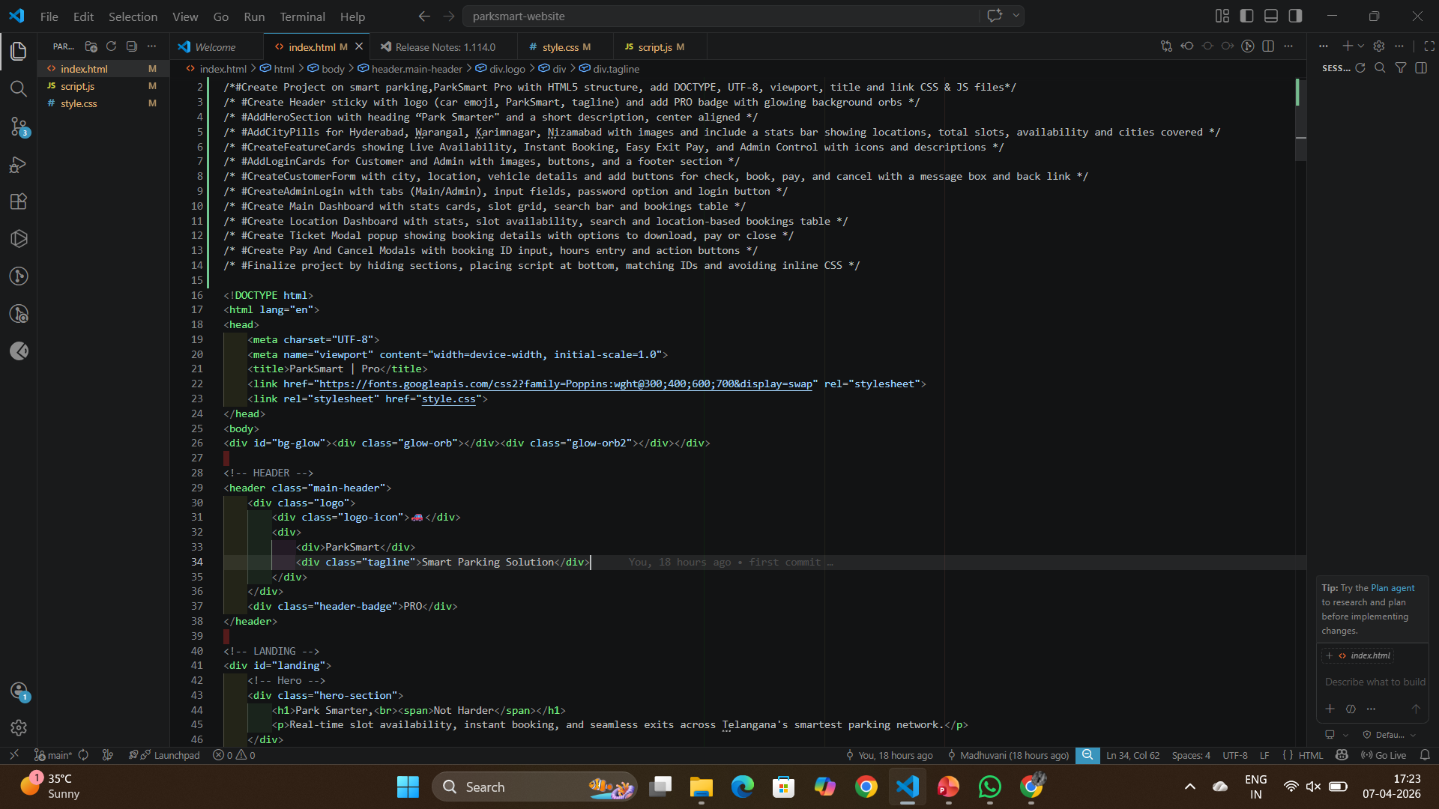
🖥️ Proof of Prompts generating codes
ParkSmart Pro · Smart Parking Solution

Slide 10
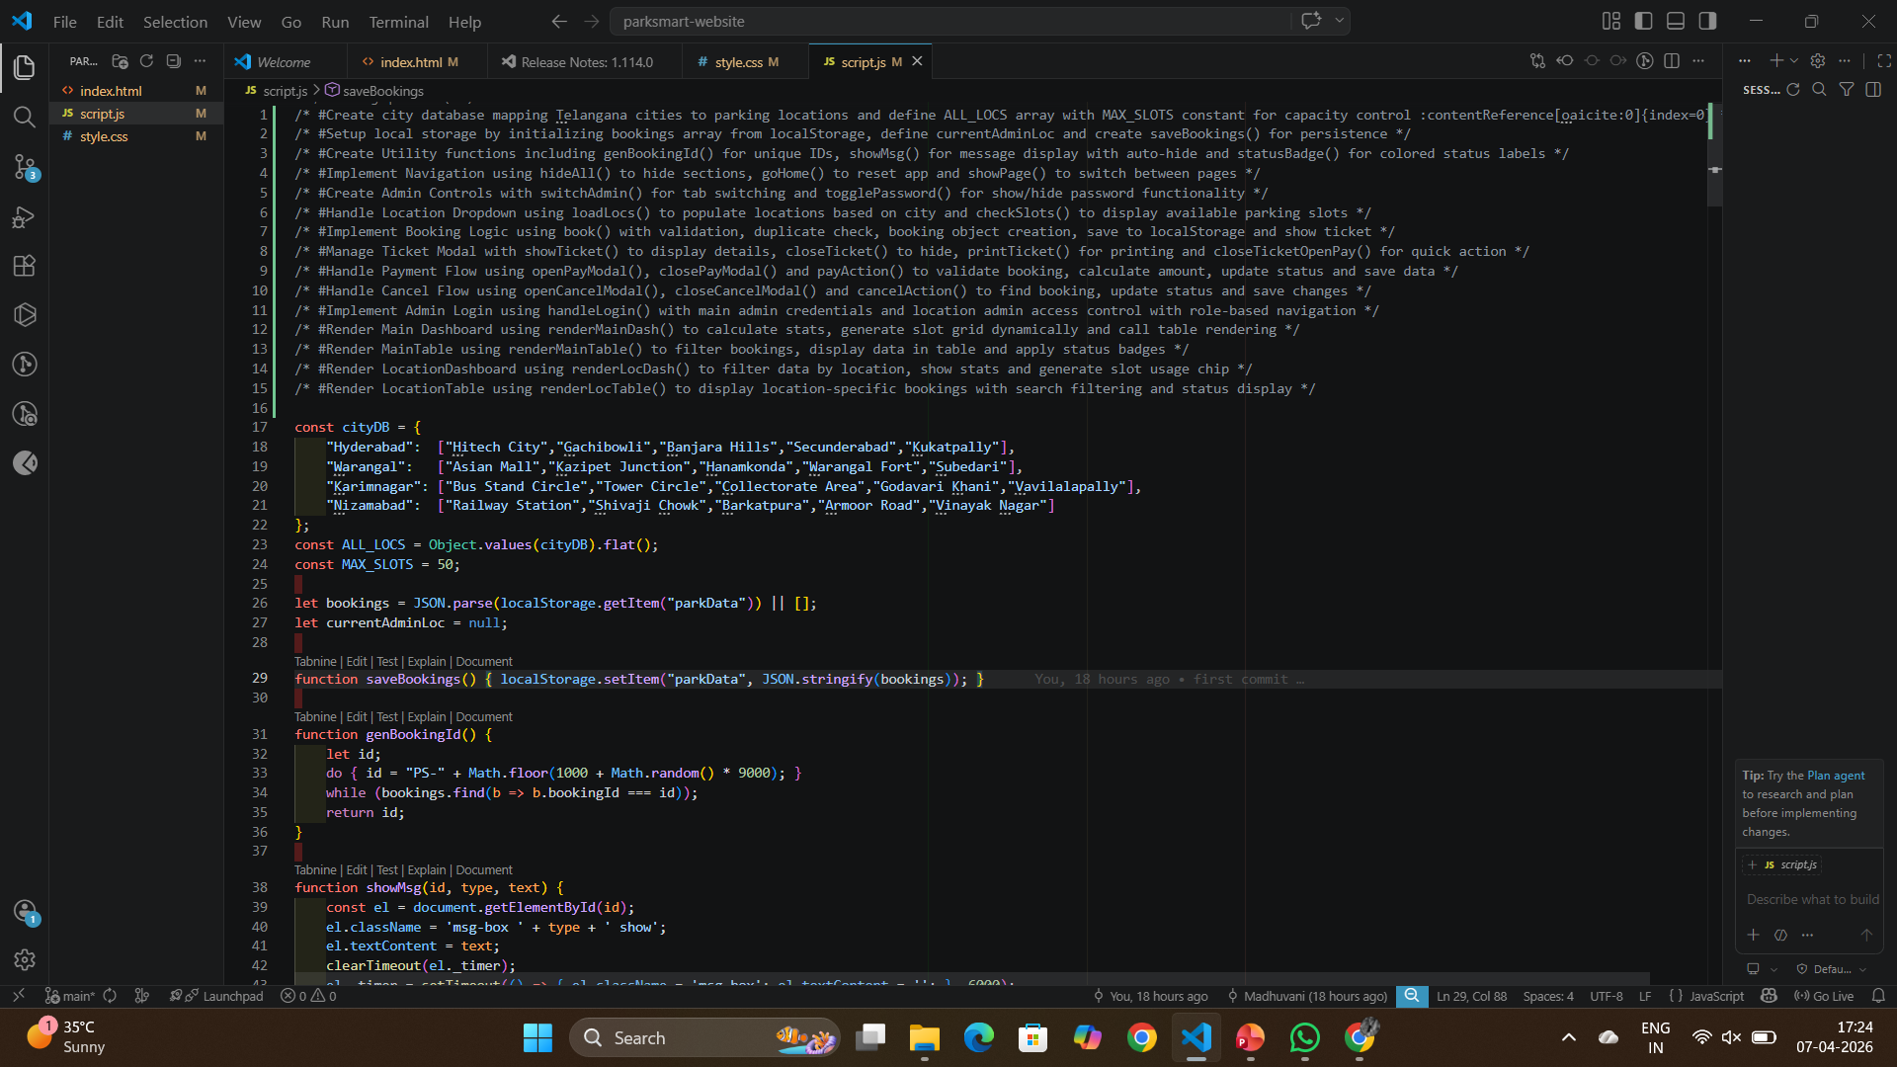
🖥️ Proof of Prompts generating codes
ParkSmart Pro · Smart Parking Solution

Slide 11
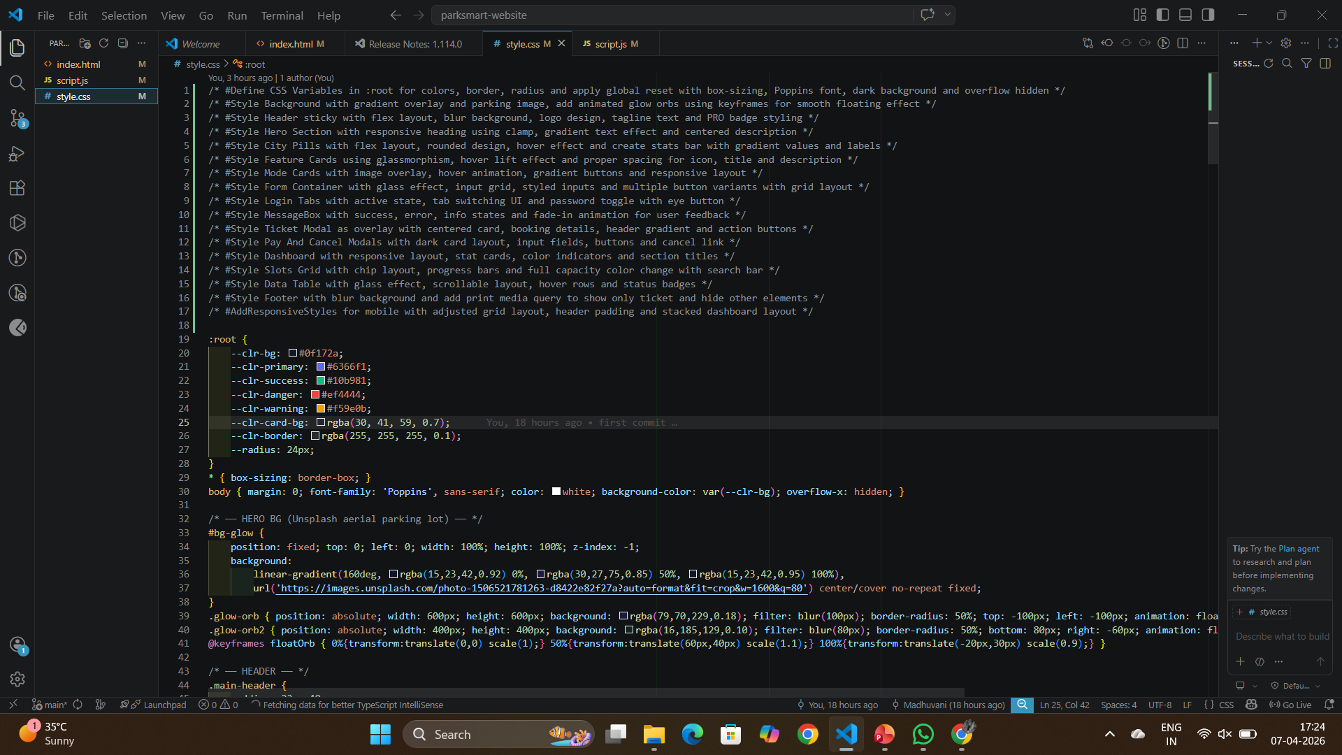
🖥️ Proof of Prompts generating codes
ParkSmart Pro · Smart Parking Solution

Slide 12
📚 References
01
WEB TECHNOLOGY
02
WEB TECHNOLOGY
MDN Web Docs — HTML5 Reference
MDN Web Docs — CSS3 Reference
Mozilla Developer Network. (2024). HTML: HyperText Markup Language. https://developer.mozilla.org/en-US/docs/Web/HTML
Mozilla Developer Network. (2024). CSS: Cascading Style Sheets. https://developer.mozilla.org/en-US/docs/Web/CSS
03
PROGRAMMING
04
TYPOGRAPHY
JavaScript — The Definitive Guide
Google Fonts — Poppins Typeface
Flanagan, D. (2020). JavaScript: The Definitive Guide (7th ed.). O'Reilly Media. ISBN: 978-1491952023
Google Fonts. (2024). Poppins — Google Fonts. https://fonts.google.com/specimen/Poppins
05
WEB STORAGE
06
IMAGE ASSETS
Web Storage API — localStorage
Unsplash Free Photography API
W3C / WHATWG. (2024). Web Storage API. https://developer.mozilla.org/en-US/docs/Web/API/Window/localStorage
Unsplash. (2024). Beautiful free photos. https://unsplash.com — Used for city images and background.
07
AI TOOLS
08
DEVELOPMENT TOOL
ChatGPT / Claude AI (Coding Assistance)
Visual Studio Code — Code Editor
OpenAI / Anthropic. (2024). AI assistants used for code suggestions, debugging, and content generation during development.
Microsoft. (2024). Visual Studio Code. https://code.visualstudio.com — Primary IDE used throughout development.
ParkSmart Pro · Smart Parking Solution · Madhuvani Nallala · CSE-AIML 3rd Year 2nd Sem

