Slide 1
Best Practices in Coding

Slide 2
Why ???
Some basic issues in every development team
fundamental discipline issues in coding
number of years of exp. does not match delivery
by the time they actually become good coders, they are promoted to leads
70% of the whole employees, belong 0-4 years of experience
The rework time in coding is the actual killer
20-25% of the time is spent in reworking in software – that means, fix the mistakes done

Slide 3
How???

Slide 4
Commenting
Commenting is necessary for maintaining any program
Without commenting, the program is not complete
Do not assume that the other person who reads this program will understand it clearly
If commenting is not done at the beginning, it is forgotten.
Program - a physical file – you need to comment the following at the top.
at the top of the program - header comment
what the program achieves
who coded on what day

Slide 5
Classes
Comment at the beginning of the class about
what the class does
class Employee
// this class is used to manage all information
// about employees and retrieve specific data
Methods within classes
what this method/function/procedure does
what are the parameters and their purpose
what are the return values

Slide 6
Comment before every loop.
Comment before every file or database operation
Comment before every if condition

Slide 7
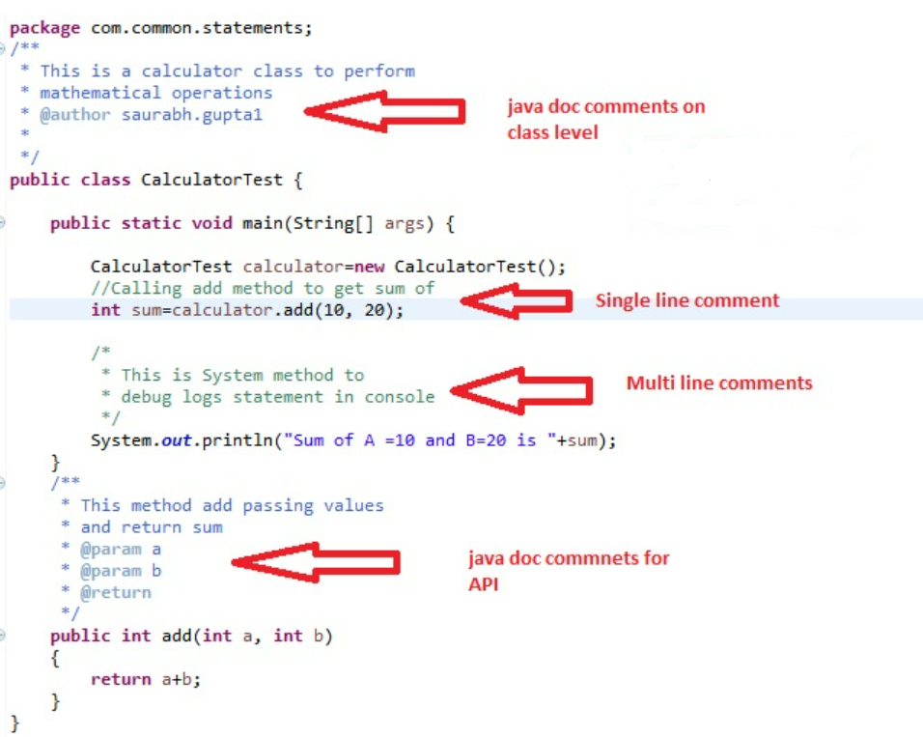

Slide 8
Naming Conventions
Readability improves understanding; that further improves maintainability
If programs are not consistent, maintenance is tough
If 20 developers work in a project and each one names functions in the way, he/she wants.
We must have a document on naming conventions
Every document must be named properly, and it must be stored in a proper folder.

Slide 9
You need to have a convention for naming
Programs
Classes
Methods
Variables
Labels in programs
Reusable library functions
There are established methods like Pascal casing, camel casing etc.
Usually, you will tend to use a mixture of uppercase, lowercase letters, underscore etc.
The ultimate aim is to achieve consistency across programs

Slide 10
Avoid Hard coding
Placing a number or quoted text inside active code is hard coding
This is deadly as the program restricts itself to this hard coded value
To make a change, you need to change code, recompile and redeploy
Usual way to avoid hard coding is to use constants at the top of a program; here also, you need to edit the program, but the change is in one place
Other way is to put all configurable values in a csv or dat file. Every program must read the name value pair from the file and later use them in the code
E.g., MAX_LENGTH 150, PORT 8097

Slide 11
Modularity of code
Modularity is important for easy maintenance
Do not write lengthy methods or procedures
We can split the modules based on
A functional operation as per requirements
A piece of code is used in more than one place
Logical breakdown of events in the functionality
Modularity must be decided right at the design level itself
Modular programs are easy to debug
Fixes done on modular programs are easy to isolate from other regression effects

Slide 12
Examine the loops
A loop is - repeat some logic for specific number of times or as long as a condition is true/false
If this is not checked, it can run forever, infinitely and can bring down the server
Loop Sample
gateway 1 // variables, flags
xyz = 10
loop starts here
...gateway 2 // variables, flags, counters
..
logic
... gateway 3
loop ends here
gateway 4

Slide 13
Gateways are the check posts where we must watch the value of the variables, loop counters and loop flags
Ensure proper resetting of flags and counters and check their values and gateways of the loops
Never allocate memory inside a loop
Never instantiate a class inside a loop; if needed, close it within the loop
Usually, companies do not suggest more than 3 levels in the loops

Slide 14
Exceptions
Issues may be caused by programmer
Issues may be caused by system
Most of the languages allow try-catch or on-error-go to exceptions
Exception is also an error condition
we do not know when it will happen
1. Any file operations – handle exceptions, because
file may not exist
file is already opened by someone
file does not have privilege
file is already full

Slide 15
2. Any database operation – handle exceptions, because
database you may not have rights
database is down
connections exhausted
3. Memory
low memory exception
pointers - writing in privileged memory
array boundary breach
4. Any external devices
your program accesses webcam or printer

Slide 16
Performance
We need to monitor CPU, memory, network
Memory is directly related to variables and object – do not declare huge arrays or objects
CPU is consumed more when you deal with DB or files or devices
Any database operations, open late and close the connection early.
Usage of indexes in queries must be examined

Slide 17
Any column used in where condition of db query must have index on it
Any memory allocated must be freed – else the program will shut down after some time
Any object instantiated must be released – else system will be depleted of memory and hence performance will come down

Slide 18
Program Logic
Usually, the logic design will be provided to the developer
If it is not provided, take 30 minutes and write the logic of the program in English first
Do not start coding right away. You will make so many assumptions and it will spoil the show
Get the logic approved by the team lead and then start coding

Slide 19
Developers usually feel that this takes time; but it reduces the time effectively while coding and reworking
Since developers are not used to documenting, they feel it is not their job. Hence, they miss a lot of finer points
If you write the logic first, you will get a lot of clarifications at that time itself and hence the code will come out clean

Slide 20
THANK YOU
- SIVA KARTHIK MADAPARTHI

