Slide 1
Object Relational Mapping (ORM)
Object/Relational Mapping(ORM) is a technique that allows programmers to map fields and properties of classes to fields in relational database tables, and vice versa, in order to store objects in relational databases.

Slide 2
Why is ORM being used?
ORM can provide a level of abstraction towards the database
ORM can saves programmers time
Speeds-up Development – eliminates the need for repetitive SQL codes
Reduces Development time and costs

Slide 3
Advantages of ORM
Can radically reduce the amount of code you need to write – 30% compared to JDBC for server side application
Applications are easier to maintain
A well-written ORM will implement design patterns to force you to use best practices for application design
Reduced Testing

Slide 4
Disadvantages of ORM
Performance characteristics of the tool may affect your application’s performance
Need to know SQL for high level abstractions developers cannot rely on the orm fully
Effects on Schema and Migrations

Slide 5
When to use ORM?
Well-suited to ORM
      Read-Modify-Write life cycle
      Little requirement for stored procedures
      Typical server-side applications are fairly well suited for ORM

Slide 6
JPA
It is a API act as a bridge between a object model and relational model. This API have collection of classes and methods to persistently store the vast amount of data into a database which is provided by Oracle Corporation.

Slide 7
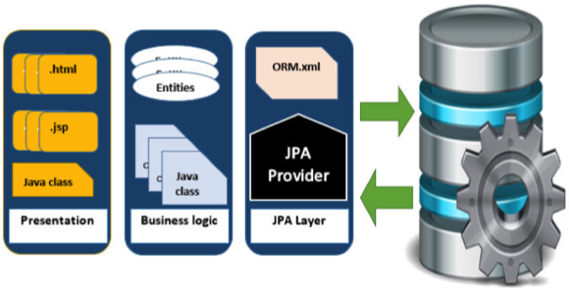

Slide 8
JPA ARCHITECTURE:
Entity-Entities are the persistence object
Entity-manager it is an interface which manages persistence of the objects, one entity manager can manage multiple entities.
Entity Transaction it is in one to one relationship with entity manager

Slide 9
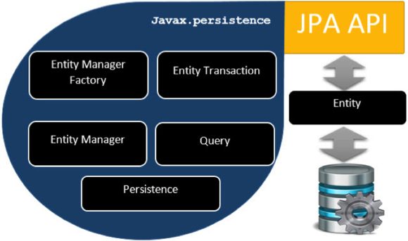
Entity Manger Factory- it is the factory class for entity manager it creates and manges multiple entity manager instances
  Persistence is class contains starting method to obtain entity manger factory
    Query is an interface it is implemented by each JPA to obtain relational objects

Slide 10
Annotations
@Entity- Specifies that class is an entity
@Table- Used to specify the table name
@Column- Specifies column mapping
@Id- This annotation specifies the primary key of the entity
@GeneratedValue- This annotation specifies the generation strategies for the values of primary key.
@OrderBy- Sort your data using this annotation ex:@OrderBy(id asc)
@Transient- This annotation specifies the property which is not persistent the value is never stored into database
@Lob- Large objects are declared with @Lob
We have another set of annotations that are used to specify the association mapping between different tables and entities.

Slide 11
JPA One-To-One Mapping
The One-To-One mapping represents a single-valued association where an instance of one entity is associated with an instance of another entity. In this type of association one instance of source entity can be mapped atmost one instance of target entity.

Slide 12
@OneToOne Example In this example, we will create a One-To-One relationship between a Student and Library in such a way that one student can be issued only one type of book
@Entity
public class Student {
@Id
@GeneratedValue(strategy=GenerationType.AUTO)
private int s_id;
private String s_name;
@Entity
public class Library {
@Id
@GeneratedValue(strategy=GenerationType.AUTO)
private int b_id;
private String b_name;
@OneToOne
Private Student stud;

Slide 13
          EntityManagerFactory emf = Persistence.createEntityManagerFactory( "Book_issued" );
EntityManager em = emf.createEntityManager( );
em.getTransaction( ).begin( );
Student st1=new Student();
st1.setS_id(1);
st1.setS_name("Vipul");
Student st2=new Student();
st2.setS_id(2);
st2.setS_name("Vimal");
em.persist(st1);
em.persist(st2);
Library lib1=new Library();
lib1.setB_id(101);
lib1.setB_name("Data Structure");
lib1.setStud(st1);
Library lib2=new Library();
lib2.setB_id(102);
lib2.setB_name("DBMS");
lib2.setStud(st2);
em.persist(lib1);
em.persist(lib2);
em.getTransaction().commit();
em.close();
emf.close();

Slide 14
JPA One-To-Many Mapping
The One-To-Many mapping comes into the category of collection-valued association where an entity is associated with a collection of other entities. Hence, in this type of association the instance of one entity can be mapped with any number of instances of another entity.
@OneToMany(targetEntity=Library.class)
private List books_issued;

Slide 15
Library lib1=new Library();
lib1.setB_id(101);
lib1.setB_name("Data Structure");
Library lib2=new Library();
lib2.setB_id(102);
lib2.setB_name("DBMS");
em.persist(lib1); em.persist(lib2);
ArrayList<Library> list=new ArrayList<Library>();
list.add(lib1); list.add(lib2);
Student st1=new Student();
st1.setS_id(1);
st1.setS_name("Vipul");
st1.setBooks_issued(list);
em.persist(st1);

Slide 16
JPA Many-To-One Mapping
The Many-To-One mapping represents a single-valued association where a collection of entities can be associated with the similar entity. Hence, in relational database any more than one row of an entity can refer to the similar rows of another entity.
@ManyToOne
private Library lib;

Slide 17
em.getTransaction().begin();
Library lib=new Library();
lib.setB_id(101);lib.setB_name("Data Structure");
em.persist(lib);
Student st1=new Student();
st1.setS_id(1);st1.setS_name("Vipul");
st1.setLib(lib);
Student st2=new Student();
st2.setS_id(2);st2.setS_name("Vimal");
st2.setLib(lib);
em.persist(st1);
em.persist(st2);
After the execution two tables will be generated. Library table contains library information and student table represents the mapping between student and library

Slide 18
JPA Many-To-Many Mapping
The Many-To-Many mapping represents a collection-valued association where any number of entities can be associated with a collection of other entities. In relational database any number of rows of one entity can be referred to any number of rows of another entity.
@ManyToMany(targetEntity=Library.class)
private List lib;
@ManyToMany(targetEntity=Student.class)
private List stud;

Slide 19
em.getTransaction().begin();
Student st1=new Student(1,"Vipul",null);
Student st2=new Student(2,"Vimal",null);
em.persist(st1);em.persist(st2);
ArrayList<Student> al1=new ArrayList<Student>();
ArrayList<Student> al2=new ArrayList<Student>();
al1.add(st1); al1.add(st2);
al2.add(st1);al2.add(st2);
Library lib1=new Library(101,"Data Structure",al1);
Library lib2=new Library(102,"DBMS",al2);
em.persist(lib1);
em.persist(lib2);
em.getTransaction().commit();
em.close();

