Slide 1
SOLID PRINCIPLES

Slide 2
What is SOLID PRINCIPLES & Why?
Conceptualized by Robert C. Martin
Object-oriented approach that are applied to software structure design
Ensures that the software is modular, easy to understand, debug, and refactor
Aim to reduce the design flaws and implement best practices in the software system.
It reduces the dependencies so that a block of code can be changed without affecting the other code blocks.

Slide 3
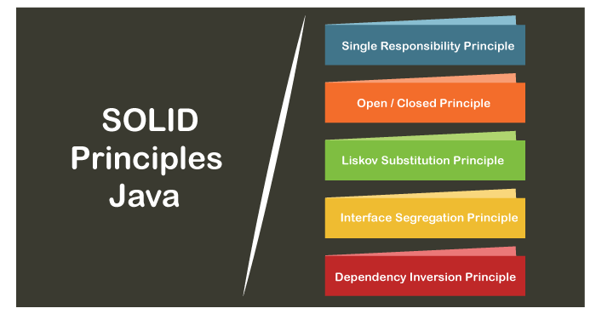
What does the SOLID principles actually means

Slide 4
Single Responsibility Principle (SRP):
“There should never be more than one reason for a class to change.”
i.e., every Java class must perform a single functionality.
Implementation of multiple functionalities in a single class mashup the code and if any modification is required may affect the whole class.
Adhering to this principle in design of classes and modules, leads to separation of concerns(SoC) and maintainable code.

Slide 5
Open-Closed Principle (OCP)
“A module should be open for extension but closed for modification.”
This principle is based on abstractions.
The extension allows us to implement new functionality to the module.
The use of abstractions and the Open-Closed principle leads to maintainable and loosely coupled systems.

Slide 6
Liskov Substitution Principle(LSP)
“Subtypes must be behaviorally substitutable for their base types.”
It applies to inheritance in such a way that the derived classes must be completely substitutable for their base classes.
if class A is a subtype of class B, then we should be able to replace B with A without interrupting the behavior of the program.

Slide 7
Interface Segregation Principle (ISP)
“Many client-specific interfaces are better than one general-purpose interface.”
Interface Segregation Principle is similar to the single responsibility principle.
larger interfaces split into smaller ones. Because the implementation classes use only the methods that are required

Slide 8
Dependency Inversion Principle (DIP)
“High-level modules should not depend on low-level modules. Both should depend upon abstractions.”
Use abstraction (abstract classes and interfaces) instead of concrete implementations.
Abstraction does not depend on detail but the detail depends on abstraction.

Slide 9
Thankyou..!

