Slide 1
WEBSERVICES
HARI
Notes:
this is the presentation

Slide 2

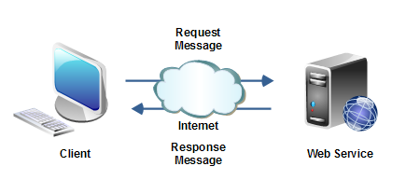



Webservices:

Slide 3

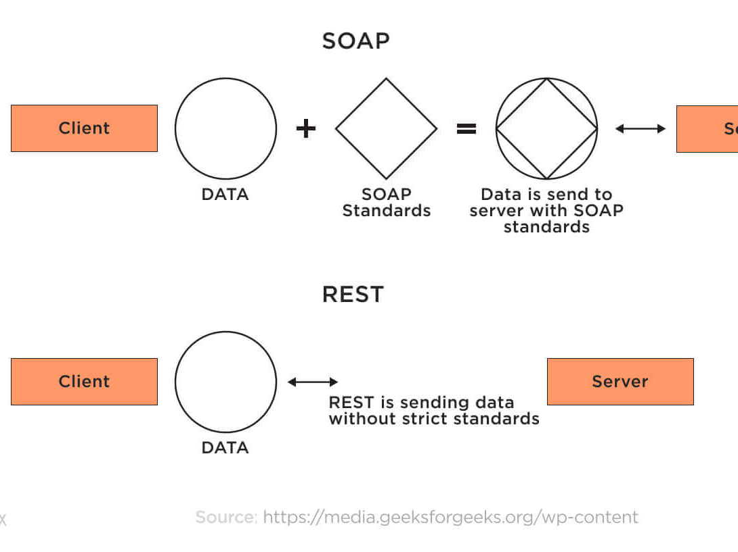

Slide 4
Hypertext Transfer Protocol (HTTP)
A communications protocol
Allows retrieving inter-linked text documents (hypertext)
World Wide Web.
HTTP Verbs
HEAD
GET
POST
PUT
DELETE
TRACE
OPTIONS
CONNECT
GET /index.html HTTP/1.1
Host: www.pitt.edu
Browser
Web Server
HTTP/1.1 200 OK
Content-Type: text/html
<html><head>…

Slide 5
Representational State Transfer (REST)
A style of software architecture for distributed hypermedia systems such as the World Wide Web.
Introduced in the doctoral dissertation of Roy Fielding
One of the principal authors of the HTTP specification.
A collection of network architecture principles which outline how resources are defined and addressed
Notes:
this is the presentation

Slide 6
REST and HTTP
The motivation for REST was to capture the characteristics of the Web which made the Web successful.
URI Addressable resources
HTTP Protocol
Make a Request – Receive Response – Display Response
Exploits the use of the HTTP protocol beyond HTTP POST and HTTP GET
HTTP PUT, HTTP DELETE

Slide 7
REST - not a Standard
REST is not a standard
JSR 311: JAX-RS: The JavaTM API for RESTful Web Services
But it uses several standards:
HTTP
URL
XML/HTML/GIF/JPEG/etc (Resource Representations)
text/xml, text/html, image/gif, image/jpeg, etc (Resource Types, MIME Types)

Slide 8
Httpmethods:
Get (safe,idompotent,cachable)
Put(idompotent)
Post
Delete(idompotent)
Head
Options
patch

Slide 9
Naming Resources
REST uses URI to identify resources
http://localhost/books/
http://localhost/books/ISBN-0011
http://localhost/books/ISBN-0011/authors
http://localhost/classes
http://localhost/classes/cs2650
http://localhost/classes/cs2650/students
As you traverse the path from more generic to more specific, you are navigating the data

Slide 10
Features of rest :
Client server
Statelessness
Cachable
Uniforminterface
Layered system
Code on demand

Slide 11
HTTP GET
How clients ask for the information they seek.
Issuing a GET request transfers the data from the server to the client in some representation
GET http://localhost/books
Retrieve all books
GET http://localhost/books/ISBN-0011021
Retrieve book identified with ISBN-0011021
GET http://localhost/books/ISBN-0011021/authors
Retrieve authors for book identified with ISBN-0011021

Slide 12
HTTP PUT, HTTP POST
HTTP POST creates a resource
HTTP PUT updates a resource
POST http://localhost/books/
Content: {title, authors[], …}
Creates a new book with given properties
PUT http://localhost/books/isbn-111
Content: {isbn, title, authors[], …}
Updates book identified by isbn-111 with submitted properties

Slide 13
HTTP DELETE
Removes the resource identified by the URI
DELETE http://localhost/books/ISBN-0011
Delete book identified by ISBN-0011

Slide 14
Representations
How data is represented or returned to the client for presentation.
Two main formats:
JavaScript Object Notation (JSON)
XML
It is common to have multiple representations of the same data

Slide 15
Representations
XML
<COURSE>
<ID>CS2650</ID>
<NAME>Distributed Multimedia Software</NAME>
</COURSE>
JSON
{course
{id: CS2650}
{name: Distributed Multimedia Sofware}
}

Slide 16
Why is it called "Representational State Transfer"?
Resource
Client
http://www.boeing.com/aircraft/747
Fuel requirements
Maintenance schedule
...
Boeing747.html
The Client references a Web resource using a URL. A representation of the resource is returned (in this case as an HTML document).
The representation (e.g., Boeing747.html) places the client application in a state. The result of the client traversing a hyperlink in Boeing747.html is another resource accessed. The new representation places the client application into yet another state. Thus, the client application changes (transfers) state with each resource representation --> Representation State Transfer!

Slide 17
Architecture Style
Request
(XML doc)
HTTP GET
URL 1
doGet()
Response
(XML doc)
HTTP Response
doPost(id)
Request
(XML doc)
HTTP POST
URL 1
REST Engine
(locate resource and generate response)
Web/Proxy Server
Response
(JSON doc)
HTTP Response
doDelete()
PO
(XML doc)
HTTP DELETE
URL 1
Response
(TEXT doc)
HTTP Response

Slide 18
Real Life Examples
Google Maps
Google AJAX Search API
Yahoo Search API
Amazon WebServices

Slide 19
REST and the Web
The Web is an example of a REST system!
All of those Web services that you have been using all these many years - book ordering services, search services, online dictionary services, etc - are REST-based Web services.
Alas, you have been using REST, building REST services and you didn't even know it.

Slide 20
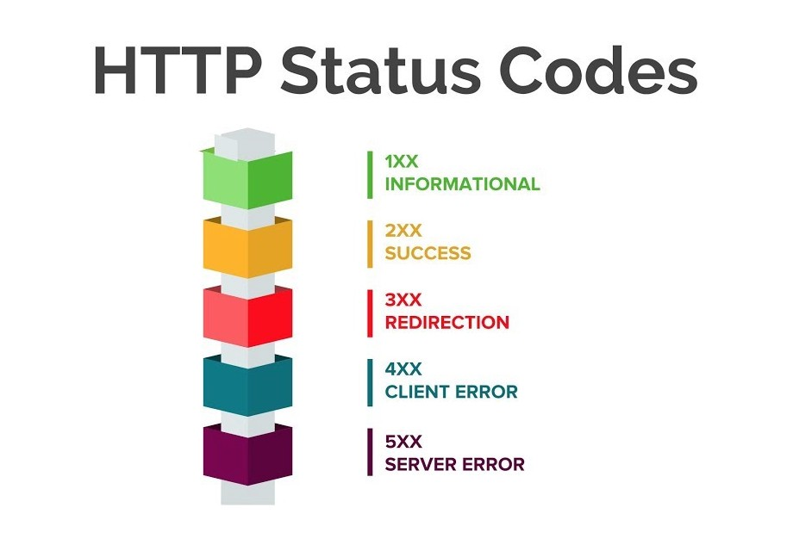
Http status codes:

Slide 21
REST Implementations
Restlet
http://www.restlet.org/
Project Zero
http://www.projectzero.org
GlassFish Jersey
https://jersey.dev.java.net/
JBoss RESTeasy
http://www.jboss.org/resteasy/

