Slide 1

Normalization

Slide 2

Normalization
Is the process of eliminating duplicate or redundant data in a relational database design
Redundancy of data causes
  inconsistency problems due to changes (inserts, updates and deletes)
  wastage of storage space

Slide 3
Normalization Example - Order
Sun Industries
Order Field List
Order No
Date
Customer Code
Customer Name
Address
Item No
Item Name
Quantity Ordered
Unit Price
Total Price
Price Total
Freight
Total Order Value
Order Form
Order No:
Date:
Customer Code:
Name and Address:
Item
No
Item Name
Qty
Unit
Price
Total Price
Total:
Freight:
Total Order Value:

Slide 4
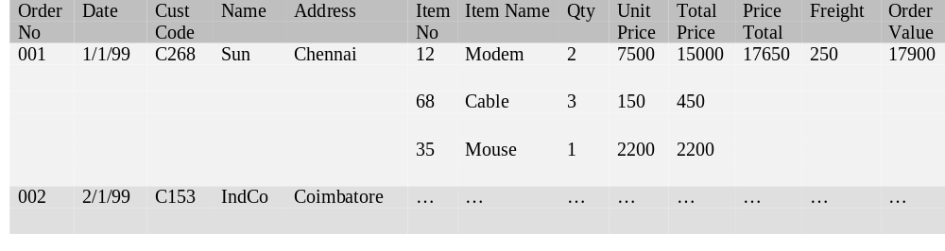
Order Fields in a Relational Table
Column values should be atomic

Slide 5
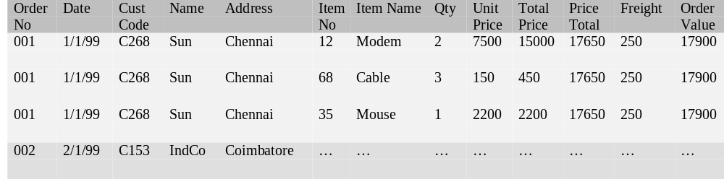
Order Fields in a Relational Table
Duplication of data Causes
  Inconsistency problems due to updates
  Wastage of storage space

Slide 6
Order - Fields
These fields repeat many times for every order.
This is called a repeating group.
Repeating groups violate the conditions of 1st normal form.
Sun Industries
Order Form
Order No:
Date:
Customer Code:
Name and Address:
Order Field List
Order No
Date
Customer Code
Customer Name
Address
Item No
Item Name
Quantity Ordered
Unit Price
Total Price
Price Total
Freight
Total Order Value
Item
No
Item Name
Qty
Unit
Price
Total Price
Total:
Freight:
Total Order Value:

Slide 7
First Normal Form - Definition
A table is said to satisfy the First Normal Form if it contains no repeating groups.

Slide 8
First Level of Normalization - Procedure
Remove the repeating groups into a separate table.
        Identify the primary key for the original table.
Order Field List
Order No
Date
Customer Code
Customer Name
Address
Item No
Item Name
Quantity Ordered
Unit Price
Total Price
Price Total
Freight
Total Order Value
Order Table
Order No
Date
Customer Code
Customer Name
Address
Price Total
Freight
Total Order Value
Order Item Table
Item No
Item Name
Quantity Ordered
Unit Price
Total Price

Slide 9
First Level of Normalization - Procedure
3. Use the primary key of the original table in the repeating group table as a foreign key.
  This is done to identify which order a given order item belongs to.
4. Identify the primary key for the repeating group table.
  This primary key will include the foreign key added in step 2. So the primary key for this table will be composite.
Order Table
Order No
Date
Customer Code
Customer Name
Address
Price Total
Freight
Total Order Value
Order Item Table
Order No
Item No
Item Name
Quantity Ordered
Unit Price
Total Price

Slide 10
Tables In First Normal Form
Now these tables do not contain any repeating groups.
So they are in First Normal Form.
Order Table
Order No
Date
Customer Code
Customer Name
Address
Price Total
Freight
Total Order Value
Order Item Table
Order No
Item No
Item Name
Quantity Ordered
Unit Price
Total Price

Slide 11
Second Normal Form - Definition
A table is said to satisfy the Second Normal Form if
1. the table is in First Normal Form and
2. all non-keys are functionally dependent on the full primary key.
Explanations
  Non-key is a field that is not part of the primary key

Slide 12
Functional Dependence
A field F is said to depend on the primary key if the primary key is both necessary and sufficient to determine the value of F.
This is called Functional Dependence.
Consider the Order table.
Necessary
  To determine the date of an order, the Order No is required.
  Without Order No, Date can not be determined.
  Hence Order No is necessary for Date
Sufficient
  Given an Order No, the date of the order can be determined.
  No other field is required for determining Date.
  Hence Order No is sufficient for Date.
Hence Order No is both necessary and sufficient to determine the value of Date.
Hence Date is said to depend on Order No.
Order Table
Order No
Date
Customer Code
Customer Name
Address
Price Total
Freight
Total Order Value

Slide 13
Second Normal Form - Violation
Order Item Table
Order No
Item No
Item Name
Quantity Ordered
Unit Price
Total Price
Consider Item Name. It depends only on Item No.
  viz. Item No alone is both necessary and sufficient to determine Item Name.
Order No is not necessary to determine Item Name.
Hence Item Name does not depend on the full primary key (Order No + Item No).
So this table violates Second Normal Form.

Slide 14
Second Level of Normalization - Procedure
1. Remove all non-keys that do not depend on the full primary key into a separate table.
2. Add to this table, the portion of the primary key on which the non-keys depended.
Order Item Table
Order No
Item No
Quantity Ordered
Unit Price
Total Price
Order Item Table
Order No
Item No
Item Name
Quantity Ordered
Unit Price
Total Price
Item Table
Item No
Item Name

Slide 15
Tables in Second Normal Form
Now these tables do not contain any non-keys with partial dependence on the primary key.
So they are in Second Normal Form.
Order Table
Order No
Date
Customer Code
Customer Name
Address
Price Total
Freight
Total Order Value
Order Item Table
Order No
Item No
Quantity Ordered
Unit Price
Total Price
Item Table
Item No
Item Name

Slide 16
Third Normal Form - Definition
A table is said to satisfy the Third Normal Form if
1. the table is in Second Normal Form and
2. no non-key has a transitive dependence on the primary key.
Explanations:
Transitive
  If A = B and B = C, we conclude that A = C. The “=“ operation is transitive.
  Here if field F1 depends on field F2, and field F2 depends on field F3, then field F1 has a transitive dependence on F3.

Slide 17
Third Normal Form - Violation
Consider Customer Name and Address.
They depend on Order No but not directly.
They depend on Customer Code which in turn depends on Order No.
So they only have a transitive dependence on Order No.
Order Table
Order No
Date
Customer Code
Customer Name
Address
Price Total
Freight
Total Order Value

Slide 18
Third Level of Normalization - Procedure
Remove the non-keys (Customer Name and Address) that are transitively dependent on the primary key (Order No) into a separate table.
Add to this table, the intermediate non-key (Customer Code) on which the non-keys directly depended.
Order Table
Order No
Date
Customer Code
Price Total
Freight
Total Order Value
Order Table
Order No
Date
Customer Code
Customer Name
Address
Price Total
Freight
Total Order Value
Customer Table
Customer Code
Customer Name
Address

Slide 19
Tables in Third Normal Form
These tables do not have any non-keys that are transitively dependent on the primary key.
So they are in Third Normal Form.
Order Table
Order No
Date
Customer Code
Price Total
Freight
Total Order Value
Order Item Table
Order No
Item No
Quantity Ordered
Unit Price
Total Price
Item Table
Item No
Item Name
Customer Table
Customer Code
Customer Name
Address

Slide 20
Tables in Third Normal Form - With Relationships
Customer Table
Customer Code
Customer Name
Address
Order Table
Order No
Date
Customer Code
Price Total
Freight
Total Order Value
Order Item Table
Order No
Item No
Quantity Ordered
Unit Price
Total Price
Item Table
Item No
Item Name

Slide 21
Calculated Columns
Order Item Table
Order No
Item No
Quantity Ordered
Unit Price
Total Price
Consider Total Price.
It is calculated as the product of Quantity Ordered and Unit Price.
Hence it is a calculated column. (Also called derived column.)
A calculated column often violates Third Normal Form.
  Total Price does not depend on the primary key directly but only transitively through the Quantity Ordered and Unit Price columns.
Calculated columns are removed to satisfy the Third Normal Form.
  Instead the value of the calculated column is calculated every time a row is accessed in a form or report.

Slide 22
Denormalization
Is the process of purposefully including redundant data in a relational database design for some benefit such as better performance or easier coding.

Slide 23
Denormalization - Situation 1
Typical case of denormalization:
  Calculated columns are purposefully included in the table design (despite violating the Third Normal Form).
  This may be done for better performance.
Order Item Table
Order No
Item No
Quantity Ordered
Unit Price
Order Item Table
Order No
Item No
Quantity Ordered
Unit Price
Total Price
Lower performance due to repeated calculation of Total Price.
Better performance due to storage of Total Price data.

Slide 24
Denormalization - Situation 2
Order Item Table
Order No
Item No
Item Name
Quantity Ordered
Unit Price
Total Price
Here Item Name is purposefully introduced (despite violating Second Normal Form).
This may be done for increasing the performance of a report based on this table.

Slide 25
Cost of Denormalization - Situation 1
Recalculation cost
  Whenever either Quantity Ordered or Unit Price changes, the Total Price has to recalculated and updated.
  Code to calculate and update Total Price needs to be called whenever either Quantity Ordered or Unit Price is updated.
Order Item Table
Order No
Item No
Quantity Ordered
Unit Price
Total Price

Slide 26
Cost of Denormalization - Situation 2
Update cost
  Whenever the Item Name changes in the Item Table, it has to change in the Order Item Table also.
  Extra code has to be written to accomplish this.
Item Table
Item No
Item Name
Order Item Table
Order No
Item No
Item Name
Quantity Ordered
Unit Price
Total Price

Slide 27
Normalization - Another Example
Book Table
Book No
Book Name
Publisher Code
Publisher Name
Member Code
Member Name
Date of Issue
Date of Return

Slide 28
Normalization - Another Example (contd.)
Book Table
Book No
Book Name
Publisher Code
Publisher Name
Member Code
Member Name
Date of Issue
Date of Return
Repeating group.
Violates First Normal Form.
Remove into separate table.
Book Table
Book No
Book Name
Publisher Code
Publisher Name
Book Issue Table
Member Code
Member Name
Date of Issue
Date of Return

Slide 29
Normalization - Another Example
Identify primary key for first table.
Include this in second table.
Identify primary key for second table.
Repeating groups eliminated.
Tables are in First Normal Form.
Book Table
Book No
Book Name
Publisher Code
Publisher Name
Book Issue Table
Book No
Member Code
Member Name
Date of Issue
Date of Return

Slide 30
Normalization - Another Example
Book Table
Book No
Book Name
Publisher Code
Publisher Name
Publisher Name does not directly depend on Book No but only transitively.
It depends directly only on Publisher Code.
Transitive dependence on primary key - violates Third Normal Form.

Slide 31
Normalization - Another Example
Book Table
Book No
Book Name
Publisher Code
Remove Publisher Name into a separate table.
Also include Publisher Code in this table.
These two tables now satisfy Third Normal Form.
Publisher Table
Publisher Code
Publisher Name

Slide 32
Normalization - Another Example
Book Issue Table
Book No
Member Code
Member Name
Date of Issue
Date of Return
Member Name depends only on Member Code and not on Book No.
Dependence on partial primary key - violates Second Normal Form.

Slide 33
Normalization - Another Example
Book Issue Table
Book No
Member Code
Date of Issue
Date of Return
Remove Member Name into separate table.
Also include Member Code in this table.
These two tables now satisfy Second Normal Form.
Member Table
Member Code
Member Name

Slide 34
Normalization - Another Example - Final Design
Book Table
Book No
Book Name
Publisher Code
Publisher Table
Publisher Code
Publisher Name
Book Issue Table
Book No
Member Code
Date of Issue
Date of Return
Member Table
Member Code
Member Name

Slide 35
Normalization - Another Example - Final Design –
With Relationships
Book Table
Book No
Book Name
Publisher Code
Publisher Table
Publisher Code
Publisher Name
Member Table
Member Code
Member Name
Book Issue Table
Book No
Member Code
Date of Issue
Date of Return

Slide 36

Thank You
World Headquarters
Global Delivery Center
3270 West Big Beaver Road
Troy, MI 48084, U.S.A
Phone : 248.786.2500
Fax : 248.786.2515
E-mail : contact@htcinc.com
Web : www.htcinc.com
SDF II, Phase II
MEPZ, Tambaram
Chennai - 600 045
India
Phone : +91 44 2262 3522
Fax : +91 44 2262 7713

