Slide 1


NEXT GEN EMPLOYABILITY PROGRAM
CREATING A FUTURE-READY WORKFORCE
Student Name :
NALELLA CHANDU
Student ID :
College Name :
2103A52062
SR UNIVERSITY

Slide 2
CAPSTONE PROJECT SHOWCASE
Project Title
Music Player Website(Spotify Clone) with React and ExpressJS Framework
Abstract | Problem Statement | Project Overview | Proposed Solution | Technology Used | Modelling & Results | Conclusion | Q&A

Slide 3
Abstract
1
Purpose: Create a responsive and user-friendly music player website that replicates the core features of Spotify, including music streaming, playlists, and user recommendations.
2
Technology: Built using React for the frontend and ExpressJS for the backend, ensuring seamless and scalable performance.
3
Features: Includes song search, playback controls, user authentication, personalized playlists, and recommendations.
4
Outcome: Deliver a functional and engaging platform that offers a modern music streaming experience.

Slide 4


Problem Statement
In the digital age, music streaming platforms dominate the way users consume music. However, developing a robust and scalable system for music streaming remains challenging due to the need for high performance, efficient data handling, and a user-friendly interface.

Slide 5

Project Overview
The project aims to develop a web-based music player platform similar to Spotify, offering users the ability to stream music, manage playlists, and discover new songs. The system integrates frontend and backend technologies to provide a seamless user experience.

Slide 6
Proposed Solution
Frontend: Use React to build a dynamic and responsive user interface with components for navigation, song search, and playlist management.
Backend: Use ExpressJS to handle API requests, authentication, and integration with a database for user and song data management.
Database: Store user profiles, song metadata, playlists, and playback history using a database like MongoDB or PostgreSQL.
Additional Features: Incorporate JWT for secure user authentication and implement recommendations using machine learning algorithms for personalization.

Slide 7
Modelling & Result
User Authentication: JWT-based login and sign-up with secure password storage.
Music Playback: Integration of a music streaming API for playback.
Playlists and Recommendations: Recommendation algorithms based on user preferences and historical data.
Responsive Design: Ensures compatibility with desktop, tablet, and mobile devices.
Expected Result: A scalable, high-performance music player application with intuitive navigation and personalized features.

Slide 8
Technology used
Frontend: ReactJS, Redux (for state management), Material-UI or TailwindCSS for styling.
Backend: Node.js with ExpressJS.
Database: MongoDB or PostgreSQL.
Authentication: JSON Web Tokens (JWT).
Music Streaming: Integration with APIs for streaming or custom server setup for audio files.
Hosting: Deployed using services like Vercel (Frontend) and AWS/Heroku (Backend).

Slide 9
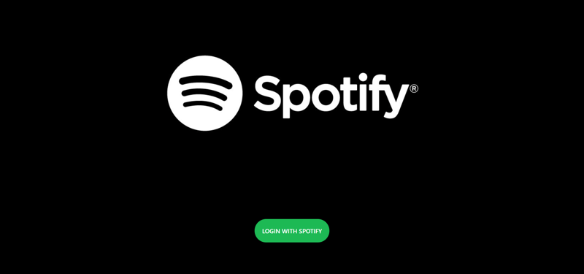
Modelling & Result

Slide 10
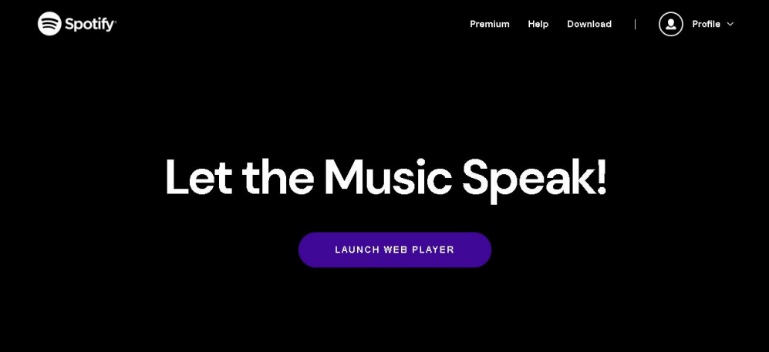
Modelling & Result

Slide 11

Conclusion
The project demonstrates the capability to develop a scalable and interactive music streaming platform. With React and ExpressJS as core frameworks, the Spotify Clone serves as a proof-of-concept for efficient music delivery, user personalization, and a high-quality user interface. This project has significant potential for enhancement, such as adding offline playback or integrating advanced AI-based recommendations.

Slide 12


Notes:
Thank You !!

