Slide 1
ME469: Reviewing FD, EBVC, CC, CVFEM, FEM
Stefan P. Domino^{1,2}
¹ Computational Thermal and Fluid Mechanics, Sandia National Laboratories
² Institute for Computational and Mathematical Engineering, Stanford
SAND2018-4536 PE

Slide 2
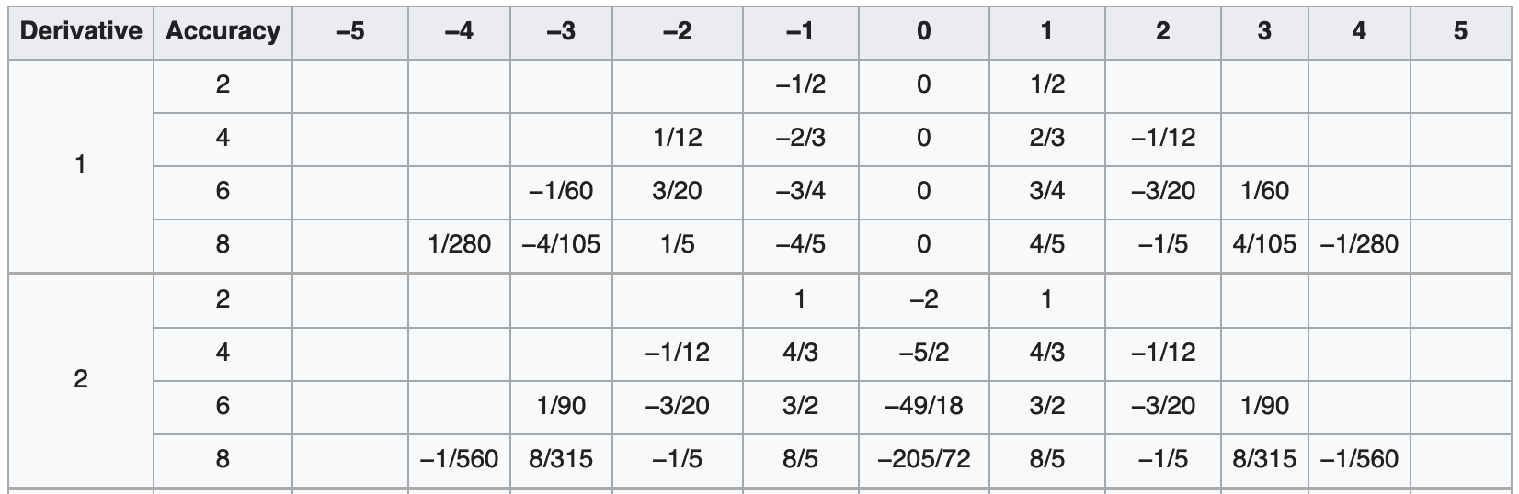
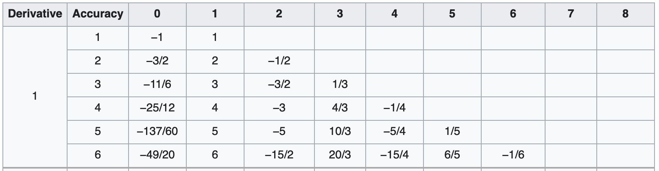
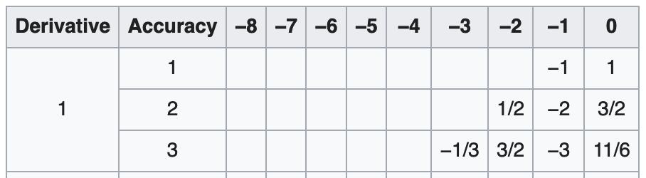
In Contrast: Finite Difference (For Our Simple Model Equation)
With terms: time, advection and diffusion
For a finite difference, centered (2nd order stencil), the continuous PDE can be discretized as:
Noting, above the n+1 fully implicit approach that is solved over the finite difference “mesh”
What is an alternative? Finite-volume/element…..
Central finite difference
Forward finite difference
J-2
J-1
j
J+1
J+2
Backward finite difference

Slide 3
Review of Discretization Options: New, a nodal-basis…
Degree-of-freedom (DOF) for:
Cell-centered: Stencil is based on an element:face:element
DOFs at vertices of elements, or “nodes”, element:node (CVFEM, FEM), edge:node (EBVC)
Definition of an interpolation function:
is the Lagrange function associated with node n
is the value of the DOF at node n
The nodal basis functions obey equipartition of unity and satisfy,

Slide 4
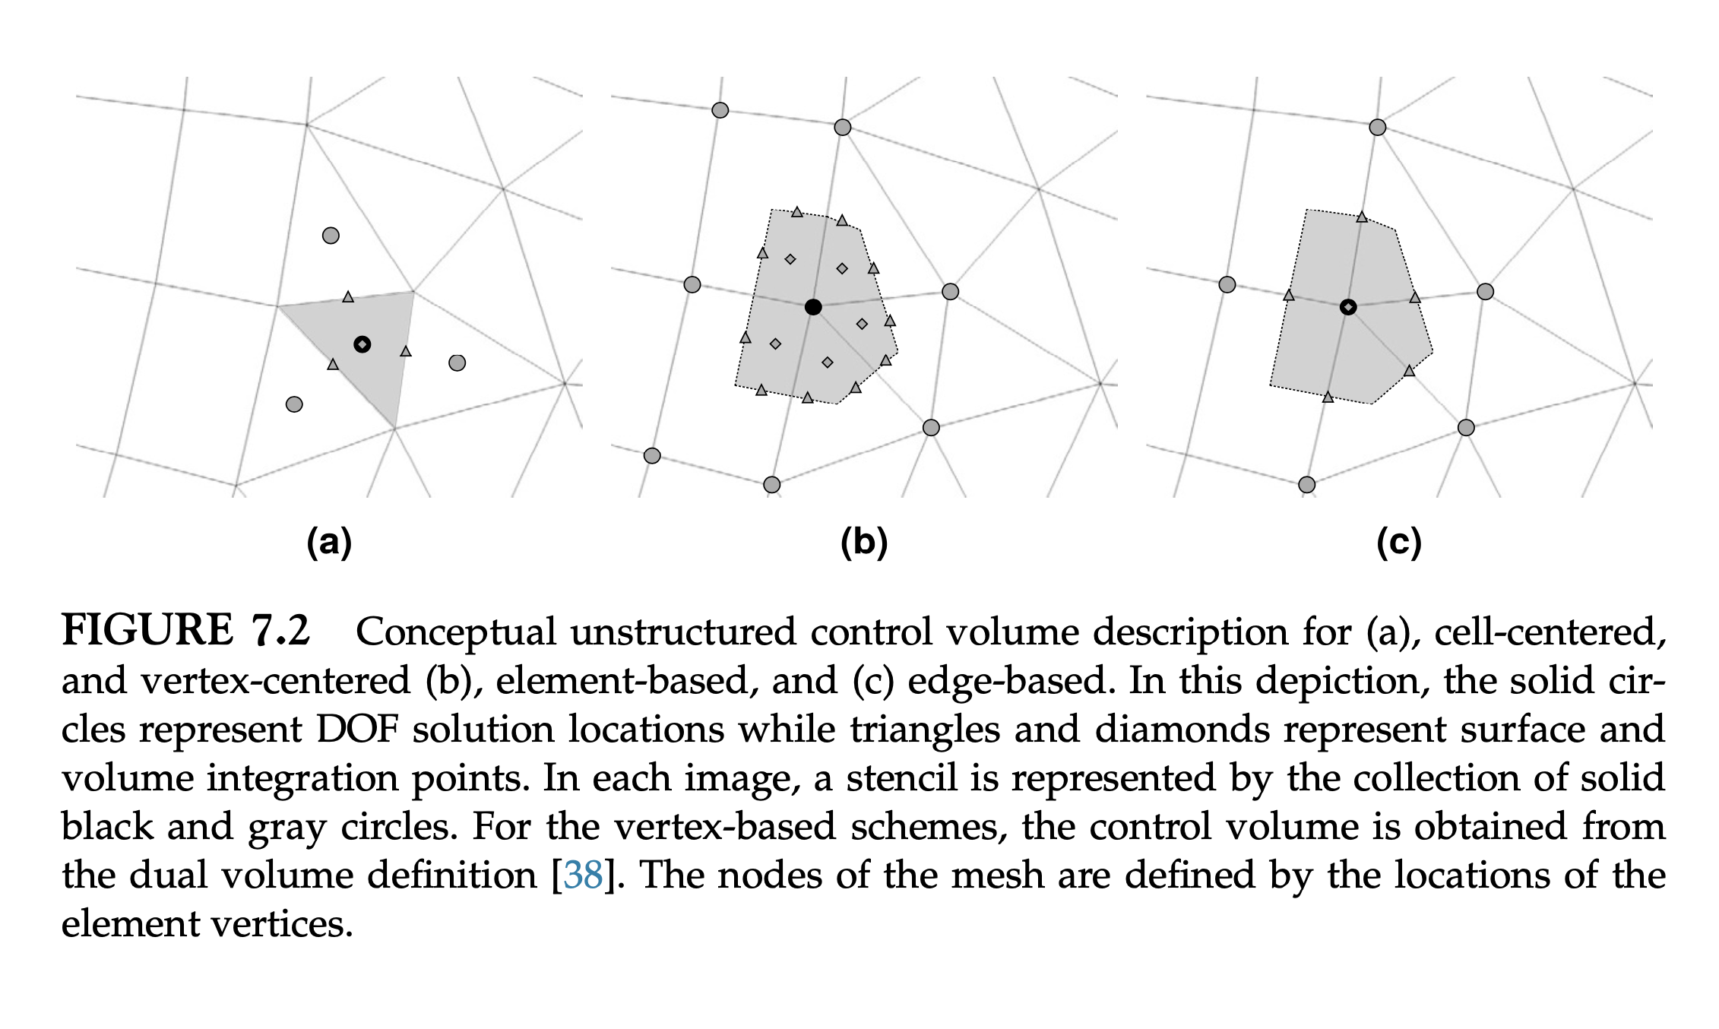
Three Finite Volume Stencils

Slide 5
Fundamentals of Discretization: Surface vs Volume Integrations
Given a partial differential equation (PDE) and associated volumetric form:
Applying Gauss Divergence provides the standard finite volume form for fluxes in surface integral form (no distinction between internal control volume faces and boundary faces):
We can also multiple PDE by an arbitrary test function, w, and integrate over a volume,
Next, integrate by parts and apply
Gauss-Divergence. Note, that test function must be differentiable – shown here, at least once..
Interior
Boundary

Slide 6
The Consistent Mass Matrix
When evaluating the volumetric contributions using the full stencil, this approach is known as a consistent mass matrix as compared to the previous lumped mass matrix that is supported by CC and EBVC
(Consistent)
(Lumped)
Convecting Taylor Vortex analytical solution; error computed at 1 second
Shown to be the
convergence rate,
2nd order

Slide 7
EBVC: Advection Term Discretization
For advection, we have transformed the volume integral to a surface integration
Therefore, a patch of edges are required for the full assembly at node 2
Recall, that the mass flow rate at an integration point is prescribed
Moreover, since the integration point is at the edge mid-point, φ_{ip} = (φ^{R} + φ^{L})/2
This is a central- or Galerkin-based advection operator; shown in conservative form, i.e, is in divergence form and has been integrated-by-parts
n5
e3
n1
n2
n3
n1 (L)
n2 (R)
n2 (L)
n3 (R)
e1
e2
e1
e2
e4
n4

Slide 8
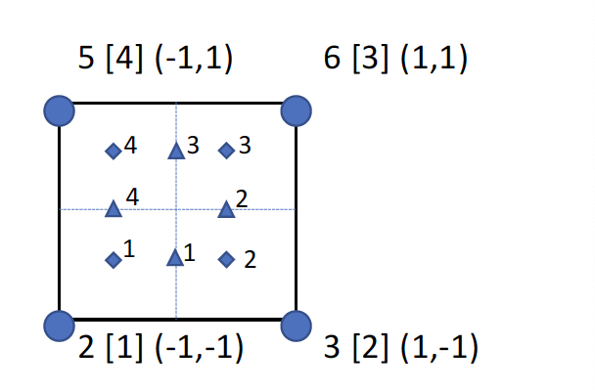
Deep Dive on CVFEM: Advection Discretization (no stabilization)
For advection, we have transformed the volume integral to a surface integration
Therefore, a patch of elements are required for the full assembly at node 2
Recall, that the mass flow rate at an integration point is prescribed
Integration points can also be shifted from the sub-control surface to the edge midpoint (while still using the integration point area vector)
This is a central- or Galerkin-based advection operator
Notes:
Common to integrate-by-parts, however, not required
Advection term need not be in divergence form (non-conserved form is suitable)

Slide 9
EBVC: Diffusion
For diffusion, we have transformed the volume integral to a surface integration
Therefore, a patch of edges are required for the full assembly at node 2
n5
n1 (L)
n2 (R)
n2 (L)
n3 (R)
e3
e1
e2
n1
n2
n3
e1
e2
e4
n4

Slide 10
Deep Dive on CVFEM: Diffusion Discretization
For diffusion, we have transformed the volume integral to a surface integration
Therefore, a patch of elements are required for the full assembly at node 2
Note that the CVFEM approach is absent any non-orthogonality corrections;
However, high aspect ratio elements are now challenging…
Recall our underlying basis:
n2 (L)
n3 (R)
No non-orthogonality!
e2

Slide 11
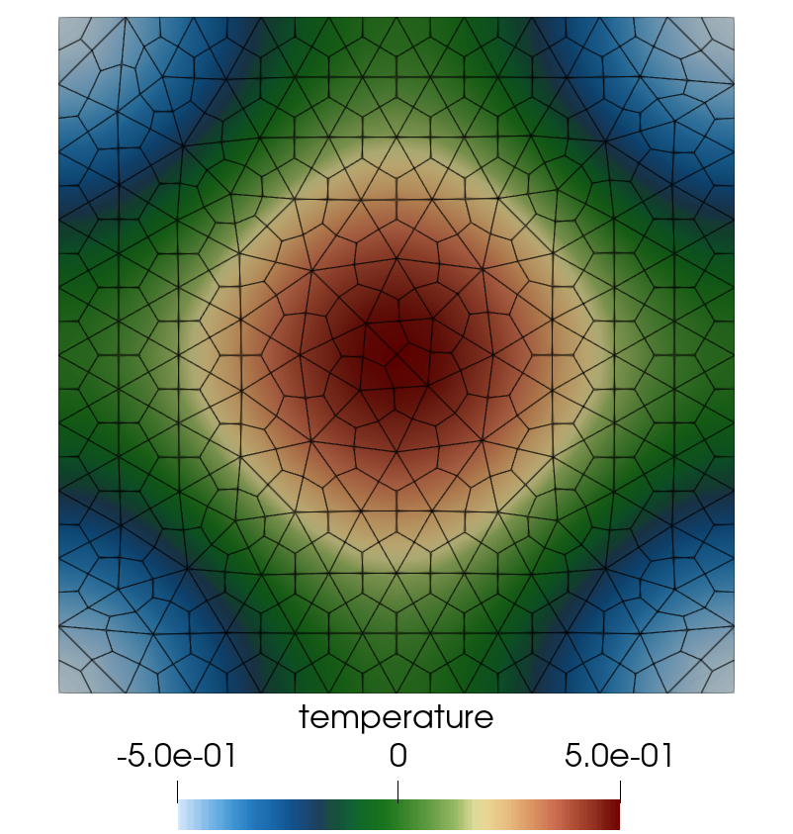
For Instance, Verification of The Diffusion Operator

